Slide 1


CV5100: Modelling, Uncertainty and Data for Engineers MODULE 3: MACHINE LEARNING, lecture 1: Introduction

Slide 2
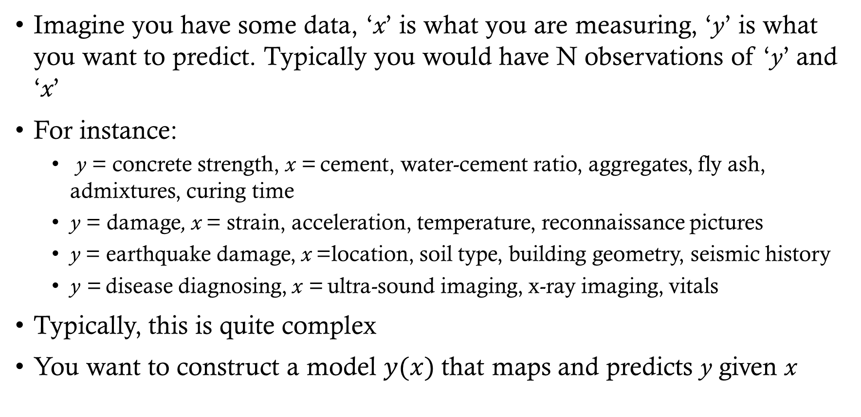
introduction
Imagine you have some data, ‘x’ is what you are measuring, ‘y’ is what you want to predict. Typically you would have N observations of ‘y’ and ‘x’
For instance:
y = concrete strength, x = cement, water-cement ratio, aggregates, fly ash, admixtures, curing time
y = damage, x = strain, acceleration, temperature, reconnaissance pictures
y = earthquake damage, x =location, soil type, building geometry, seismic history
y = disease diagnosing, x = ultra-sound imaging, x-ray imaging, vitals
Typically, this is quite complex
You want to construct a model $y(x)$ that maps and predicts y given x

Slide 3


Linear regression as an example
$$y$$
$$x$$

Slide 4
introduction
Two ways to approach this problem:
You come up with the form of model, i.e. you design the “Design” Matrix based on some physics or knowledge of the system. You fit the parameters!
Example - Least Squares, Time Series Analysis etc
More control of parameters but less flexibility of model
You let some algorithm decide what is the form of the model, i.e. some algorithm decides the “Design” Matrix that best fits the data.
This is machine learning
Less control of parameters (or model for that matter) but more flexibility of model

Slide 5
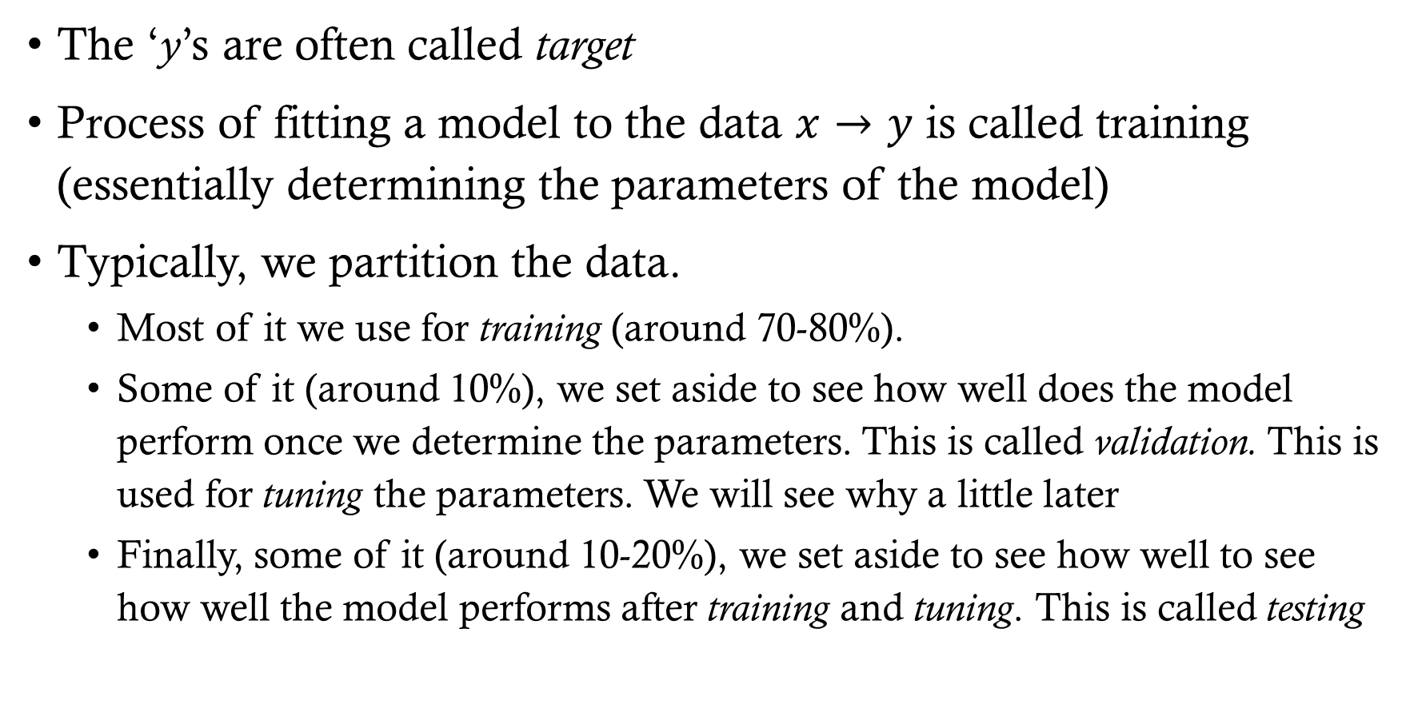
ML JARGON
The ‘y’s are often called target
Process of fitting a model to the data $x→y$ is called training (essentially determining the parameters of the model)
Typically, we partition the data.
Most of it we use for training (around 70-80%).
Some of it (around 10%), we set aside to see how well does the model perform once we determine the parameters. This is called validation. This is used for tuning the parameters. We will see why a little later
Finally, some of it (around 10-20%), we set aside to see how well to see how well the model performs after training and tuning. This is called testing
Notes:
Explain using line fit

Slide 6
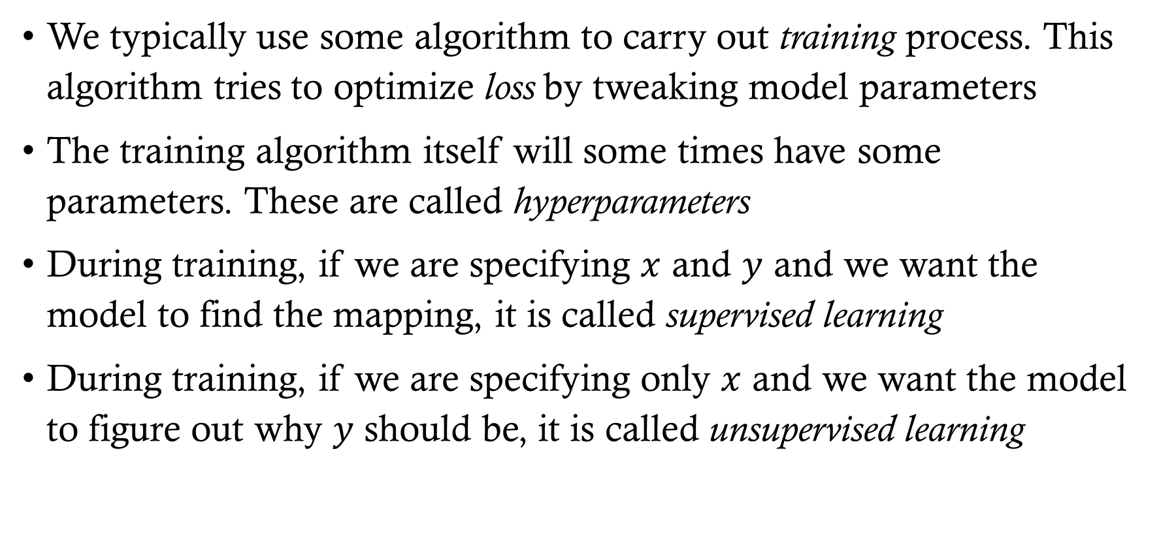
ML JARGON
We typically use some algorithm to carry out training process. This algorithm tries to optimize loss by tweaking model parameters
The training algorithm itself will some times have some parameters. These are called hyperparameters
During training, if we are specifying $x$ and $y$ and we want the model to find the mapping, it is called supervised learning
During training, if we are specifying only $x$ and we want the model to figure out why $y$ should be, it is called unsupervised learning

Slide 7
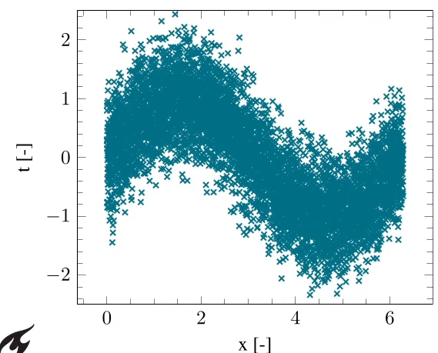
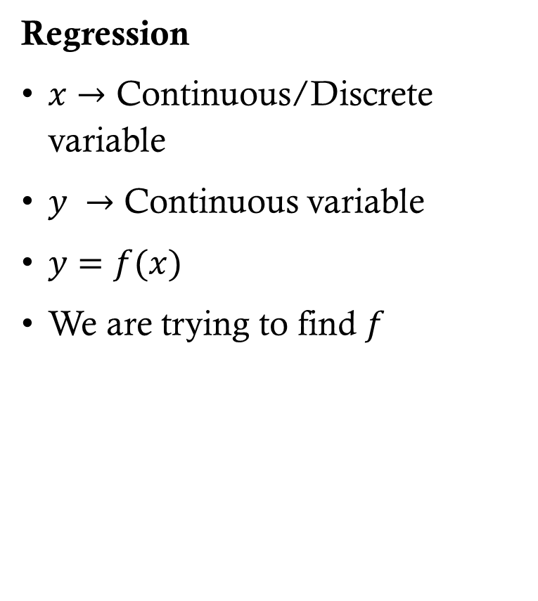
Types of machine learning problems
Regression
$x→$ Continuous/Discrete variable
$y →$ Continuous variable
$y=f(x)$
We are trying to find $f$
y [-]
https://www.youtube.com/watch?v=UF53i6ivoxs&t=41s

Slide 8


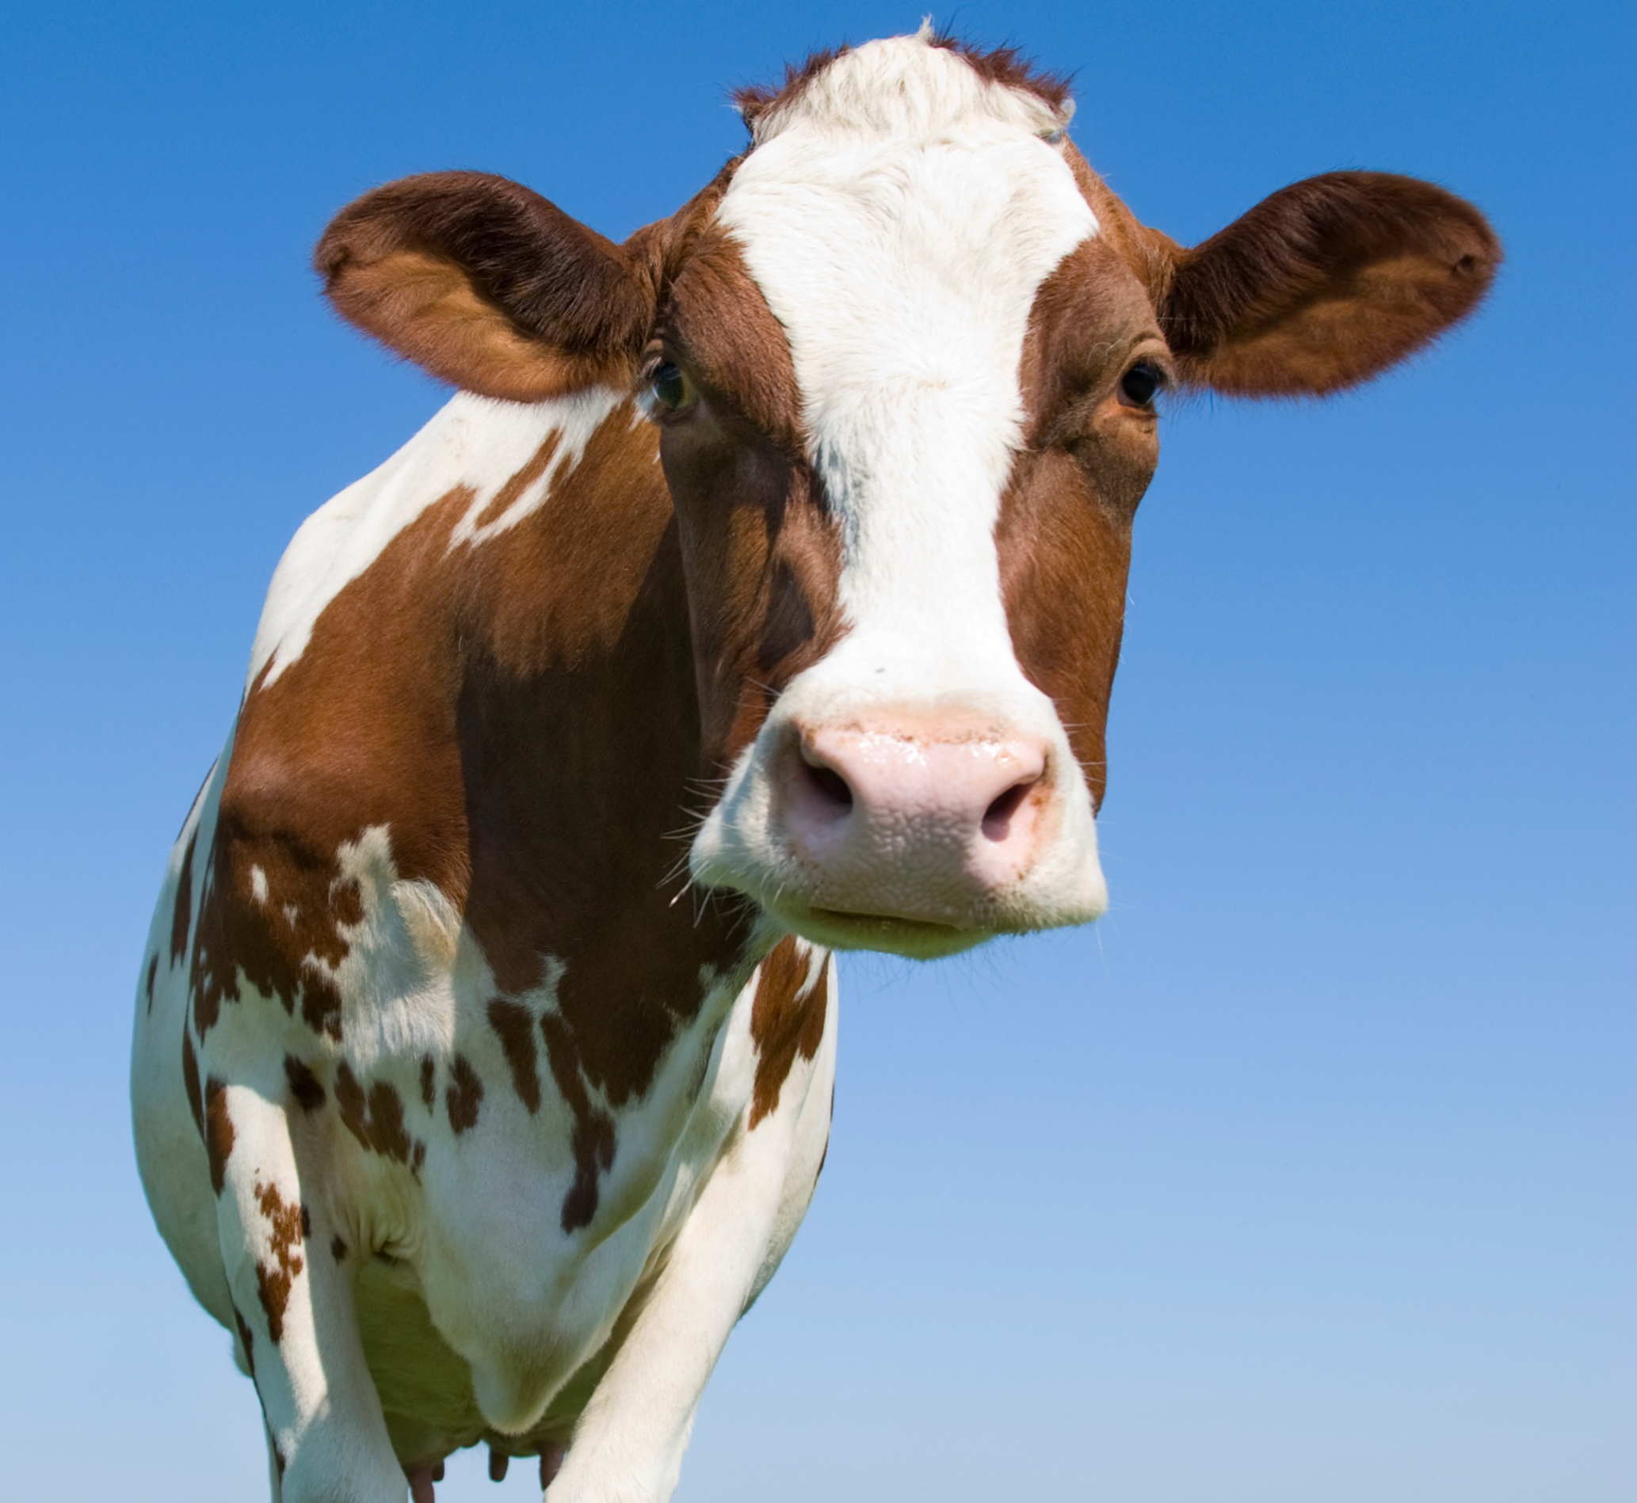
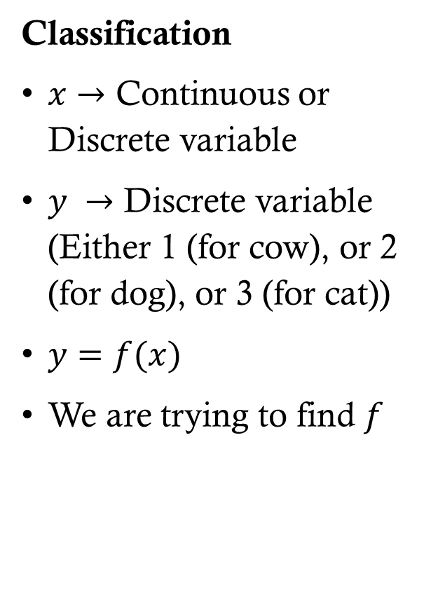
Types of machine learning problems
Classification
$x→$ Continuous or Discrete variable
$y →$ Discrete variable (Either 1 (for cow), or 2 (for dog), or 3 (for cat))
$y=f(x)$
We are trying to find $f$
Cow
Dog
Cat
MODEL
Cow
Dog
Cat
MODEL
Cow
Dog
Cat
MODEL

Slide 9
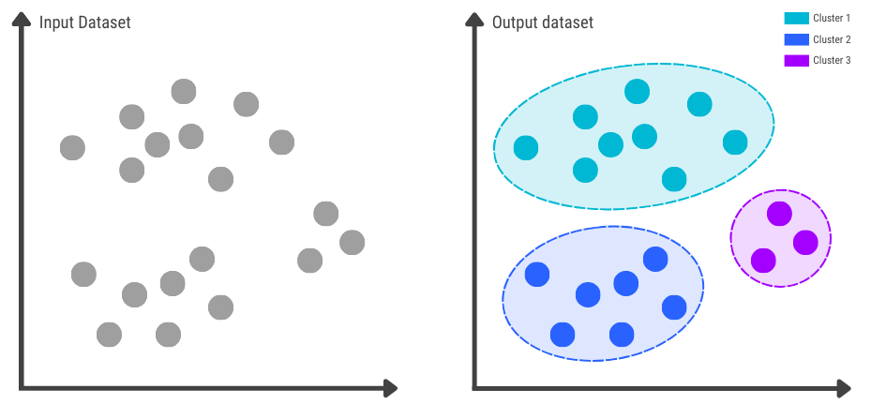
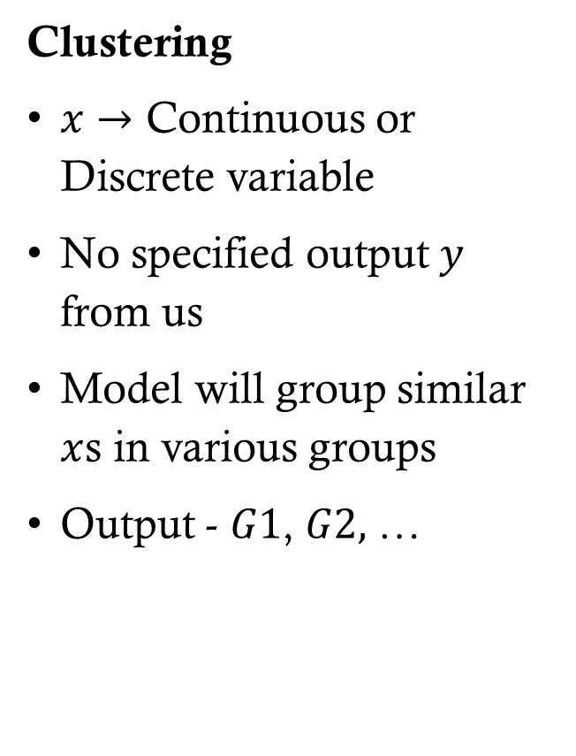
Types of machine learning problems
Clustering
$x→$ Continuous or Discrete variable
No specified output $y$ from us
Model will group similar $x$s in various groups
Output - $G1$, $G2,$ …
https://www.pi.exchange/blog/clustering-in-machine-learning

Slide 10
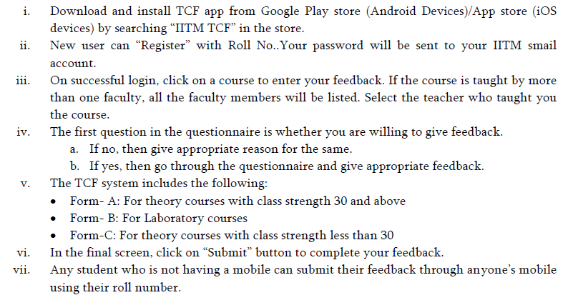
TCF

