Slide 1


CV5100: Modelling, Uncertainty and Data for Engineers MODULE 3: MACHINE LEARNING, lecture 2:Linear regression

Slide 2

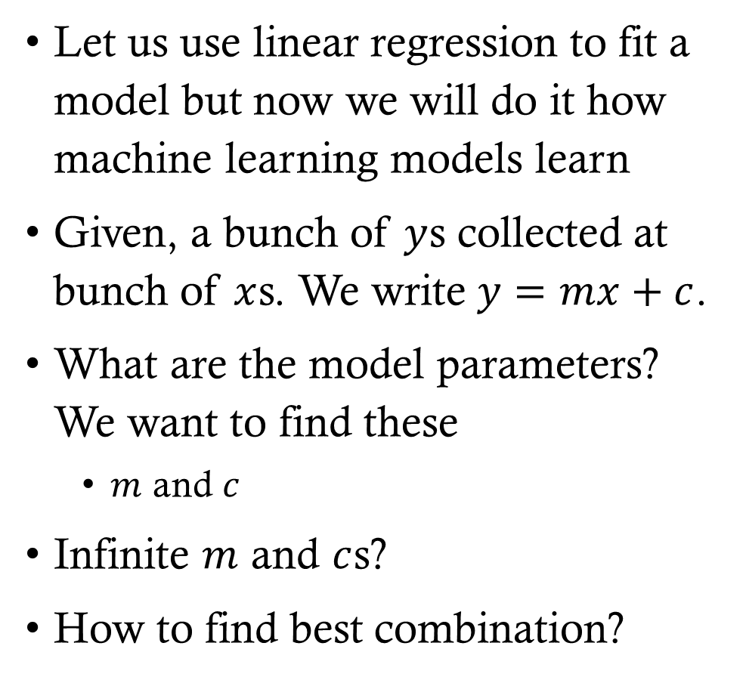

Linear regression from machine learning perspective
Let us use linear regression to fit a model but now we will do it how machine learning models learn
Given, a bunch of $y$s collected at bunch of $x$s. We write $y=mx+c$.
What are the model parameters? We want to find these
$m$ and $c$
Infinite $m$ and $c$s?
How to find best combination?
$$y$$
$$x$$

Slide 3





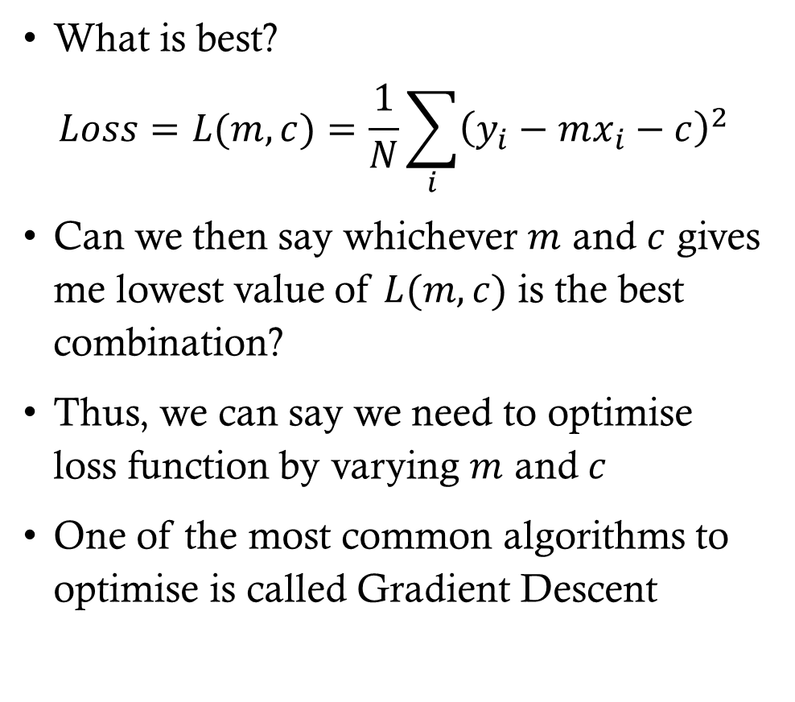






Linear regression from machine learning perspective
What is best?
$$Loss=L(m,c)=\frac{1}{N}\sum_{i}{{\left(y_{i}−mx_{i}−c\right)}^{2}}$$
Can we then say whichever $m$ and $c$ gives me lowest value of $L(m,c)$ is the best combination?
Thus, we can say we need to optimise loss function by varying $m$ and $c$
One of the most common algorithms to optimise is called Gradient Descent
$$y$$
$${\left(y_{8}−mx_{8}−c\right)}^{2}$$
$${\left(y_{7}−mx_{7}−c\right)}^{2}$$
$${\left(y_{6}−mx_{6}−c\right)}^{2}$$
$$y=mx+c$$
$${\left(y_{5}−mx_{5}−c\right)}^{2}$$
$${\left(y_{2}−mx_{2}−c\right)}^{2}$$
$${\left(y_{4}−mx_{4}−c\right)}^{2}$$
$${\left(y_{3}−mx_{3}−c\right)}^{2}$$
$${\left(y_{1}−mx_{1}−c\right)}^{2}$$
$$x$$

Slide 4
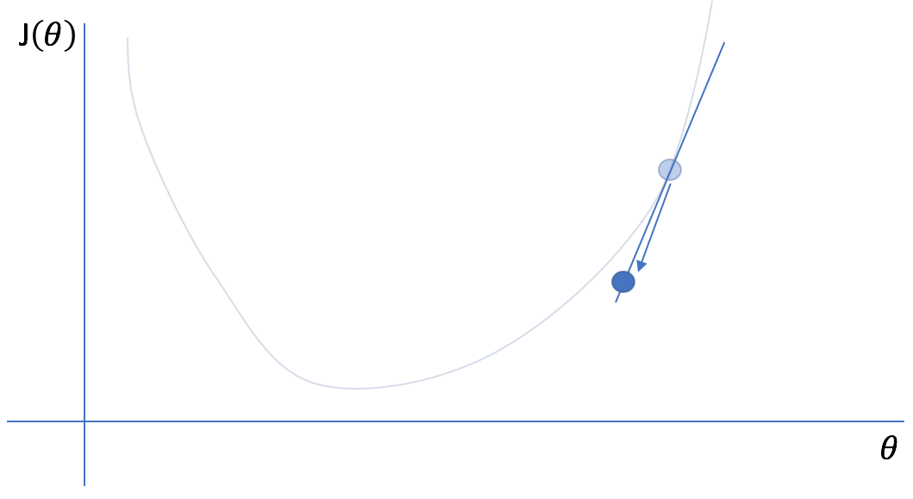
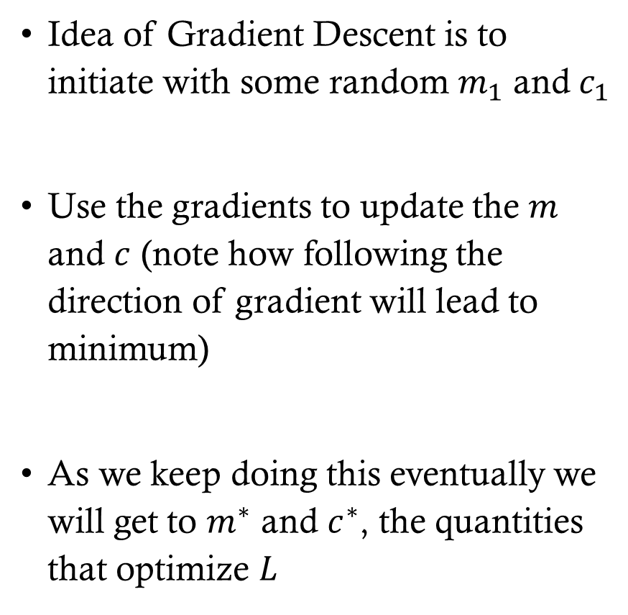

Gradient descent
Idea of Gradient Descent is to initiate with some random $m_{1}$ and $c_{1}$
Use the gradients to update the $m$ and $c$ (note how following the direction of gradient will lead to minimum)
As we keep doing this eventually we will get to $m^{∗}$ and $c^{∗}$, the quantities that optimize $L$
$$L\left(θ\right)$$
https://www.jeremyjordan.me/gradient-descent/

Slide 5
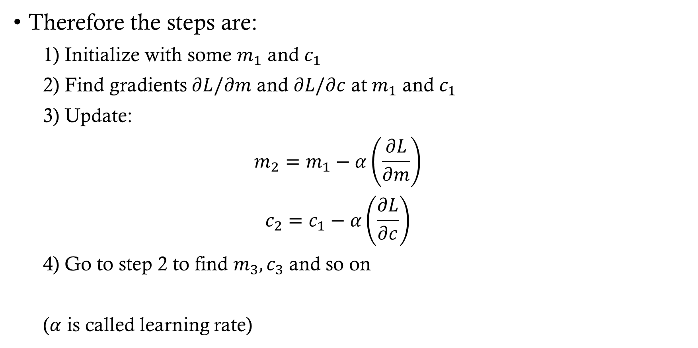
Gradient descent
Therefore the steps are:
1) Initialize with some $m_{1}$ and $c_{1}$
2) Find gradients $∂L/∂m$ and $∂L/∂c$ at $m_{1}$ and $c_{1}$
3) Update:
$$m_{2}=m_{1}−α\left(\frac{∂L}{∂m}\right)$$
$$c_{2}=c_{1}−α\left(\frac{∂L}{∂c}\right)$$
4) Go to step 2 to find $m_{3},c_{3}$ and so on
($α$ is called learning rate)

Slide 6
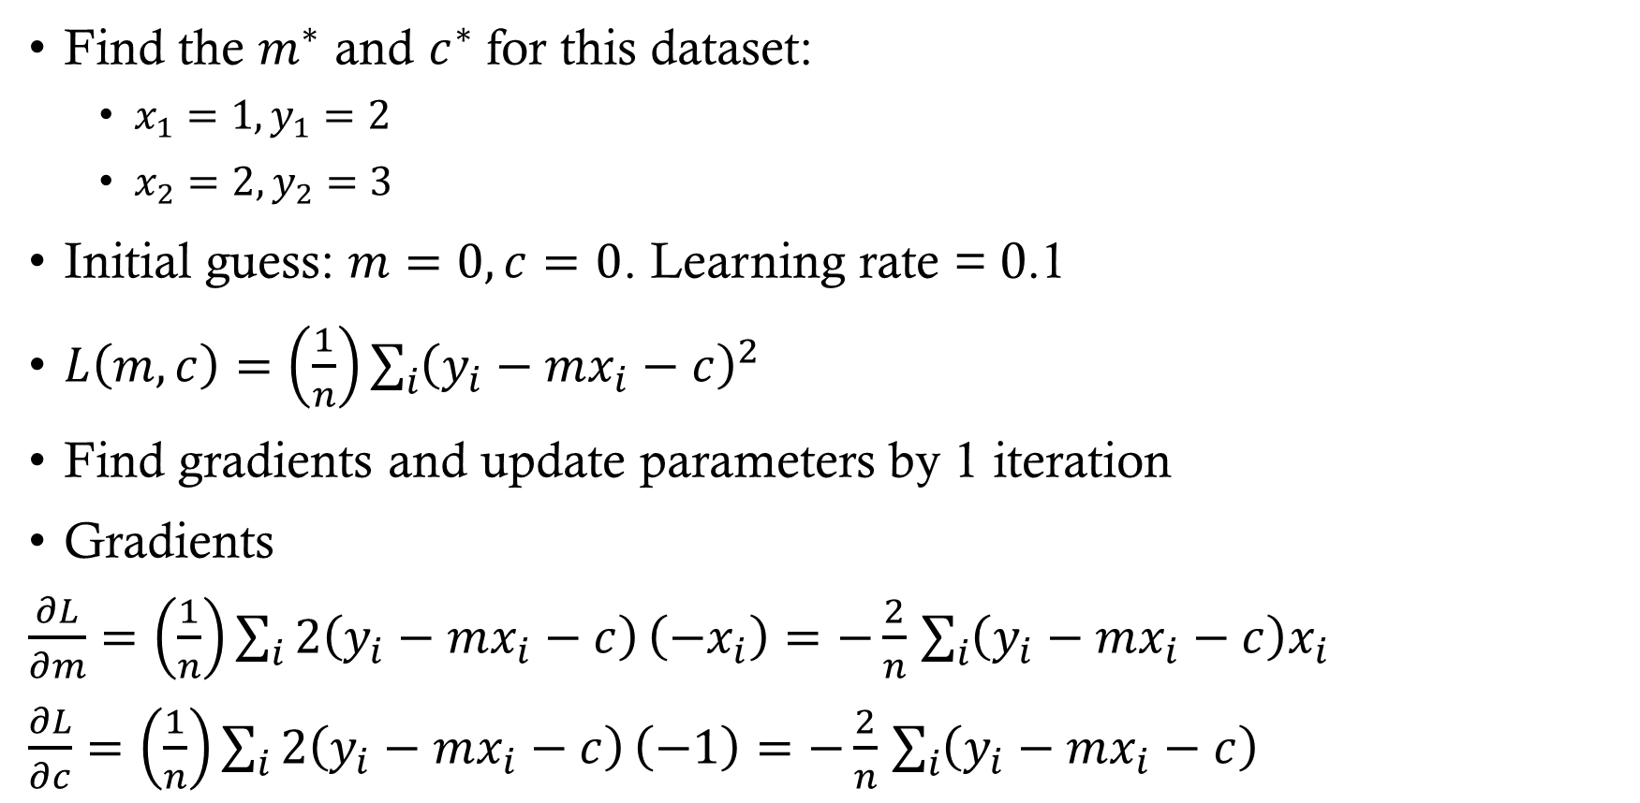
Gradient descent: Example
Find the $m^{∗}$ and $c^{∗}$ for this dataset:
$x_{1}=1, y_{1}=2$
$x_{2}=2, y_{2}=3$
Initial guess: $m=0, c=0$. Learning rate = 0.1
$L\left(m,c\right)=\left(\frac{1}{n}\right)\sum_{i}{{\left(y_{i}−mx_{i}−c\right)}^{2}}$
Find gradients and update parameters by 1 iteration
Gradients
$\frac{∂L}{∂m}=\left(\frac{1}{n}\right)\sum_{i}{2\left(y_{i}−mx_{i}−c\right)}\left(−x_{i}\right)=−\frac{2}{n}$ $\sum_{i}{\left(y_{i}−mx_{i}−c\right)x_{i}}$
$\frac{∂L}{∂c}=\left(\frac{1}{n}\right)\sum_{i}{2\left(y_{i}−mx_{i}−c\right)}\left(−1\right)=−\frac{2}{n}$ $\sum_{i}{\left(y_{i}−mx_{i}−c\right)}$

Slide 7

Gradient descent: Example
At $m=0, c=0$
$$L=\left(\frac{1}{2}\right)\left[{\left(2−0\right)}^{2}+{\left(3−0\right)}^{2}\right]=6.5$$
$\frac{∂L}{∂m}=−\frac{2}{2}$ $\left(\left(2−0\right)∗1+\left(3−0\right)∗2\right)=−8$
$\frac{∂L}{∂c}=−\frac{2}{2}$ $\left(\left(2−0\right)+\left(3−0\right)\right)=−5$
Update
$$m_{1}=m_{0}−α\frac{∂L}{∂m}=0−0.1∗−8=0.8$$
$$c_{1}=c_{0}−α\frac{∂L}{∂c}=0−0.1∗−5=0.5$$
$$L=\left(\frac{1}{2}\right)∗\left[{\left(2−1.3\right)}^{2}+{\left(3−2.1\right)}^{2}\right]=0.65$$

Slide 8
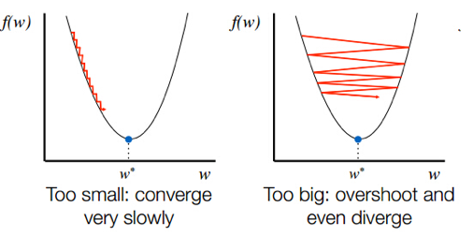
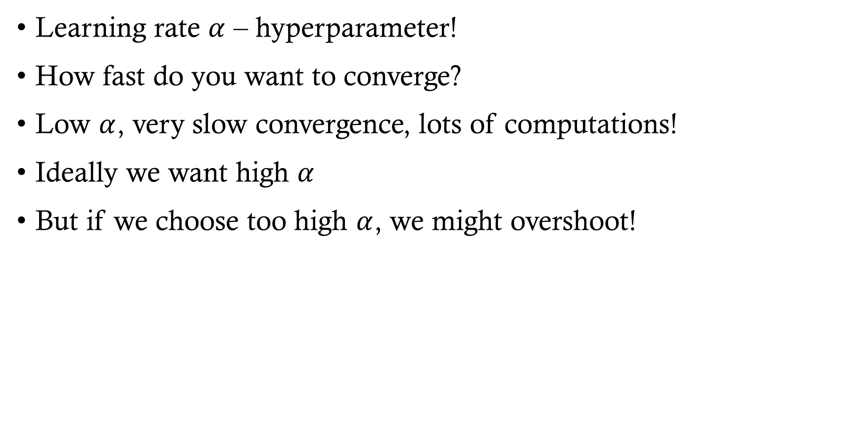
Gradient descent
Learning rate $α$ – hyperparameter!
How fast do you want to converge?
Low $α$, very slow convergence, lots of computations!
Ideally we want high $α$
But if we choose too high $α$, we might overshoot!
https://neptune.ai/blog/deep-learning-optimization-algorithms

