Slide 1


CV5100: Modelling, Uncertainty and Data for Engineers MODULE 3: MACHINE LEARNING, lecture 3:Linear regression & KNN

Slide 2
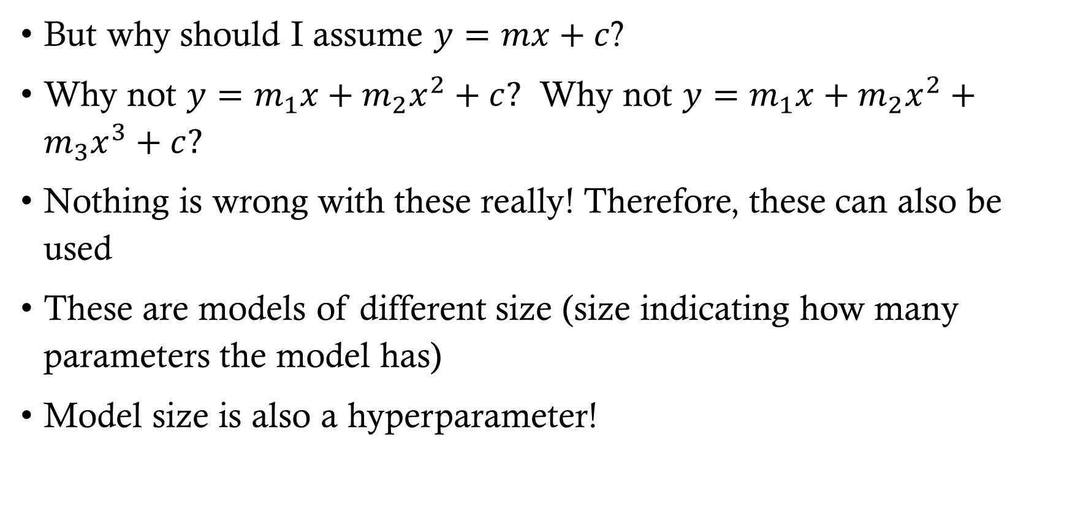
Model size
But why should I assume $y=mx+c$?
Why not $y=m_{1}x+m_{2}x^{2}+c?$ Why not $y=m_{1}x+m_{2}x^{2}+m_{3}x^{3}+c?$
Nothing is wrong with these really! Therefore, these can also be used
These are models of different size (size indicating how many parameters the model has)
Model size is also a hyperparameter!

Slide 3
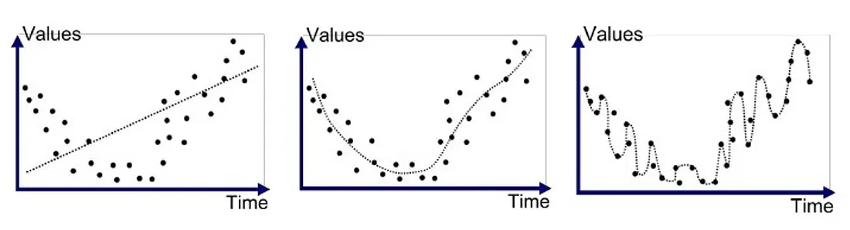



Model size
Price
Price
Price
Sq. Ft.
Sq. Ft.
Sq. Ft.
$$y=mx+c$$
$$y=m_{1}x+m_{2}x^{2}+c$$
$$y=m_{1}x+m_{2}x^{2}+m_{3}x^{3}+c$$
Underfitting: Not capturing the full trend. If we use this model for large Sq. Ft. we will predict much higher price
Correct fit: We are capturing all the trends adequately!
Overfitting: We are fitting way too well! We are fitting noise also. If we use this model for prediction we would end making vastly different prediction every time due to noise
MATLAB Code

Slide 4
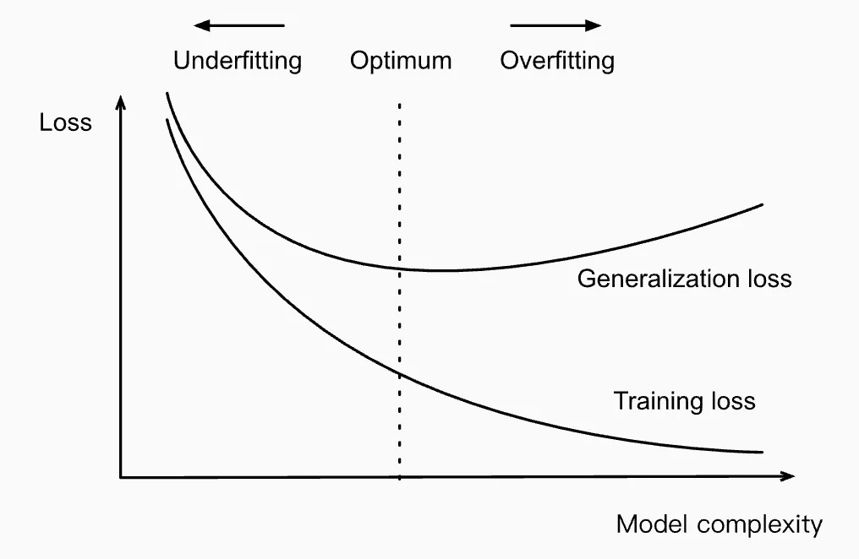
Underfitting vs overfitting
Underfitting:
Will always incur some minimum error because we have not given model enough flexibility
The parameters will not change much with varying data. Things will not blow up
Overfitting:
The parameters will change significantly with varying data. Things can blow up
Bias Variance Tradeoff: Bias means expressibility. If I want to fit a linear function to quadratic dataset, there is always some fixed error I will see. However, if I want to fit a quartic function to linear dataset, there is chance of overfitting! High bias, low variance but low bias, high variance!

Slide 5
Validation
As we saw model size, learning rate all of these also influence the final model we trained
Therefore, it is good to make informed choices. This is where we will use validation set
In practice, we do the following:
Split the dataset: Training, validation, testing
Train multiple models by varying hyperparameters
Select the hyperparameters with lowest validation error
Degree (Model Complexity) | Learning Rate | Train Error | Validation Error
1 (linear) | Low (0.01) | High | High
1 | Medium (0.1) | Medium | Medium
1 | High (1.0) | Diverges / oscillates | Diverges
2 (quadratic) | Low (0.01) | Medium | Medium-Low
2 | Medium (0.1) | Low | Lower
2 | High (1.0) | Jumps around | High
8 (overfit model) | Low (0.01) | Very Low | High
8 | Medium (0.1) | Very Low | Very High
8 | High (1.0) | Blows up | Blows up

Slide 6
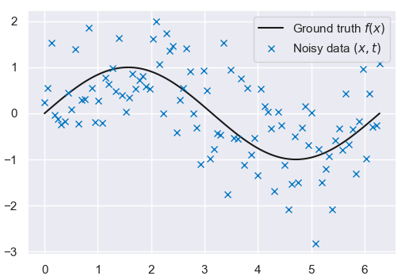



K-nearest neighbors
k-Nearest Neighbors method is a machine learning technique
Given, a bunch of $y$s collected at bunch of $x$s
We don’t care about a model. We just want to predict! Let us see how using a toy problem. We make 100 noisy measurements of $y=sin\left(x\right)$from $x=0$ to $x=2π$. In reality, we won’t know $y=sin⁡(x)$
Ground truth
Noisy data (x,y)
$$y$$
$$x$$

Slide 7
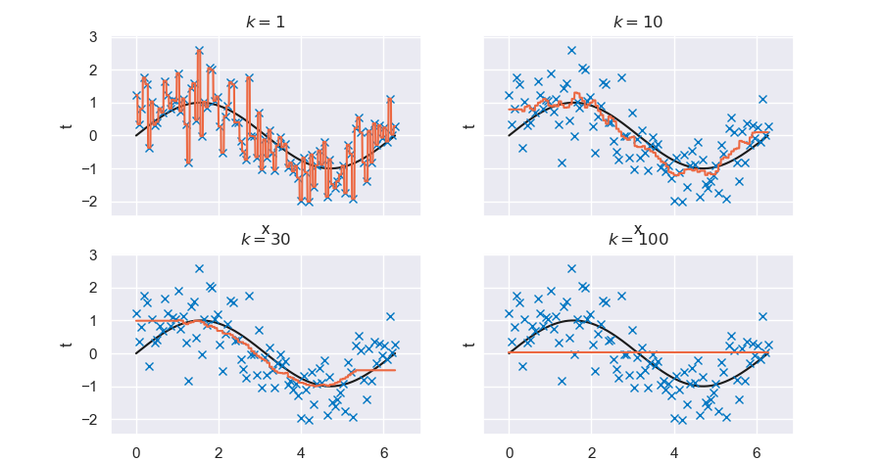

K-nearest neighbors
Naïve approach to do this is look at $y_{i}$s at $x_{i}$s surrounding $x$ and take their average to get an estimate $y$
This is called k-nearest neighbors
y
y
y
y

Slide 8
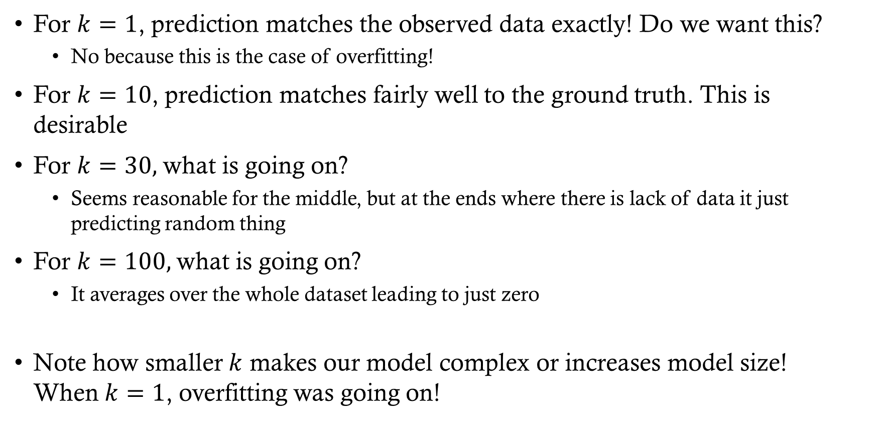
K-nearest neighbors
For $k=1$, prediction matches the observed data exactly! Do we want this?
No because this is the case of overfitting!
For $k=10$, prediction matches fairly well to the ground truth. This is desirable
For $k=30,$ what is going on?
Seems reasonable for the middle, but at the ends where there is lack of data it just predicting random thing
For $k=100,$what is going on?
It averages over the whole dataset leading to just zero
Note how smaller $k$ makes our model complex or increases model size! When$k=1$, overfitting was going on!

Slide 9
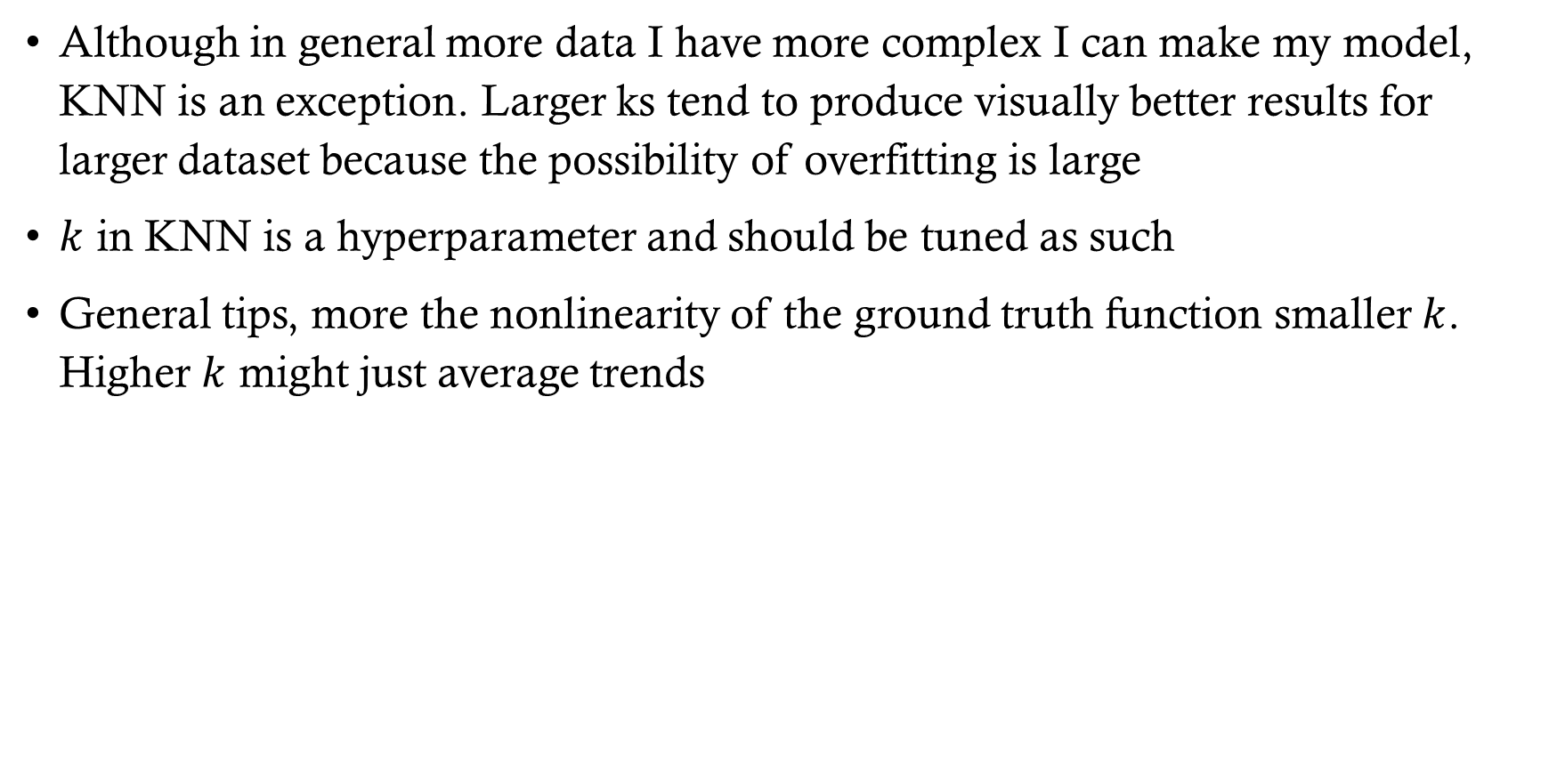
K-nearest neighbor tips and tricks
Although in general more data I have more complex I can make my model, KNN is an exception. Larger ks tend to produce visually better results for larger dataset because the possibility of overfitting is large
$k$ in KNN is a hyperparameter and should be tuned as such
General tips, more the nonlinearity of the ground truth function smaller $k$. Higher $k$ might just average trends

