Slide 1
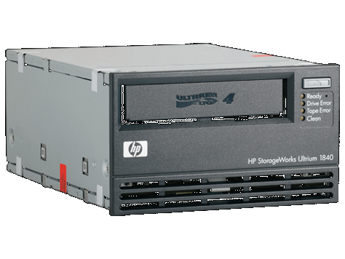
Phobos LRS architecture : big picture
Reading from Clients sockets
...
Communication Thread
Input requests queue per family
...
Scheduler internal
ordered queue per family
Family 1 Scheduling Thread
...
Family 2 Scheduling Thread
Scheduled queue per device
...
...
Device Thread 1
Device Thread n
Device Thread n + 1
Device Thread m
Running set per device
Comm.
Thread
Comm.
Thread
Comm.
Thread
Comm.
Thread
To-sync set per device
Device
Thread
Device
Thread
Device
Thread
Device
Thread
Response Queue
Writing into Clients sockets
Comm.
Thread
...

