Slide 1
Adherencia centro

Slide 2
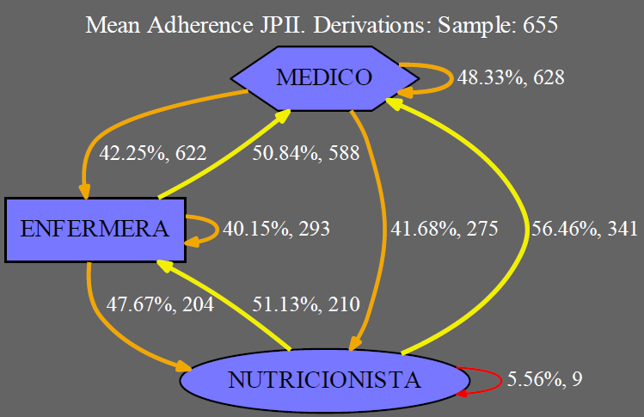

Slide 3
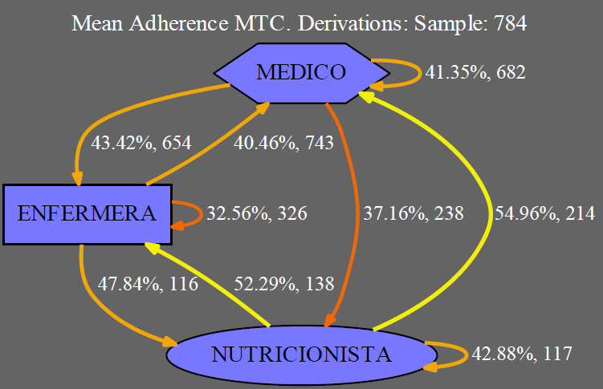

Slide 4
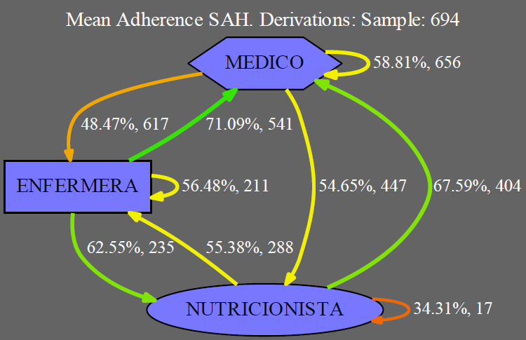

Slide 5
MEDICO -> MEDICO
 | JPII | MTC | SAH
JPII |  | 0.01% | < 0.01%
MTC |  |  | < 0.01%
SAH

Slide 6
MEDICO -> ENFERMERA
 | JPII | MTC | SAH
JPII |  | 27.95% | 0.07%
MTC |  |  | 0.65%
SAH

Slide 7
MEDICO -> NUTRICIONISTA
 | JPII | MTC | SAH
JPII |  | 13.06% | 0.01%
MTC |  |  | < 0.01%
SAH

Slide 8
ENFERMERA -> MEDICO
 | JPII | MTC | SAH
JPII |  | < 0.01% | < 0.01%
MTC |  |  | < 0.01%
SAH

Slide 9
ENFERMERA -> ENFERMERA
 | JPII | MTC | SAH
JPII |  | 1.37% | < 0.01%
MTC |  |  | < 0.01%
SAH

Slide 10
ENFERMERA -> NUTRICIONISTA
 | JPII | MTC | SAH
JPII |  | 48.77% | 0.05%
MTC |  |  | 0.30%
SAH

Slide 11
NUTRICIONISTA -> MEDICO
 | JPII | MTC | SAH
JPII |  | 35.25% | 0.03%
MTC |  |  | 0.03%
SAH

Slide 12
NUTRICIONISTA -> ENFERMERA
 | JPII | MTC | SAH
JPII |  | 41.14% | 15.73%
MTC |  |  | 26.41%
SAH

Slide 13
NUTRICIONISTA -> NUTRICIONISTA
 | JPII | MTC | SAH
JPII |  | < 0.01% | 1.50%
MTC |  |  | 23.94%
SAH

