Slide 1
Adherencia centro (120 días)

Slide 2
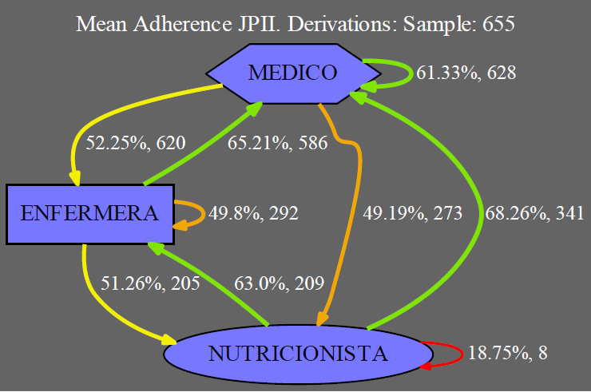

Slide 3
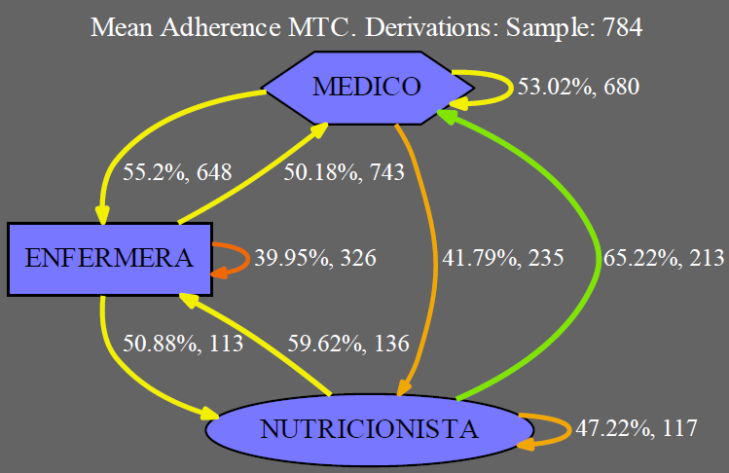

Slide 4
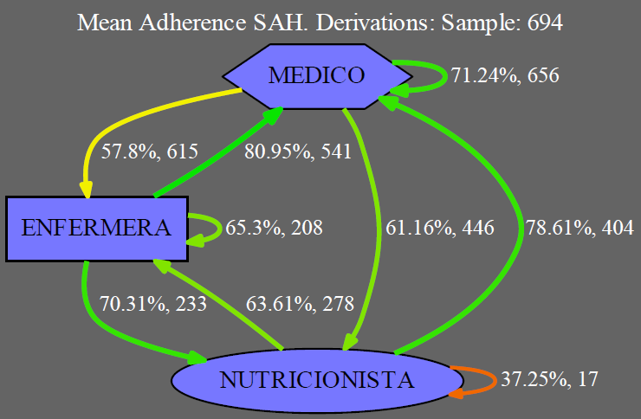

Slide 5
MEDICO -> MEDICO
 | JPII | MTC | SAH
JPII |  | 0.01% | < 0.01%
MTC |  |  | < 0.01%
SAH

Slide 6
MEDICO -> ENFERMERA
 | JPII | MTC | SAH
JPII |  | 7.66% | 0.26%
MTC |  |  | 10.38%
SAH

Slide 7
MEDICO -> NUTRICIONISTA
 | JPII | MTC | SAH
JPII |  | 3.66% | 0.02%
MTC |  |  | < 0.01%
SAH

Slide 8
ENFERMERA -> MEDICO
 | JPII | MTC | SAH
JPII |  | < 0.01% | < 0.01%
MTC |  |  | < 0.01%
SAH

Slide 9
ENFERMERA -> ENFERMERA
 | JPII | MTC | SAH
JPII |  | 0.33% | 0.01%
MTC |  |  | < 0.01%
SAH

Slide 10
ENFERMERA -> NUTRICIONISTA
 | JPII | MTC | SAH
JPII |  | 47.36% | < 0.01%
MTC |  |  | 0.01%
SAH

Slide 11
NUTRICIONISTA -> MEDICO
 | JPII | MTC | SAH
JPII |  | 20.80% | 0.02%
MTC |  |  | 0.01%
SAH

Slide 12
NUTRICIONISTA -> ENFERMERA
 | JPII | MTC | SAH
JPII |  | 25.42% | 44.13%
MTC |  |  | 20.12%
SAH

Slide 13
NUTRICIONISTA -> NUTRICIONISTA
 | JPII | MTC | SAH
JPII |  | 5.17% | 17.53%
MTC |  |  | 21.30%
SAH

