Slide 1



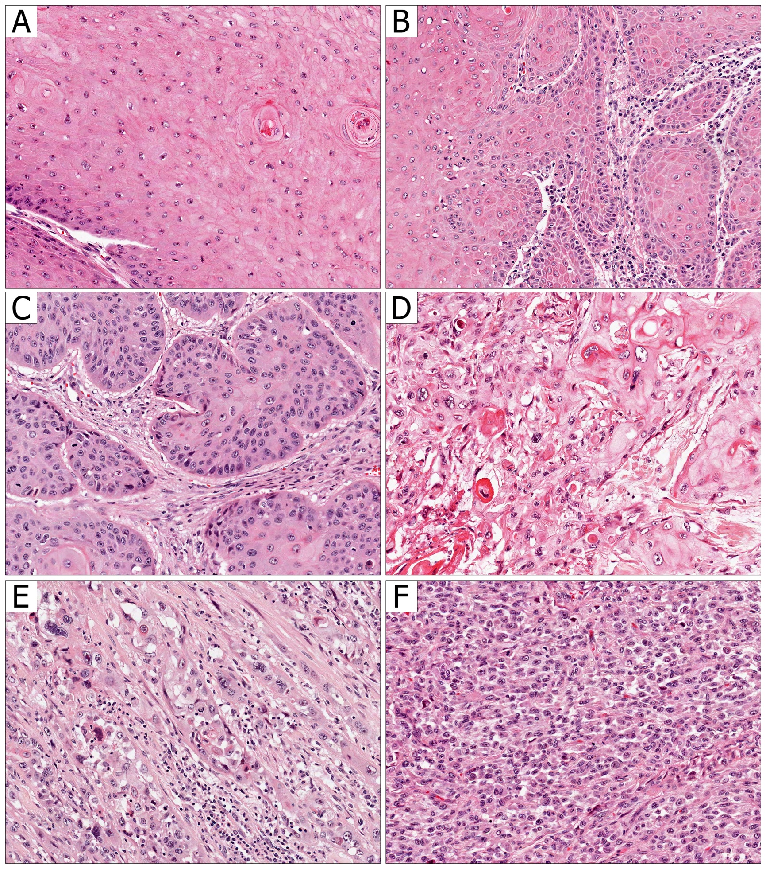
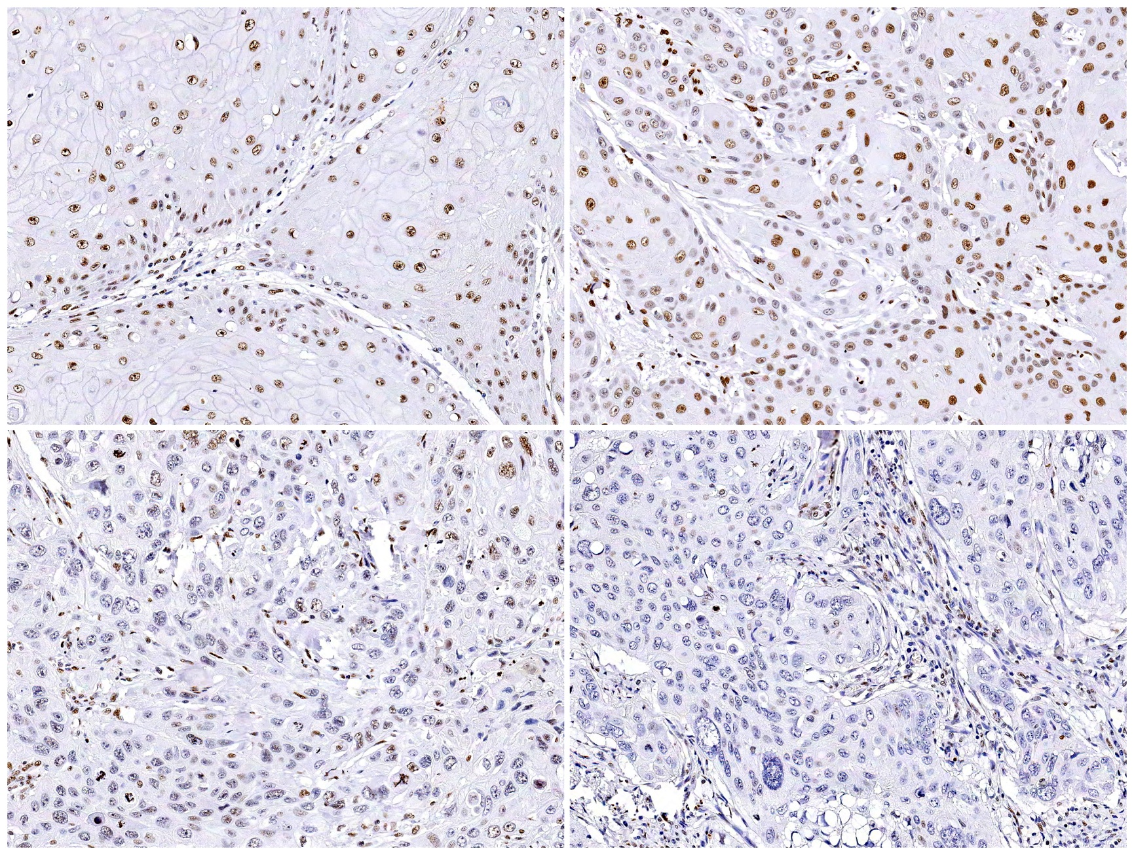
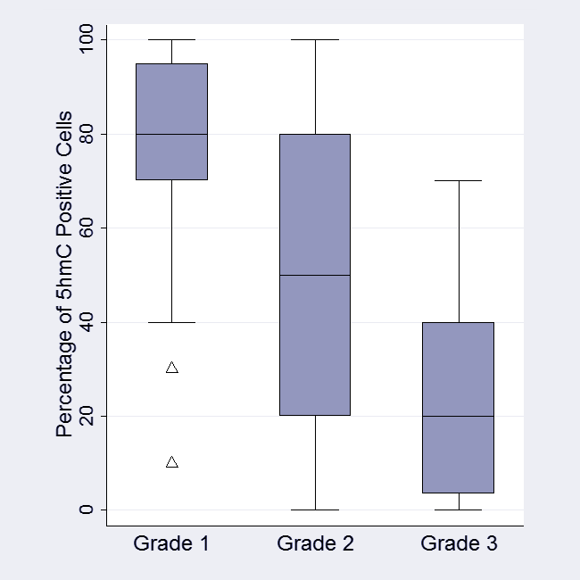
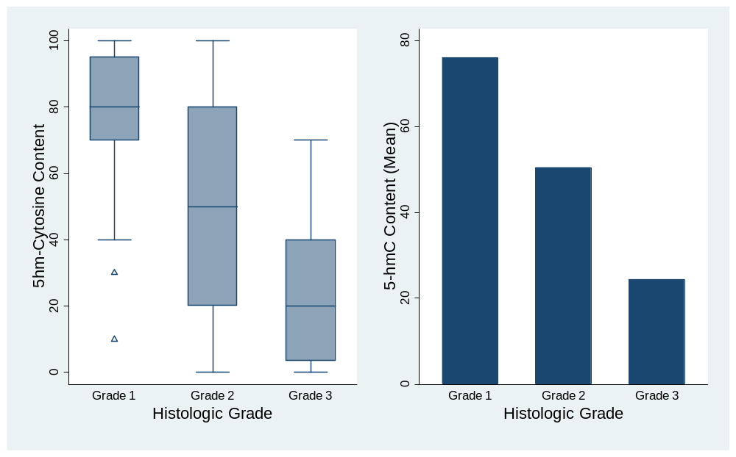
5-Hydroxy-Methyl-Cytosine Content is Strongly Associated with Degree of Histological Differentiation in Penile Squamous Cell Carcinomas
Michael C. Haffner, MD¹; George J. Netto, MD^{1,2,3}; William G. Nelson MD, PhD¹; Srinivasan Yegnasubramanian MD, PhD¹
Kristen L. Lecksell, BS³; Antonio L. Cubilla, MD⁴; Alcides Chaux, MD^{3,5}
Departments of ¹Oncology, ²Urology & ³Pathology, Johns Hopkins University School of Medicine, Baltimore, MD
⁴Instituto de Patología e Investigación, Asunción, Paraguay, ⁵Norte University School of Medicine, Asunción, Paraguay
ABSTRACT
BACKGROUND
Cytosine methylation represents an important epigenetic modification that plays a crucial role in normal differentiation as well as carcinogenesis. Recent evidence suggests that methylated cytosine (5mC) can become oxidized to 5-hydroxymethylcytosine (5hmC) in mammalian genome. We have recently shown that global 5hmC levels are greatly reduced in invasive adenocarcinoma. Here we evaluate the status of 5hmC in squamous cell carcinoma of the penis and explore the association of 5hmC with the degree of tumor differentiation.
DESIGN
Thirty-eight formalin-fixed paraffin-embedded archival cases of penile squamous cell carcinoma were selected to build a tissue microarray (TMA). Each tumor was sampled 3-9 times. TMA spots were scanned using the APERIO system and uploaded to the TMAJ platform (http://tmaj.pathology.jhmi.edu). In total, 147 individual TMA spots were evaluated. Histological grade was assigned in each spot. Global 5hmC levels were assessed using a 5hmC specific antibody and standard immunohistochemical techniques. Extent of 5hmC staining was estimated in each spot as a percentage of positive cells. Association between 5hmC extent and grade was evaluated by the Kruskal-Wallis test and trends were confirmed using Cuzick’s test.
RESULTS
Normal squamous epithelium showed strong staining for 5hmC. In invasive tumors, extent of 5hmC staining showed a strong association with tumor differentiation. 5hmC levels decreased with increasing histologic grade (Figure 1). Differences were significant (P = .0001), as well as trend across ordered categories (P < .0001).
CONCLUSION
In penile squamous cell carcinomas, global 5hmC levels significantly decrease with increased histologic grade. Our finding suggests that alterations in 5hmC levels are associated with carcinogenesis and are inversely correlated with tumor differentiation in penile squamous cell carcinoma.
INTRODUCTION
Epigenetic modifications play a crucial role in cellular differentiation and have been implicated in numerous disease states including cancer.
One of the most studied of these modifications is the addition of a methyl group on the 5-position of the cytosine (5mC) base in a CpG dinucleotide.
We have recently shown that global 5hmC levels are greatly reduced in invasive adenocarcinomas. However, the 5hmC content in penile squamous cell carcinomas (SCC) has not been evaluated before.
MATERIAL & METHODS
A tissue microarray (TMA) was built at the Johns Hopkins TMA Lab Core (Baltimore, MD) from 38 formalin-fixed, paraffin-embedded cases of penile SCC that were identified from the pathology files of the Instituto de Patología e Investigación (Asuncion, Paraguay).
For each case, 1 to 4 blocks were selected, and 3 tissue cores of 1 mm each were obtained per block, giving a representation of 3–12 TMA spots per case.
Nontumor nonpenile tissues were also included in the TMAs as internal controls.
Histologic grading was done spot by spot, as follows:
  Grade 1: tumors composed of well differentiated cells, almost undistinguishable from normal squamous cells except for the present of minimal basal/parabasal cell atypia.
  Grade 3: tumors predominantly composed of anaplastic cells with little or no keratinization, scanty or minimal amount of cytoplasm, nuclear enlargement with thick nuclear membrane, nuclear pleomorphism, clumped chromatin, prominent nucleoli and abundant mitotic figures.
  Grade 2: this was an exclusion category, including tumors not fitting into criteria described for grades 1 or 3.
Global 5hmC levels were evaluated using a recently described protocol (Oncotarget 2011;2:627).
From the TMA, a total of 147 TMA spots were scanned using the APERIO system (Aperio Technologies, Inc., Vista, CA) and uploaded to TMAJ, an open-source platform for online evaluation of TMA images (available at http://tmaj.pathology.jhmi.edu).
TMA spots were evaluated on a computer screen, and percentages of positive cells (nuclear staining) were estimated by naked eye, spot by spot.
Association between percentage of 5hmC positive cells and grade was evaluated by the Kruskal-Wallis test and trends were confirmed using Cuzick's test. A 2-tailed P < 0.05 was required for statistical significance.
Data were analyzed using StataSE Release 11 (StataCorp LP, College Station, TX)
FIGURE 3: In situ Detection of 5-hydroxymethylcytosine (5hmC) in Penile Squamous Cell Carcinomas (SCC). 5hmC immunohistochemical staining (nuclear staining) decreased from well-differentiated (grade 1) tumors (A and B) to moderately-differentiated (grade 2) tumors (C) to poorly-differentiated (grade 3) tumors (D).
RESULTS
In nonpenile nontumor tissues, distribution and levels of 5hmC were in agreement with those previously described (Oncotarget 2011;2:627). Briefly, stratified epithelia, including that in skin, cervix, oral mucosa, and bladder urothelium, exhibited a 5hmC staining in which apical cells showed higher 5hmC levels as compared to basal cells
In penile SCC the distribution by histologic grades was as it follows: grade 1, 24 spots (16%); grade 2, 63 spots (43%); grade 3, 60 spots (41%).
In penile SCC we observed a progressive decrease in 5hmC levels from grade 1 (mean 76%, median 80%), to grade 2 (mean and median 50%), to grade 3 (mean 24%, median 20%). These differences were statistically significant (P = 0.0001).
Trend across ordered categories also showed a significant decrease in 5hmC levels (P < 0.001).
CONCLUSIONS
In penile SCC, levels of 5-hydroxymethylcytosine levels decrease with increasing histologic grade.
Our finding suggests that alterations in 5hmC levels are associated with tumor progression and are inversely correlated with tumor differentiation in invasive penile SCC.
Future studies focusing on penile precursor lesions (penile intraepithelial neoplasia) will evaluate if these alterations in 5hmC expression are a crucial event in early carcinogenesis.
FIGURE 1: Histologic Grades in Penile Squamous Cell Carcinomas (SCC). A) Grade 1 SCC. B) Tumor showing both grade 1 and grade 2 areas, these tumors were classified as grade 2 SCC. C) Grade 2 SCC. D) Keratinizing grade 3 SCC. E) Grade 3 SCC. F) Solid grade 3 SCC.
FIGURE 2: 5-hydroxymethylcytosine (5hmC) levels in Penile Squamous Cell Carcinomas (SCC). 5hmC levels were higher in grade 1 and lower in grade 3 SCC. (A) shows the distribution and (B) shows the mean values of 5hmC, by histologic grade

