Slide 1




DIBBs Brown Dog Converting and Extracting

Slide 2
Conversion & Extraction Example
Given an image file, convert it to a different format and use face detection extraction to tag image.
For this example, you will need token to access the Brown Dog service.
If running on local installation of Brown Dog service, make sure, all opencv abd OCR extractors are running along with Clowder, Rabbitmq, Mongodb, fence, and redis server.
Go to script location and open for editting
cd /home/ubuntu/git/bd-tutorial-problems/06-Combined
nano combined-ex.py

Slide 3
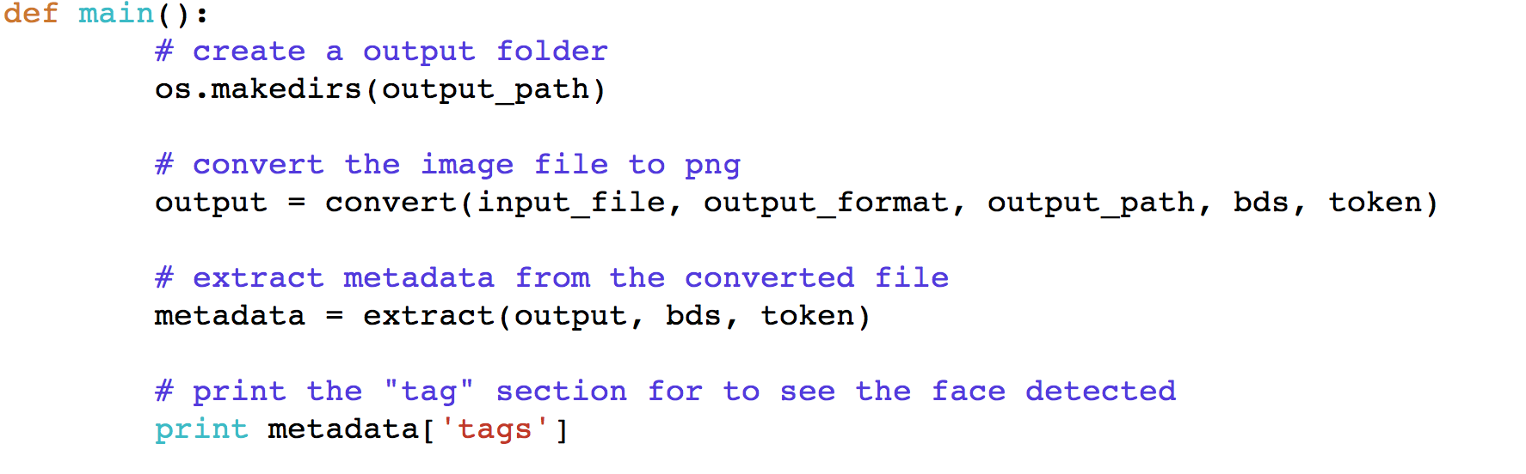
Overview
Main function

Slide 4

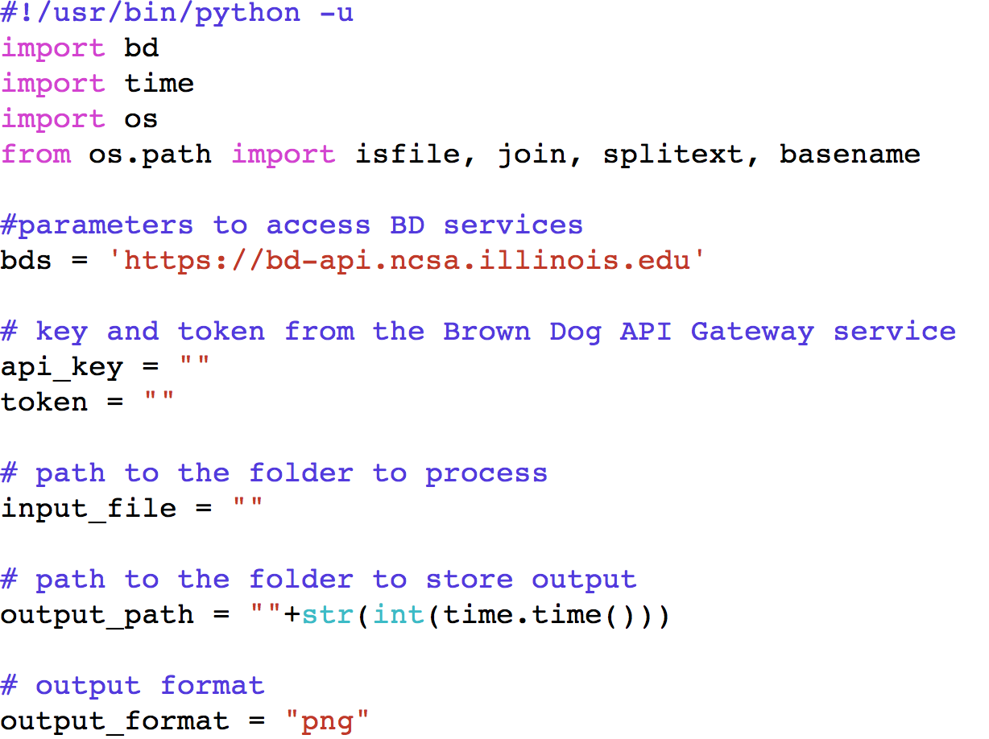
Initialize Parameters
Initialize all parameters required for this example
input_file = “/home/ubuntu/git/samplefiles/combined/input/dollar_bill.jpg”
output_path = “/home/ubuntu/git/bd-tutorial-problems/06-Combined”+str(int(time.time()))”

Slide 5
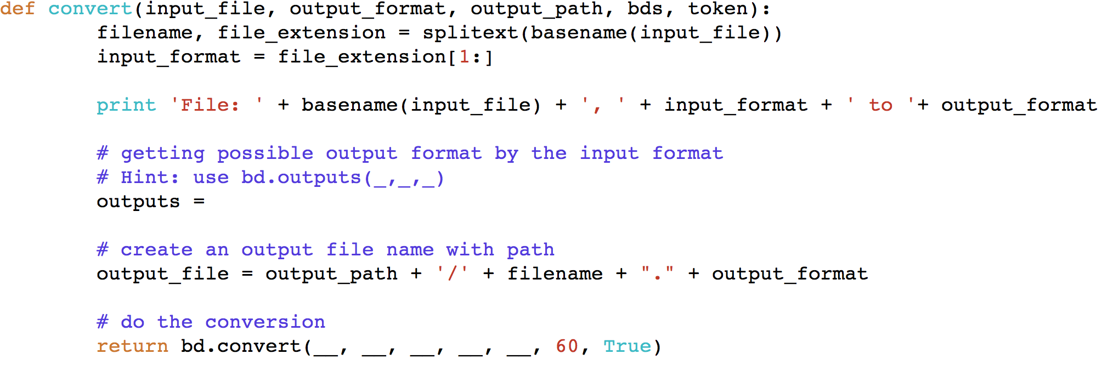
bd.py Convert Function Calls
Convert the input image file to png format using bd.convert()

Slide 6
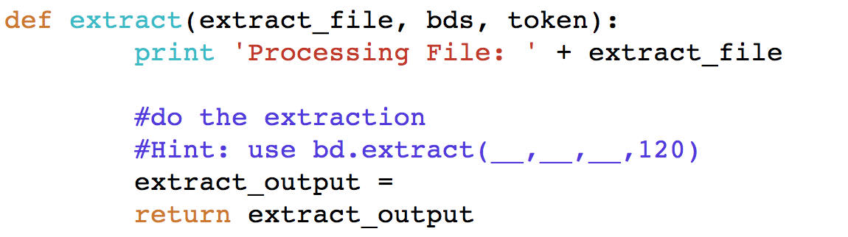
bd.py Extract Function Call
Now do the extraction on the converted file

Slide 7

Found a Person
Run the program
Tags for the image will be printed out

