Slide 1

Data Structures & Algorithms
Linked Lists: Dynamic Memory & Pointers
Module 3 | BSIT 2nd Year

Slide 2



Lesson Overview
Beyond Static Contiguity
This module bridges the gap between static memory management and flexible runtime data organization.
▹
Dynamic Execution: Utilize pointer variables for direct address manipulation on the Heap.
▹
Abstract Architecture: Construct Singly Linked Lists utilizing self-referential structures.
▹
Algorithmic Operations: Execute robust pointer linking strategies for node insertion, traversal, and safe deletion.

Slide 3
Learning Objectives
LO1: Analyze Dynamic Memory Mechanics
Demonstrate understanding of memory architecture, pointer dereferencing, dynamic functions (malloc, free), and rigorous memory leak prevention.
LO2: Construct Self-Referential Structures
Design robust node models using structs and self-referential pointers, correctly establishing head/tail tracking at runtime.
LO3: Execute Advanced Singly Linked List Operations
Synthesize algorithmic logic for multi-scenario node insertion (head, middle, tail) and edge-case-safe node deletion.

Slide 4




Memory Architecture: Stack vs. Heap
Stack Memory
Heap Memory
▹
Allocation: Automatic, compile-time/runtime execution.
▹
Allocation: Manual, explicit runtime request by code.
▹
Lifetime: Scoped strictly to function context; cleared on return.
▹
Lifetime: Persistent until explicitly freed or program exit.
▹
Structure: Fixed size, contiguous, highly structured (LIFO).
▹
Structure: Large flexible pool, non-contiguous block memory.
▹
Speed: Fast execution via hardware registers.
▹
Speed: Slightly slower access via pointer dereferencing.

Slide 5
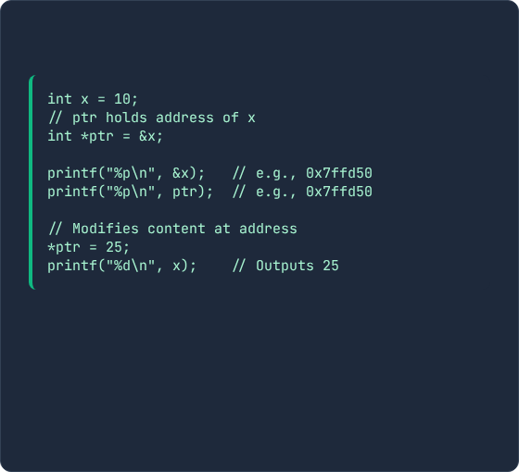
Pointer Fundamentals
Core Operators
C/C++ Example
A pointer is a variable whose stored value is the hexadecimal memory address of another variable.
Address-of Operator (&): Retrieves the exact memory location in RAM.
Dereference Operator (*): Accesses or modifies the actual data stored at the memory address.
Null Pointer: Initialized to NULL (or nullptr) to explicitly point to zero/invalid memory.

Slide 6

Dynamic Management Functions
Runtime allocation functions manage heap memory when variable sizes cannot be predetermined:
•
malloc(size): Allocates contiguous block. Uninitialized.
•
calloc(num, size): Allocates array. Automatically zero-fills.
•
realloc(ptr, size): Resizes an existing block safely.
•
free(ptr): Deallocates heap memory back to OS pool.
Critical Step: Always check if malloc returns NULL to prevent crashes.

Slide 7








Critical Memory Pitfalls
Memory Leaks
Dangling Pointers
Dynamically allocated heap blocks lose all pointer references without being explicitly freed. Exhausts system RAM.
Pointer continues referencing an address after it has been freed. Access causes unpredictable crashes.
Double Free
Wild Pointers
Executing free() twice on the same address corrupts internal heap structures, inviting exploits.
Pointers declared without initialization containing arbitrary addresses. Always initialize to NULL.

Slide 8
Arrays vs. Linked Lists
Property | Contiguous Array | Singly Linked List
Memory Layout | Contiguous block in memory | Non-contiguous scattered heap nodes
Access Time | O(1) Direct Indexing | O(n) Sequential Traversal
Insert/Delete (Start) | O(n) (requires element shifting) | O(1) (simple pointer re-linking)
Insert/Delete (End) | O(1) amortized (if capacity exists) | O(n) without tail pointer; O(1) with tail
Memory Overhead | Zero extra pointers per element | Requires extra memory for pointer(s)

Slide 9
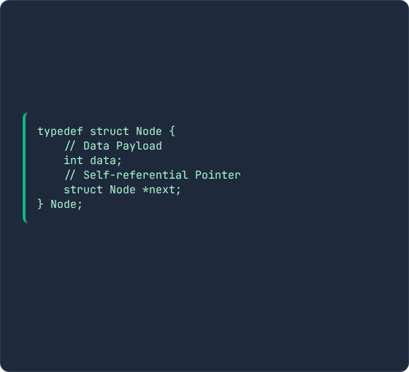
Node Structure & Self-Reference
The Node Concept
Self-Referential Struct (C)
Unlike arrays, nodes are allocated individually on the heap and chained together via pointer links.
A struct containing a pointer pointing to another struct of the identical type.
Data Field: Holds the payload (e.g., integer).
Next Pointer: A reference holding the memory address of the subsequent node.

Slide 10
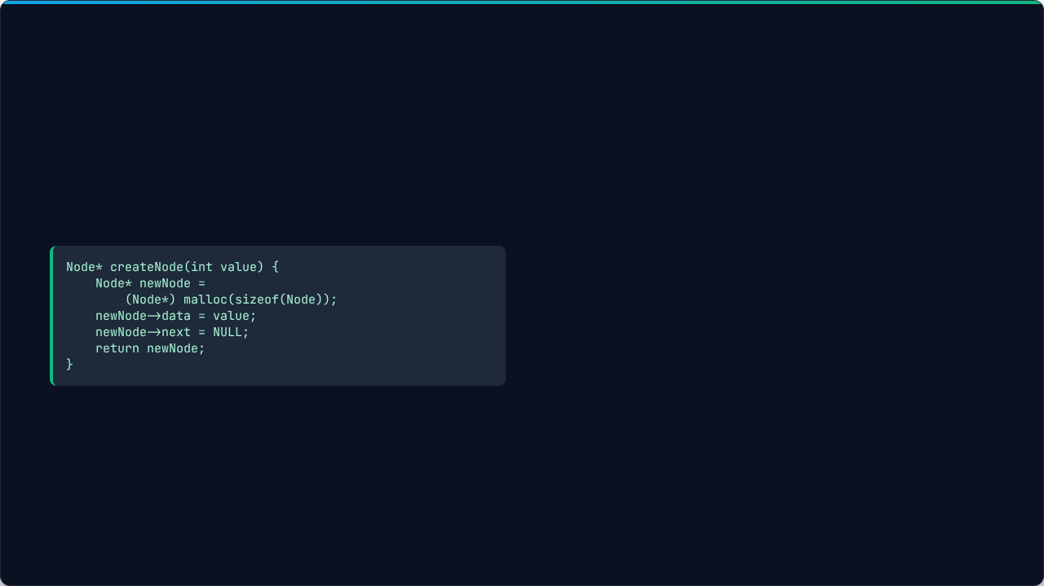

Dynamic Node Instantiation
A linked list is referenced by a special pointer named HEAD, which stores the address of the initial node.
Instantiating a dynamic node requires requesting heap memory, assigning data, and setting the next pointer to NULL.

Slide 11
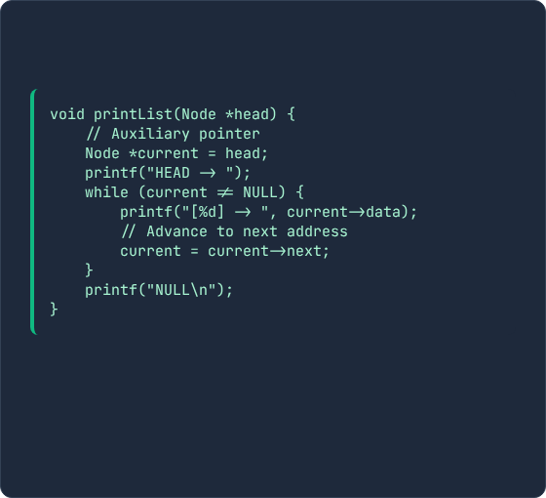
List Traversal
Sequential Mechanics
Implementation
Traversal visits each node sequentially, starting from HEAD, until reaching the end (NULL).
Critical Rule:
Because altering the HEAD pointer causes loss of the entire list, traversal MUST always use an auxiliary temporary pointer.

Slide 12
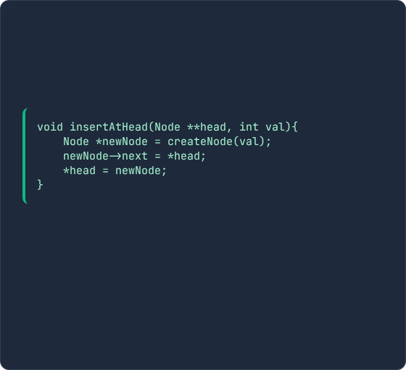
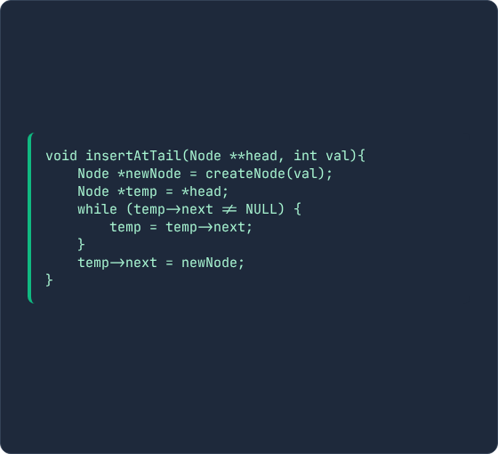
Insertion Scenarios
Insertion at HEAD (O(1))
Insertion at TAIL (O(n))
The new node's next pointer is set to current head address. Head pointer is re-assigned.
Traverse to the final node (next == NULL), attach new node.

Slide 13






Safe Node Deletion
Delete HEAD O(1)
Delete Target Key
Delete TAIL O(n)
Store current HEAD in temporary pointer. Shift HEAD to HEAD->next. Issue free() on temp.
Traverse with two pointers (current & prev). Unlink matching node from sequence before freeing it.
Traverse to second-to-last node. Free temp->next. Set temp->next = NULL.

Slide 14

Knowledge Check
Ready to unchain your memory constraints?
Discussion Prompt:
Why does node deletion in the middle of a linked list require an auxiliary prev pointer in addition to the current pointer during traversal?

Slide 15
Core References
Cormen, T. H., Leiserson, C. E., Rivest, R. L., & Stein, C. (2022).
Introduction to Algorithms (4th ed.). MIT Press. Chapter 10: Elementary Data Structures.
Kernighan, B. W., & Ritchie, D. M. (1988).
The C Programming Language (2nd ed.). Prentice Hall. Chapter 5: Pointers and Arrays.
Weiss, M. A. (2014).
Data Structures and Algorithm Analysis in C++ (4th ed.). Pearson. Chapter 3: Lists, Stacks, and Queues.

Slide 16



Image Sources
http://googleusercontent.com/image_collection/image_retrieval/1671580812311958761_0
Source: elements.envato.com
http://googleusercontent.com/image_collection/image_retrieval/11952116971872545259_0
Source: elements.envato.com
http://googleusercontent.com/image_collection/image_retrieval/6594879158731003910_0
Source: elements.envato.com

Slide 17



Image Sources
https://images.stockcake.com/public/c/8/8/c88fcf21-6667-4951-8e38-c99c589f4252_large/neon-neural-networks-stockcake.jpg
Source: stockcake.com
https://media.easy-peasy.ai/172597de-9259-42e6-ba2d-069ad50a7ecf/c8c32d6b-4fde-4fe5-9e71-67ea405f5a26_medium.webp
Source: easy-peasy.ai
https://www.udacity.com/_next/image?url=https%3A%2F%2Fvideo.udacity-data.com%2Ftopher%2F2024%2FOctober%2F670987a7_nd256%2Fnd256.jpg&w=3840&q=80
Source: www.udacity.com

