Slide 1

Experience the joy of praying for others

Slide 2

What we built

Slide 3
The mission
Personal prayer for everyone on earth
Encourage people to pray every day, for three people every day

Slide 4
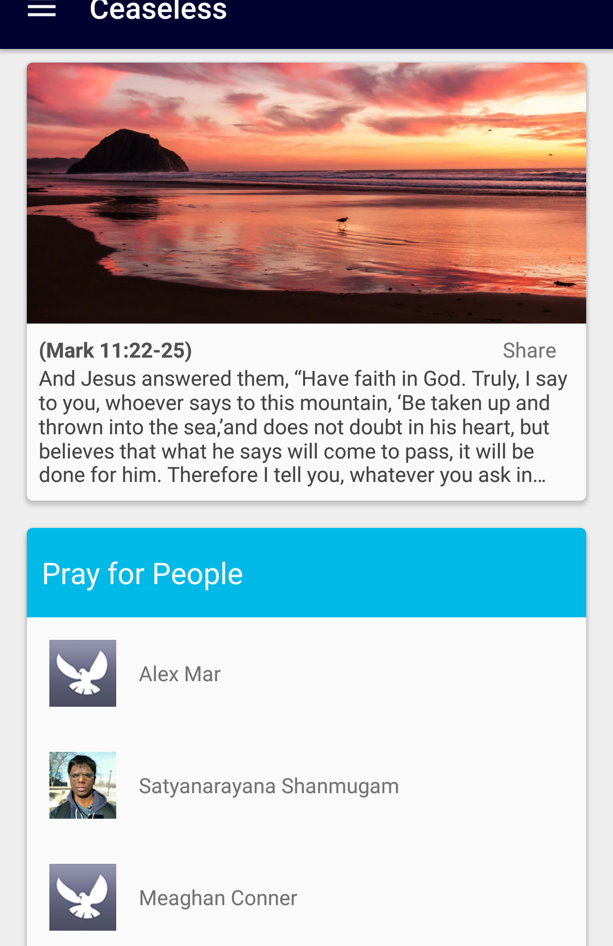

Slide 5
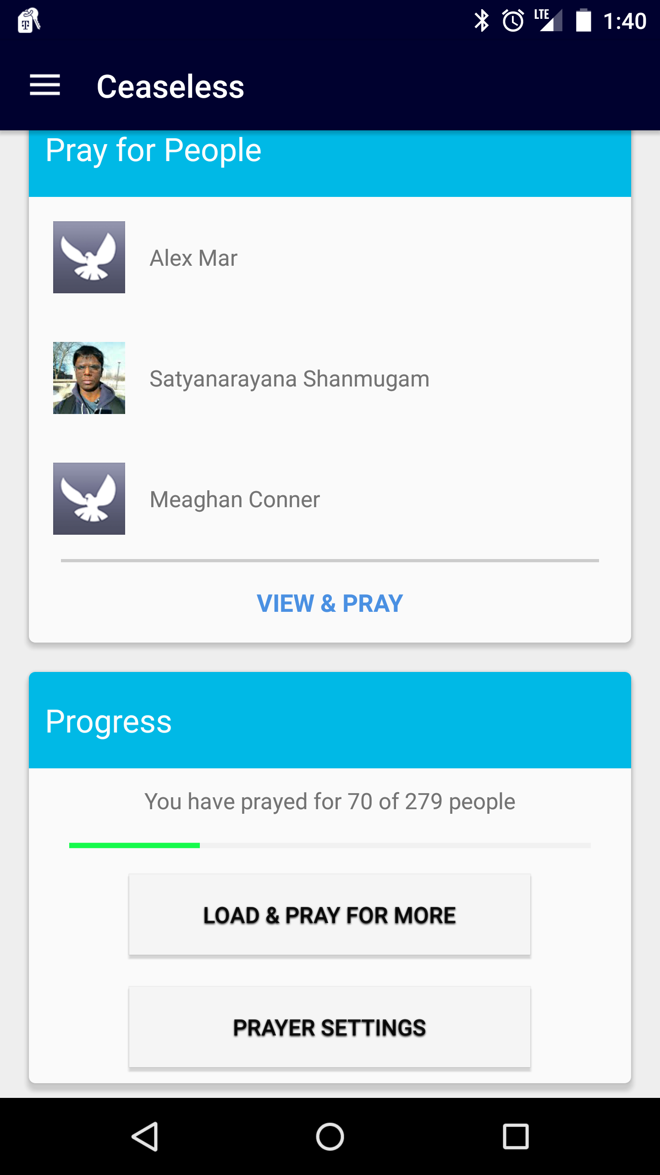

Slide 6
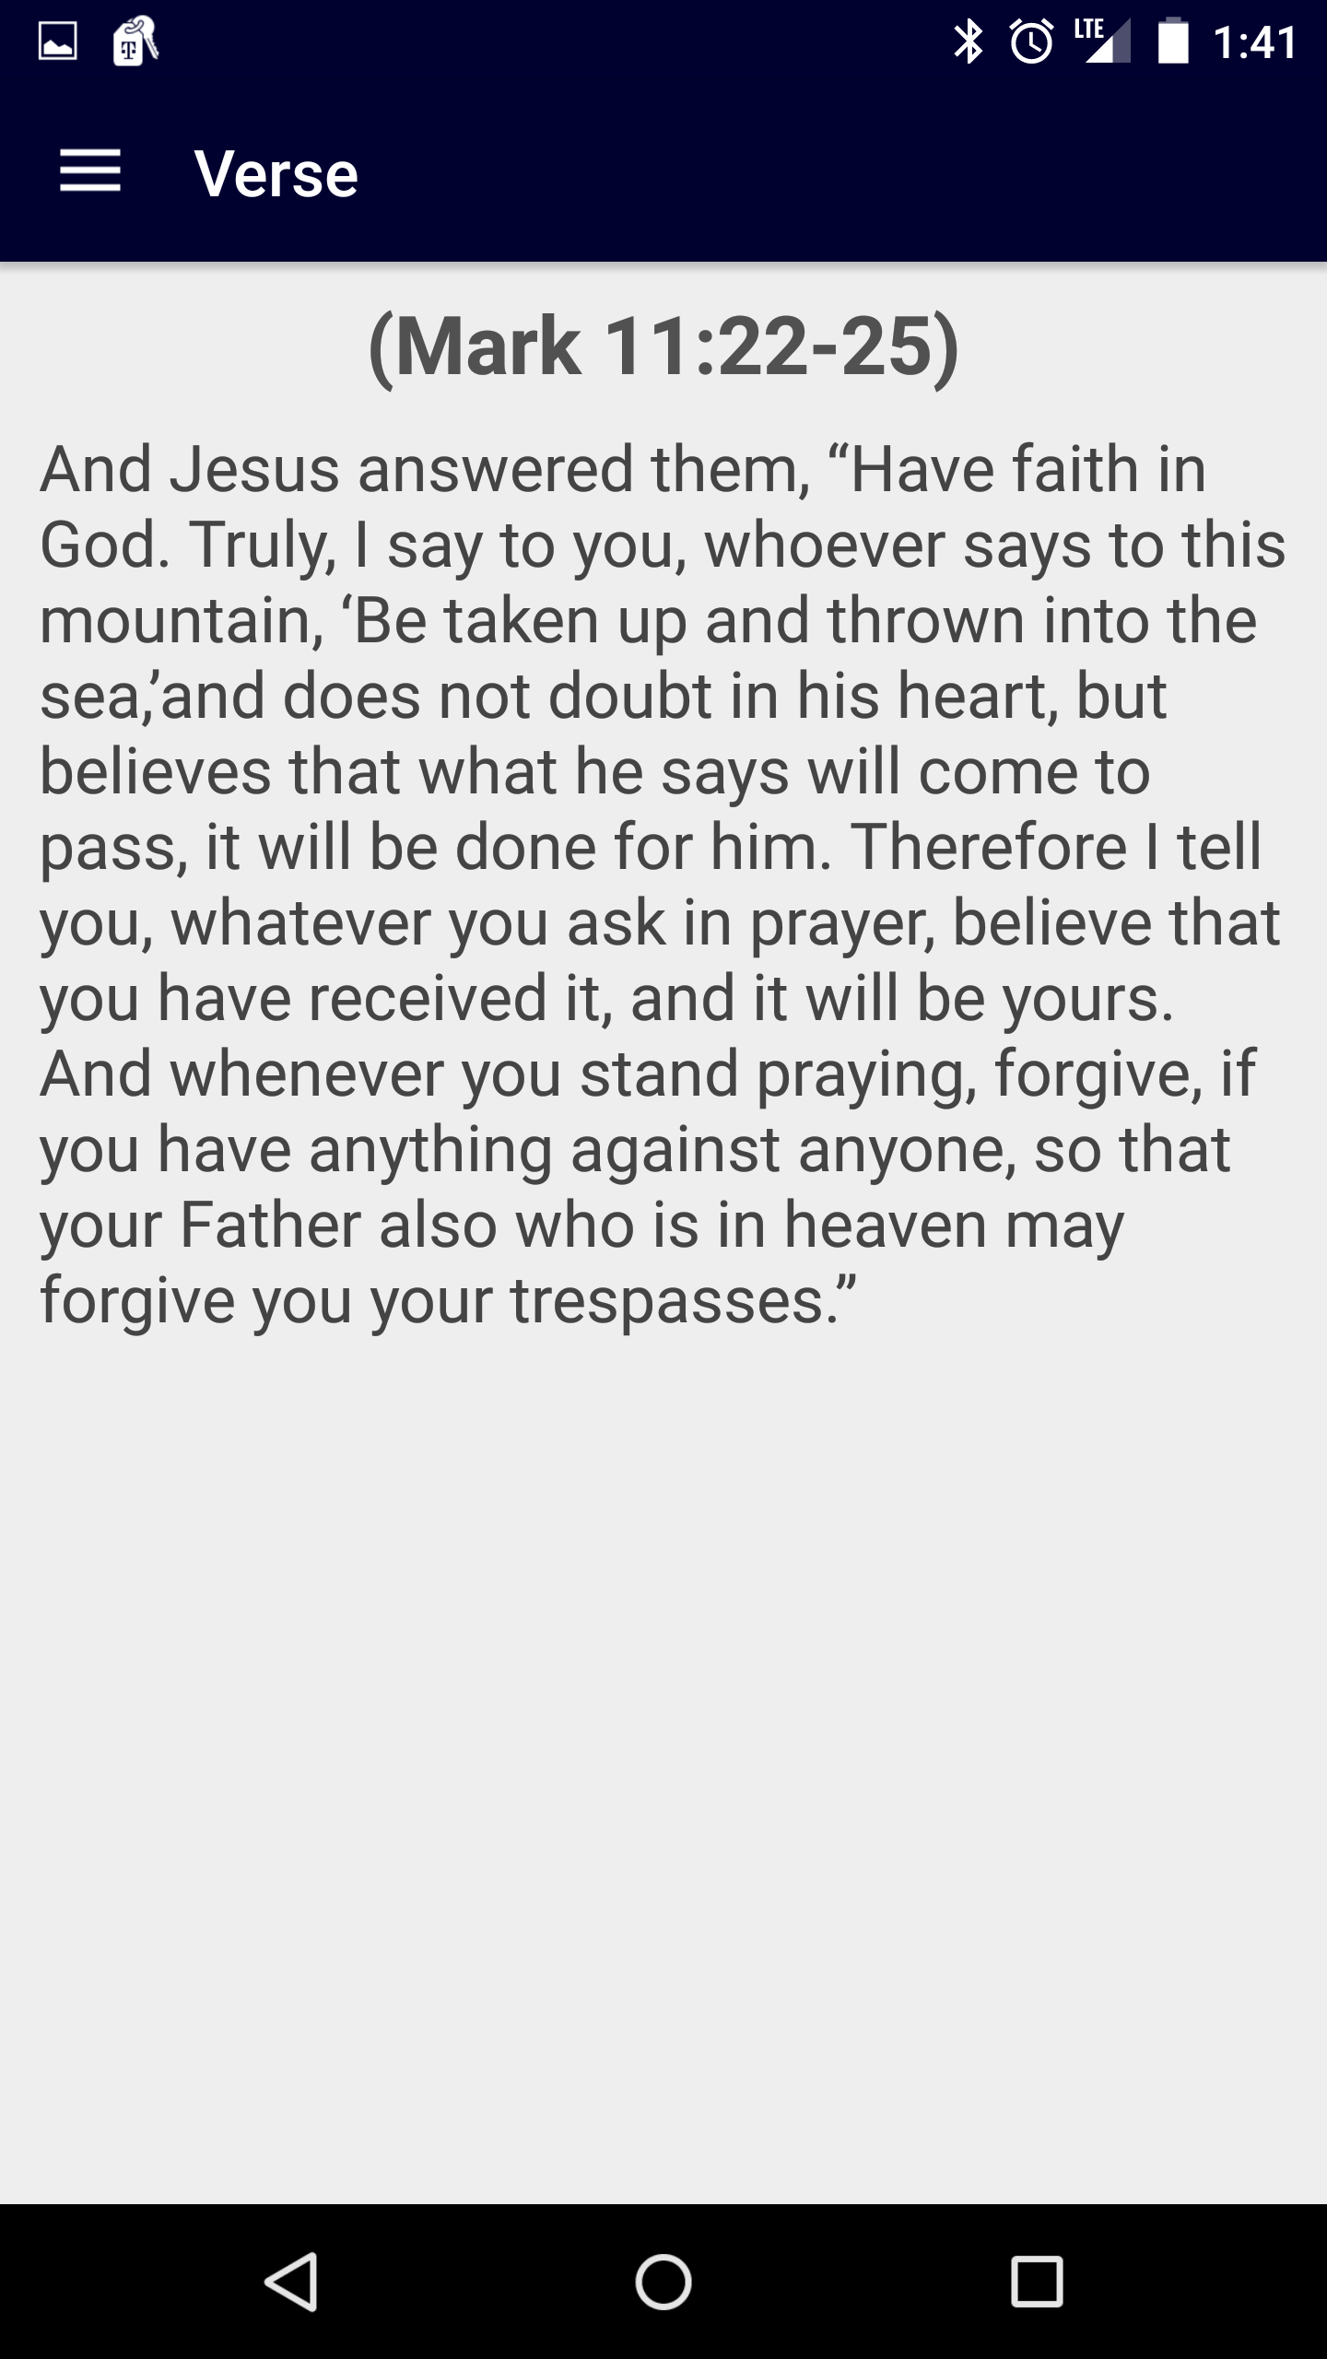

Slide 7
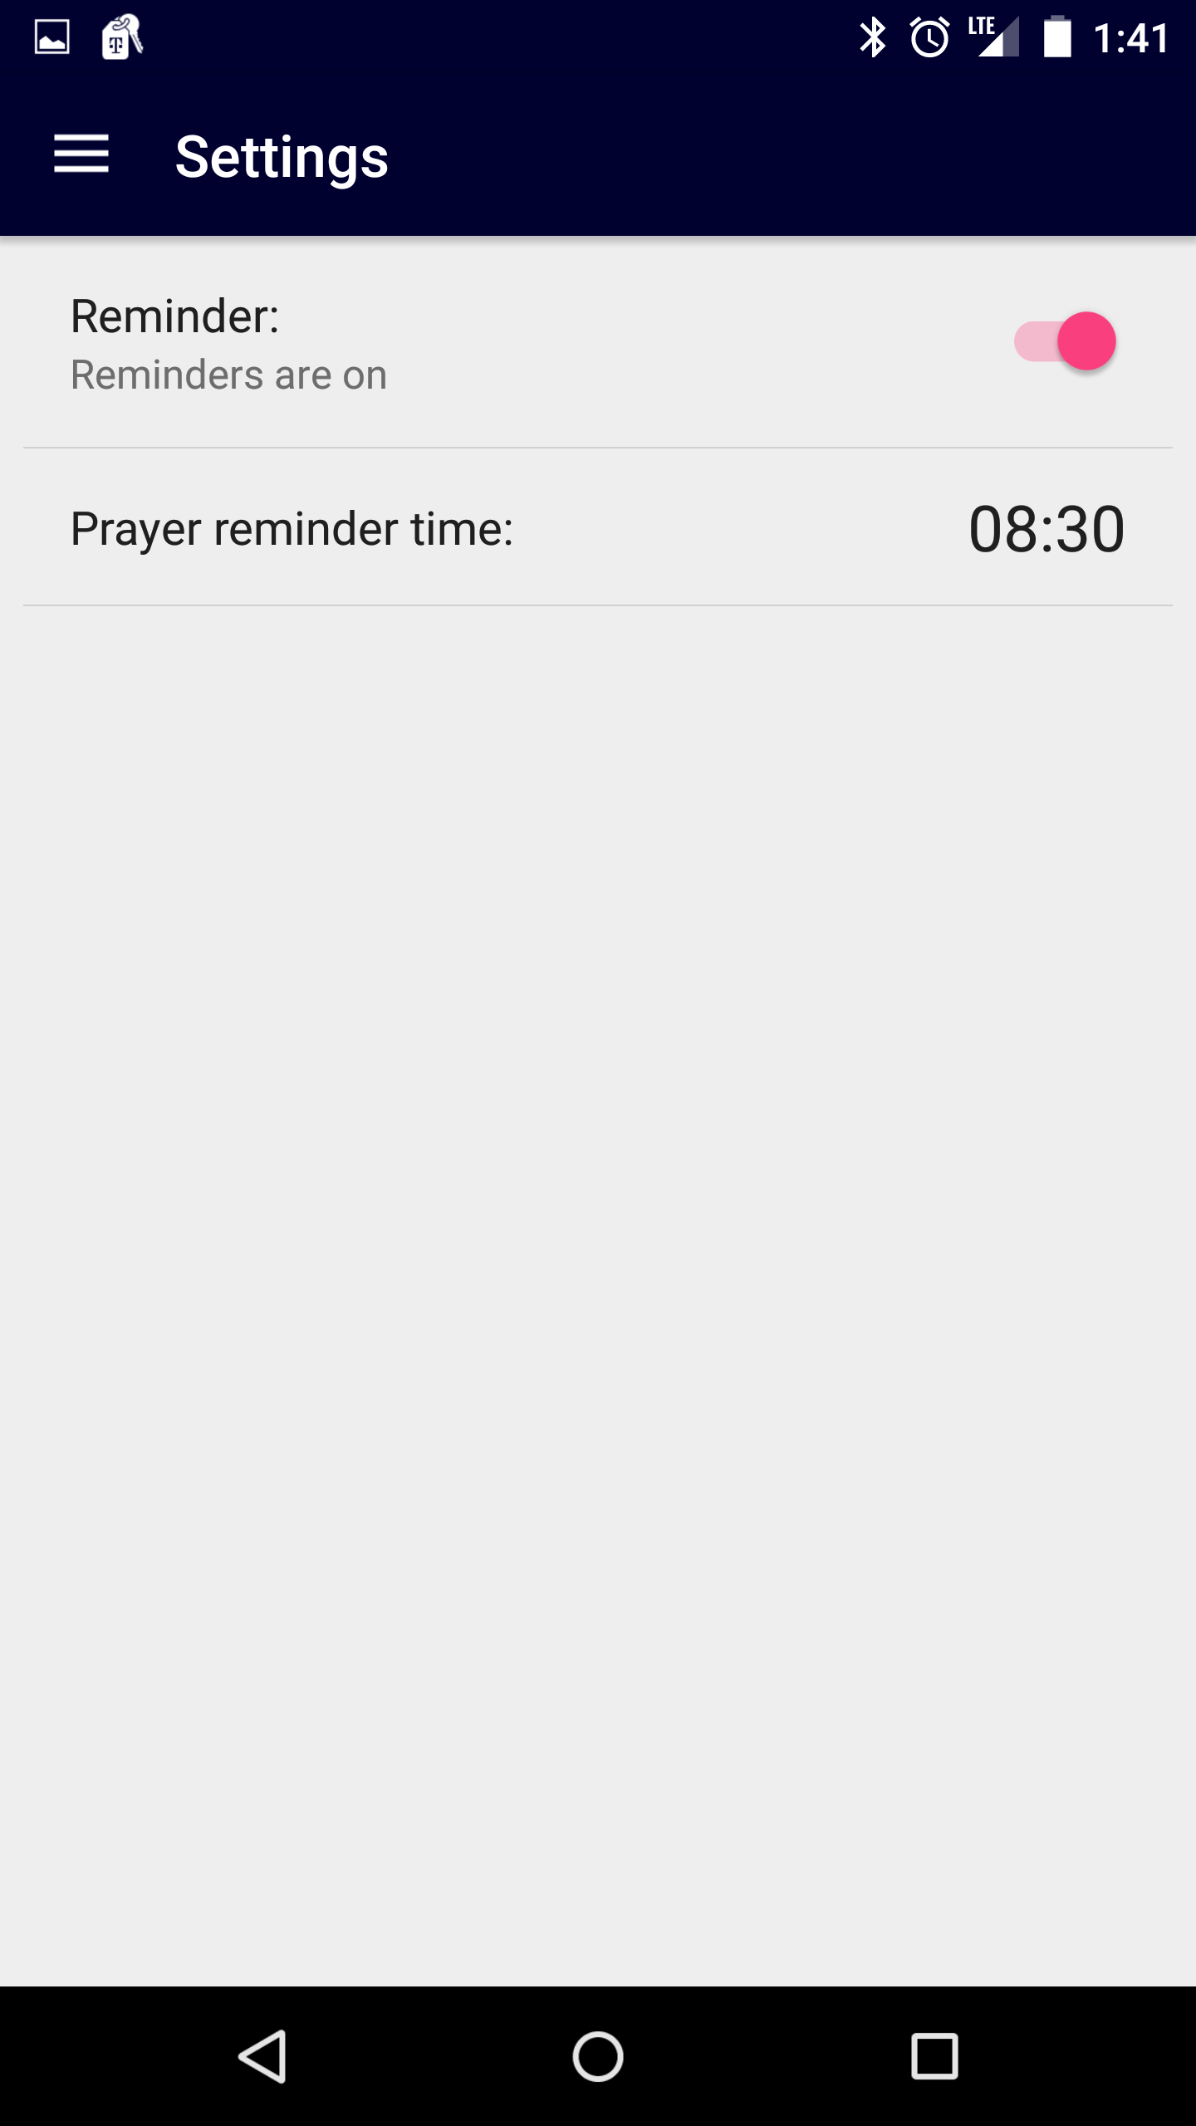

Slide 8
Localization
Reach the Whole World

Slide 9
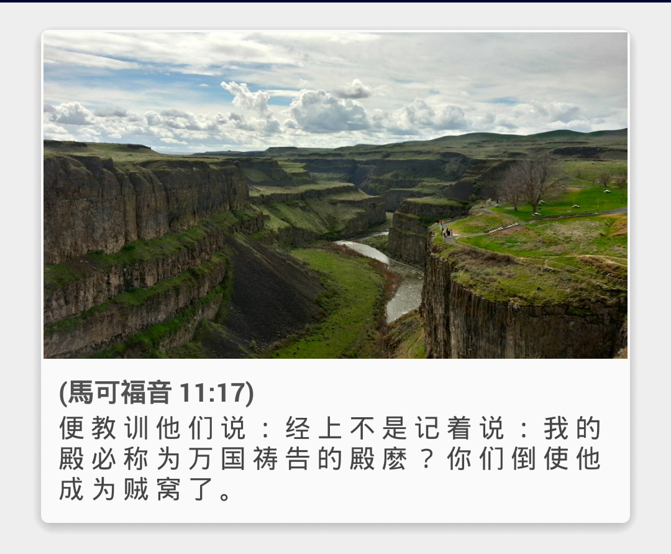
简体中文 (Simplified Chinese)

Slide 10


coming soon
+ global Android marketplaces

