Slide 1
Functional Groups of
Organic Compounds
Learning goal: Identify, name and draw the structures of the common functional groups.
Notes:
OC Lecture Notes Apr 08
Prepared by Srivani Sistla

Slide 2
Functional Groups
Organic compounds are classified according to the type of functional group(s) present.
Functional groups composed of an atom or groups of atoms …
  a structural features
  similar physical properties
  undergo __________ chemical reactions

Slide 3
Very important because they are:
Functional Groups
units by which organic compounds are divided into classes.
sites of chemical reactions
basis for naming organic compounds

Slide 4
Functional Groups
Organic compounds can be represented as
R - <functional group>
The symbol R represents the rest of the molecule
Useful in simplifying or summarizing equations

Slide 5
Classification of Organic Compounds
Alkane
Alkene
Alkyne
Aromatic
Haloalkane (Alkylhalide)
Alcohol
Ether
Aldehyde
Ketone
Carboxylic acid
Ester
Amine
Amide

Slide 6
Alkane, Alkene and Alkyne
| | - C – C - C = C - C ≡ C - | |
Functional Group
Alkane Alkene Alkyne
Example CH₃CH₂CH₃ CH₃CH=CH₃ CH₃C≡CH
Propane Propene Propyne

Slide 7
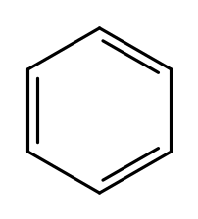
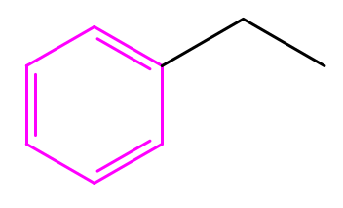
Haloalkane and Aromatic
Functional Group
– X
X : F, Cl, Br, I
Alkyl halide Benzene Ring
(Haloalkane) (Aromatic)
Example CH₃CH₂CH₂Cl
1-Chloropropane Ethylbenzene

Slide 8
Alcohol and Ether
Functional Group
– O – H – O –
Alcohol Ether
Example CH₃CH₂CH₂OH CH₃CH₂-O-CH₃
1-Propanol Ethyl methyl ether

Slide 9
Aldehyde and Ketone
H
| |
– C = O – C = O
Functional Group
Aldehyde Ketone
Example CH₃CH₂C=O CH₃ – C – CH₃
| ||
H O
Propanal Acetone
Notes:
OC Lecture Notes Apr 08
Prepared by Srivani Sistla

Slide 10
Carboxylic Acid and Ester
OH O
| ||
– C = O – C – O –
Functional Group
Carboxylic Ester Acid
Example CH₃CH₂C=O CH₃ – C – O - CH₃
| ||
OH O
Propanoic Acid Methyl Acetate

Slide 11
Amine and Amide
H O H
| || |
– N – H – C – N – H
Functional Group
Amine Amide
Example CH₃CH₂CH₂ CH₃CH₂ – C – NH₂
| ||
NH₂ O
1-Propanamine Propanamide

Slide 12

Practice
Classify the following organic compounds according to their functional groups:
CH₃ CH₂OH
CH₃ CH₂NHCH₃
H₃C-O-CH₃
Amine
Carboxylic acid
Alcohol
Ether

