Slide 1
STEREOCHEMISTRY

Slide 2
ISOMERISM
Constitutional Isomers
Stereoisomers
Configurational isomers
Conformational isomers
Optical isomers
Enantiomers
Diastereomers
Geometrical isomers

Slide 3
Constitutional Isomers
When two different compounds have the same molecular formula but differ in the nature or sequence of bonding, they are called constitutional isomers.
Jika dua senyawa memiliki rumus molekul yang sama tetapi sifat atau urutan ikatannya berbeda, mereka disebut isomer konstitusional.

Slide 4
Stereoisomers
Stereoisomers are compounds where the atoms are connected in the same order but with different geometries, i.e. they differ in the three-dimensional arrangements of groups or atoms in space.
Stereoisomer adalah molekul-molekul yang mempunyai rumus molekul dan konektivitas sama tetapi berbeda posisi atom-atom penyusunnya atau bentuk tiga dimensi susunannya

Slide 5
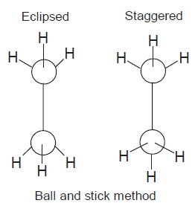
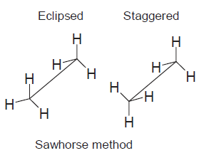
Stereoisomer - Conformational isomers

Slide 6
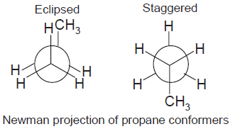
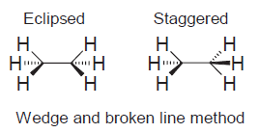
Stereoisomer - Conformational isomers

Slide 7
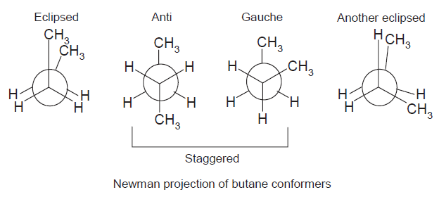
Stereoisomer - Conformational isomers

Slide 8
Stereoisomer - Conformational isomers
Torsional - akibat eclipsing ikatan pada atom yang bertetangga
Steric - akibat tolakan atom yang berdekatan.
Angle - akibat ekspansi atau kompresi dari sudut hibridisasi ikatan normal - sp, 180º; sp², 120º; sp³, 109º.

Slide 9
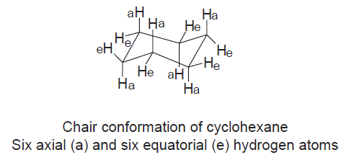
Stereoisomer - Conformational isomers

Slide 10
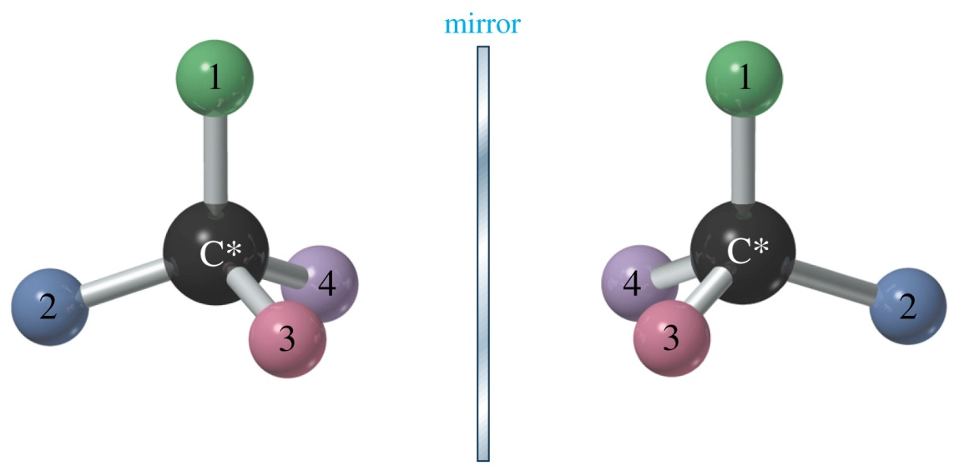
Stereoisomer - Configurational isomers
Chirality
Tetrahedral (i.e. sp3-hybridized) carbon atom with four different atoms or groups attached.
Chiral molecules do not have a plane of symmetry.

Slide 11
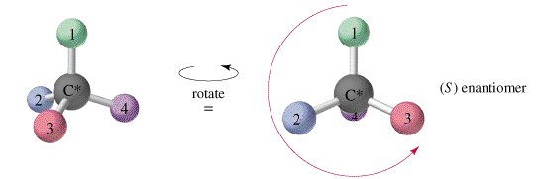
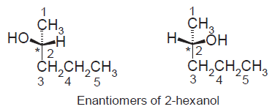
Stereoisomer - Configurational isomers
Nomenclature Enantiomers
(R) rectus and (S) sinister system

Slide 12
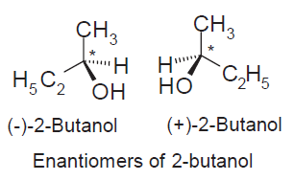
Stereoisomer - Configurational isomers
Enantiomers
The Greek word enantio means ‘opposite’.
A chiral molecule and its mirror image are called enantiomers or an enantiomeric pair.

Slide 13
Stereoisomer - Configurational isomers
Properties of enantiomers
Share same physical properties, e.g. melting points, boiling points and solubilities.
Same chemical properties.
Differ in their activities with plane polarized light.
Differ pharmacological actions.

Slide 14
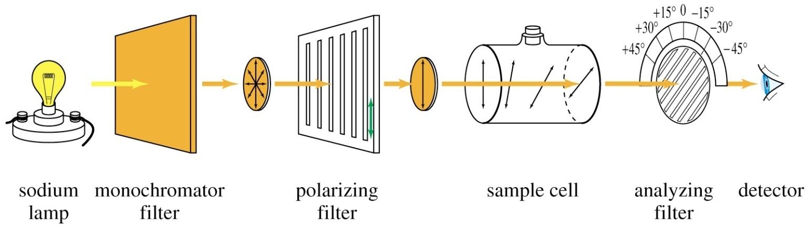
Stereoisomer - Configurational isomers
Optical isomers

Slide 15
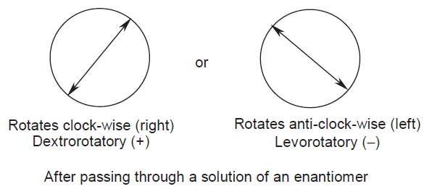
Stereoisomer - Configurational isomers
Optical isomers
Compounds that rotate plane-polarized light are called optically active.

Slide 16
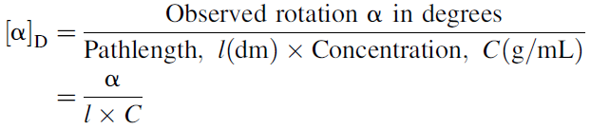
Stereoisomer - Configurational isomers
Specific rotations

Slide 17
Stereoisomer - Configurational isomers
Geometrical isomers
Geometrical isomerism is found in alkenes and cyclic compounds.
trans (opposite side) and cis (same side) isomers.
H
H
H
CH
3
C
C
C
C
H
C
CH
3
H
C
H
3
3
cis-2-Butena
trans-2-Butena
mp -139°C, bp 4°C
mp -106°C, bp 1°C

Slide 18
Stereoisomer - Configurational isomers
Geometrical isomers
To simplify this situation, the E/Z system is used for naming geometrical isomers. Z stands for German zusammen, which means the same side, and E for German entgegen, meaning on the opposite side.

Slide 19
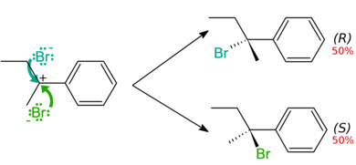
Rasemic
Mixture of (D) and (L) enantiomers in same composition.
Optically non-active
Rasemic mixture have different boiling and melting point from the nature enantiomers.

Slide 20

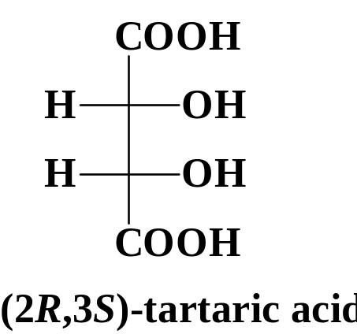
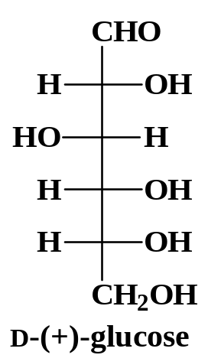
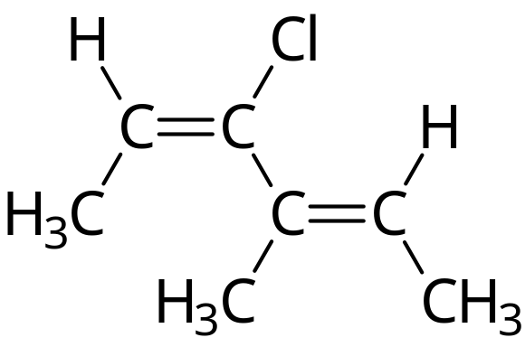
*
(2E, 4E)-3-chloro-4methyl-2,4-hexadiene

