Slide 1
Kimia Analisis

Slide 2



Introduction to Analytical Chemistry
Classical Analytical Methods
Gravimetric methods
Volumetric methods - Titrations with Indicators
Chemistry in solution
  Precipitation
  Acid-base reactions
  Metal complexes
  Electrochemistry
Instrumental methods UV/visible Spectrometry
HPLC

Slide 3
ANALYTICAL CHEMISTRY
- Deals with the separation, identification, quantification,
and statistical treatment of the components of matter
Two Areas of Analytical Chemistry
Qualitative Analysis
- Deals with the identification of materials in a given sample
(establishes the presence of a given substance)

Slide 4
ANALYTICAL CHEMISTRY
- Deals with the separation, identification, quantification,
and statistical treatment of the components of matter
Quantitative Analysis
- Deals with the quantity (amount) of material
(establishes the amount of a substance in a sample)
Some analytical methods offer both types of information (GC/MS)

Slide 5
ANALYTICAL CHEMISTRY
Analytical Methods
Gravimetry (based on weight)
Titrimetry (based on volume)
Electrochemical (measurement of potential, current, charge, etc)
Spectral (the use of electromagnetic radiation)
Chromatography (separation of materials)

Slide 6
ANALYTICAL CHEMISTRY
General Steps in Chemical Analysis
Formulating the question
(to be answered through chemical measurements)
Selecting techniques
(find appropriate analytical procedures)
Sampling
(select representative material to be analyzed)
Sample preparation
(convert representative material into a suitable form for analysis)

Slide 7
ANALYTICAL CHEMISTRY
General Steps in Chemical Analysis
Analysis
(measure the concentration of analyte in several identical portions)
(multiple samples: identically prepared from another source)
(replicate samples: splits of sample from the same source)
Reporting and interpretation
(provide a complete report of results)
Conclusion
(draw conclusions that are consistent with data from results)

Slide 8
Quantitative analysis
Example :
  Iron in an ore sample
  Electrolyte level in blood
  Presence of lead in a water sample
  Concrete strength
www.themegallery.com
Company Logo

Slide 9
Factor to consider
1. accuracy and sensitivity
2. cost
3. number of sample to be assayed
4. number of components in a sample
The approach we taken, must produce the result you require in a timely, cost effect manner – primarily determined by the type of sample you have.

Slide 10
Samples.
Must be representative.
Steps must be taken to ensure that your results reflect average composition.
Example – determination of iron in an ore.
    - Minerals and ores are heterogeneous. To assay single sample may not yield results for an entire sample lot.

Slide 11
Samples.
Proper sample selection and preparation can help minimize this problem.

Slide 12
Sample selection
Require some knowledge as to sample source and history.
One common approach is to select several random samples for analysis.
-Powder the samples
-Blend the powders
-Select a fraction for assay

Slide 13
Sample preparation
One must then convert the sample to a suitable form for the method of analysis.
Based on the method, this may include :
  Drying to ensure an accurate weight.
  Sample dissolution.
  Elimination or masking of potential interference.
  Conversion of analyte to a single or measurable form.

Slide 14
Samples replicates
All methods have errors associated with them.
Using multiple samples and replicates helps track and identify this error.
Multiply samples
  Identically prepared from another source.
  used to verify if your sampling was valid.

Slide 15
Replicate samples
splits of the same sample.
Helps track and identify errors in method.

Slide 16
Calibration
For most methods, we measure a response that is proportional to the concentration of our analyte.
  Gravimetric – weight of a precipitate.
  Titration - volume of a titrant. required.
  Spectrophotometric – light absorbed.
  Chromatographic – peak area.

Slide 17
Results
Once your response has been obtained, the final steps is to calculate your results.
This will include
  Application of your standard curve.
  Estimation of error based on replicates.
  Reporting in a standard, usable format.

Slide 18
SIGNIFICANT FIGURES
www.themegallery.com
Angka Pasti
- hasil tanpa bilangan tak pasti
- Tidak ada angka tidak pasti ketika menghitung benda atau orang
(24 murid, 4 kursi, 10 pencil)
- Tidak ada angka tak pasti dalam pecahan sederhana
(1/4, 1/7, 4/7, 4/5)
Angka tak pasti
- Berhubungan dengan ketidak pastian
Company Logo

Slide 19
Bilangan bermakna
www.themegallery.com
Dalam mengukur suatu kuantitas, angka nol yang terletak di sebelah kanan titik desimal dan juga di sebelah kanan digit yang bukan nol yang pertama selalu dihitung sebagai bilangan bermakna
Contoh :
0,00215 m = 1,25 x 10⁻³
  (angka nol hanya menunjukkan letak titik desimal dan bukan digit hasil pengukuran = bukan bilangan bermakna)
12,30 m = 1,230 x 10¹ (nol bil bermakna)
Company Logo

Slide 20
RULES FOR SIGNIFICANT FIGURES
www.themegallery.com
Rounding off Numbers
1. In a series of calculations, carry the extra digits through
to the final result before rounding off to the required
significant figures
2. If the first digit to be removed is less than 5, the
preceding digit remains the same
(2.53 rounds to 2.5 and 1.24 rounds to 1.2)
Company Logo

Slide 21
RULES FOR SIGNIFICANT FIGURES
www.themegallery.com
Rounding off Numbers
3. If the first digit to be removed is greater than 5, the
preceding digit increases by 1
(2.56 rounds to 2.6 and 1.27 rounds to 1.3)
4. If the digit to be removed is exactly 5
- The preceding number is increased by 1 if that
results in an even number
(2.55 rounds to 2.6 and 1.35000 rounds to 1.4)
- The preceding number remains the same if that
results in an odd number
(2.45 rounds to 2.4 and 1.25000 rounds to 1.2)
Company Logo

Slide 22
RULES FOR SIGNIFICANT FIGURES
www.themegallery.com
The certainty of the calculated quantity is limited by the least
certain measurement, which determines the final number of
significant figures
Multiplication and Division
The result contains the same number of significant figures as the
measurement with the least number of significant figures
2.0456 x 4.02 = 8.223312 = 8.22
3.20014 ÷ 1.2 = 2.6667833 = 2.7
Company Logo

Slide 23
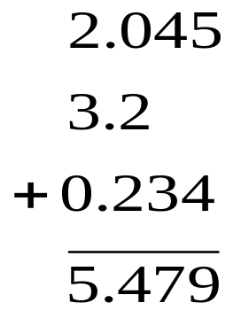
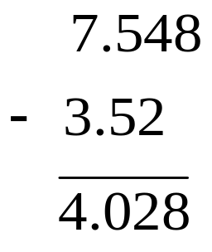
RULES FOR SIGNIFICANT FIGURES
www.themegallery.com
The certainty of the calculated quantity is limited by the least
certain measurement, which determines the final number of
significant figures
Addition and Subtraction
The result contains the same number of decimal places as the
measurement with the least number of decimal places
= 4.03
= 5.5
Company Logo

Slide 24
SCIENTIFIC NOTATION
www.themegallery.com
Used to express too large or too small numbers (with many zeros)
in compact form
The product of a decimal number between 1 and 10 (the coefficient)
and 10 raised to a power (exponential term)
24,000,000,000,000 = 2.4 x 10¹³
Exponent (power)
Exponential term
coefficient
0.000000458 = 4.58 x 10⁻⁷
Company Logo

Slide 25
SCIENTIFIC NOTATION
www.themegallery.com
Provides a convenient way of writing the required
number of significant figures
6300000 in 4 significant figures = 6.300 x 10⁶
2400 in 3 significant figures = 2.40 x 10³
0.0003 in 2 significant figures = 3.0 x 10⁻⁴
Company Logo

Slide 26
SCIENTIFIC NOTATION
www.themegallery.com
Add exponents when multiplying exponential terms
(5.4 x 10⁴) x (1.23 x 10²) = (5.4 x 1.23) x 10 ⁴⁺²
= 6.6 x 10⁶
Subtract exponents when dividing exponential terms
(5.4 x 10⁴)/(1.23 x 10²) = (5.4/1.23) x 10 ⁴⁻²
= 4.4 x 10²
Company Logo

Slide 27
BALANCING CHEMICAL EQUATIONS
Whole numbers are placed on the left side of the formula (called
coefficients) to balance the equation (subscripts remain unchanged)
The coefficients in a chemical equation are the smallest set of whole
numbers that balance the equation
C₂H₅OH(l) + O₂(g)
2CO₂(g) + 3H₂O(g)
(5+1)=6 H atoms
3(1x2)=6 H atoms
Place 3 in front of H₂O to balance H atoms

Slide 28
BALANCING CHEMICAL EQUATIONS
Whole numbers are placed on the left side of the formula (called
coefficients) to balance the equation (subscripts remain unchanged)
The coefficients in a chemical equation are the smallest set of whole
numbers that balance the equation
C₂H₅OH(l) + 3O₂(g)
2CO₂(g) + 3H₂O(g)
1+(3x2)=7 O atoms
(2x2)+3=7 O atoms
Place 3 in front of O₂ to balance O atoms

Slide 29
BALANCING CHEMICAL EQUATIONS
Whole numbers are placed on the left side of the formula (called
coefficients) to balance the equation (subscripts remain unchanged)
The coefficients in a chemical equation are the smallest set of whole
numbers that balance the equation
C₂H₅OH(l) + 3O₂(g)
2CO₂(g) + 3H₂O(g)
2 C atoms
(5+1)=6 H atoms
1+(3x2)=7 O atoms
2 C atoms
(3x2)=6 H atoms
(2x2)+3=7 O atoms
Check to make sure equation is balanced
When the coefficient is 1, it is not written

Slide 30
BALANCING CHEMICAL EQUATIONS
States of reactants and products
Physical states of reactants and products are represented by:
(g): gas
(l): liquid
(s): solid
(aq): aqueous or water solution
C₂H₅OH(l) + 3O₂(g)
2CO₂(g) + 3H₂O(g)

Slide 31
BALANCING CHEMICAL EQUATIONS
Balance the following chemical equations
Fe(s) + O₂(g)
Fe₂O₃(s)
C₁₂H₂₂O₁₁(s) + O₂(g)
CO₂(g) + H₂O(g)
(NH₄)₂Cr₂O₇(s)
Cr₂O₃(s) + N₂(g) + H₂O(g)

Slide 32
MOLAR MASS
Add atomic masses to get the formula mass (in amu)
= molar mass (in g)
That is, the mass of 1 mole of the substance in g
1 mole = 6.02214179 x 10²³ entities (atoms or molecules)
Usually rounded to 6.02 x 10²³ (Avogadro’s number)
This implies that 6.02 x 10²³ amu = 1.00 g
Atomic mass (amu) = mass of 1 atom
molar mass (g) = mass of 6.02 x 10²³ atoms

Slide 33
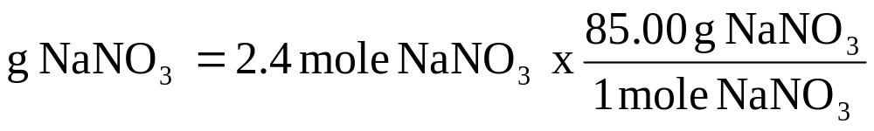
MOLAR MASS
Calculate the mass of 2.4 moles of NaNO₃
Molar mass NaNO₃ = 22.99 + 14.01 + 3(16.00)
= 85.00 g /1 mole NaNO₃
= 204 g NaNO₃
= 2.0 x 10² g NaNO₃

Slide 34
CHEMICAL FORMULA
Consider Na₂S₂O₃:
1. Two atoms of sodium, two atoms of sulfur, and three atoms of
oxygen are present in one molecule of Na₂S₂O₃
2. Two moles of sodium, two moles of sulfur, and three moles of
oxygen are are present in one mole of Na₂S₂O₃

Slide 35
CHEMICAL FORMULA
How many moles of sodium atoms, sulfur atoms, and oxygen
atoms are present in 1.8 moles of a sample of Na₂S₂O₃?
I mole of Na₂S₂O₃ contains 2 moles of Na, 2 moles of S, and 3
moles of O

Slide 36
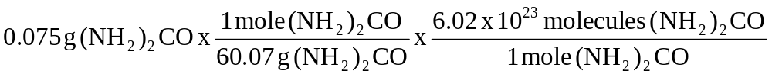
CHEMICAL CALCULATIONS
Calculate the number of molecules present in 0.075 g of urea,
(NH₂)₂CO
Given mass of urea:
- convert to moles of urea using molar mass
- convert to molecules of urea using Avogadro’s number
= 7.5 x 10²⁰ molecules (NH₂)₂CO

Slide 37
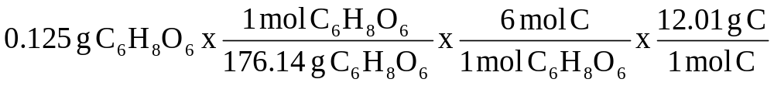
CHEMICAL CALCULATIONS
How many grams of carbon are present in a 0.125 g of vitamin C,
C₆H₈O₆
Given mass of vitamin C:
- convert to moles of vitamin C using molar mass
- convert to moles of C (1 mole C₆H₈O₆ contains 6 moles C)
- convert moles carbon to g carbon using atomic mass
= 0.0511 g carbon

Slide 38
CHEMICAL EQUATIONS
(STOICHIOMETRIC CALCULATIONS)
Given:
C₃H₈(g) + 5O₂(g) → 3CO₂(g) + 4H₂O(g)
A) 1 molecule of C₃H₈ reacts with 5 molecules of O₂ to produce
3 molecules of CO₂ and 4 molecules of H₂O
B) 1 mole of C₃H₈ reacts with 5 moles of O₂ to produce
3 moles of CO₂ and 4 moles of H₂O

Slide 39
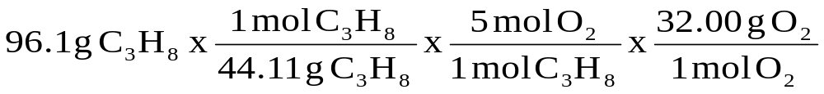
CHEMICAL EQUATIONS
(STOICHIOMETRIC CALCULATIONS)
Given:
C₃H₈(g) + 5O₂(g) → 3CO₂(g) + 4H₂O(g)
What mass of oxygen will react with 96.1 g of propane?
- make sure the equation is balanced
- calculate moles of propane from given mass and molar mass
- determine moles of oxygen from mole ratio (stoichiometry)
- calculate mass of oxygen
= 349 g O₂

Slide 40
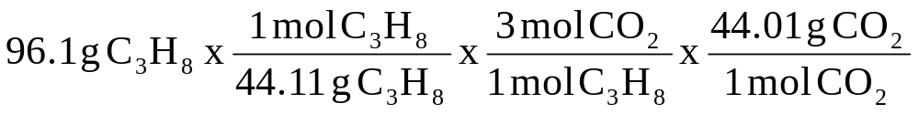
CHEMICAL EQUATIONS
(STOICHIOMETRIC CALCULATIONS)
Given:
C₃H₈(g) + 5O₂(g) → 3CO₂(g) + 4H₂O(g)
What mass of CO₂ will be produced from 96.1 g of propane?
- make sure the equation is balanced
- calculate moles of propane from given mass and molar mass
- determine moles of CO₂ from mole ratio (stoichiometry)
- calculate mass of CO₂
= 288 g CO₂

Slide 41
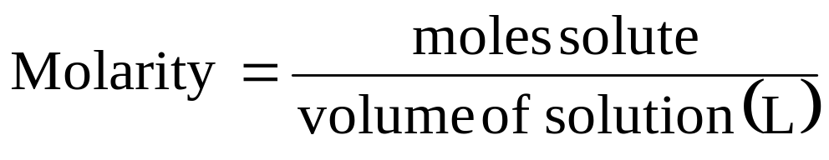
CONCENTRATION OF SOLUTIONS
- The amount of solute dissolved in a given quantity of solvent or
solution
Molarity (M)
The number of moles of solute per liter of solution
A solution of 1.00 M (read as 1.00 molar) contains 1.00 mole of
solute per liter of solution

Slide 42
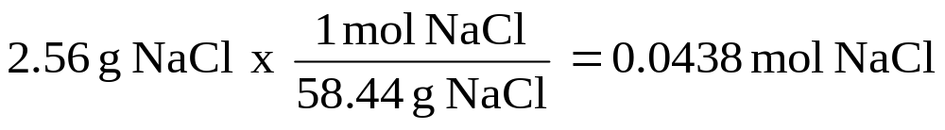
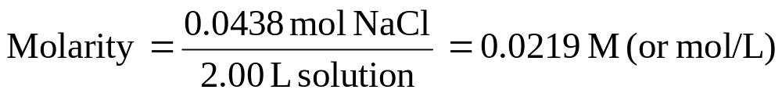
CONCENTRATION OF SOLUTIONS
Calculate the molarity of a solution made by dissolving 2.56 g of
NaCl in enough water to make 2.00 L of solution
- Calculate moles of NaCl using grams and molar mass
Convert volume of solution to liters
- Calculate molarity using moles and liters

Slide 43
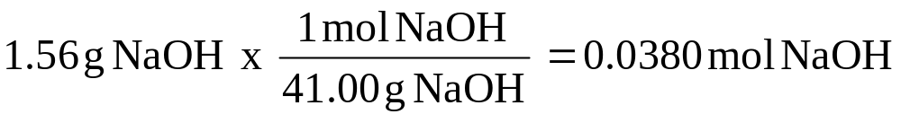
CONCENTRATION OF SOLUTIONS
After dissolving 1.56 g of NaOH in a certain volume of water,
the resulting solution had a concentration of 1.60 M. Calculate the
volume of the resulting NaOH solution
- Convert grams NaOH to moles using molar mass
- Calculate volume (L) using moles and molarity

Slide 44
CONCENTRATION OF IONS
Consider:
1.00 M NaCl: 1.00 M Na⁺ and 1.00 M Cl⁻
1.00 M ZnCl₂: 1.00 M Zn²⁺ and 2.00 M Cl⁻
1.00 M Na₂SO₄: 2.00 Na⁺ and 1.00 M SO₄²⁻

Slide 45
CONCENTRATION OF IONS
Calculate the number of moles of Na⁺ and SO₄²⁻ ions in 1.50 L
of 0.0150 M Na₂SO₄ solution
0.0150 M Na₂SO₄ solution contains:
2 x 0.0150 M Na⁺ ions and 0.0150 M SO₄²⁻ ions
Moles Na⁺ = 2 x 0.0150 M x 1.50 L = 0.0450 mol Na⁺
Moles SO₄²⁻ = 0.0150 M x 1.50 L = 0.0225 mol SO₄²⁻

Slide 46
Ketepatan
Adalah berapa dekat kesamaan hasil pengukuran yang diperoleh dari jumlah yang sama

Slide 47
Akurasi
Menunjukkan berapa dekat kesamaan hasil pengukuran dengan nilai yang sebenarnya

Slide 48
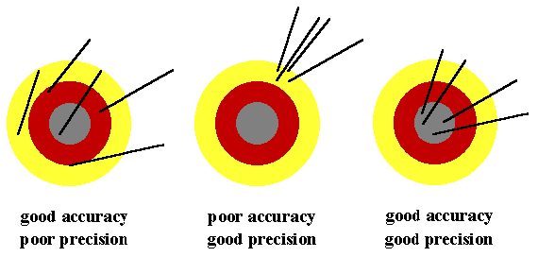
There is a difference - you
need both

Slide 49
Good luck

