Slide 1
Organic Chemistry
An Introduction

Slide 2
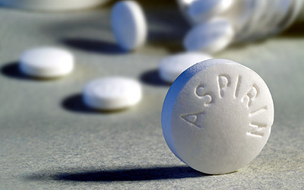
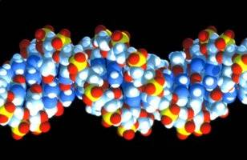
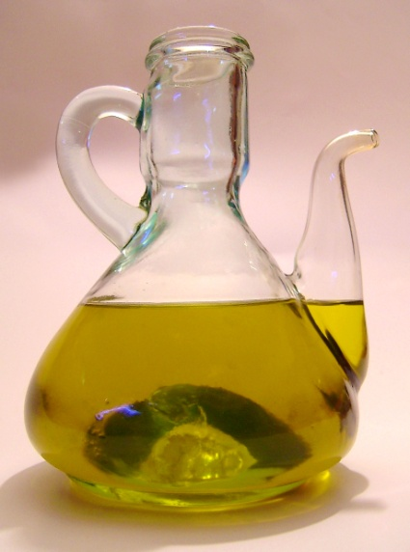
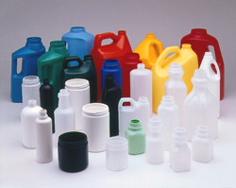
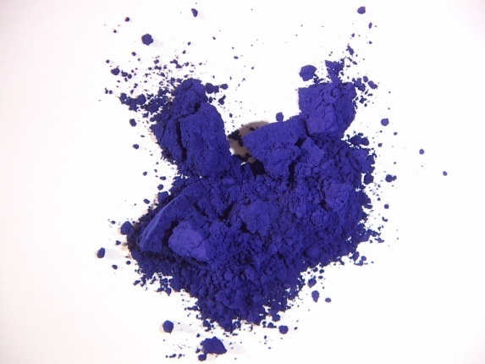
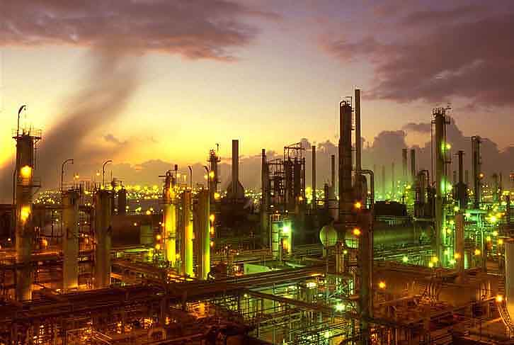
Some organic chemicals
Medicines
Active Pharmaceutical Ingredients
Excipients
DNA
Fuels
Materials
Essential oils
Pigments

Slide 3
Organic chemicals make up
Foods and foodstuff
Flavours and fragrances
Medicines
Materials, polymers, plastics
Plant, animal and microbial matter; natural products
A vast range of manufactured goods
[pharmaceuticals, foods, dyestuffs, adhesives, coatings, packaging, lubricants, cosmetics, films & fibres, etc. etc.]

Slide 4
Socio-economic importance in Ireland
Drugs/medicines: Pharmaceuticals
Other organic products: Fine Chemicals
Pharmaceutical & Fine Chemicals = PharmaChemical sector
Ireland (2006) PharmaChemical exports: >€37bn
~ 40% of total manufacturing exports
Employs ~ 20,000 – 50% of these graduates
Ireland is one the No. 1 location for Pharmaceutical Investment in the EU

Slide 5
Stages of pharmaceutical development & manufacture
Phase I & II
Clinical
Trials
Phase III
Clinical
Trials
Lead
Discovery
Pre-Clinical
Development
Launch &
Manufacture
Research
Research & Development
Process Chemistry Optimisation & Support
Organic
Drug Discovery Chemistry
Organic Process Chemistry
Emerging areas in Ireland
Current area of strength in Ireland

Slide 6
Aspects of organic molecules
Structure & bonding
Atom to atom connectivity
3D shape (Stereochemistry)
Naming (Nomenclature)
Physical properties
Interaction with physical world
Chemical properties
Transformation of molecular structure (Reactions)
How reactions occur (Mechanism)

Slide 7
Organic
Molecules
Hydrocarbons
[C & H only]
Other classes of
Organic Molecules
Textbook: Organic Chemistry, A Short Course
H. Hart, L. E. Craine, D. J. Hart and C. M. Hadad

Slide 8
Learning Organic Chemistry
Relatively low factual content
Understanding concepts essential
Value of the subject lies in application of concepts (problem solving)
Lectures: presentation of key facts and concepts
Tutorials/Workshops: application of concepts to problem solving
Tutorials/Workshops an integral part of delivery
Tues 1-2pm LL4 or Thurs 1-2pm FSB_A1

Slide 9
Using elemental (combustion) analysis: a worked example
Galactose: a sugar obtained from milk
Molecular weight = 180.156 g mol⁻¹
What is the Molecular Formula?
Carry out elemental analysis
Galactose
0.1000 g
Combustion
CO₂
0.1450 g
H₂O
0.0590 g
O₂
0.0540 g
+
+
Mol. Wt. / g mol⁻¹
44
18
32
No. of moles
0.0033
0.0033
0.0017
1C
2H
1O
Empirical Formula =
CH₂O

Slide 10
Molecular Formula =
(CH₂O)_{n}
Mol. Wt. “CH₂O” = 30.026 g mol⁻¹
Mol. Wt. galactose = 180.156 g mol⁻¹ ⇒ n = 6
i.e. Molecular Formula =
C₆H₁₂O₆
Atomic Wts. C: 12.011; H: 1.008; O: 15.999
6 x 12.011
%C =
x 100
= 40.00%
180.156
Likewise:
12 x 1.008
6 x 15.999
%H =
x 100
= 6.71%
%O =
x 100
= 53.28%
180.156
180.156

Slide 11
Galactose C: 40.00%
H: 6.71%
O: 53.28%
Elemental analysis data presented in this way
Can use as an experimental measure of purity
A pure material should return elemental analysis data which is within ±0.30% for each element
E.g. given two samples of galactose
Sample 2
C: 40.11%
H: 6.70%
O: 53.19%
Sample 1
C: 39.32%
H: 7.18%
O: 53.50%
Sample impure
Sample pure

Slide 12
Electronic configuration of Carbon
C 1s² 2s² 2p²
Covalent bonds: sharing of electrons between atoms
Carbon: can accept 4 electrons from other atoms
i.e. Carbon is tetravalent (valency = 4)
Ethane: a gas (b.p. ~ -100ºC)
Empircal formula (elemental combustion analysis): CH₃
i.e. an organic chemical
Measure molecular weight (e.g. by mass spectrometry): 30.070 g mol⁻¹, i.e (CH₃)_{n} n = 2
Implies molecular formula = C₂H₆

Slide 13
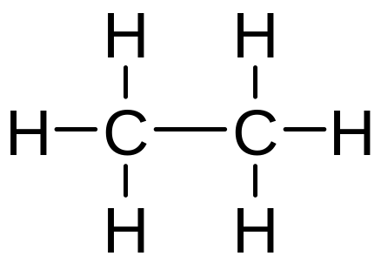
Molecular formula: gives the identity and number of different atoms comprising a molecule
Ethane: molecular formula = C₂H₆
Valency: Carbon 4
Hydrogen 1
Combining this information, can propose
i.e. a structural formula for ethane

Slide 14
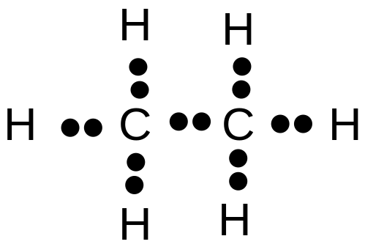
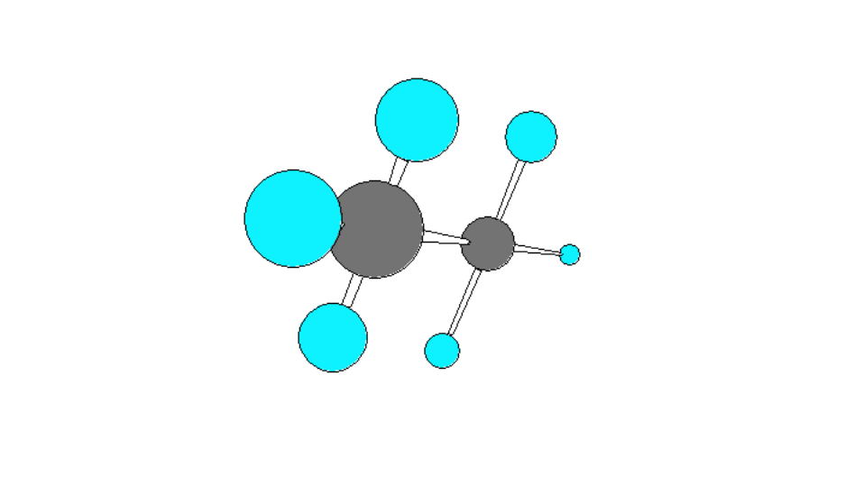
Each line represents a single covalent bond
i.e. one shared pair of electrons
Structural formulae present information on atom-to-atom connectivity
However, is an inadequate represention of some aspects of the molecule
Suggests molecule is planar
Suggests different types of hydrogen

Slide 15
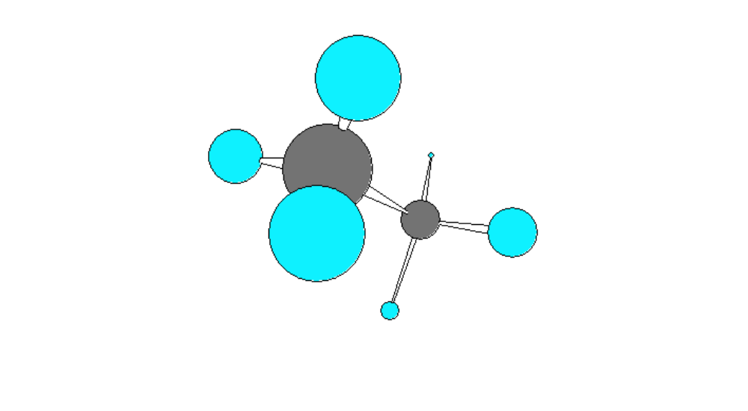
Experimental evidence shows:
Ethane molecules not planar
All the hydrogens are equivalent
3 Dimensional shape of the molecule has tetrahedral carbons
Angle formed by any two bonds to any atom = ~ 109.5º

Slide 16
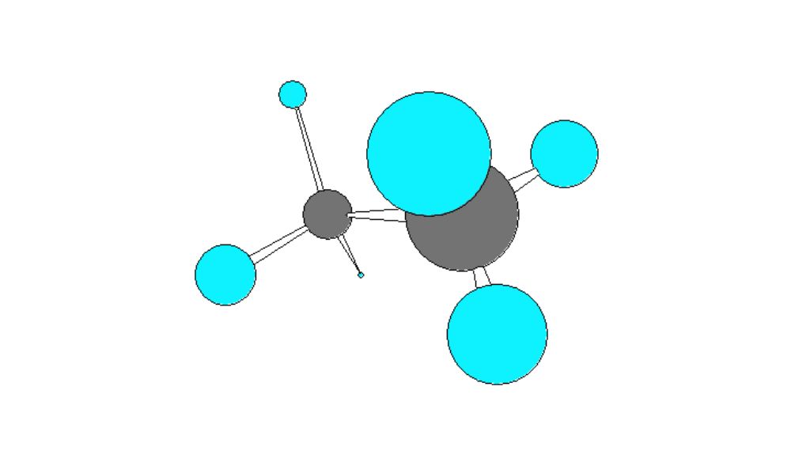
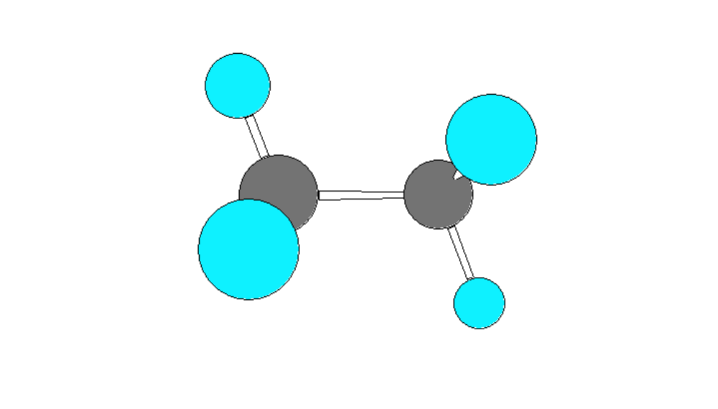

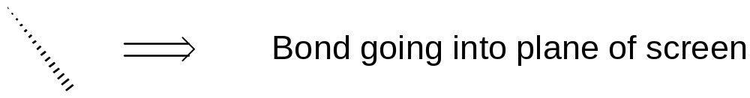
109.5°
109.5°
109.5°
109.5°
Need to be able to represent 3D molecular structure in 2D

Slide 17
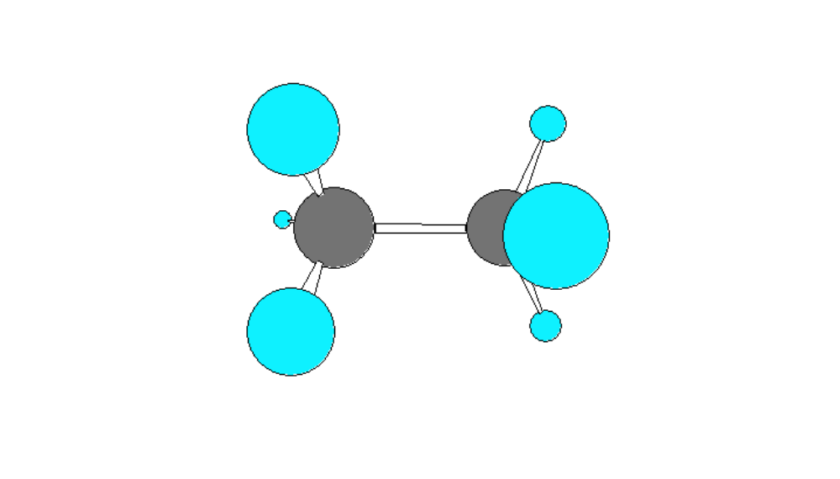
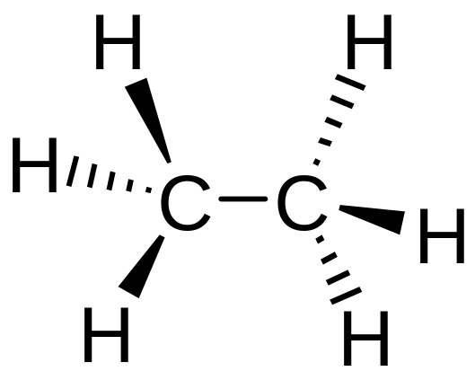
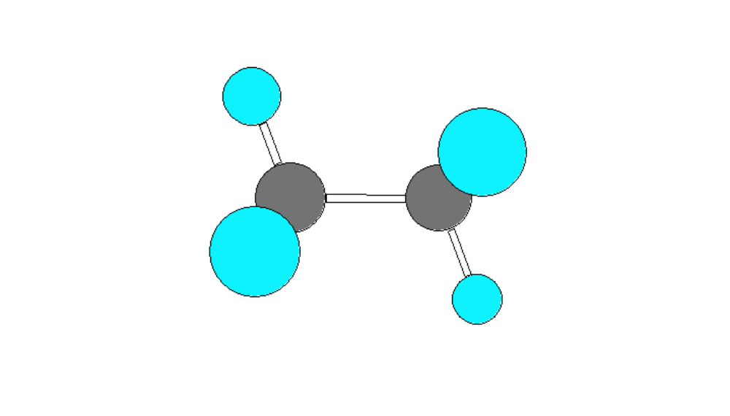
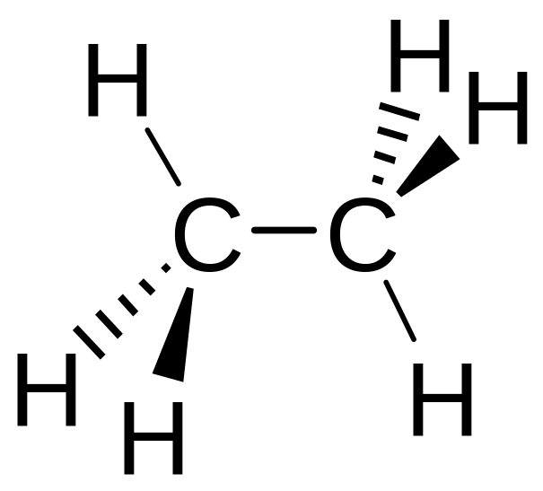
e.g.
=
Or
₌

Slide 18
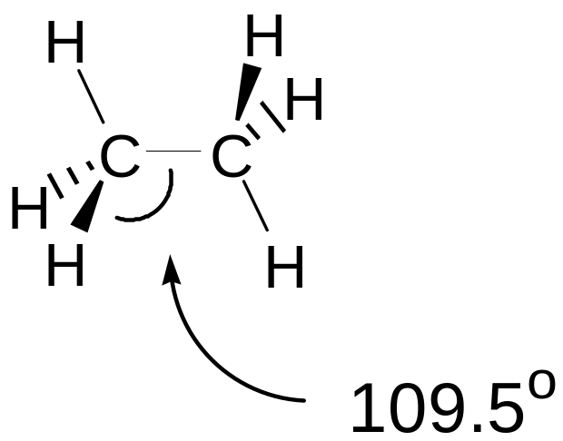
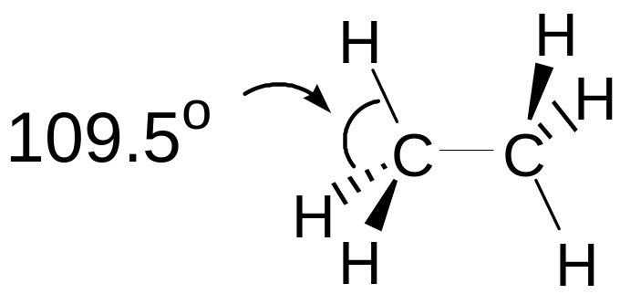
Angle between any two bonds at a Carbon atom = 109.5º

Slide 19
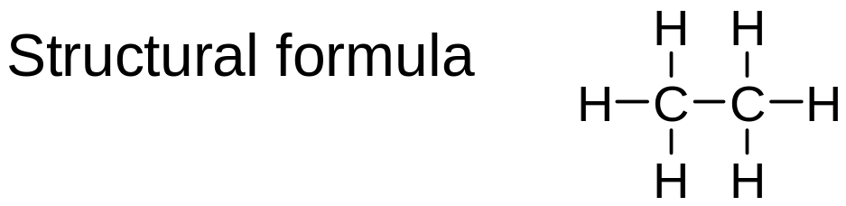
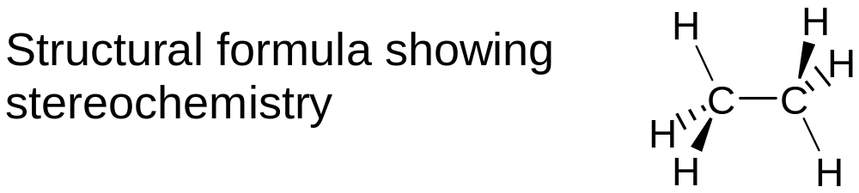
Ethane: a gas b.p. ~ -100ºC
Empirical formula: CH₃
An organic chemical
Substance composed of organic molecules
Molecular formula C₂H₆
Identity and number of atoms comprising each molecule
Atom-to-atom connectivity
3D shape

Slide 20
Ethane: a substance composed of molecules of formula C₂H₆
30.070 g of ethane (1 mole) contains 6.022 x 10²³ molecules (Avogadro’s number)
Can use the structural formula to show behaviour of molecules
Assume all molecules of a sample behave the same
Sometimes need to consider behaviour of a population of molecules

Slide 21
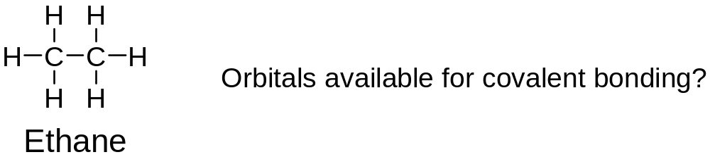
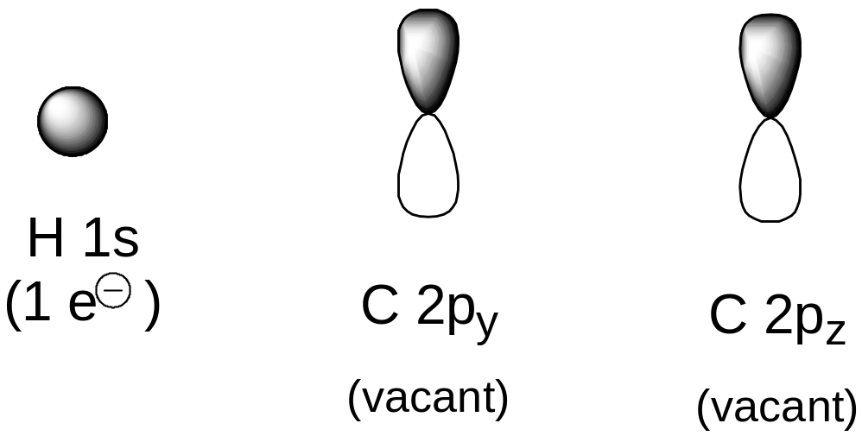
Electronic configuration of Carbon C 1s² 2s² 2p²
Hydrogen H 1s¹

Slide 22
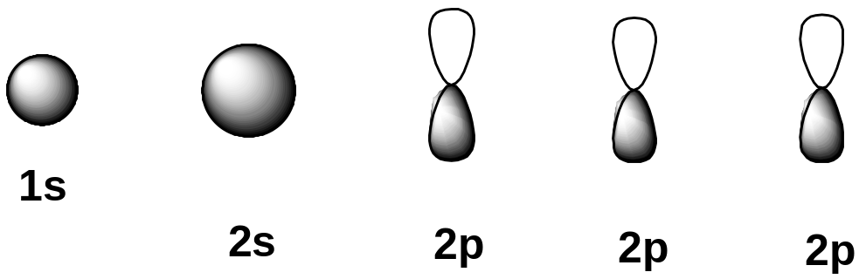
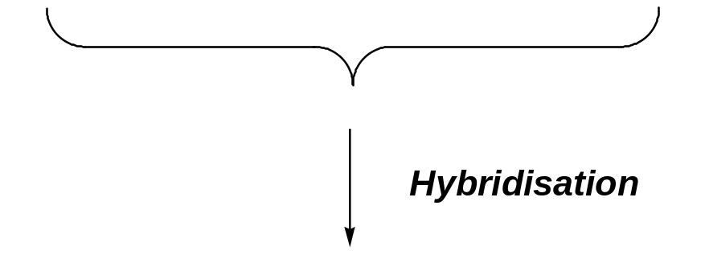
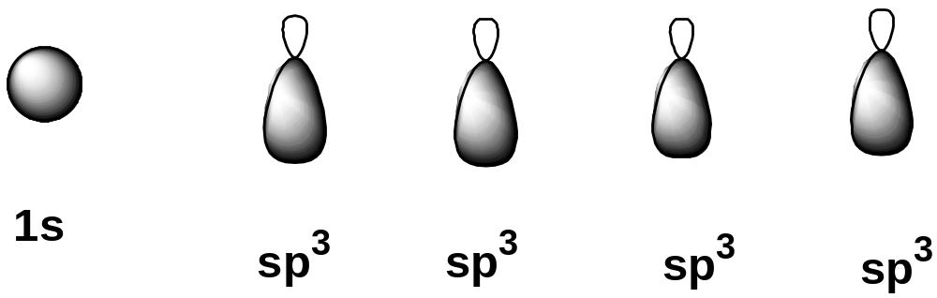
However, know that the geometry of the Carbons in ethane is tetrahedral
Cannot array p_{y} and p_{z} orbitals to give tetrahedral geometry
Need a modified set of atomic orbitals - hybridisation
(2e⁻)
(1e⁻) (1e⁻) (1e⁻) (1e⁻)

Slide 23
Bonding in ethane
Atomic orbitals available:
2 Carbons, both contributing 4 sp³ hybridised orbitals
6 Hydrogens, each contributing an s orbital
Total atomic orbitals = 14
Combine to give 14 molecular orbitals
7 Bonding molecular orbitals; 7 anti-bonding molecular orbitals
Electrons available to occupy molecular orbitals
One for each sp³ orbital on Carbon;
one for each s orbital on Hydrogen
= 14
Just enough to fully occupy the bonding molecular orbitals
Anti-bonding molecular orbitals not occupied

Slide 24
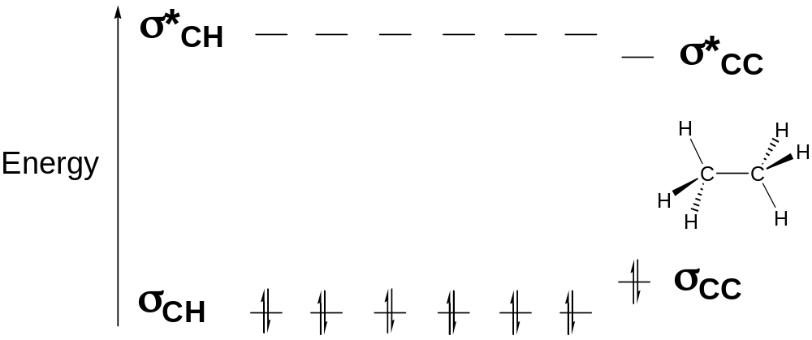
Ethane: molecular orbital diagram
σ molecular orbitals: symmetrical about the bond axis

Slide 25
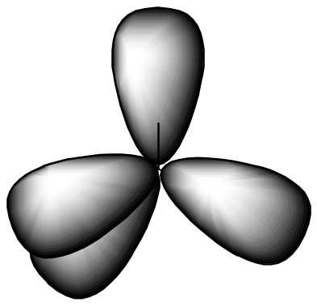
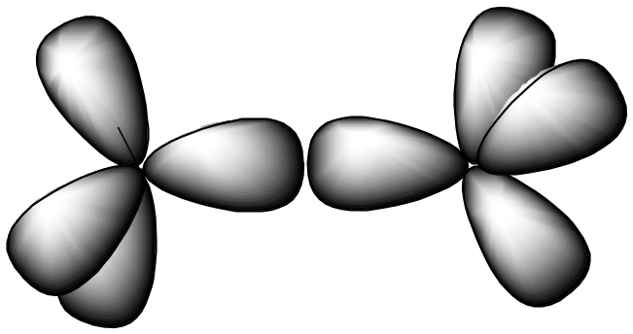
Visualising the molecular orbitals in ethane
Four sp³ hybridised orbitals can be arrayed to give tetrahedral geometry
sp³ hybridised orbitals from two Carbon atoms can overlap to form a Carbon-Carbon σ bond
Each sp³ orbital contributes one electron to form C-C [C..C]
C-C σ bond

Slide 26
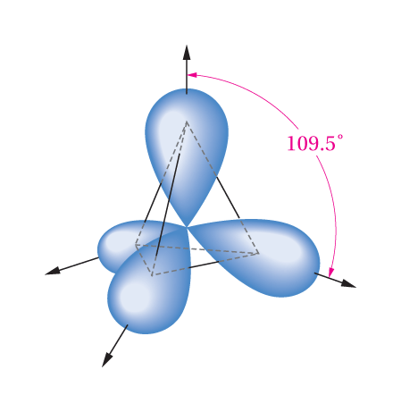
An sp³ orbital extends mainly in one direction from the nucleus and forms bonds with other atoms in that direction.

Slide 27
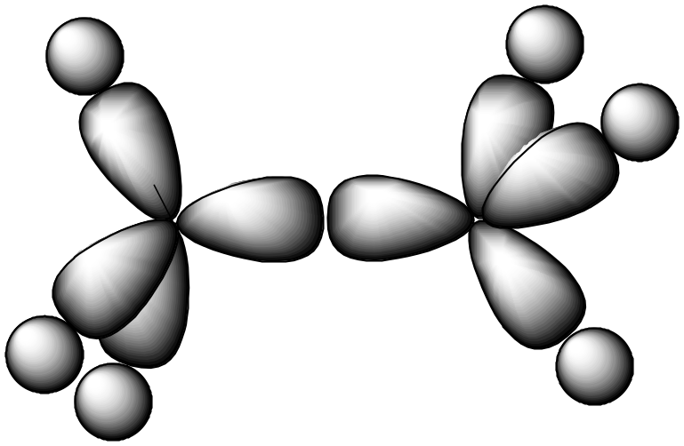
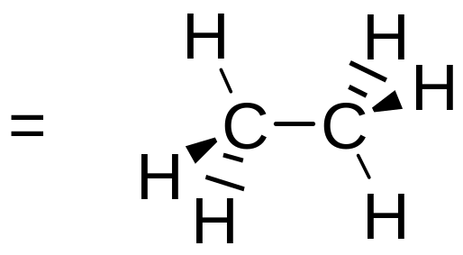
Carbon sp³ orbitals can overlap with Hydrogen 1s orbitals to form Carbon-Hydrogen σ bonds
Each sp³ orbital contributes one electron; each s orbital contributes one electron to form C-H [C..H]
[Anti-bonding orbitals also formed; not occupied by electrons]
σ bonds: symmetrical about the bond axis

Slide 28
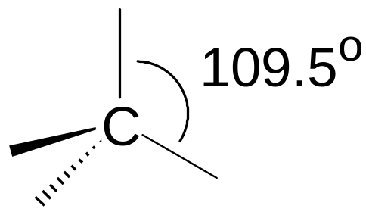
Geometry of Carbon in ethane is tetrahedral and is based upon sp³ hybridisation
sp³ hybridised Carbon = tetrahedral Carbon
Tetrahedral angle ≈ 109.5º

Slide 29
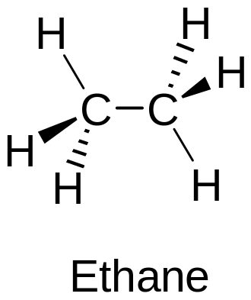
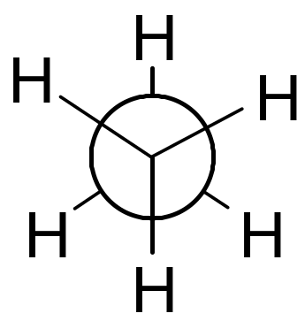
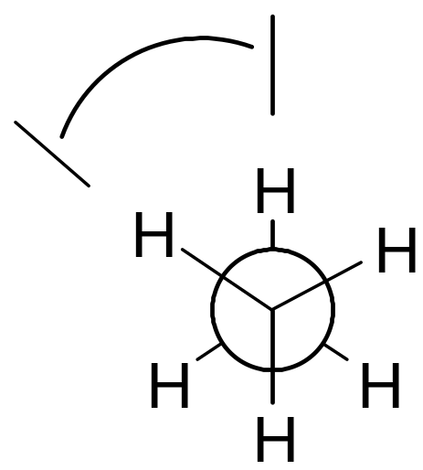
This represents a particular orientation of the C-H bonds on adjacent Carbons
View along C-C bond:
Newman projection
φ
Can select one C-H bond on either carbon and define a dihedral angle or torsional angle (φ)

Slide 30
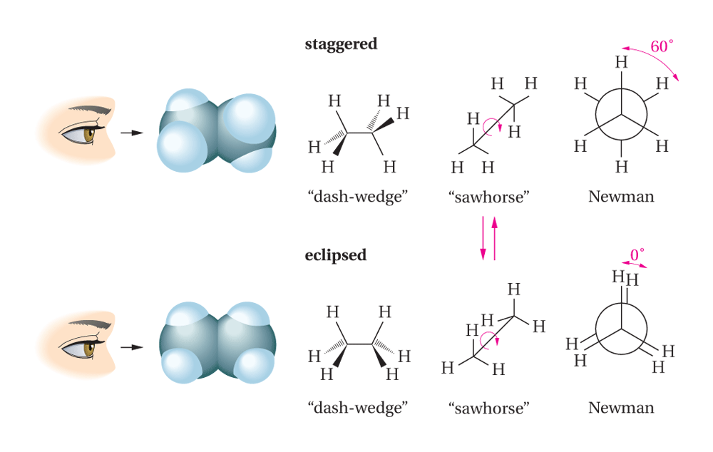

Slide 31
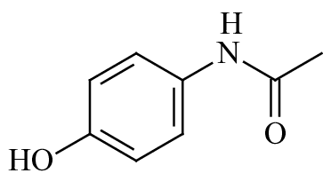
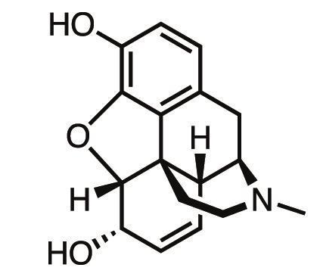
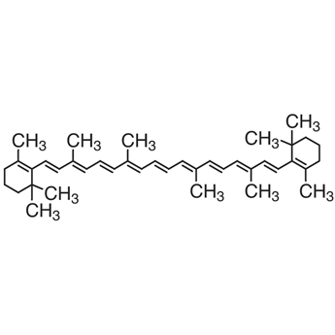
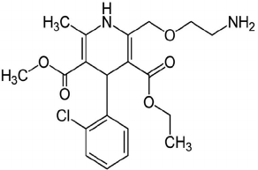
Perhatikan senyawa berikut !!
paracetamol
morphine
caroten
amlodipin

