Slide 1
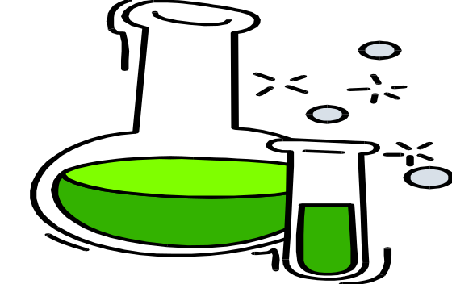
Basic Principles of HPLC
Kimia analisis

Slide 2
What is Liquid Chromatography?
LIQUID CHROMATOGRAPHY
  is the
SCIENCE of SEPARATING
  the
CHEMICAL COMPOUNDS
  that are in the
    SAMPLE
We can then
Identify and Quantitate
  What is Present
©2012 Waters Corporation

Slide 3
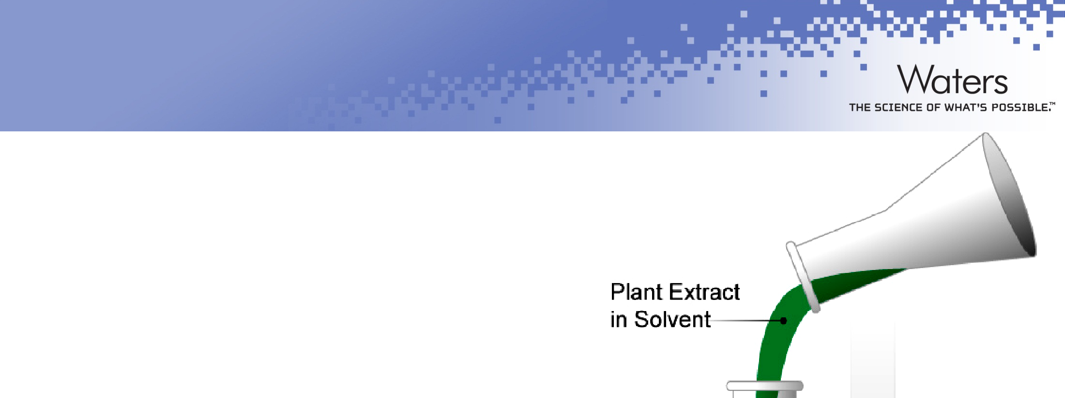
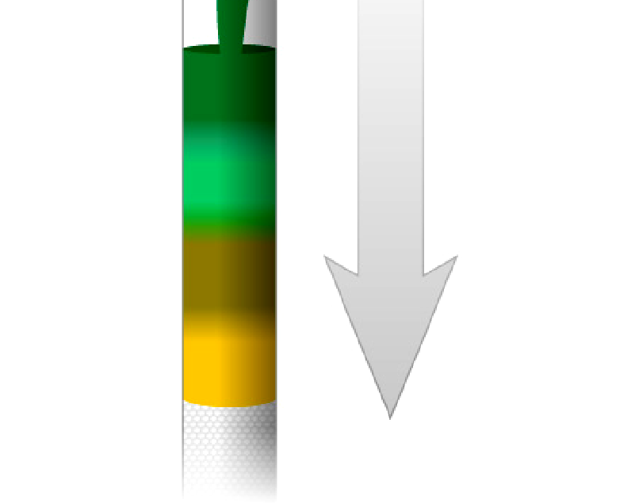
Origin of Liquid Chromatography:
Dr. Mikhail Tswett’s Experiment (1903)
Tall glass open column filled with sand-like particles
Ground-up plant extract
Poured into the column and saw colored “bands” develop as the extract percolated down thru
the column
Different compounds had separated
Greek
Colored “Bands”
Chroma | -- | color
Graphy | -- | writing/study of
Note: “Tswett” in Russian means Color
©2012 Waters Corporation

Slide 4
Chromatography Technology
Several Major Types
  GC {Gas Chromatography}
  LC {Liquid Chromatography}
    TLC (Thin Layer Chromatography
    Paper Chromatography
    HPLC (High Performance Liquid Chromatography)
    UPLC® (Ultra Performance Liquid Chromatography)
    SPE (Solid Phase Extraction)
    Flash Chromatography
©2012 Waters Corporation

Slide 5
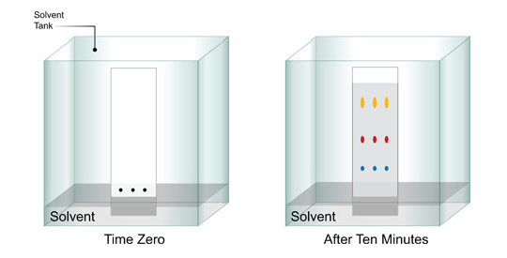
Three Modes of Liquid Chromatography
Thin Layer Chromatography (TLC)
©2012 Waters Corporation

Slide 6

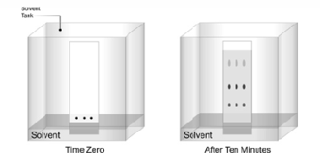
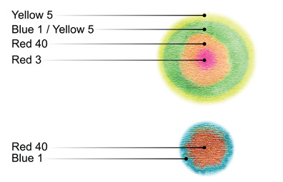
Three Modes of Liquid Chromatography
Thin Layer Chromatography (TLC)
Paper Chromatography
©2012 Waters Corporation

Slide 7
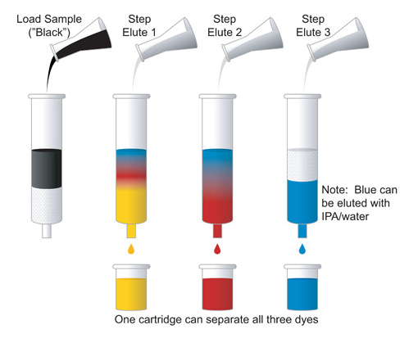
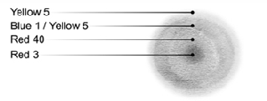

Three Modes of Liquid Chromatography
Thin Layer Chromatography (TLC)
Paper Chromatography
Column Chromatography
  Solid Phase Extraction
  HPLC
  UPLC®
  Flash Chromatography
©2012 Waters Corporation

Slide 8
H
igh
P
erformance
L
iquid
C
hromatography

Slide 9
H
igh
P
ressure
L
iquid
C
hromatography

Slide 10
H
igh
P
riced
L
iquid
C
hromatography

Slide 11
What is HPLC?
High Performance Liquid Chromatography (HPLC) is a column Chromatography technique in which:
  A cartridge or column is packed with a sorbent (stationary phase).
  A liquid (mobile phase) is passed through the packed column.
  A dissolved sample (in a liquid) is injected into the flow path of the mobile phase. (this is an “sample band”)
  The sample band separates into individual analyte bands as it passes through the HPLC column.
  Analytes bands are detected
  A chromatogram is generated; analyte bands are seen as “peaks”
  Peaks are quantitated
©2012 Waters Corporation

Slide 12
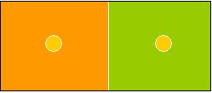
Partitioning
Separation is based on the analyte’s relative solubility between two liquid phases
Mobile Phase
Stationary Phase
Solvent
Bonded Phase

Slide 13
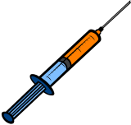
Instrumentation
Gradient Controller
•
Pump
Column
Detector
Injector
Mobile Phases
Notes:
Mobile Phases - Component solvents/mobile phases to make up gradient
Gradient Controller - Sets up gradient - linearity, steps, ramps, number of solvents/mobile phases (binary, ternary, quaternary).
Pump - Dual piston, Pulse free, Able to deliver 4000PSI, Precision flow rates of 0.001mL/min, Flow range 0.001-10.001 mL/min.
Injector - How do you inject a sample in to a flowing sream at 4000PSI? If you tried you’d have the syringe plunger go thru a wall! The sample injector utilizes a set of valves in which a sample loop switchs in-and-out the flowing stream. You introduce the sample by injecting it into the sample loop which has a fixed volume. The fixed volume injected replaces the contents of the loop so therefore for manual injection you should have enough injected to completely replace the previous loop contents. The sample is automatically introduced into the flowing stream by valve switching.

Slide 14

Instrumentasi HPLC

Slide 15
Cara kerja hplc

Slide 16
HPLC - Modes
Normal Phase.
- Polar stationary phase and non-polar solvent.
• Reverse Phase.
- Non-polar stationary phase and a polar solvent.
Notes:
- “Like dissolves like”. In Normal Phase the analyte will be partitioned preferentially in the mobile phase and provide little interaction with the stationary phase. This is not desirable since selective retention on the column will be very hard to control. It can be controlled by modifying the stationary phase, a very time consuming and expensive proposition even if feasible.
In Reverse Phase the opposite is true. The analyte will be partitioned preferentially in the stationary phase (“Like dissolves like”). and by simply modifying the mobile phase, by adjusting the polarity, ionic strength or pH, selectivity can be virtually fully controlled.

Slide 17

Common Reverse Phase Solvents
Methanol
CH₃OH
• Acetonitrile
CH₃CN
• Tetrahydrofuran
• Water
H₂O
Notes:
It is common practice to make up these organic solvents as mixtures with water or, in a lot of cases, have each pure solvent mixed under instrument control and changed at a certain rate with time (gradient). Gradients can be simple or complex. Simple - as a linear gradient (ramp); Complex as steps (start and hold) and ramps together. You can have a solvent or several solvents being controlled at the same time with a changing modifier such as a pH buffer.
Methanol - Most common solvent. Close to water in structure. Miscible in all proportions with H₂O so that for less polar organics you can have the power of 90% Methanol with 10% H₂O.
Acetonitrile - Highly polar, very low UV absorbance. Also completely miscible with H₂O but lacking in hydrogen bonding capability thus affording a different partitioning effect.
Tetrahydrofuran - Molecule has high dipole moment. More soluble with non-polar compounds.
Water - Also a very common solvent. Used to make up solvent modifiers to adjust pH (buffers) as well as ion-pairing reagents.
Emphasize degassing (“bends”- bubble in detector) and for particle-free (dust could be up to 10X size of particles of solid support).
555- 25mM H₃PO₄:MeCN(90:10)->10:90
605 - 0.1M pH4.7 OAc: MeCN (1:1) isocratic.
610 - MeCN:H₂O -> MeCN
8316 - 100% H₂O
8330 - MeOH:H₂O isocratic
8331 - MeOH:H₂O(HOAc-C₁₀SO₃H)
8332- MeOH:H₂O (3:2-CN), (1:1-C-18)
8325-A=MeCN:0.01M OAc (75:25), B= MeCN -> 60%MeCN total.
λ= 190 for MeCN, λ= 205 for MeOH, λ= 190 for H₂O, λ~ 290 for THF, λ~ 255 for 1% HOAc and λ~ 260 NH₄OAc (1M)

Slide 18
Columns
Solid Support - Backbone for bonded phases.
  Usually 10µ, 5µ or 3µ silica or polymeric particles.
Bonded Phases - Functional groups firmly linked (chemically bound) to the solid support.
  Extremely stable
  Reproducible
Guard - Protects the analytical column:
  Particles
  Interferences
  Prolongs the life of the analytical column
• Analytical - Performs the separation.

Slide 19
Bonded Phases
C-2 Ethyl Silyl -Si-CH₂-CH₃
C-8 Octyl Silyl -Si-(CH₂)₇-CH₃
    C-18 Octadecyl Silyl -Si-(CH₂)₁₇-CH₃
  CN Cyanopropyl Silyl -Si-(CH₂)₃-CN

Slide 20

Making a Bonded Phase Material: Non-Polar {Reversed-Phase}
Un-bonded Silica Polar
O
OH
C8 Trichlorosilane “Ligand”
Si CH₃
Cl
O
Si
O
Si O
OH
Cl
OH
H
O
Si
Cl
O O
OH
O
OH
O
Si
Si
CH₃
O
Si O
O
Si
O O
O
+
HCl
O
BONDED Surface Non-Polar
©2012 Waters Corporation

Slide 21
Detectors
UV
  Single wavelength (filter) [610, 8330]
  Variable wavelength (monochromator) [8316, 8325]
  Multiple wavelengths (PDA) [555]
Fluorescence [610]
Electrochemical [605]
Mass Spectrometric [8325]
Notes:
555- λ=210-310nm, main λ = 230nm.
605- V= +0.8v
610- UV=254nm, Fluor=280/389nm. (Fl then UV)
8330- UV=254nm.
8331(Tetrazene)- UV=280nm.
8332 (Nitroglycerine)- UV=214nm
8316 - UV=195nm.
8325 - PB/MS and UV @230nm

Slide 22
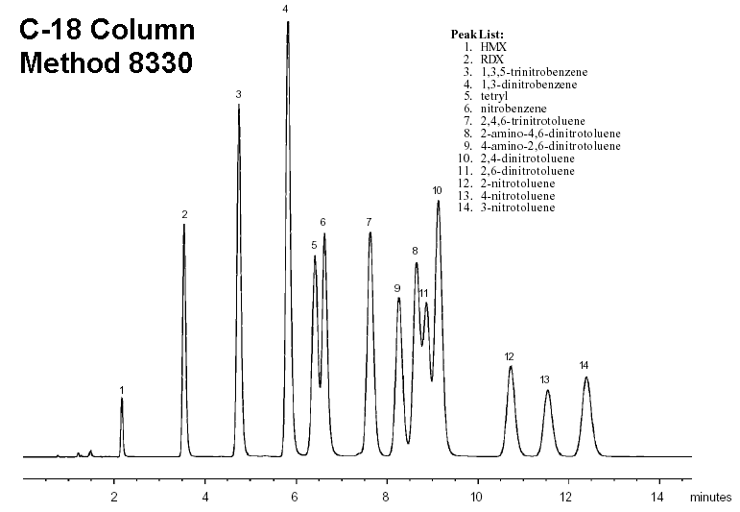
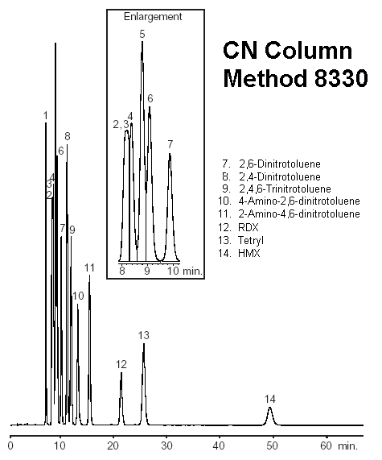
Chromatograms
Restek® ULTRA C-18 and CN Columns (250mm x 4.6mm, 5µ),
Mobile Phase: (1:1 Methanol:Water), 1.5 mL/min.
Notes:
Here is a perfect example of why we should have a confirmatory column.
Look at peaks 8, 9,10 and 11 on the C-18 chromatogram and notice the poor resolution of the group primarily due to peak 11: 2,6-dinitrotoluene.
Now notice the CN chromatogram. See how 2,6-Dinitrotoluene is separated from the two amino-dinitrotoluene compounds and the 2,4-dinitrotoluene allowing baseline resolution for all four. Also note peak 14, HMX. It takes almost 50 min to get out while it was the first (< 2.5 min) to come out on C-18.

Slide 23
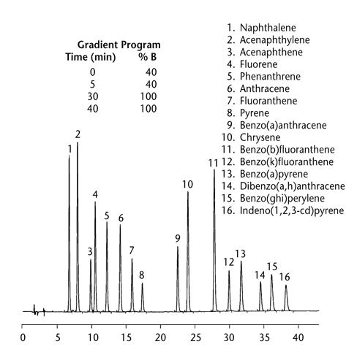
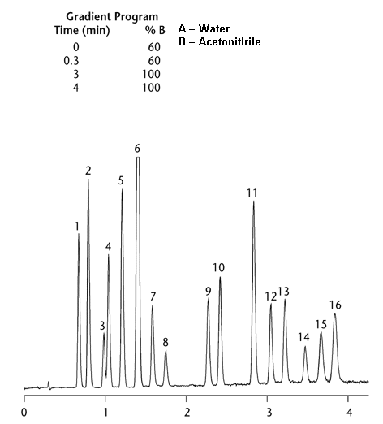
Chromatograms
A
B
Supelcosil LC-PAH Columns.
Conditions: A: 150mm x 4.6mm, 5µ.
Flow Rate: 1.5 mL/min
Conditions: B: 50mm x 4.6mm, 3µ.
Flow Rate: 3.0 mL/min
Notes:
Here are two chromatograms which very dramatically show the effect of column particle size and flow rate. Note that resolution has, for the most part, (peaks 3 and 4) NOT deteriorated. You would think that the pressure needed to run chromatogram B would be extrememly high. However, the pressure needed to run chromatogram B, due to new porous particles making up the solid support, was only 2000 PSI (about 50% higher than for A).

Slide 24
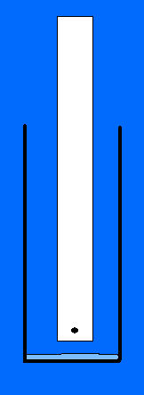
Notes:
As promised - Here is the procedure: Take a piece of paper towel, about 3/4” wide by about 5” long and at about 1/4” from the bottom and in the center touch the tip of a black water soluble marker pen on that spot. Most black markers are made up of blue, red and yellow colors.
Place it into a 7 or 9 oz plastic cup containing about 1/8” layer of water and wait.
This is paper chromatography - where the ink colors are being separated due to interaction with the water and the paper. The more the attraction of the ink molecule to the paper, the slower the speed.

Slide 25
Penggunaan HPLC
Analisis
Pemisahan
Uji kemurnian

Slide 26
Analisis dengan HPLC
Analilsis kualitatif : berdasarkan Rt (retention time)/ waktu retensi dibandingkan dengan Rt standar
Analisis kuantitatif : berdasarkan AUC (area under curve) atau tinggi puncak dibandingkan dengan AUC standar yang konsentrasinya diketahui

Slide 27
Tahapan kerja analisis hplc
Setting instrumen : pengkondisian, setting fasa gerak, panjang gelombang, laju alir, running time
Degassing
Fasa gerak, sampel
Pembuatan kurva kalibrasi
Analisis sampel
Interprestasi data dan perhitungan

Slide 28
Pembuatan fasa gerak
Fasa gerak : campuran beberapa pelarut dengan komposisi tertentu
Asetonitril : air 90: 10 v/v artinya dalam 100 mL fasa gerak mengandung 90 mL asetonitril dan 10 mL air

Slide 29
Kurva kalibrasi
Buat satu seri konsentrasi standar dengan berbagai konsentrasi
Tentukan AUC nya
Plot AUC terhadap konsentrasi standar
Cari persamaan kurva kalibrasi
Y = mx + b ; y= AUC ; m = gradien x= konsentrasi sampel ; b = intersep
Running sampel -→ AUC sampel
Cari konsentrasi analit dengan memasukkan AUC analit ke persamaan kurva

Slide 30
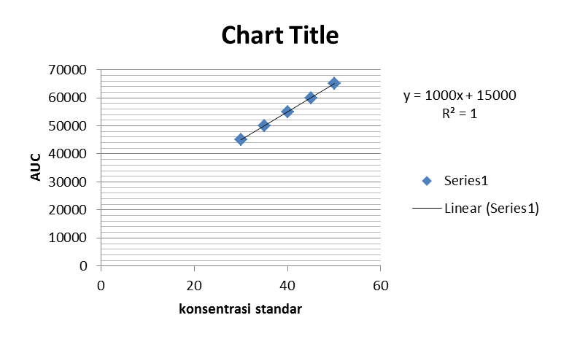
Contoh perhitungan
Persamaan kurva kalibrasi
x ( ppm ) | y (AUC)
50 | 65000
45 | 60000
40 | 55000
35 | 50000
30 | 45000
Jika AUC sampel = 4700 ; maka konsentrasi analit (x)
4700 = 1000x + 15000
X= (15000-4700) : 1000 = 10,3 ppm

