Slide 1
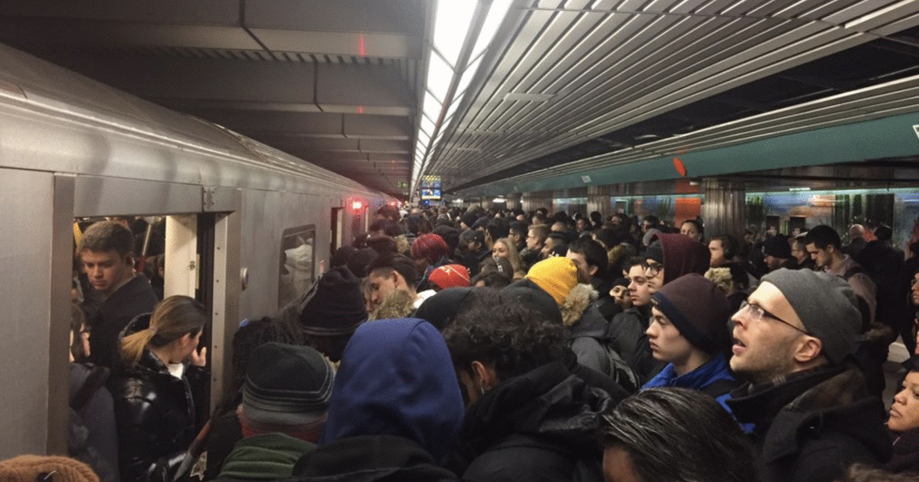

TTC Delays
U of T School of Continuing Studies – Data Analytics Bootcamp
Rohan Chaudhari
Sofiat Ishola
Daniel Adam Cebula
William Lim
Thomas Callegari
July 2019

Slide 2

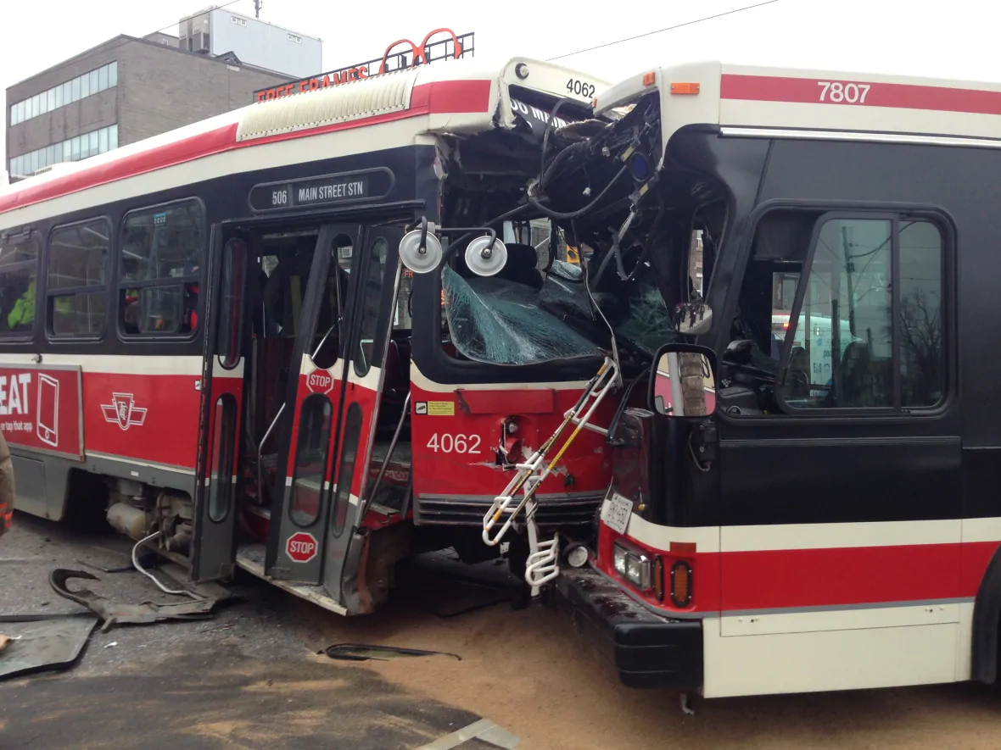
Motivation & Summary
Imagine, you wake up at 6 AM, check Google Maps to plan your commute and see that you have time, you should get to your destination in good time!
You get ready, arrive at your TTC stop and wait …… where is the bus?
Finally! A bus …. You get to the Subway and …
“Attention all customers, we are currently experiencing delays going Westbound … “
We have all been there, stuck on the TTC because of some delay. With this project we are looking to explore TTC (Subway, Streetcar & Bus) delays, narrow in on causes and try to better understand the problems behind the delays.
We will examine relationships between Routes, Day of the Week, Time of Day, Weather and anything else that comes up along the way.

Slide 3
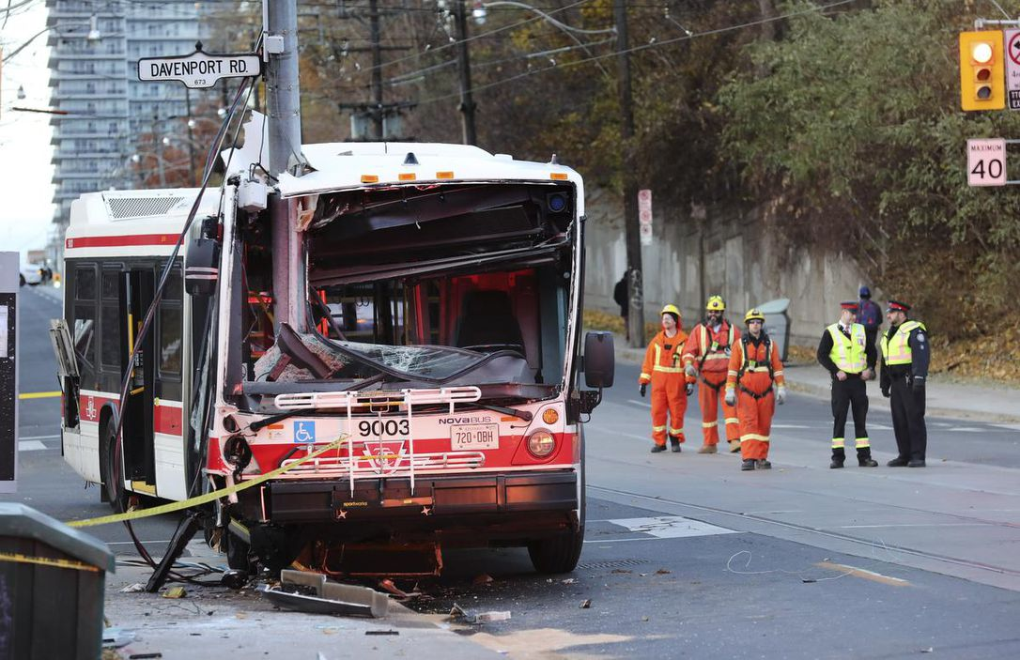
Data Questions
What factors go into TTC Delays?
Does weather impact Subway delays?
How about surface routes (Bus / Streetcar)?
Does day of the week impact Subway delays?
How about surface routes (Bus / Streetcar)?
Is there a seasonal impact?
What is the relationship between delay incidents and weather?
What Lines, Routes and Stations were impacted the most by delays?

Slide 4
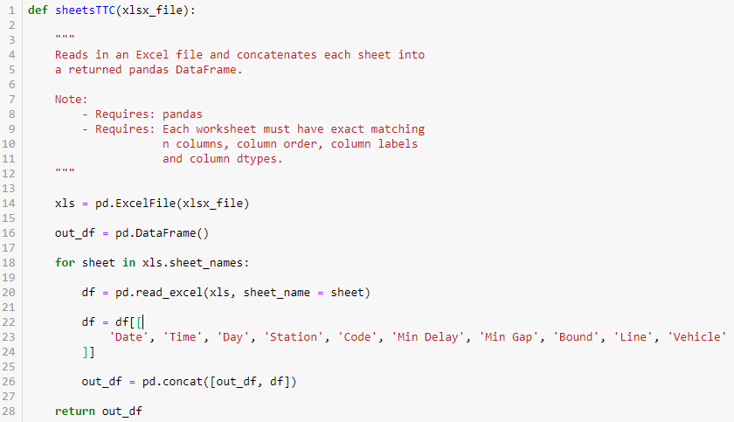
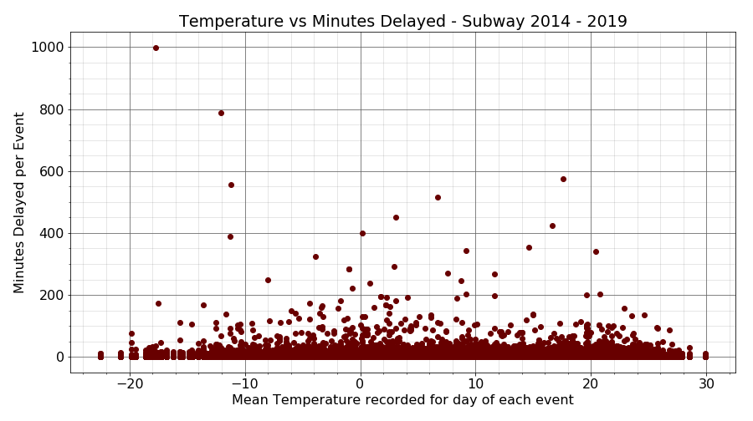
Cleanup & Exploration
Collection, Cleanup and EDA
Raw data from Open Data Toronto consisted of 30+ Excel files, each containing multiple sheets of formatted data.
Bus, Steetcar, Subway and SRT were all separate.
Additional Weather, Holiday and TTC Geo-Location data was needed to supplement TTC raw data.
Initial exploration focused on the impact of weather across the TTC system.
For Subways specifically, as shown by the scatter plot to the right, weather does not appear to play a role in delays.

Slide 5
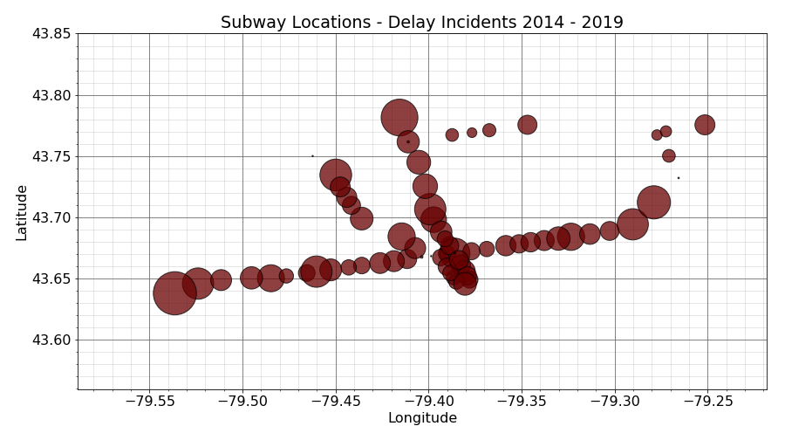
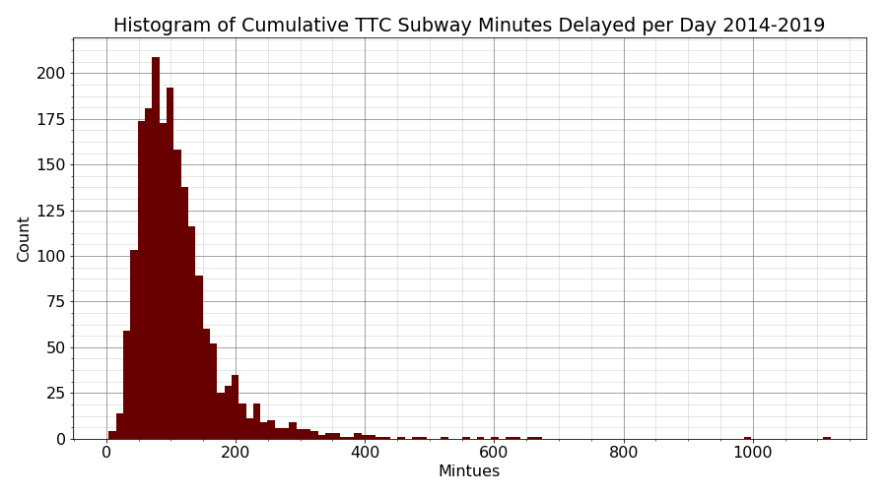
Analysis - Subway
Subway Delays
In total there are 1946 calendar days recorded in the data collected which represents 5.3 years of data.
A cumulative sum of 216,403 minutes of system wide delay for a total of 150.28 days of delays.
This represents approximately 8% of available time as delay.
Each day 111.2 mean minutes of delays were recorded with a median of 97 minutes and a daily standard deviation of 75 minutes.
Rank | Station | Count | Rank | Station | Count
1 | KIPLING STATION | 4900 | 14 | LAWRENCE STATION | 1599
2 | FINCH STATION | 3562 | 15 | YORK MILLS STATION | 1486
3 | WARDEN STATION | 2896 | 16 | GREENWOOD STATION | 1440
4 | WILSON STATION | 2655 | 17 | UNION STATION | 1365
5 | EGLINTON STATION | 2591 | 18 | EGLINTON WEST STATION | 1357
6 | ISLINGTON STATION | 2582 | 19 | OLD MILL STATION | 1311
7 | KEELE STATION | 2580 | 20 | SHEPPARD STATION | 1304
8 | VICTORIA PARK STATION | 2566 | 21 | DUNDAS WEST STATION | 1263
9 | BLOOR STATION | 2404 | 22 | ST CLAIR STATION | 1221
10 | ST CLAIR WEST STATION | 1957 | 23 | DUNDAS STATION | 1190
11 | COXWELL STATION | 1950 | 24 | DUPONT STATION | 1163
12 | JANE STATION | 1915 | 25 | CHRISTIE STATION | 1157
13 | DAVISVILLE STATION | 1725

Slide 6
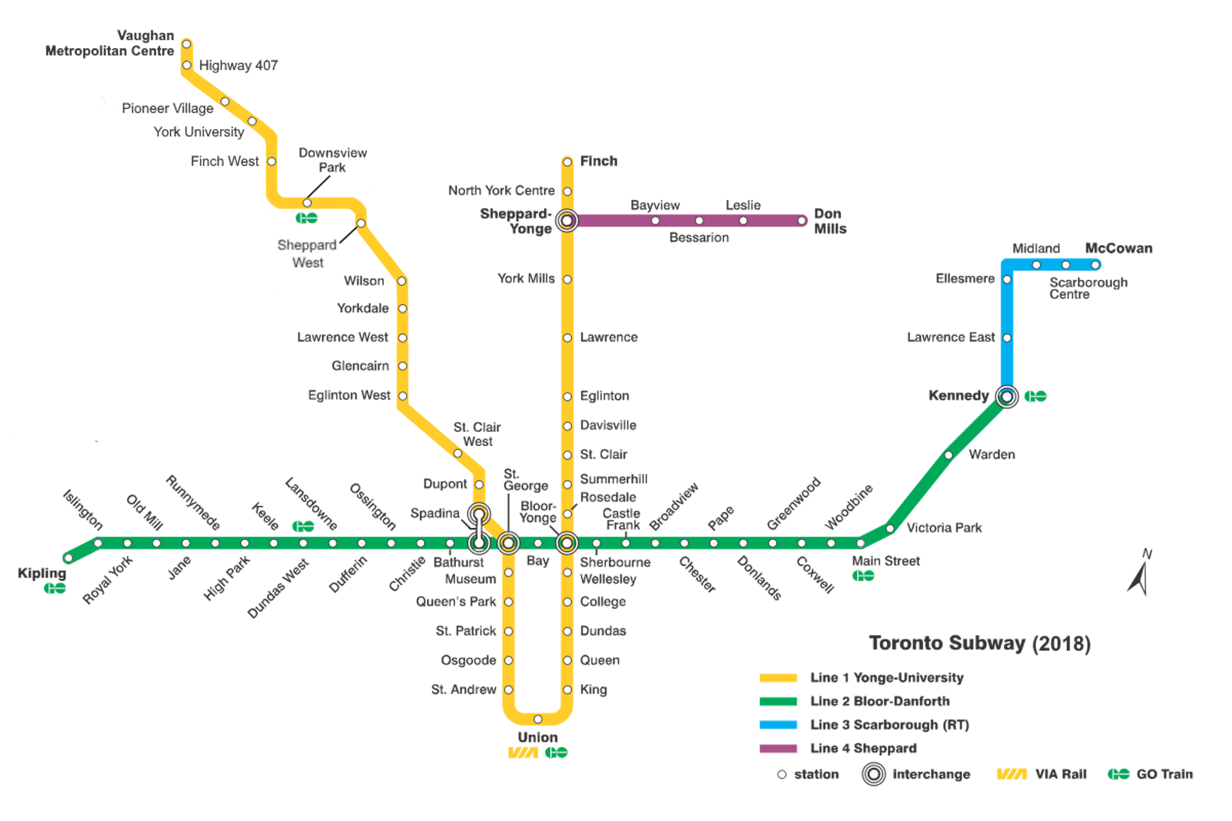
Analysis - Subway
Reference:
<https://en.wikipedia.org/wiki/List_of_Toronto_subway_stations>

Slide 7
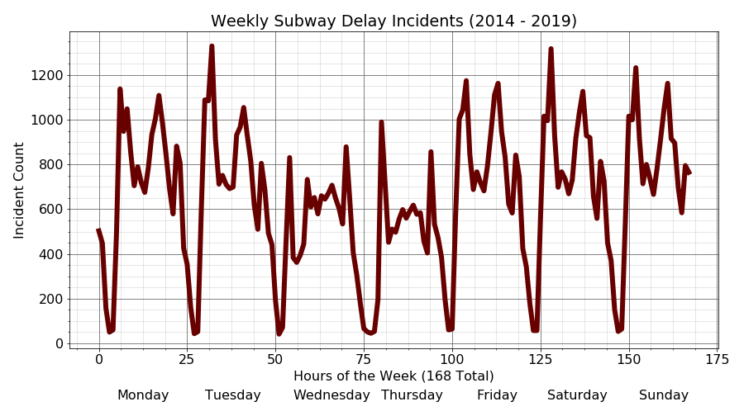
Analysis - Subway
Days of the Week

Slide 8
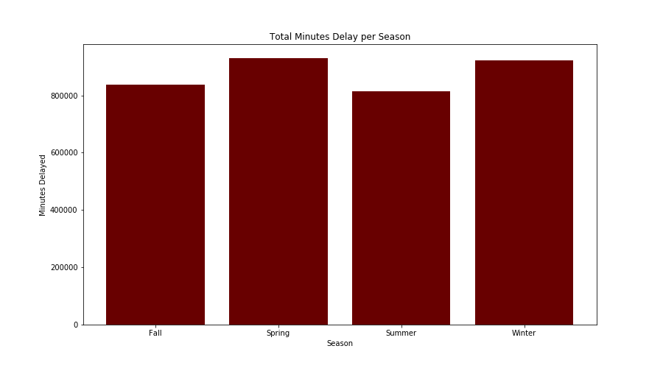
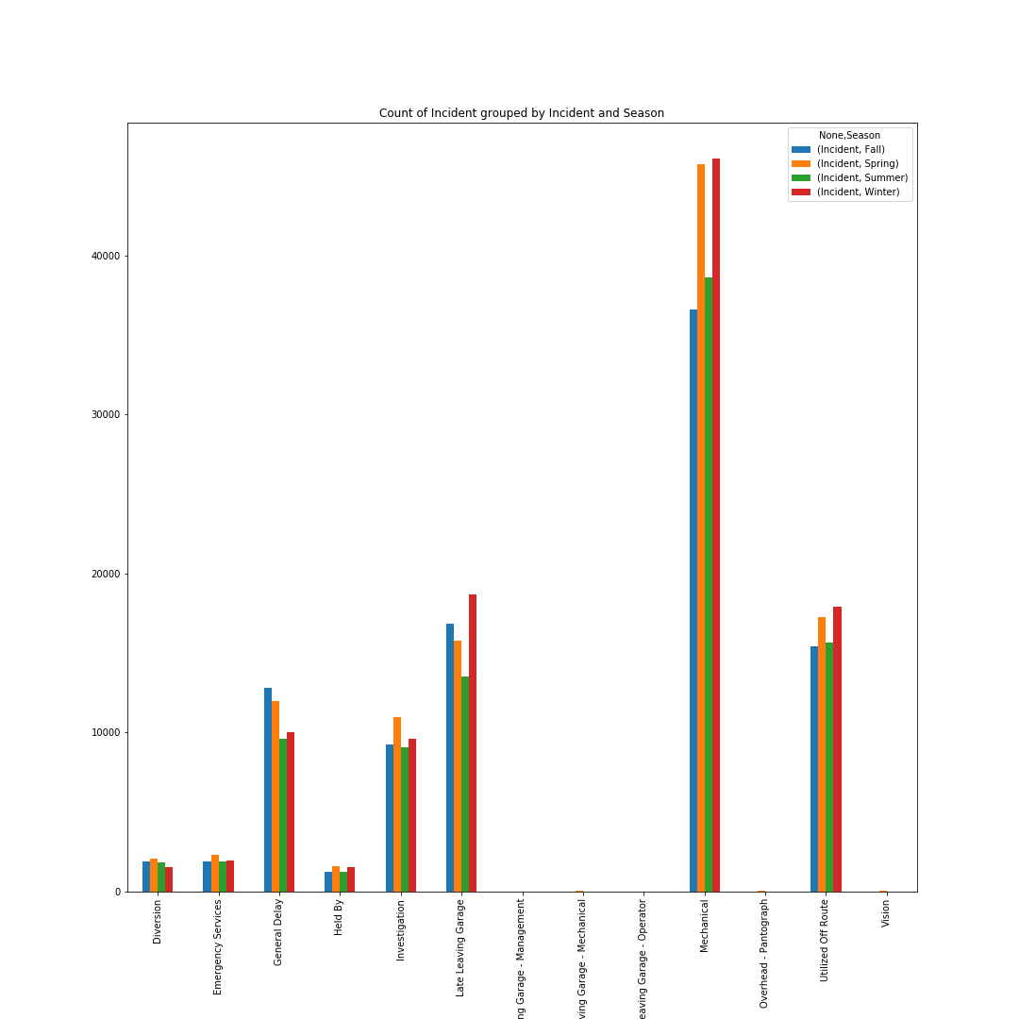
Analysis - Surface
Surface Route Delays
The first plot shows that there are more minutes delayed total in the spring and winter seasons.
The second plot shows that the number of incident type “Mechanical” and “Utilized off Route” are higher in spring and winter. These incident types occur more frequently in spring and winter and hence there are more minutes delayed in spring and winter.
Null Hypothesis: Seasonality (fall, winter, summer, spring) has no significant impact on TTC surface route (bus and streetcar) delays.
Alternate Hypothesis: Seasonality has a significant impact on TTC surface route delays.
Analysis: Based on the ANOVA test we have a p-value less than 0.05, so we are rejecting the null hypothesis. Therefore, seasonality has a significant impact on TTC surface route delays.

Slide 9
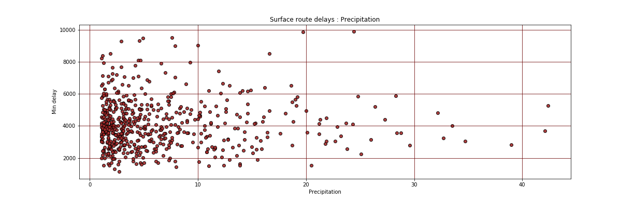
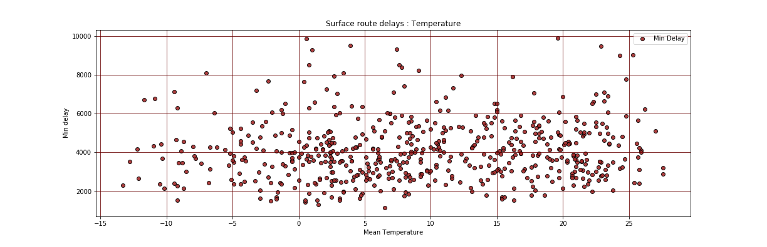
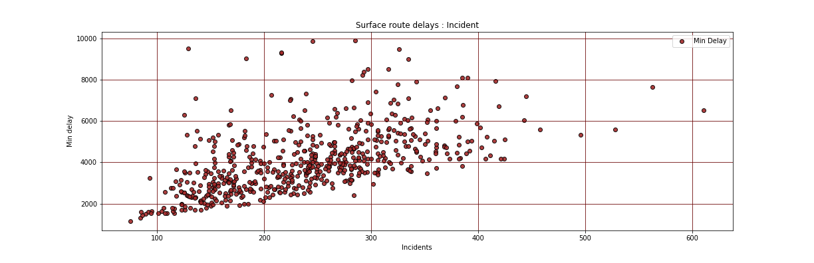
Analysis – Surface Weather
Surface Route Delays
3 main reasons for delays
Precipitation (Rain + Snow)
Temperature (High or low)
Incidents near (on) route
Null Hypothesis: Precipitation, temperature and incidents has no significant impact on TTC surface route (bus and streetcar) delays.
Alternate Hypothesis: Precipitation, temperature and incidents has significant impact on TTC surface route delays.
Analysis: Based on T-test for all 3 factors we can easily stress upon conclusion that Precipitation, temperature and incidents have no impact on delays i.e Null Hypothesis holds true.

Slide 10
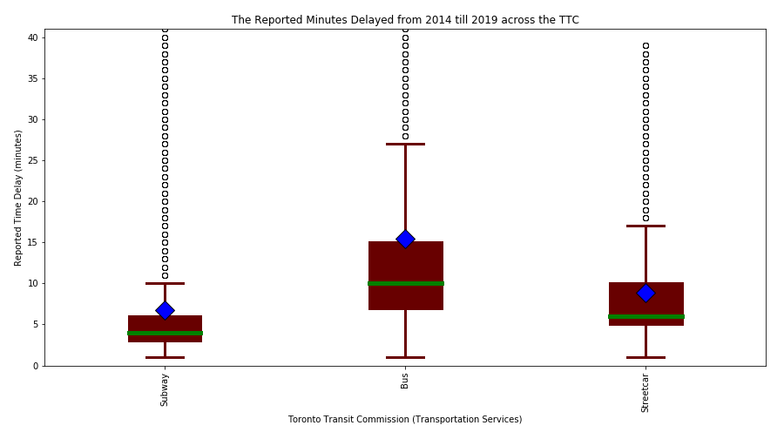
Analysis – System Weekdays
TTC Services
The first plot shows that the 3 transportation services (Subway, Bus and Streetcar) all experiencing delays in varying degrees from 2014 to 2019.
The second to fourth plots shows for subway, bus and streetcar how the time of day and week affects delay times for the TTC.
Null Hypothesis: (1) The different TTC transportation services (subway, bus and streetcar) do not have any significant time delay differences. (2) The time of day and week do not have any significant time delay differences either.
Alternate Hypothesis: Both the TTC services and time of day and week have significant delay differences.
Analysis: The data is not normally distributed. Comparison of the box plots indicate we can reject the (1) null hypothesis and not the (2).
Subway Delay Incidents: 31,993 reported delays
Bus Delay Incidents: 415,887 reported delays
Streetcar Delay incidents: 68,083 reported delays
* Only Incidents > 0 min and < 660 min are considered.

Slide 11
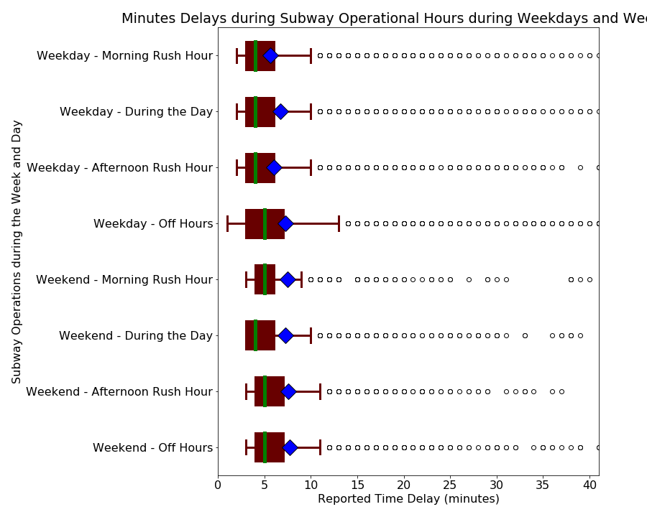
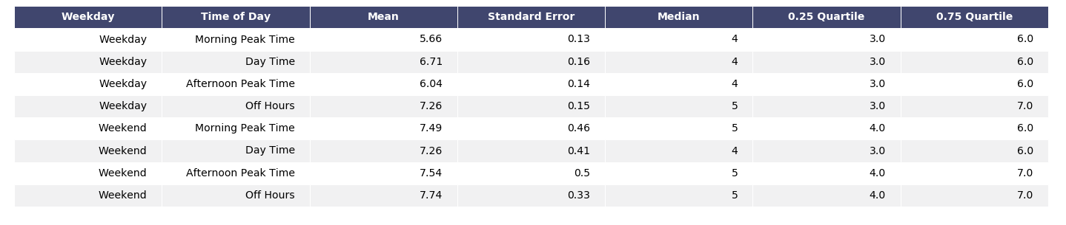
Analysis – Subway Weekdays
Morning Rush Hour:
6:30 AM – 10:00 AM
During the Day:
10:00 AM – 3:30 PM
Afternoon Rush Hour:
3:30 PM – 7:00 PM
Off Hours:
7:00 PM – 6:30 AM
Reference:
<https://www.blogto.com/city/2014/04/when_exactly_is_rush_hour_in_toronto/>

Slide 12
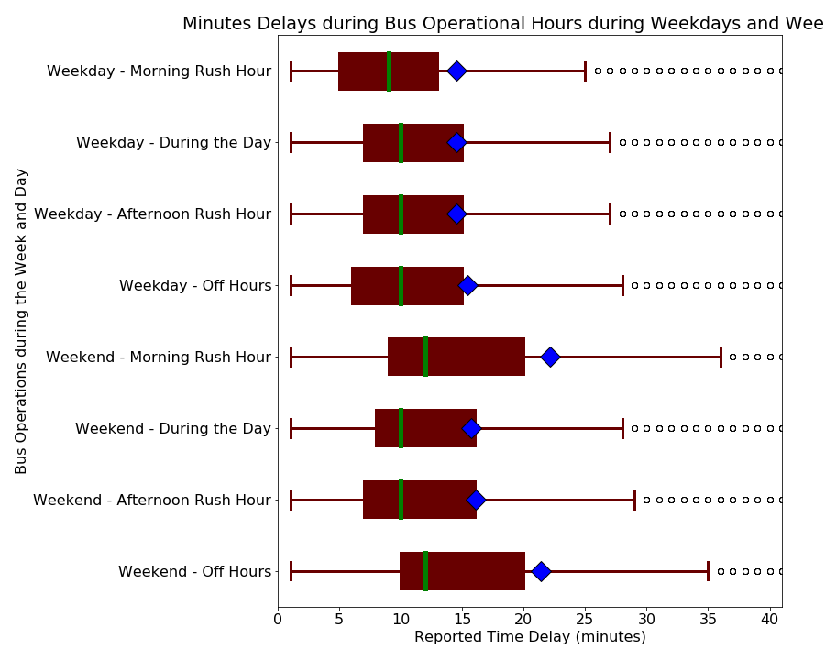
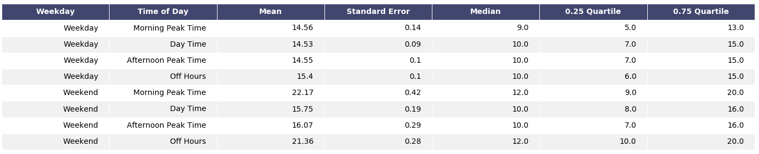
Analysis – Bus Weekdays
Morning Rush Hour:
6:30 AM – 10:00 AM
During the Day:
10:00 AM – 3:30 PM
Afternoon Rush Hour:
3:30 PM – 7:00 PM
Off Hours:
7:00 PM – 6:30 AM
Reference:
<https://www.blogto.com/city/2014/04/when_exactly_is_rush_hour_in_toronto/>

Slide 13
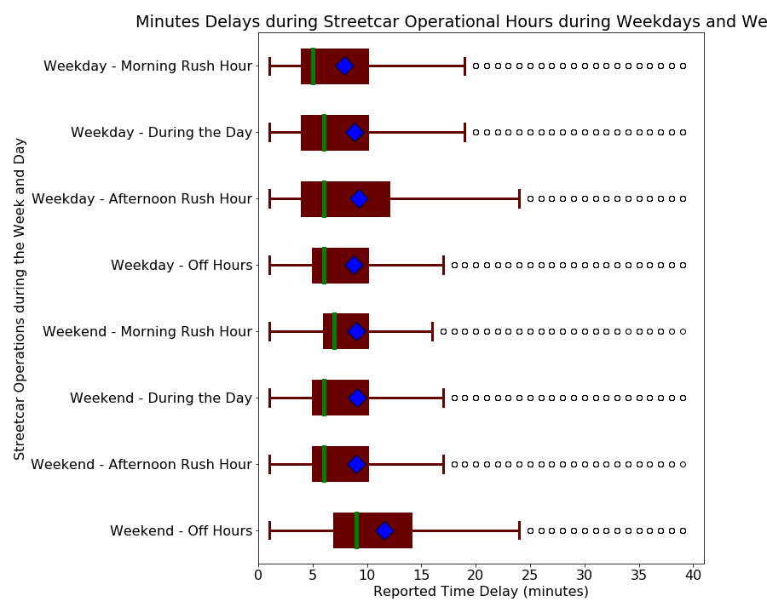
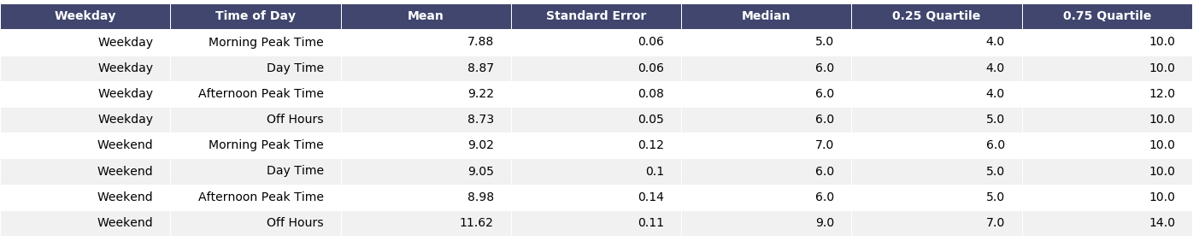
Analysis – Streetcar Weekdays
Morning Rush Hour:
6:30 AM – 10:00 AM
During the Day:
10:00 AM – 3:30 PM
Afternoon Rush Hour:
3:30 PM – 7:00 PM
Off Hours:
7:00 PM – 6:30 AM
Reference:
<https://www.blogto.com/city/2014/04/when_exactly_is_rush_hour_in_toronto/>

Slide 14
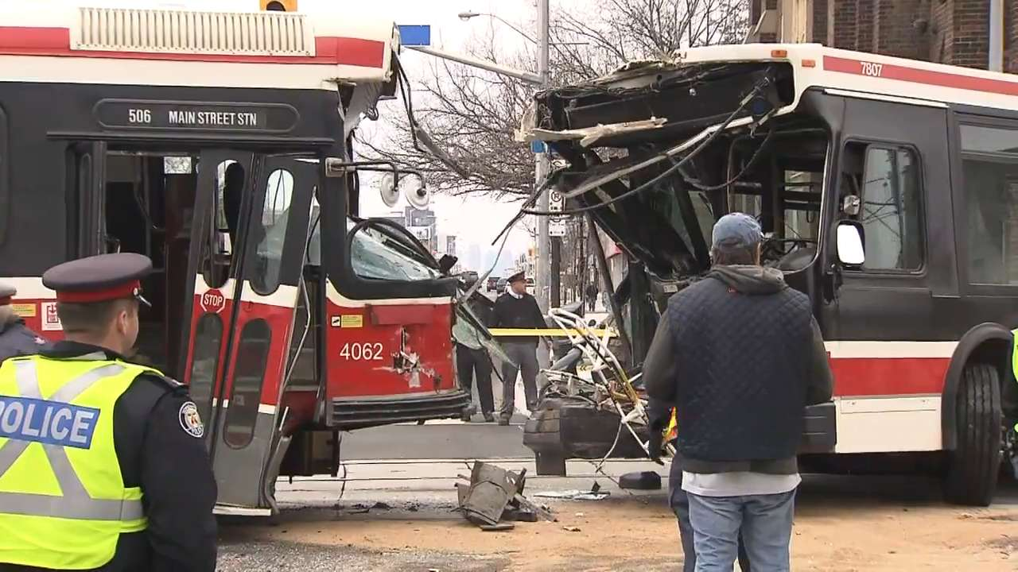
Discussion
It appears weather has no discernable role in subway delays. This makes sense as the subway system is mostly underground, on rails and have sturdy infrastructure. As for buses and streetcars the same holds true. Weather just does not impact TTC delays, whether it be rain, snow or temperature.
The top 5 stations for reporting delay incidents are Kipling, Finch, Warden, Wilson and Eglinton Stations. The top two are terminal stations, Kipling and Finch. Mike Palmer, the TTC chief operations officer, has explained that most delays occur at terminal stations as most issues are not discovered until then (Reference: https://bit.ly/2swNBKb). These delays account for 8% of total time available in the subway operating hours.
For the subway it appears that delays spike during morning and afternoon rush hours while remaining steady throughout the day and decreasing sharply in off hours.
For surface routes, bus and streetcar, it appears that the 4 seasons have an impact with delays with spring and winter having the worst delays. It appears that in those two seasons there is a higher number of “Mechanical” and “Utilized off Route” incident reports.
Comparing the delays across the 3 TTC services (subway, bus and streetcar) it is clear that the populations are significantly different. However they do not differ in terms of the day of the week or time of day.

Slide 15
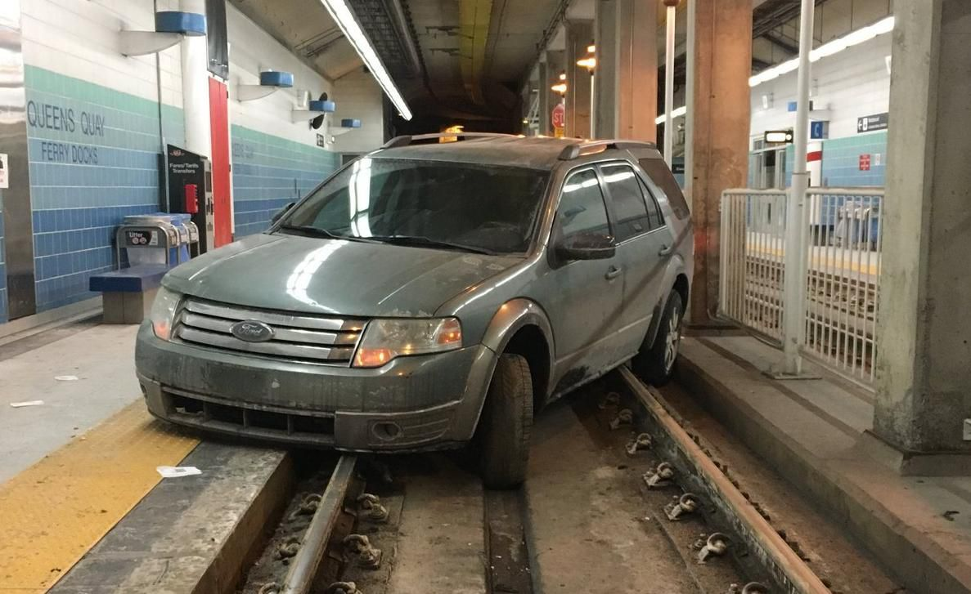
Post Mortem
The datasets we have gathered came from multiple sources. For most we needed to only manually download the .xlsx or .csv files from the respective websites. Maybe rename them for easier data munging. In regards to the subway location data and holiday list data we acquired them from third party sources which may be an issue if these third parties made a mistake.
The weather dataset was acquired from the government of Canada from this website <https://www.canada.ca/en/services/ environment/weather.html>. However the website required the use of wget module in cygwin64 program in order to download the .xlsx files in bulk from different weather stations. This took some time to learn the commands required to access the weather data.
Cleaning the data provided from the TTC was an issue as well. Several columns in the subway, bus and streetcar data, such as route, station name and direction, which were filled with numerous misspellings, short forms and unknown values which we could not make heads or tails out of. Attempts were made and the stations names were cleaned up sufficiently enough to present a heatmap of delay reports per station.
Due to the delay time data not being normally distributed it is difficult to apply any statistical tests. Non-parametric tests could be used but were not done due to time constraints.

Slide 16
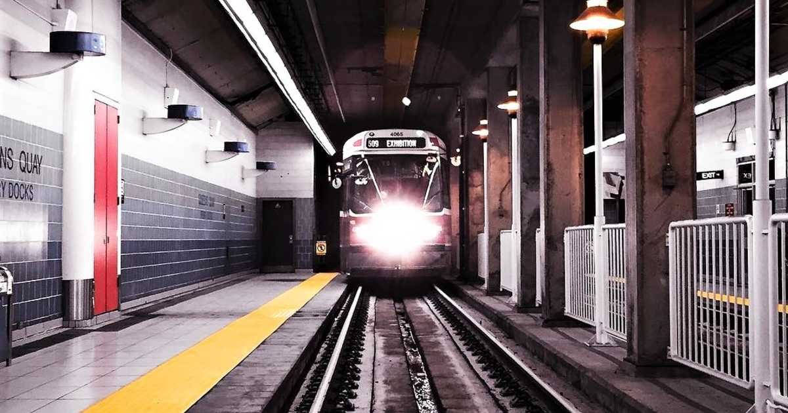
Questions?
Hopefully what you learned today will allow you to take full advantage of
the TTC services

