Slide 1

Exercises on pitfalls in imaging and good scientific conduct in image data analysis and presentation
Lecture Series „Good Scientific Conduct“
Peter Zentis
04.07.2019

Slide 2
Agenda
Exercise -1
Image data management/ data provenance with OMERO
Exercise 0
Combined use of OMERO and FIJI
Exercise 1
Brightness and contrast/ Background correction / Quantifying fluorescence intensities
Exercise 2
Defining regions of interest / measuring object sizes
Exercise 3 (optional)
Resampling
Exercise 4
Creation of figure for presentation/publication
Software download: https://uni-koeln.sciebo.de/s/fWMgvVpe57S9IGd

Slide 3
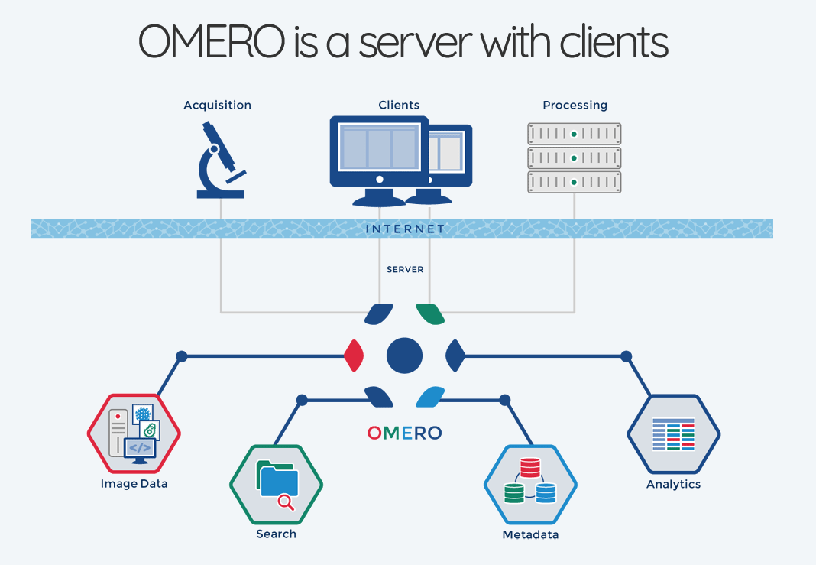
Image data management
Image source: Petr Walczysko, https://downloads.openmicroscopy.org/presentations/2019/ELMI/OMERO-workshop/#/3

Slide 4
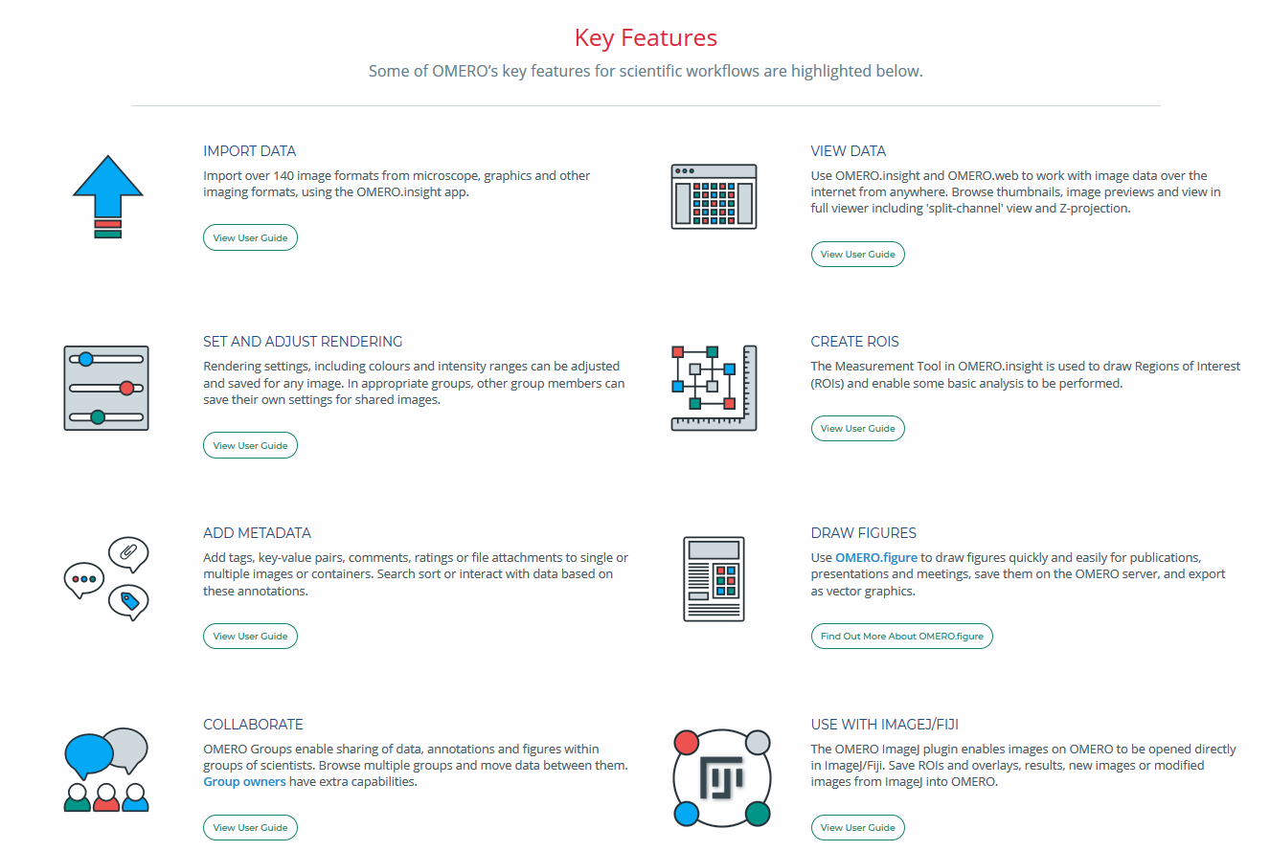
Image data management
Image source: OMERO website, https://www.openmicroscopy.org/omero/scientists/, July, 3rd, 2019

Slide 5
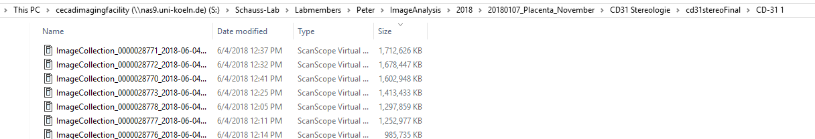
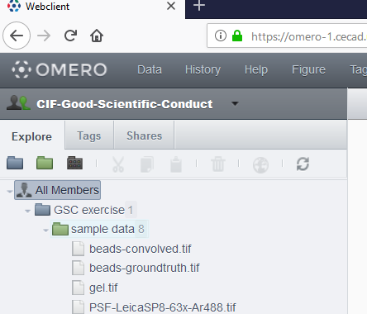
Image data management
Data hierarchy
In OMERO exist just 2 levels of hierarchy: Projects
and Datasets

Slide 6
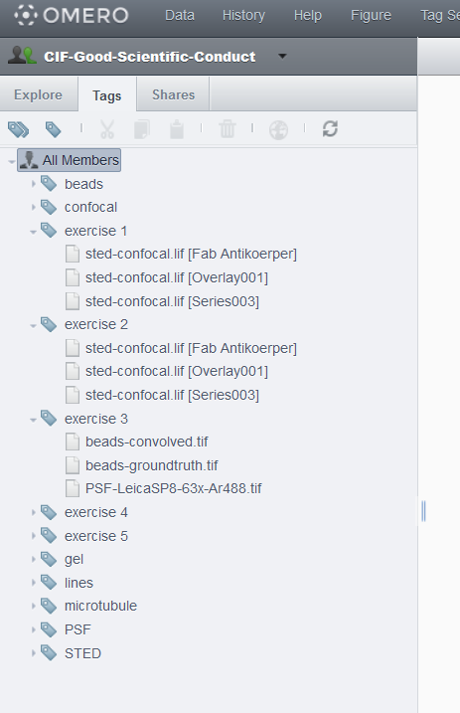
Image data management
Data hierarchy
Keeping your data in a well structured, easily retrievable way is simplified by tags
The auto-tagger allows to transfer grown folder hierarchies into tagged images in OMERO

Slide 7
Exercise -1: Getting started with FIJI and OMERO
Login to the OMERO web client: https://omero-1.cecad.uni-koeln.de

Slide 8
Exercise -1: Getting started with FIJI and OMERO
Omero offers a save (backuped) storage to organize your imaging data
Your image data is well searchable/retrievable (if you curate it > Autotagger)
You can unequivocally refer to your image with a unique (o a given server) link to the image
It allows collaboration within groups (permission management available) with different possibilities of annotation (comments, ratings, tags, key-value-pairs, tables, attachments)
It offers convenient access to your image contents (i.e. many vendor specific formats are supported, metadata is easily accessible
Simple adjustments can quickly be made, without duplicating or interfering with the integrity of your original data
You can download your original data or convert it into general purpose formats
Simple measurements are possible and are linked to the image data

Slide 9
Exercise 0: Combined use of OMERO and FIJI

Slide 10
Exercise 0: Combined use of OMERO and FIJI
Omero can be connected to many analysis tools (ImageJ/Fiji, Cellprofiler, KNIME, Matlab, R)
You can access your images from FIJI using the OMERO-Fiji-plugin
You can process analyze your images in FIJI without interfering with the integrity of your original data (i.e. if you modify the image, you have to save it as a new image to OMERO
You can also save ROIs and Measurements to OMERO (which avoids the problem in FIJI, that ROIs and measurements are not linked to the image you obtained them from

Slide 11
Guidelines
Image acquisition
Archive raw data
Image quantification
Image visualization
Object counting
Intensity measurements
Background subtraction
Contrast / brightness adjustment
Almost everything
Almost nothing
(bg substraction,
flat-field correction,
Median filter)
Pseudocolors
Cropping
Other things are possible but
must be disclosed in the figure
legend (e.g. gamma, filters etc)
Must be described in detail
in the Methods section
Inspired by Vibor Laketa

Slide 12
Exercise 1: Brightness and contrast/ Background correction / Quantification

Slide 13
Exercise 1: Brightness and contrast/ Background correction / Quantification
Brightness and contrast adjustment in FIJI (not in OMERO) potentially changes the intensity values in your image, i.e. adjusted images are not suited for intensity quantification
Background subtraction usually also changes the values, however, it is indicated before quantification as otherwise the quantification may be wrong/misleading!

Slide 14
Guidelines
Image acquisition
Archive raw data
Image quantification
Image visualization
Object counting
Intensity measurements
Background subtraction
Contrast / brightness adjustment
Almost everything
Almost nothing
(bg substraction,
flat-field correction,
Median filter)
Pseudocolors
Cropping
Other things are possible but
must be disclosed in the figure
legend (e.g. gamma, filters etc)
Must be described in detail
in the Methods section
Inspired by Vibor Laketa

Slide 15
Exercise 2: Defining regions of interest / measuring object sizes

Slide 16
Exercise 2: Defining regions of interest / measuring object sizes
When measuring spatial features in your images, be aware of the limitations of your microscope system and your image data (optical resolution, pixel size, …)
Consider deconvolution if your objects of interest are close to the resolution limit of your microscope
Be aware that the brightness of your objects, and the signal to noise ratio in your image may interfere with the accuracy of your measurement and can introduce a significant bias

Slide 17
Exercise 3: Resampling

Slide 18
Exercise 3: Resampling
Avoid resampling whenever possible, i.e. consider the required resolution when acquiring your images
Never resample images which are subjected to quantitative analysis
If you have to resample, do it only once at the very end of your figure creation process (and best disclose what you did)

Slide 19
Exercise 4: Creating a figure

Slide 20
Exercise 4: Creating a figure
OMERO.figure is a convenient tool for figure creation
Adding scale bars, adjusting brightness, color and resolution can be done easily (be aware that you can manipulate your images inappropriately by doing so!)
The original data used is easily retrieved
modifying figures gets much less error prone due to linkage to original (meta)data

