Slide 1

Computing static properties in the liquid and solid phases: radial pair distribution function
Mattia Bernetti, Post-doc
Nicola Calonaci, PhD student
Summer School on Classical Molecular Dynamics for Material Science, Nanotechnology and Biophysics
SISSA
June 17st, 2019

Slide 2
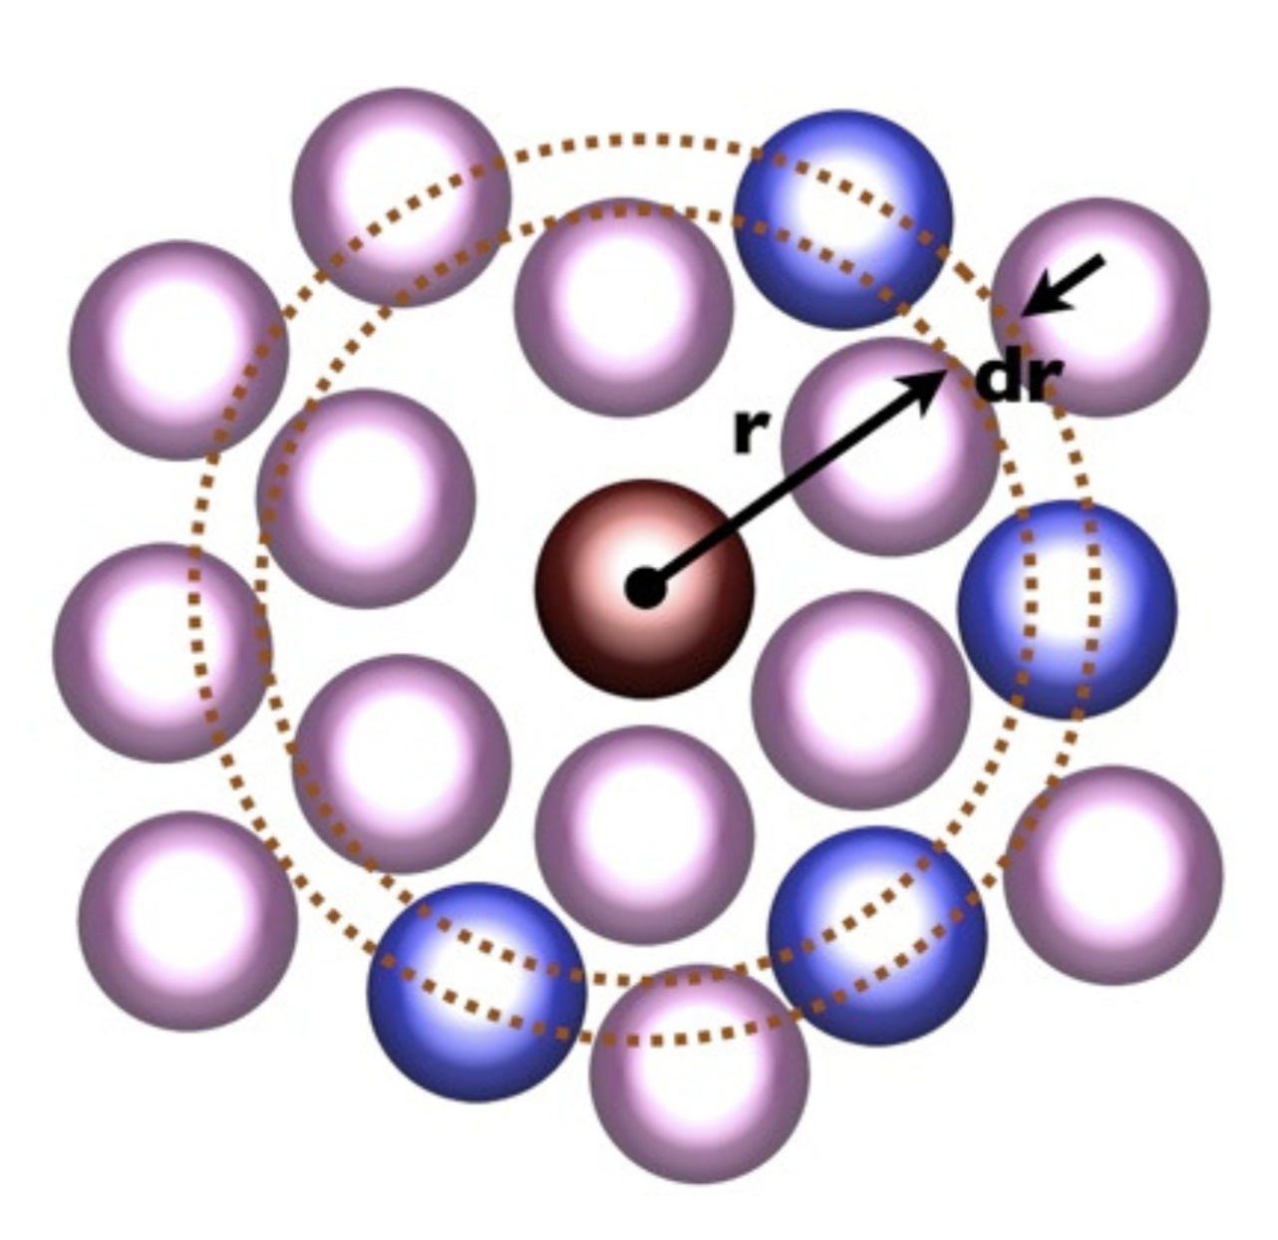

Radial distribution function g(r)
g(r) describes how the density changes as a function of the distance from a reference particle
Most simply thought as the number of atoms found at a distance r from a given atom
Non interacting particles
Given a spherical shell of thickness dr at a distance r from a refence particle, and a uniform ρ for the system:
is the number of particles included in the shell.
$$4πρr^{2}dr$$

Slide 3


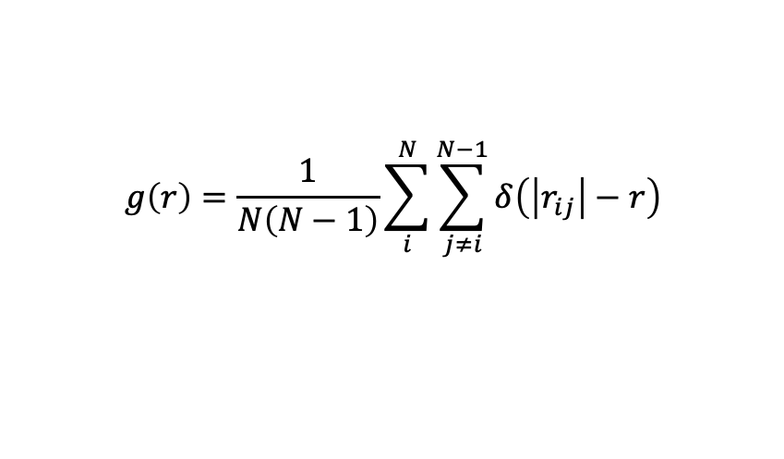
Radial distribution function g(r)
g(r) describes how the density changes as a function of the distance from a reference particle
Most simply thought as the number of atoms found at a distance r from a given atom
Interacting particles
The density r depends on the distance r as:
where ρ is the average density and:
is the radial pair distribution function for a system of N particles.
$$ρ\left(r\right)=ρg\left(r\right)$$
$$g\left(r\right)=\frac{1}{N\left(N−1\right)}\sum_{i}^{N}{\sum_{j≠i}^{N−1}{δ\left(\left|r_{ij}\right|−r\right)}}$$
If a reference particle is placed in the origin, the number of atoms included in the shell is then:
$$4πρ{g\left(r\right)r}^{2}dr$$

Slide 4
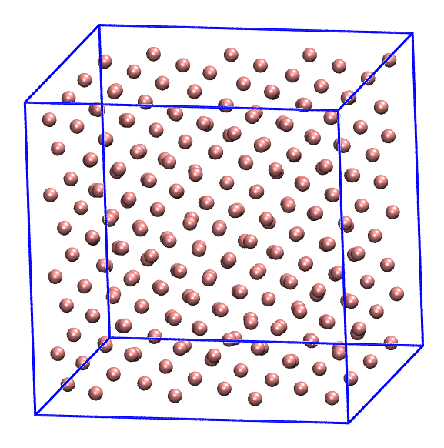
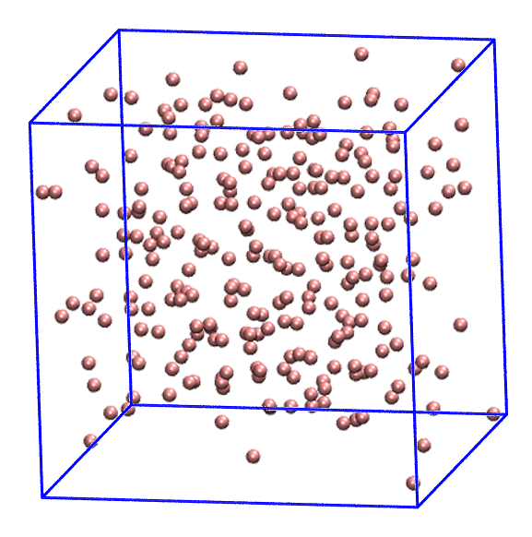
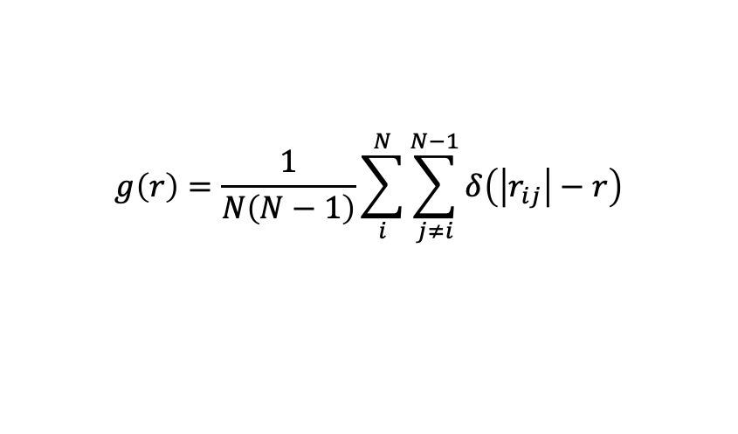
Radial distribution function g(r)
$$g\left(r\right)=\frac{1}{N\left(N−1\right)}\sum_{i}^{N}{\sum_{j≠i}^{N−1}{δ\left(\left|r_{ij}\right|−r\right)}}$$
Basic quantity in the description of a system structure
N(N - 1) = total number of pairs
|r_{ij}| = |ri - rj| = distance between particles I and j
Solid phase (crystal)
Liquid phase

Slide 5
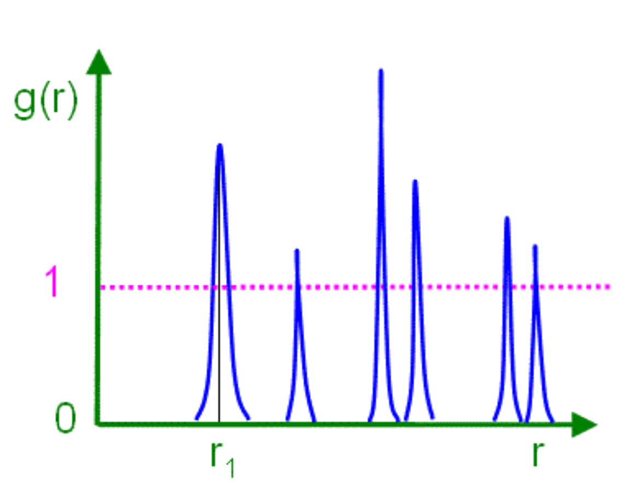
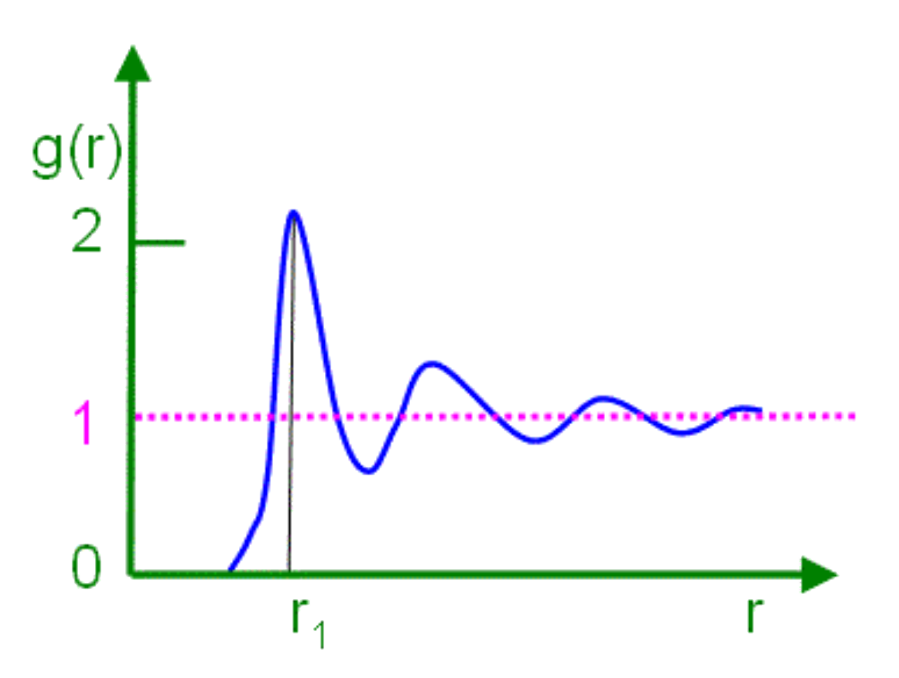
Radial distribution function g(r)
Solid phase (crystal)
Liquid phase

Slide 6
Periodic boundary conditions (PBC)

Slide 7
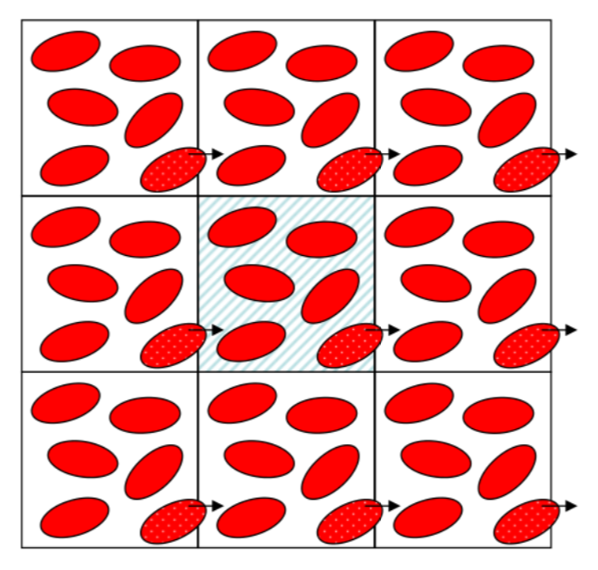
Radial distribution function g(r)
Infinite lattice built up from the repetition in space of the simulation box (unit cell)
PBC conditions allow a particle leaving the box to be replaced by one of its images entering from the opposite side

Slide 8
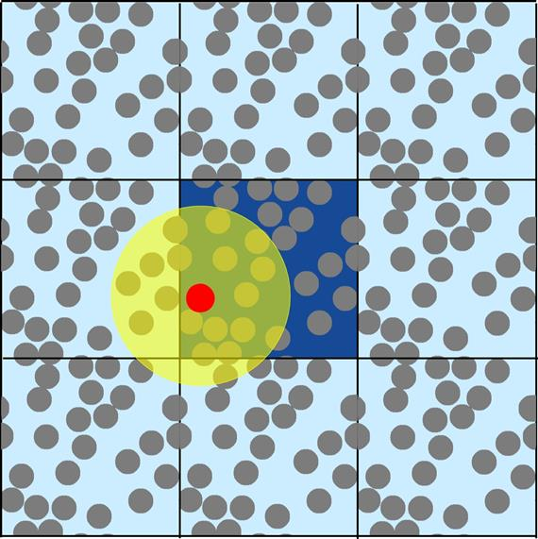



Radial distribution function g(r)
$$s_{ij}=h^{−1}{∙r}_{ij}$$
Minimum image convention
$$\left|s_{ij}^{′}\right|=\left|s_{ij}\right|−RINT\left(\left|s_{ij}\right|\right)$$
$$r_{ij}^{′}=h∙s_{ij}^{′}$$
where r_{ij} is the distance between particles i and j
Each particle interacts only with those lying in a region of the same size of the simulation box, centered on that particle
When calculating quantities depending on the pair distance between atoms A and B, we take always the image of B which is the closest to A

Slide 9
Thank you for listening!

