Slide 1
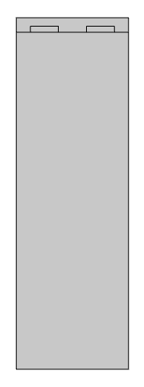
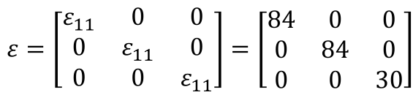
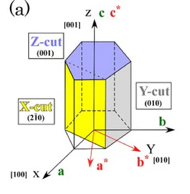
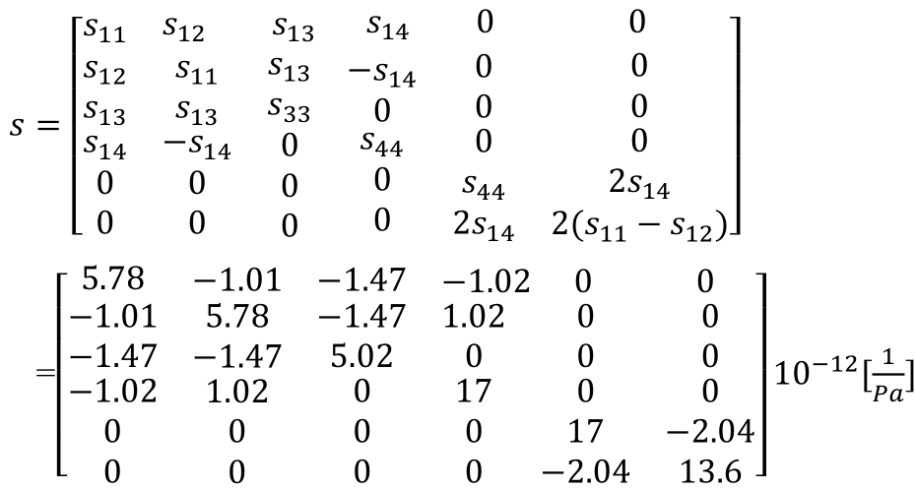
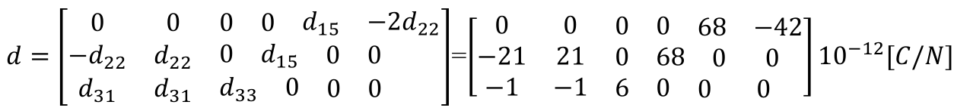
Infrachip
1. mechanical simulations
Material parameters
[Bai et al., J. Phys.: Conf. Ser. 1637 012064 (2020)]
c-axis (Z-cut)
air
Al
compliance
matrix
LiNbO₃

Slide 2
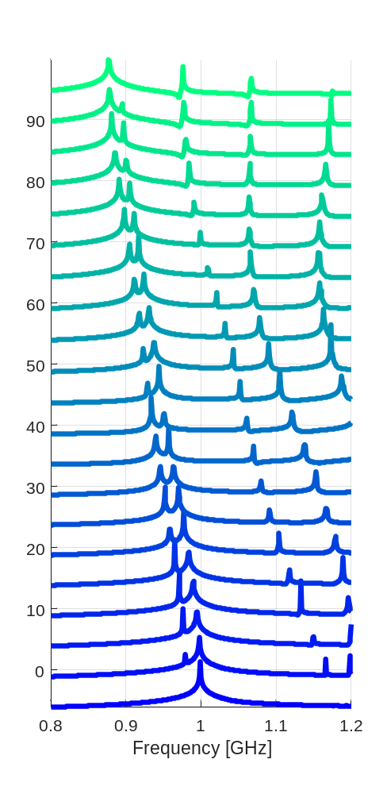
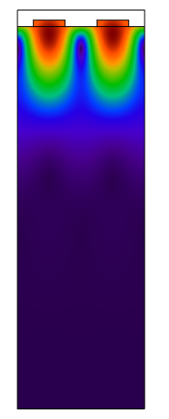
Rotazioni per Y-cut
Y
γ
π/2
Comsol
2D simulation plane
γ = 0 rotation:
Y-X plane (Y-cut)
γ = π/2 rotation:
Y-Z plane (Y-cut)
γ
X
Z
γ = 0
f = 998 MHz
log(max(w)_{topsurf})
0

Slide 3
