Slide 1
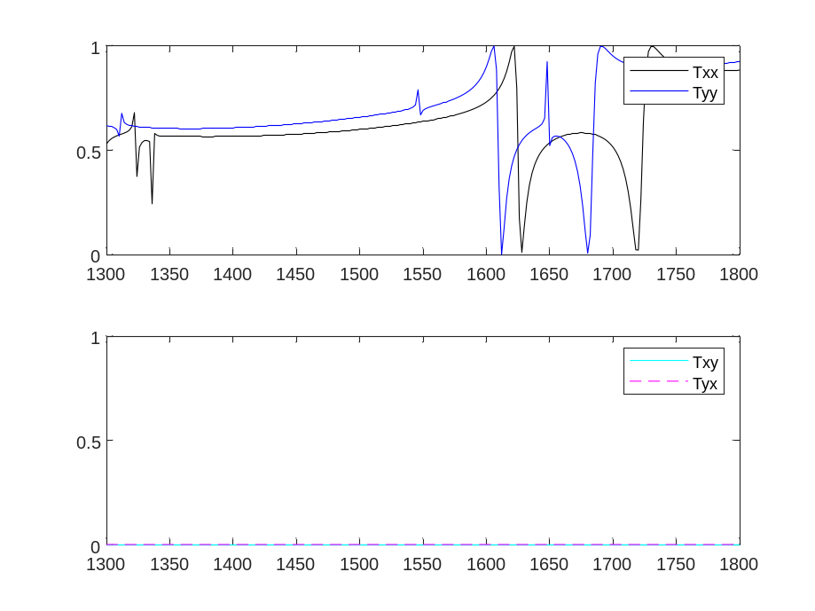
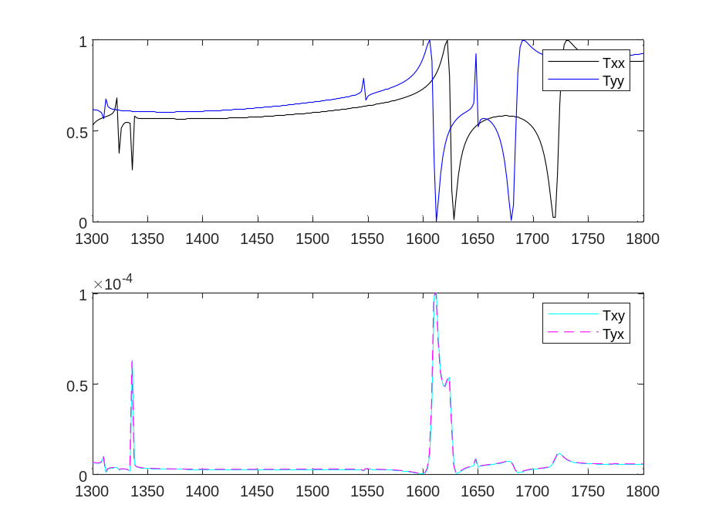
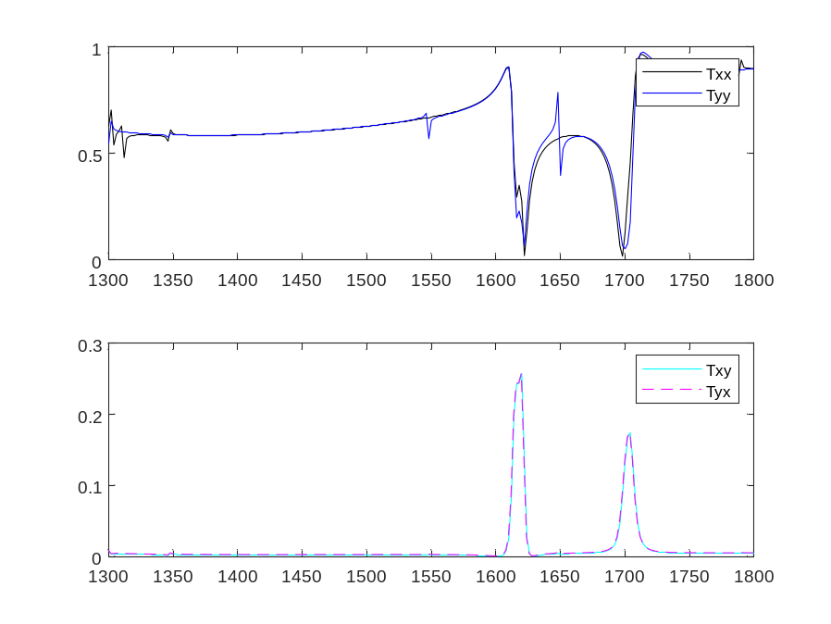
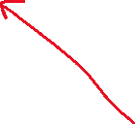
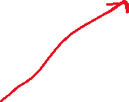

a = 1000; % periodicity
rad_hole = 200; % hole radius
dslab = 500; % slab thickness
Z-cut LN
psi = 0°
psi = 1°
psi = 45°

Slide 2




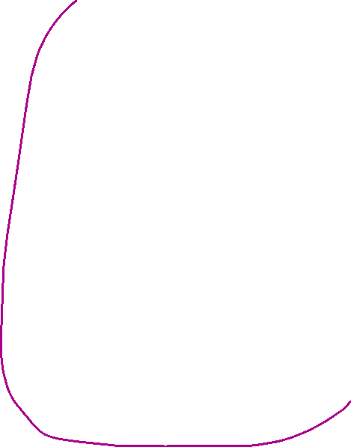











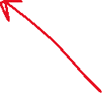



Symmetries σx and σy
Symmetries σx’ and σy’

Slide 3












Symmetry: C2z (& also σz if holes not slanted)

Slide 4
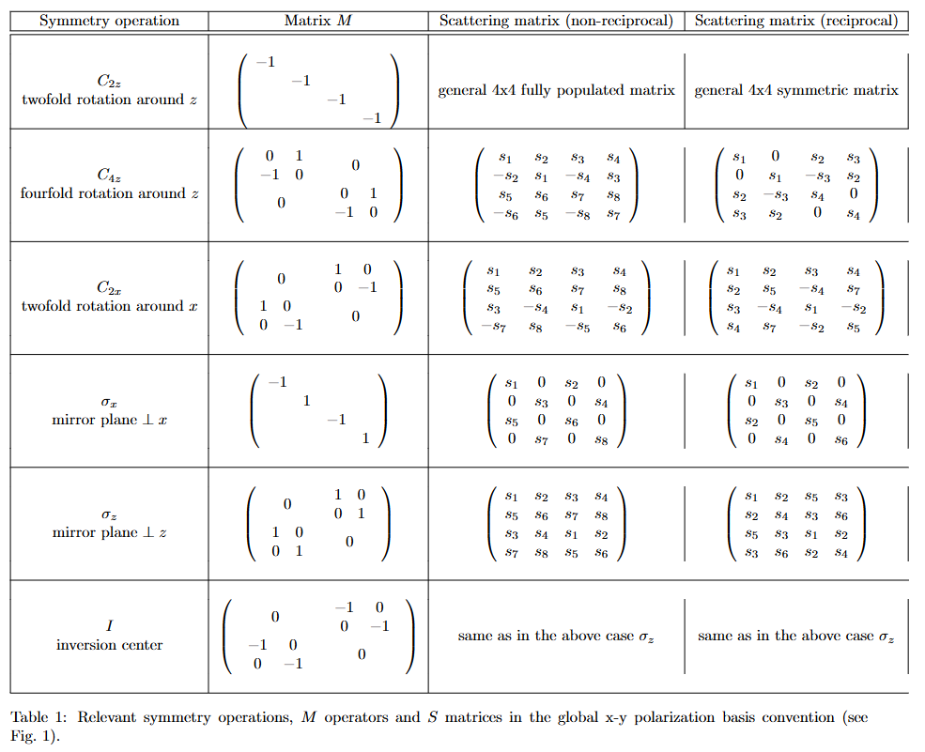
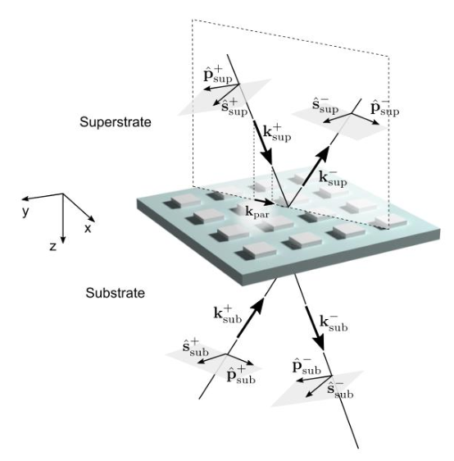
Transmission submatrix
Note: recall that PPML works with a local s-p convention (below).
Anyway, transmission submatrix in PPML will have the same form as in the table to the left.
UNPUBLISHED MATERIAL PLEASE DO NOT SHARE

