Slide 1
Optical simulations @PPML
Y-cut LiNbO3
300 nm thickness
circular holes on square lattice
Geometrical parameters:
lattice constant [a]
hole radius [r]
pattern angle [psi] with respect to crystal axis
2r
a
psi

Slide 2
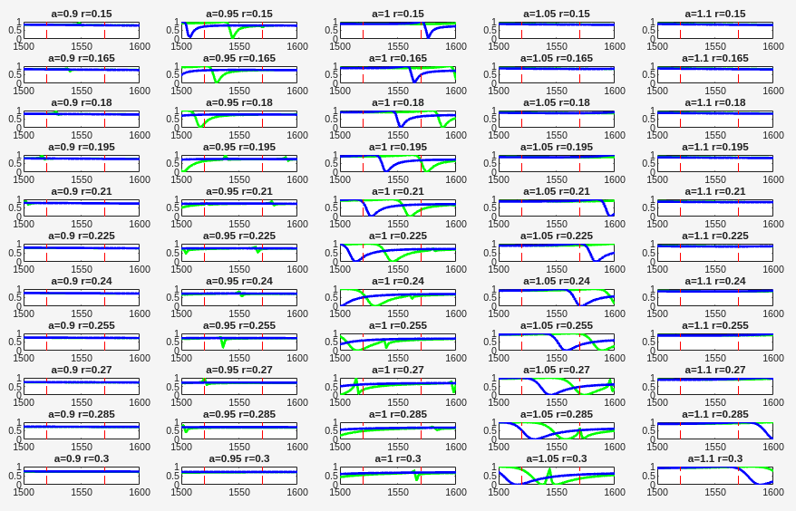
green - Txx
blue - Tyy
SET A
a = [900:50:1100];
r = [150:15:300];
psi = 0;

Slide 3
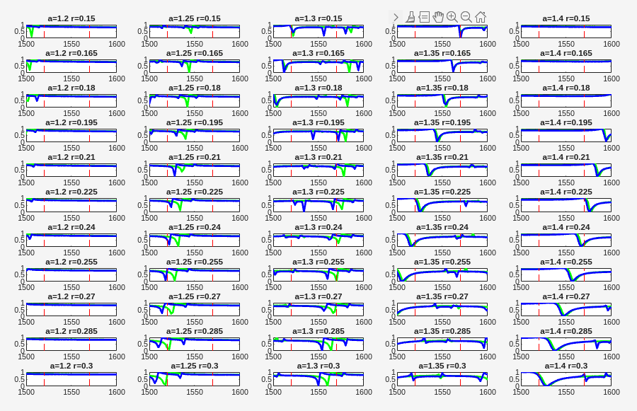
green - Txx
blue - Tyy
SET B
a = [1200:50:1400];
r = [150:15:300];
psi = 0;

Slide 4
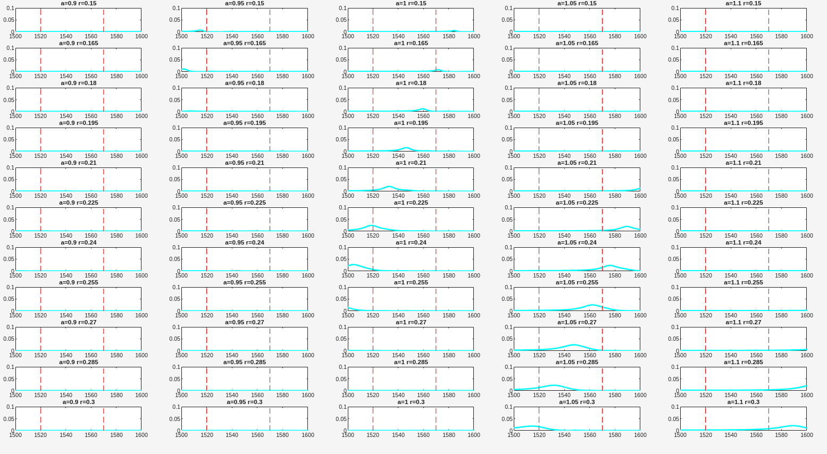
SET C
a = [900:50:1100];
r = [150:15:300];
psi = 30;
if psi = 0, both Txy and Tyx =0
psi = 45° both Txy and Tyx ≠0 in the lab frame [achiral]
psi = 30° both Txy and Tyx ≠0 in the lab frame [chiral]
red - Txy
cyan - Tyx

Slide 5
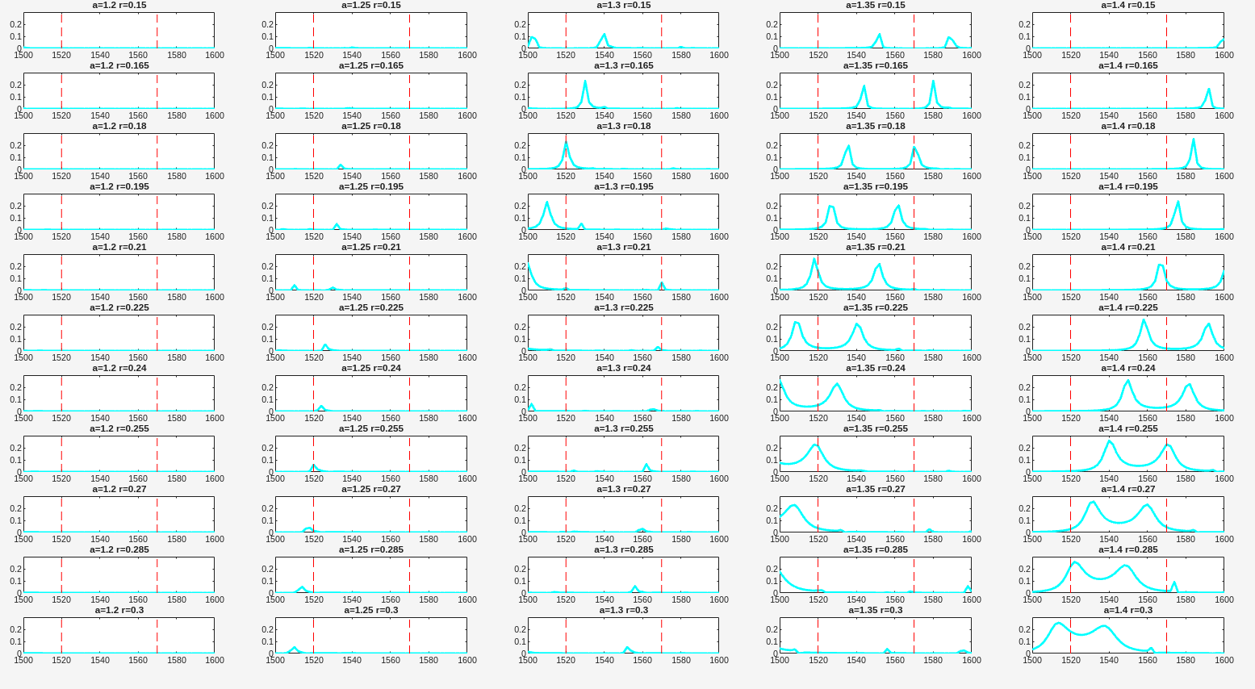
SET D
a = [1200:50:1400];
r = [150:15:300];
psi = 30;
if psi = 0, both Txy and Tyx =0
psi = 45° both Txy and Tyx ≠0 in the lab frame [achiral]
psi = 30° both Txy and Tyx ≠0 in the lab frame [chiral]
red - Txy
cyan - Tyx
more than x3 times stronger!

Slide 6
Proposal
SET A
11x5 ~100um x 100um membranes
a = [900:50:1100] -> columns;
r = [150:15:300] -> rows;
psi = 0;
SET B
11x5 ~100um x 100um membranes
a = [1200:50:1400] -> columns;
r = [150:15:300] -> rows;
psi = 0;
SET C
11x5 ~100um x 100um membranes
a = [900:50:1100] -> columns;
r = [150:15:300] -> rows;
psi = 30°;
SET D
11x5 ~100um x 100um membranes
a = [1200:50:1400] -> columns;
r = [150:15:300] -> rows;
psi = 30°;

