Slide 1
OpenERP
Analisi Prestazionale
Python script
XML-RPC vs Psycopg2
24 ottobre 2013.openerp.it XML-RPC vs Psycopg2 Dr. Piero Cecchi

Slide 2
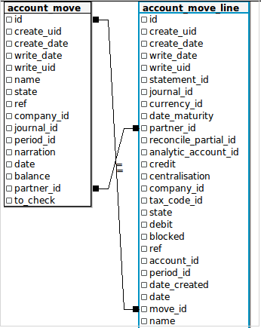
PROBLEMA REALE
In un database nella Tabella:
account_move
il Campo:
id_partner
Non è sempre presente

Slide 3
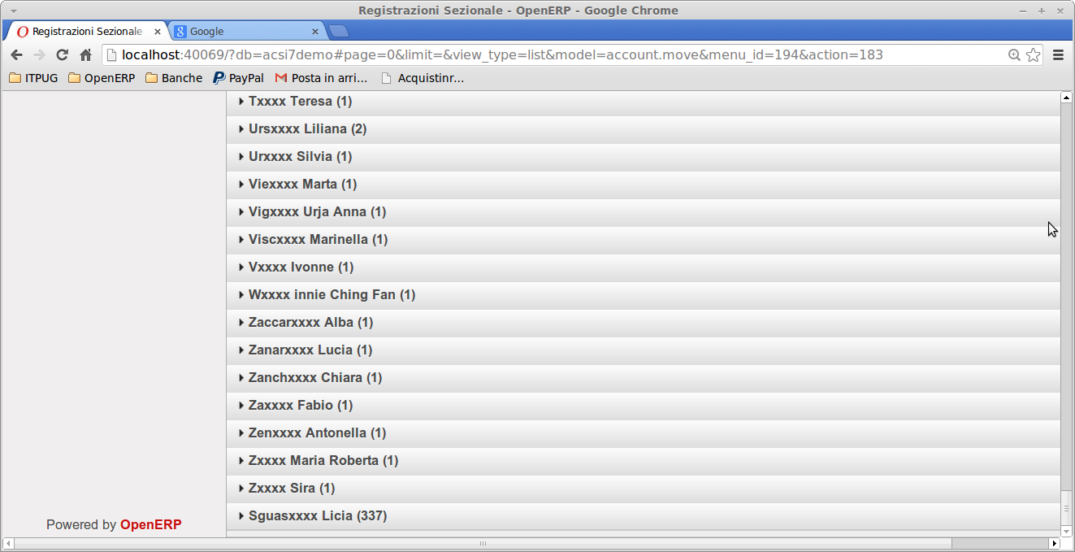
TUTTI I MOVIMENTI SENZA PARTNER SONO ABBINATI AL PRIMO ID_PARTNER DELLA TABELLA account_move_line

Slide 4
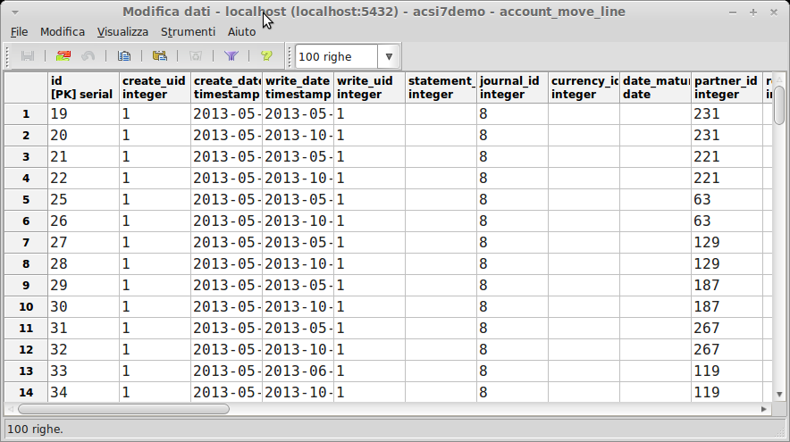
TABELLA account_move_line

Slide 5
SCRITTO PROGRAMMA IN PYTHON E XML-RPC
….......
# SEARCH ID ACCOUNT MOVE LINE
args = [('state', '=', 'valid')]
ids = sock.execute(dbname, uid, pwd, 'account.move.line', 'search', args)
splitids=str(ids).split(',')
print splitids
rowcount=1
for row in splitids:
if rowcount == len(ids):
idmove = int(row[1:-1])
else:
idmove=int(row[1:])
print idmove
fields = ['partner_id','move_id'] #fields to read
data = sock.execute(dbname, uid, pwd, 'account.move.line', 'read',idmove, fields)
splitdata = str(data).split(',')
if splitdata[0][15:] <> 'False':
idpartner = int(splitdata[0][16:])
print data
…................................esempio read xml-rpc
{'partner_id': [231, 'Sguasxxxx Licia'], 'id': 19, 'move_id': [10, 'BNK2/2013/0004']}

Slide 6
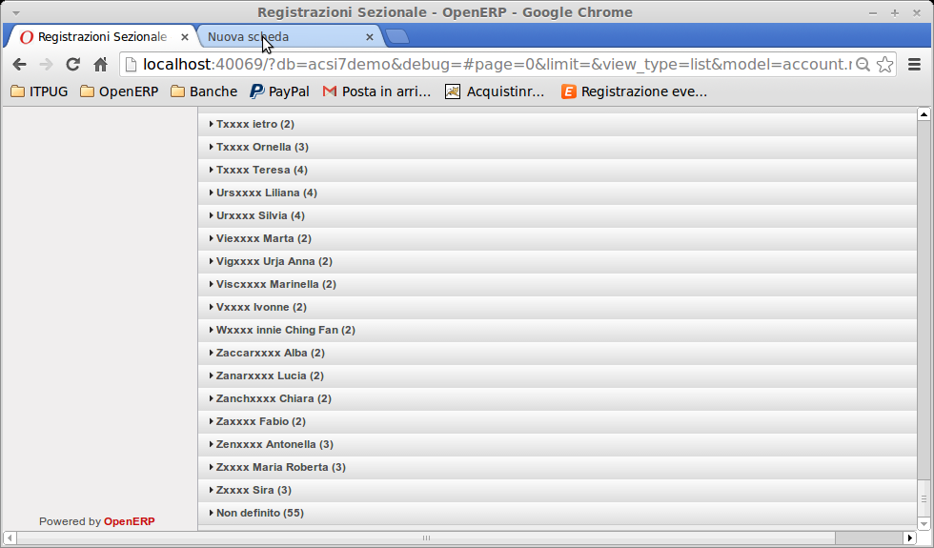
TABELLA account_move CORRETTAMENTE ABBINATA

Slide 7
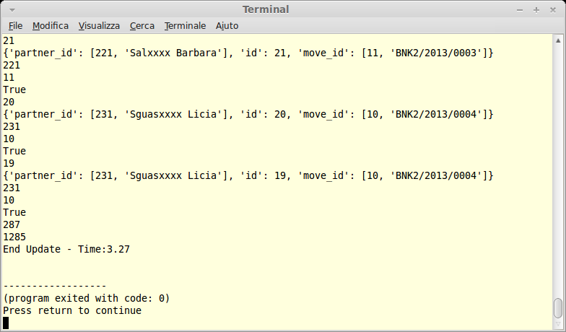
XML-RPC TIME: 3.27

Slide 8
SCRITTO PROGRAMMA IN PYTHON E PSYCOPG2
…......
c_line.execute("SELECT move_id, partner_id, credit, debit FROM
account_move_line WHERE (partner_id > 0) ORDER by partner_id")
c_line.execute("SELECT DISTINCT move_id, partner_id FROM account_move_line
ORDER by partner_id")
row_count = 0
for row in c_line:
row_count += 1
update_line="UPDATE account_move SET partner_id=%s where id=%s"
try:
c_move.execute(update_line,(row[1],row[0],))
print update_line
print "Cursor_row:%s - Partner_id:%s - Move_id:%s" %(row_count, row[1],
row[0],)
except psycopg2.DatabaseError, e:
print e.pgcode
print e.pgerror
sys.exit()
c_move.execute("COMMIT")

Slide 9
BASIC MODULE USAGE - PSYCOPG2
>>> import psycopg2
# Connect to an existing database
>>> conn = psycopg2.connect("dbname=test user=postgres")
# Open a cursor to perform database operations
>>> cur = conn.cursor()
# Execute a command: this creates a new table
>>> cur.execute("CREATE TABLE test (id serial PRIMARY KEY, num integer, data varchar);")
# Pass data to fill a query placeholders and let Psycopg perform
# the correct conversion (no more SQL injections!)
>>> cur.execute("INSERT INTO test (num, data) VALUES (%s, %s)",
... (100, "abc'def"))
# Query the database and obtain data as Python objects
>>> cur.execute("SELECT * FROM test;")
>>> cur.fetchone()
(1, 100, "abc'def")
# Make the changes to the database persistent
>>> conn.commit()
# Close communication with the database
>>> cur.close()
>>> conn.close()

Slide 10
DATABASE ERROR TEST- PSYCOPG2
#!/usr/bin/python
# Replace <USERNAME_DATABASE>, <USERNAME>, and <PASSWORD> below with your actual DB, user, and password.
import psycopg2
import sys
con = None
try:
con = psycopg2.connect(database='<USERNAME_DATABASE>', user='<USERNAME>',
password='<PASSWORD>')
cur = con.cursor()
cur.execute("SELECT * FROM testschema.testtable")1
rows = cur.fetchall()
for row in rows:
print row
except psycopg2.DatabaseError, e:
print 'Error %s' % e
sys.exit(1)
finally:
if con:
con.close()

Slide 11
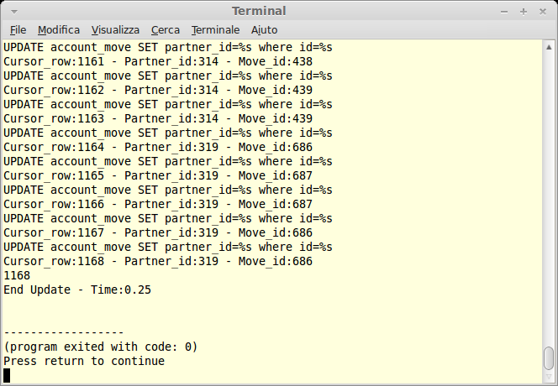
SELECT PSYCOPG2 - TIME: 0.25

Slide 12
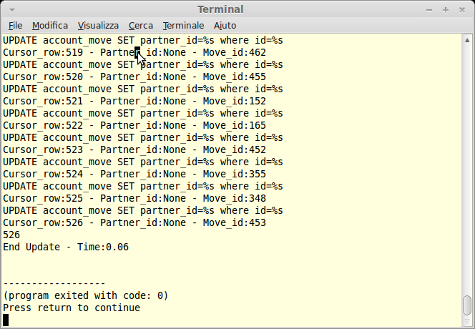
SELECT DISTINCT PSYCOPG2 - TIME: 0.06

Slide 13
SQL EXISTS - UPDATE EXAMPLE
UPDATE suppliers
SET supplier_name = (select customers.name
from customers
where customers.customer_id = suppliers.supplier_id)
WHERE EXISTS (select customers.name
from customers
where customers.customer_id = suppliers.supplier_id);

Slide 14
SCRITTO PROGRAMMA IN PYTHON E SQL EXISTS
…......
try:
conn = psycopg2.connect(conn_string)
# print the connection string we will use to connect
print "Connecting to database\n ->%s" % (conn_string)
cur = conn.cursor()
update_set = "UPDATE account_move SET partner_id = "
update_select = "(SELECT DISTINCT partner_id FROM account_move_line
WHERE account_move.id = account_move_line.move_id)"
cur.execute(update_set + update_select + " WHERE EXISTS " +update_select)
cur.execute("COMMIT")
cur.close()
conn.close()
except psycopg2.DatabaseError, e:
print e.pgcode
print e.pgerror
sys.exit()

Slide 15
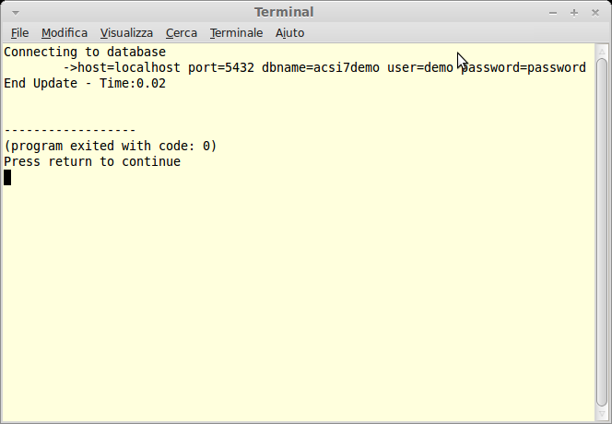
SQL EXISTS PSYCOPG2 – TIME 0.02

Slide 16
SCRIPT PSQL E SQL EXISTS
T="$(date +%s)"
psql -U demo -d acsi7demo -c "UPDATE account_move SET partner_id =
(SELECT DISTINCT partner_id FROM account_move_line
WHERE account_move.id = account_move_line.move_id)
WHERE EXISTS (SELECT DISTINCT partner_id FROM account_move_line
WHERE account_move.id = account_move_line.move_id)"
T="$(($(date +%s)-T))"
echo $T

Slide 17
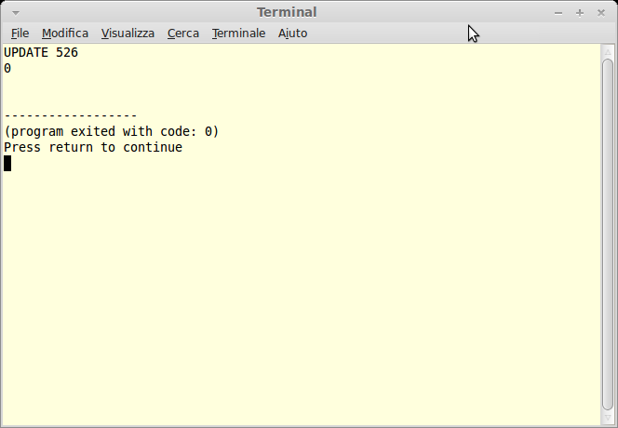
SCRIPT PSQL E SQL EXISTS TIME: 0

Slide 18
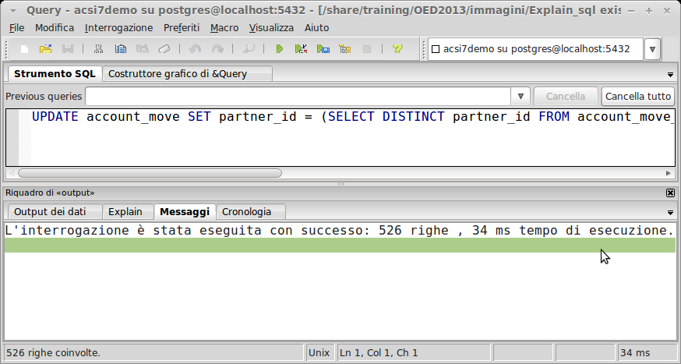
PSQL E SQL EXISTS TIME: 0,034

Slide 19
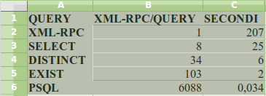
ANALISI PRESTAZIONALE

Slide 20
XML-RPC VS PSYCOPG2
XML-RPC VANTAGGI:
SICUREZZA
CONTROLLO ORM OPENERP
UTILIZZO “Etichette” CAMPI
PSYCOPG2 VANTAGGI:
VELOCITA'
UTILIZZO SQL STANDARD
PORTABILITA' QUERY

Slide 21
RINGRAZIAMENTI
Associazione OpenERP Italia
http://www.openerp-italia.org
2013.openerpday.it
Italian PostgreSQL Users Group
http://www.itpug.org
2013.pgday.it

Slide 22
Q&A
CONTATTI
piero.cecchi@gmail.com
software@cecchi.com
https://github.com/cecchip/OpenERP2013.git

