Slide 1
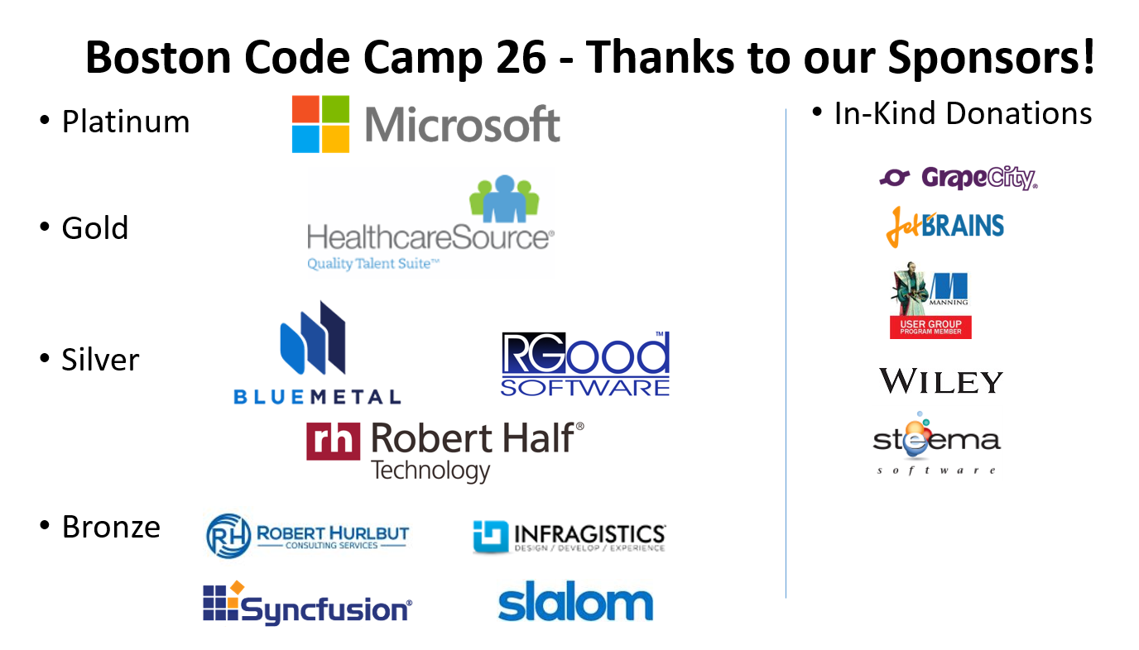

Slide 2

Application Insights
Jeremy Hutchinson
@hutchcodes

Slide 3
Jeremy Hutchinson
Contact
jrhutch@live.com
Blog
hutchcodes.net
Twitter
@hutchcodes

Slide 4
Application Insights
Jeremy Hutchinson
@hutchcodes

Slide 5
Building successful apps is hard
Notes:
Building functionality is fairly easy
But it’s difficult to create a successful application
Many obstacles, but one of the biggest is…

Slide 6
Building successful apps is hard
Competition is fierce
Getting and keeping customers requires constant improvement
Notes:
Need to be constantly improving (features and bugs) If you’re not already a market leader you need to roll out features to catch up If you’re already successful you need to stay ahead of the up and comers

Slide 7
Building successful apps is hard
Competition is fierce
Getting and keeping customers requires constant improvement
Continuous delivery is here to stay
Companies deploy monthly, weekly, daily, hourly
Notes:
Continuous delivery helps is a blessing and a curse
Let’s you react quickly with bug fixes, new features for customer requests, and refinement of features
Continuous delivery can make testing more challenging
Bugs – functions and performance

Slide 8
undefined is not a function
Notes:
How many of your users are seeing those bugs before you know about them?
Did something cause the user’s dashboard to load 500% slower?
Is there an exception occurring on the server affect 1-5% of users that isn’t being reported?
Is there a JavaScript error on the page?

Slide 9
You can’t manage what you can’t measure
Notes:
Boils down to knowing what is happing with your live application can make or break your customer’s experience.

Slide 10
Reactive vs Proactive
Notes:
“Hmmm, that shouldn’t be happening can you try…”
vs
“We’re currently working on a fix, but for now the workaround is…”

Slide 11
We know why we need monitor, but how?
Notes:
multiple services
Availability
Exceptions and diagnostics
usage events and conversion metrics?
How can you see if exceptions are affecting conversions?

Slide 12



Notes:
Cobbling something together might work if your architecture looks like this

Slide 13




Notes:
A lot harder to cobble it together when it looks like this

Slide 14
Application Insights
Jeremy Hutchinson
@hutchcodes
Notes:
The answer is of course Application Insights

Slide 15
Notes:
Application insights can monitor web and Api servers, mobile apps, browser apps, desktop apps
In addition it can give insight into how your dependencies are performing.

Slide 16
Available
Are we functioning?
Performing
How is performance?
What errors are happening?
Succeeding
What features are being used?
What is coming next?
Notes:
Application Performance Management
Trying to answer 3 questions

Slide 17
Installing Application Insights

Slide 18
Notes:
Installing Application Insights – New
In the new project dialog check the Add Application Insights
Can configure the Resource Group/App Insights name
or select an existing App Insights

Slide 19
Installing Application Insights

Slide 20
Notes:
Installing Application Insights – Existing
Right click on project and Add Application Insights
Select an existing App Insights or Configure a new one

Slide 21
Installing Application Insights
Notes:
Packages for Node, PHP, Python etc

Slide 22
Notes:
For new projects it automatically adds the javascript to report Client Side info
For existing projects you can copy/past the JS from the Portal
Stick it in your main layout

Slide 23
Installing Application Insights
Notes:
Also clients monitoring for Andriod, iPhone, Windows Phone and Desktop A lot out of box, might still want custom events/metrics

Slide 24
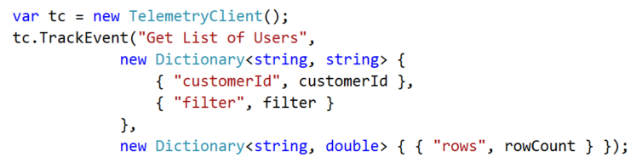
Custom Events

Slide 25
Installing Application Insights

Slide 26

Custom Metrics
Notes:
eCommerce site might want to track order amount
If it drops off after a release something is wrong

Slide 27
Demos bit.ly/boscc26
Notes:
By the time you read this that link will be dead ☹

Slide 28
Available
Are we functioning?
Performing
How is performance?
What errors are happening?
Succeeding
What features are being used?
What is coming next?
Notes:
Application Performance Management
Trying to answer 3 questions

Slide 29
Smart Detection
Failure Anomalies
Performance Anomalies
Azure Cloud Service Issues
Notes:
https://docs.microsoft.com/en-us/azure/application-insights/app-insights-proactive-diagnostics

Slide 31
Jeremy Hutchinson
Email - jrhutch@live.com
Blog - hutchcodes.net
Twitter - @hutchcodes

