Slide 1

Final Project Cohort 11

Slide 2
objective
Web platform created in order to support and Software developmet in different projects
Our purpose is to have a Nework of developers where anyone can upload their own projects.

Slide 3
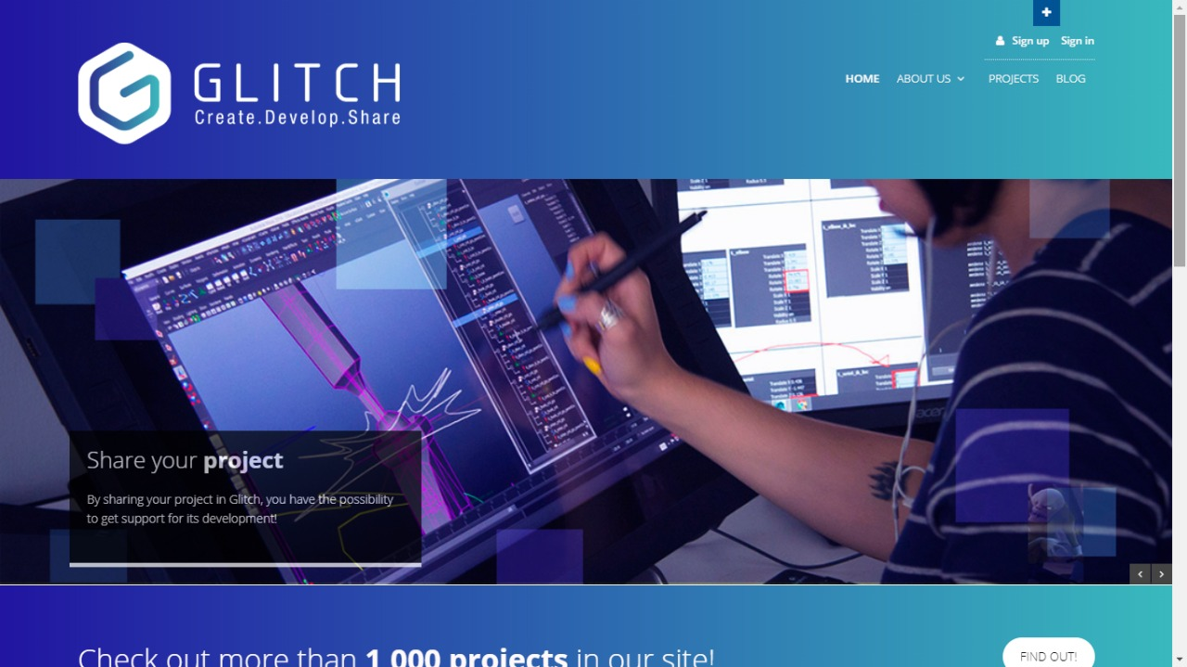
HOme

Slide 4
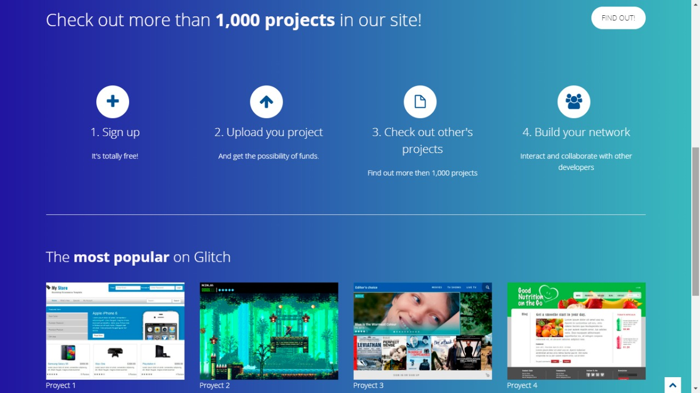
home

Slide 5
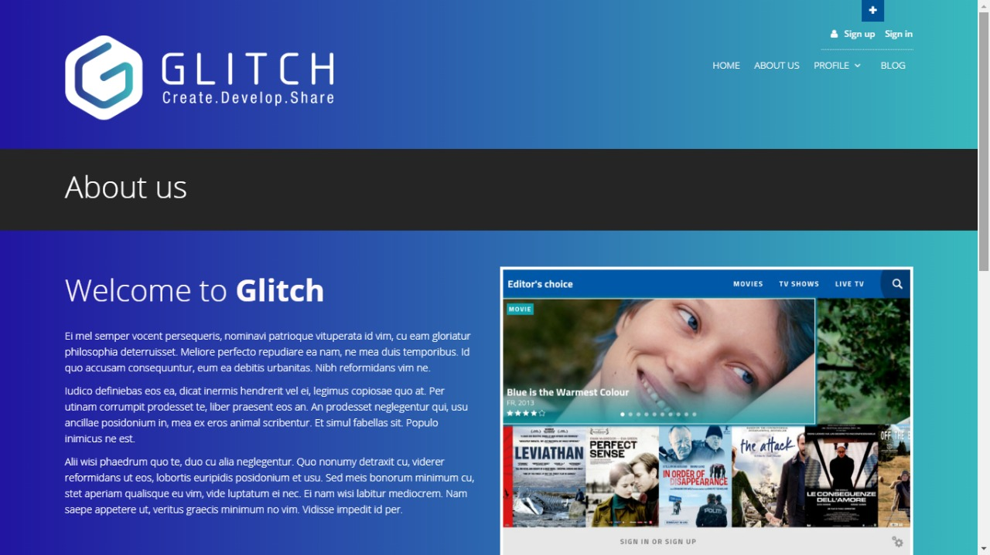
About Us

Slide 6
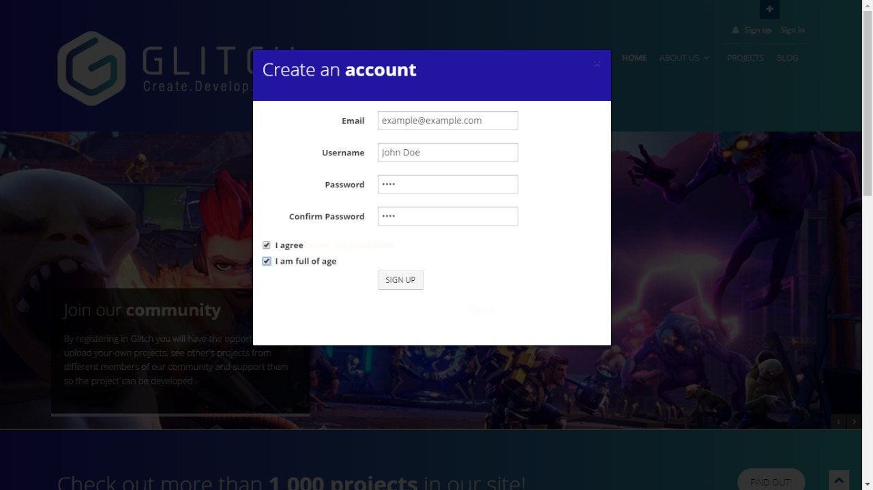
Sign up

Slide 7
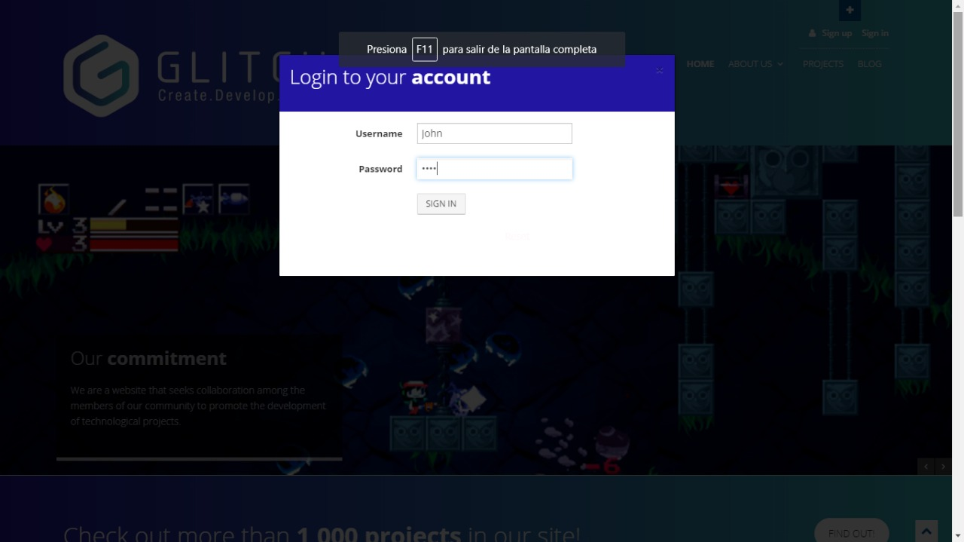
Log In

Slide 8
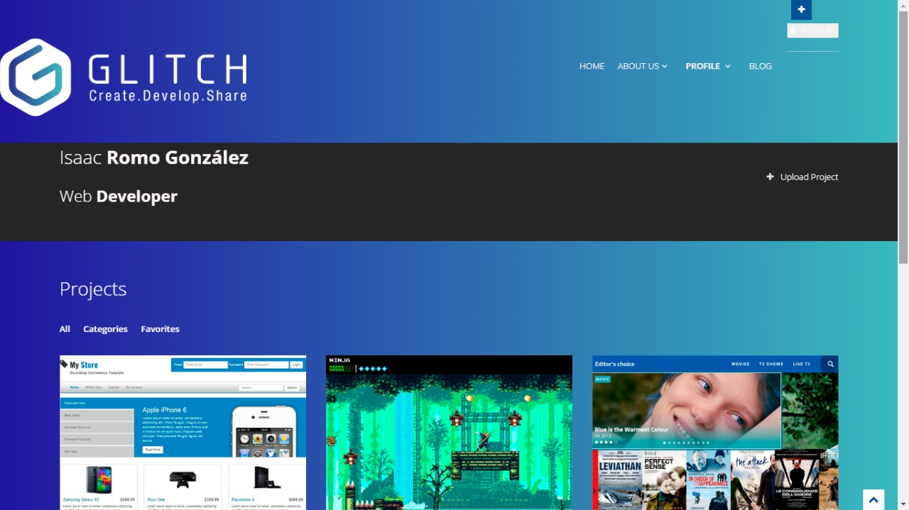
profile

Slide 9
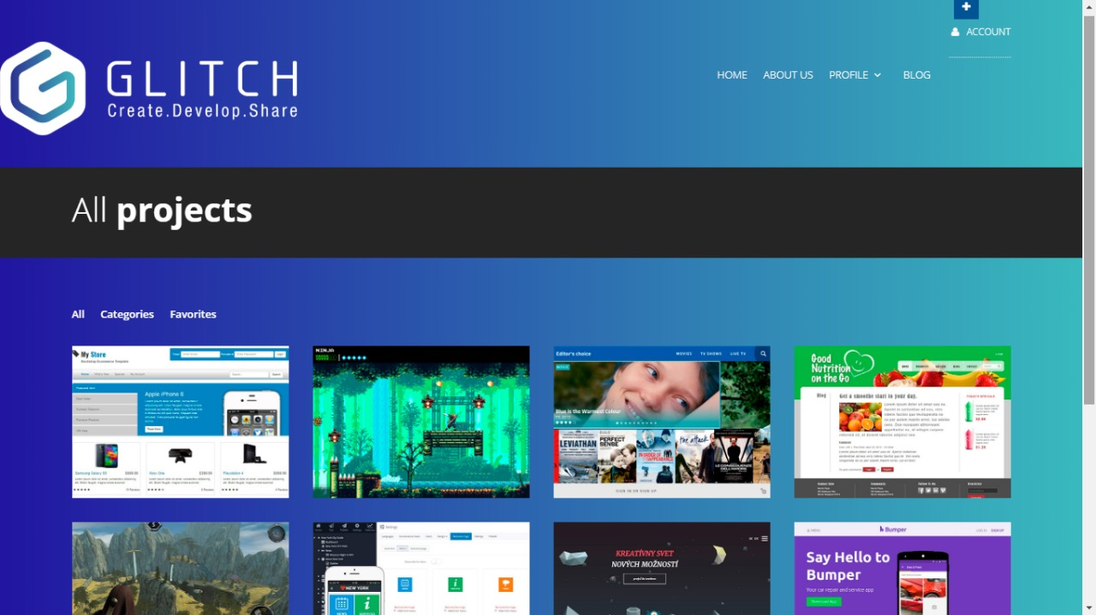
projects

Slide 10
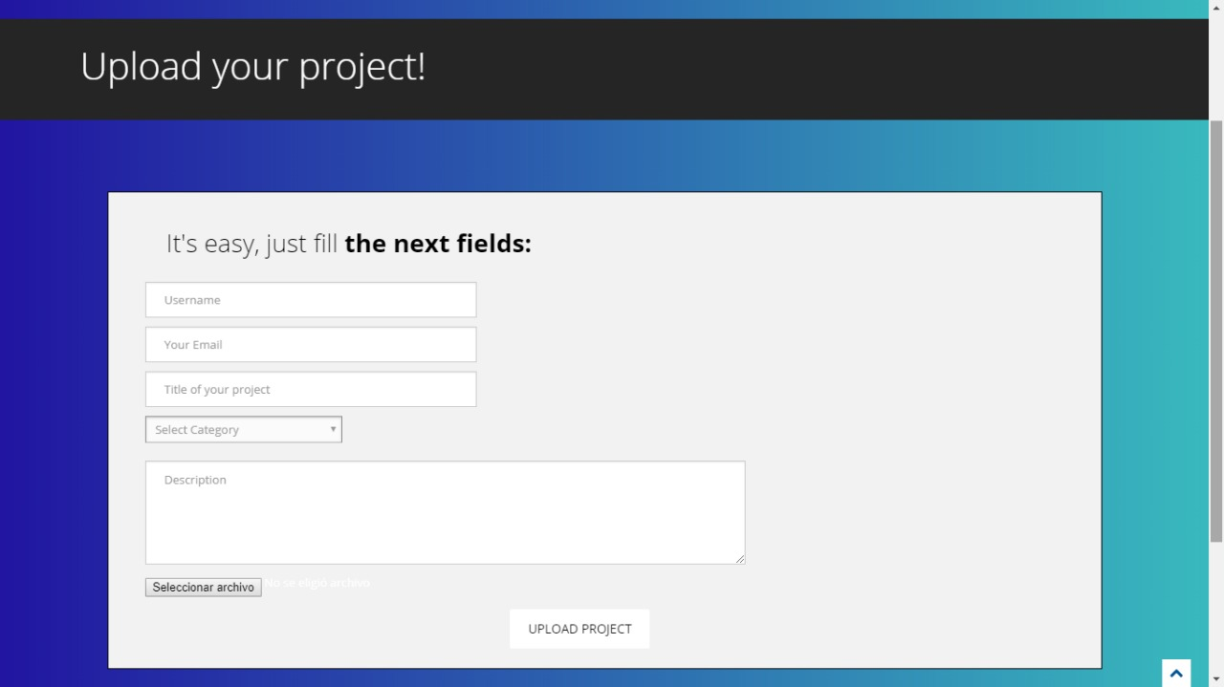
Upload Project

Slide 11
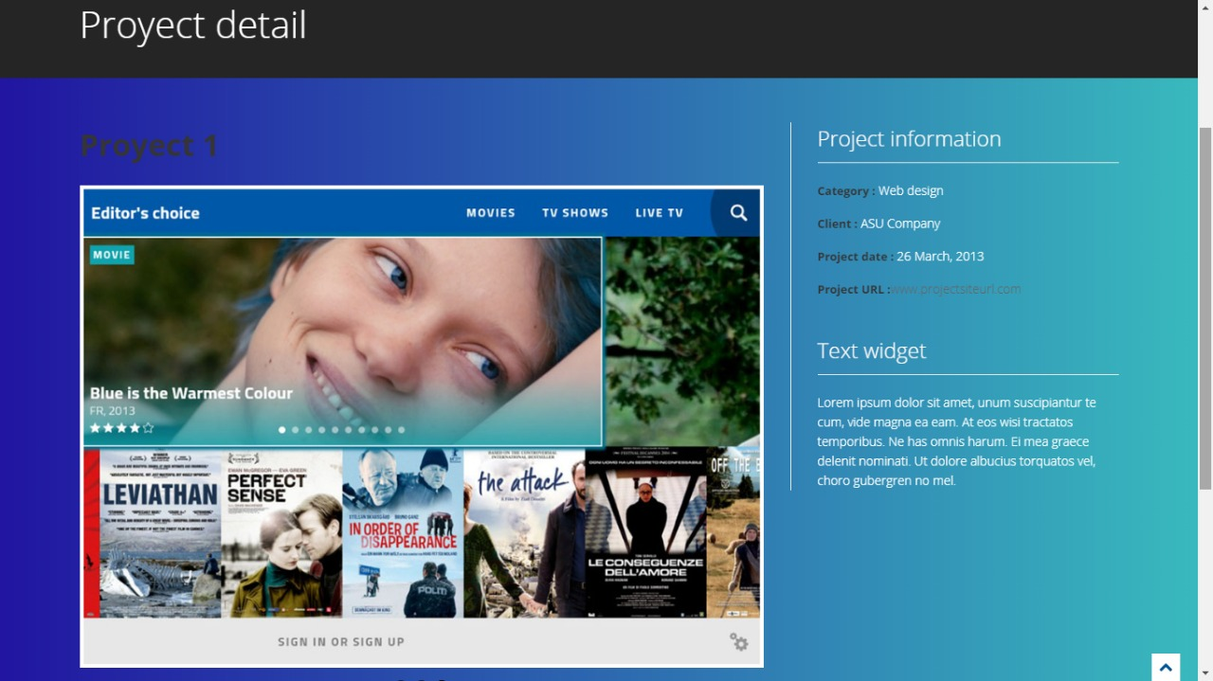
Project Detail

