Slide 1
Civilian Code Conservation Corps:
Free software for governments of all sizes

Slide 2

Cecilia Donnelly
Open Source Specialist at Open Tech Strategies
Chicago → Minneapolis
@cecilia_cmd

Slide 3
Outline
Governments should use free software
Obstacles in their way
Current state of affairs

Slide 4

Disclaimers
Focused on USA
Based on my experience
Open source

Slide 5
Why should we care?

Slide 6
“The mission of the state is to organize society for the freedom and well-being of the people. […] The state needs to insist on free software in its own computing for the sake of its computational sovereignty (the state’s control over its own computing). All users deserve control over their computing, but the state has a responsibility to the people to maintain control over the computing it does on their behalf.”
  Richard M. Stallman, “Free Software, Free Society”

Slide 7
Control

Slide 8
Is software public infrastructure or a public resource?

Slide 9
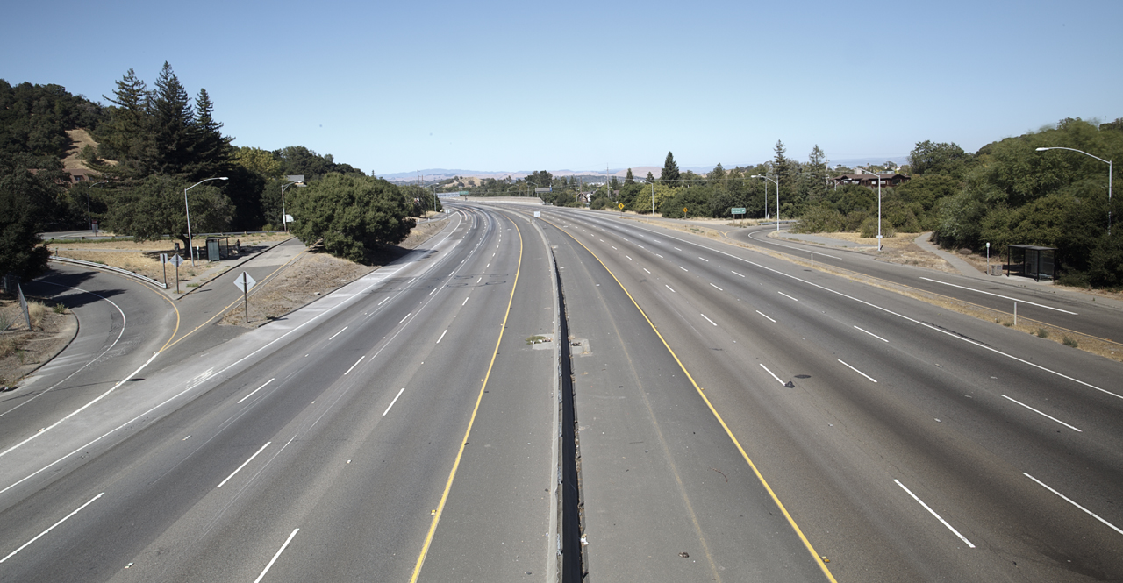
Software as infrastructure
Infrastructure: “The basic physical and organizational structures and facilities (e.g. buildings, roads, power supplies) needed for the operation of a society or enterprise.” (Oxford American Dictionary)
Image courtesy of scot63us on Flickr (CC BY-NC-ND 2.0)
Notes:
Pic source: https://www.flickr.com/photos/scottummy/4971054099/

Slide 10

Software as public resource
Once a government builds a piece of software, it becomes a national resource

Slide 11
Forest Service Multiple Use Mandate
“[…] it is the policy of the Congress that the national forests are established and shall be administered for outdoor recreation, range, timber, watershed, and wildlife and fish purposes.”
- Multiple-Use Sustained Yield Act of 1960

Slide 12
Software is infinitely replicable
(at zero marginal cost)

Slide 13
Free software is both infrastructure and a resource

Slide 14
Because software is infrastructure that can be used like a resource, the government has a duty to make it available to us

Slide 15
If you’re not convinced...

Slide 16
Open tools are more effective
Greater control
Reduced lock-in
Transparency and trust
Efficiency

Slide 17
Improved interoperability yields better public service
State of Georgia’s OpenHMIS (Homeless Management Information Systems) API
Reduces data entry burden on service providers

Slide 18
Free software helps other governments

Slide 19
Federal assistance administered by states
CBO: “17 percent of federal outlays and a quarter of spending by states and localities” is in grants from the federal government to states (as of 2011)
Half of this is Medicaid
Notes:
https://www.cbo.gov/publication/43967

Slide 20
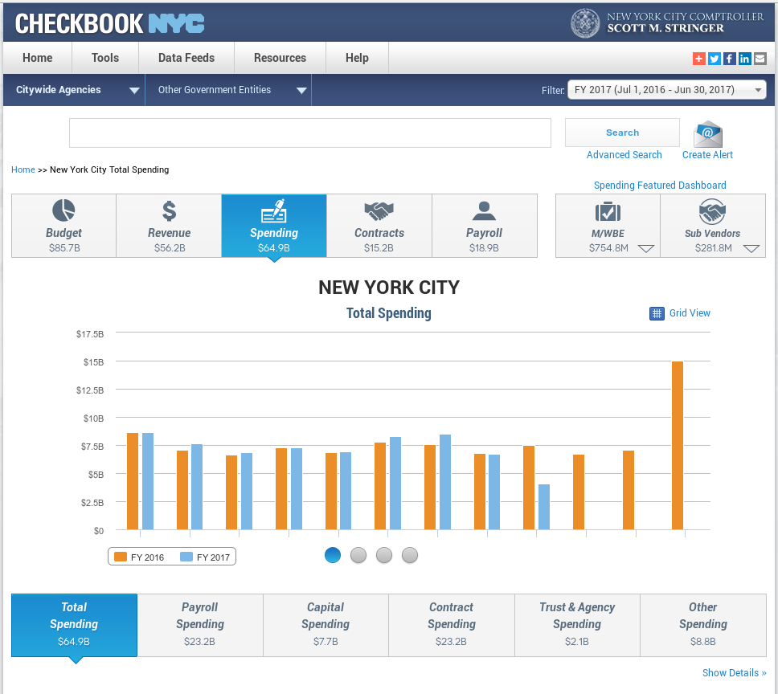
City to City sharing

Slide 21
Ok, you’re convinced

Slide 22
Why aren’t all government software projects free software?

Slide 23
Fear
“Government agencies tend to be unusually risk-averse. Somewhere at the top there's an elected official who, reasonably, sees an open source project as just one more surface area for opponents to attack.”
  Karl Fogel, “Producing Open Source Software”

Slide 24
Security

Slide 25

But who will help me support the system?

Slide 26

Vendors
Inexperienced with free software
Wary of increased competition
Image courtesy of 401kcalculator.org (CC BY-SA 2.0)
Notes:
https://www.flickr.com/photos/68751915@N05/6355318323

Slide 27
Where are we now?

Slide 28
Current events
Checkbook has been re-deployed in Texas
Medicaid “90/10” rule from early 2016
  Defines “open source”
  “(20) Systems and MMIS modules developed, installed or improved with 90 percent match must include documentation of components and procedures such that the systems could be operated by a variety of contractors or other users."

Slide 29
Open Gov Foundation and Chicago City Clerk’s Office
Digitizing City Council procedures
Building an open legislative operating system that can be adapted to the needs of other cities

Slide 30
Governments have a responsibility to free their software resources

Slide 31
More resources
Government and free software:
  www.dwheeler.com/
  ben.balter.com/2015/11/23/why-open-source/
  code.gov/
  18f.gsa.gov/
Projects and regulations mentioned in this talk:
  checkbooknyc.com
  www.federalregister.gov/documents/2015/12/04/2015-30591/medicaid-program-mechanized-claims-processing-and-information-retrieval-systems-9010
  opengovfoundation.org/

Slide 32
Thank you! Questions?

