Slide 1
Labmon
Cecilia Agosta – 1850965
Stella Condrò – 1906886
Valerio Liberati – 1849590

Slide 2
Labmon is a monster collector browser game, in which players can collect creatures by attempting captures during unique encounters. The encounter generation and rarity of the encounter is time-based, rewarding the player’s patience with better monsters. Players can earn in-game currency by catching monsters, completing collections, and sharding duplicates.
Our aim with the app is to encourage users to work from their laptop while also taking time to rest from their activities. Less interaction means better rewards in terms of monster rarity, while still having something to look forward to when taking a break.
What is Labmon?

Slide 3
Key Features
Login and authentication
User profile management
Encounter generation and monster capture for players
Updating of game data for administrators
In-game timer for keeping track of time

Slide 4
User stories and Mock Up

Slide 5
Authentication
1. As a Player, I want to register in the site, so that I can access the system
2. As a Player, I want to login in the site, so that I can use the system
3. As a Player, I want to not put my credentials in the site every time a reload the site, so that I can use the site
4. As a Player, I want to logout, so that no one else can use my account
5. As a Player, I want to access my account, so that I can edit my personal information
6. As a Player, I want to access my account, so that I can delete my personal information
7. As an Admin, I want to login in the site, so that I can manage the system
8. As an Admin, I want to not put my credentials in the site every time a reload the site, so that I can use the site
9. As an Admin, I want to logout, so that no one else can use my account
10. As an Admin, I want to access my account, so that I can edit my personal information
11. As an Admin, I want to access my account, so that I can delete my personal information
12. As an Admin, I want a secure dashboard, so that only authorized admins can manage content

Slide 6
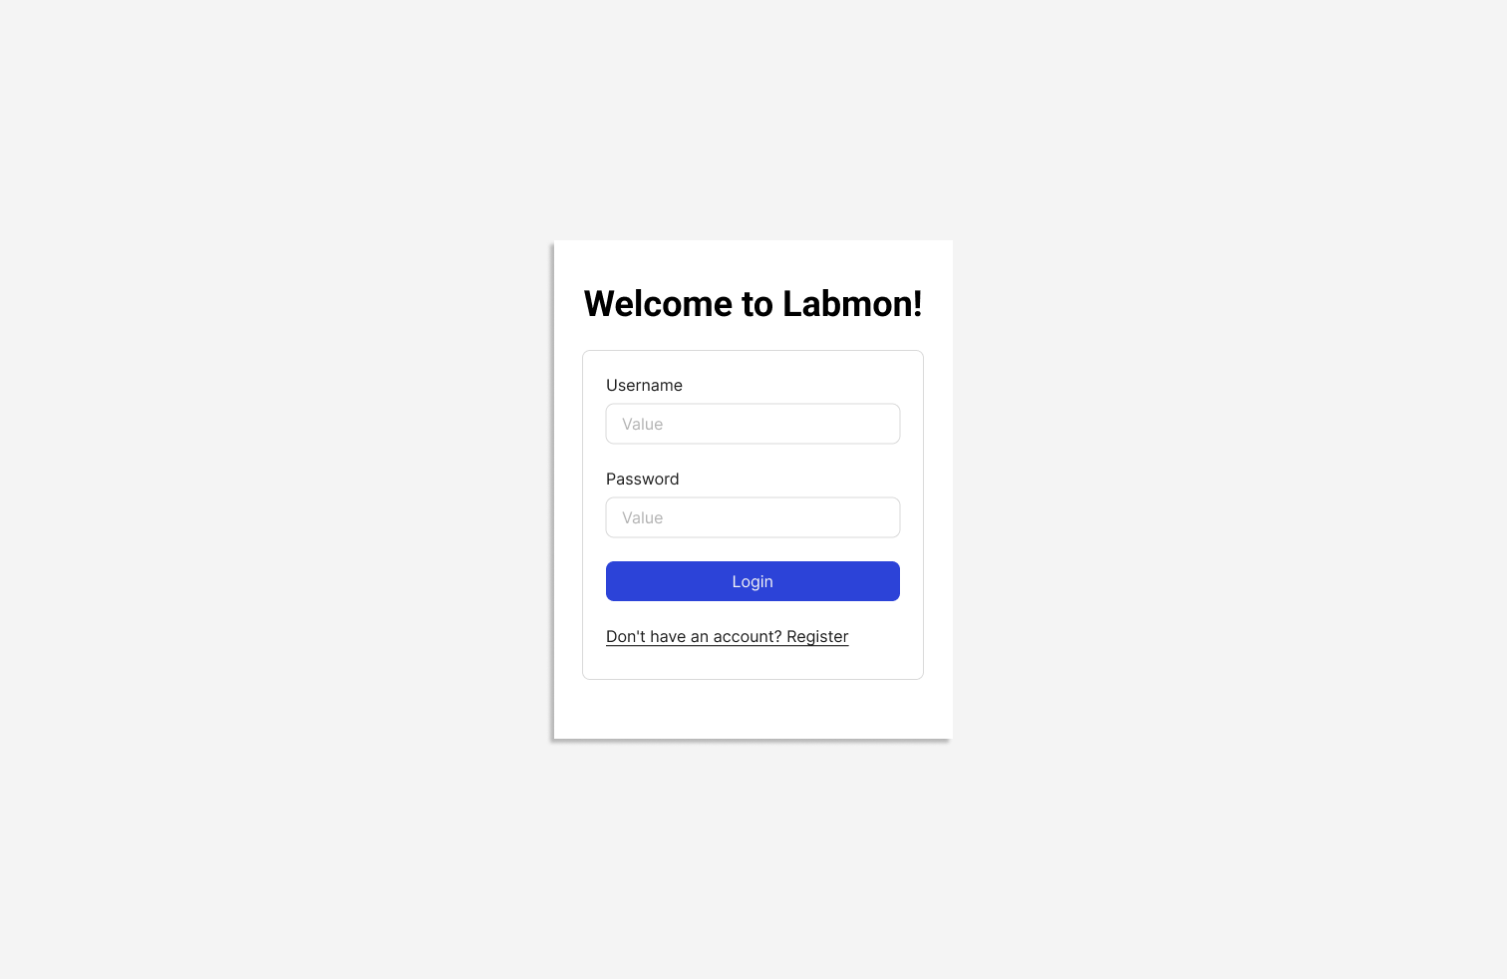
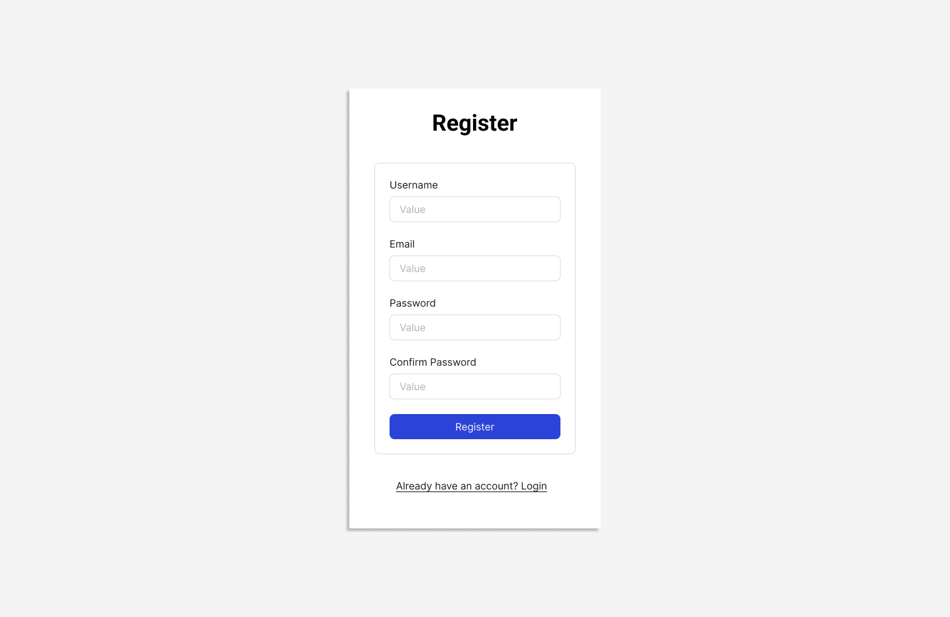
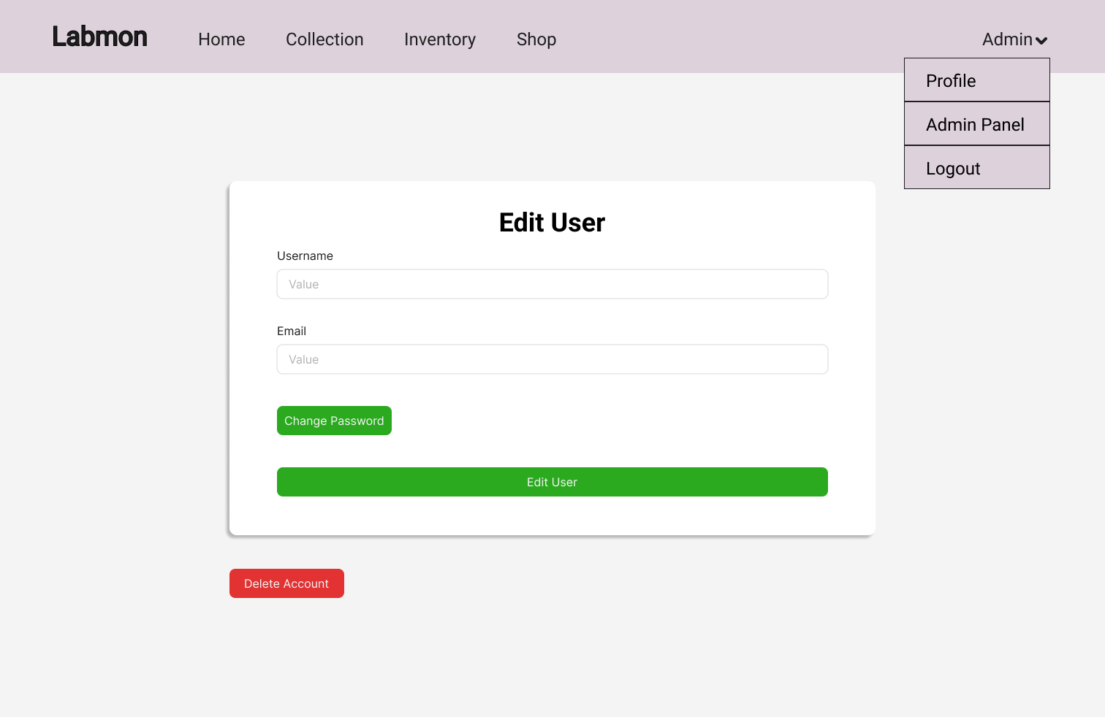
Authentication

Slide 7
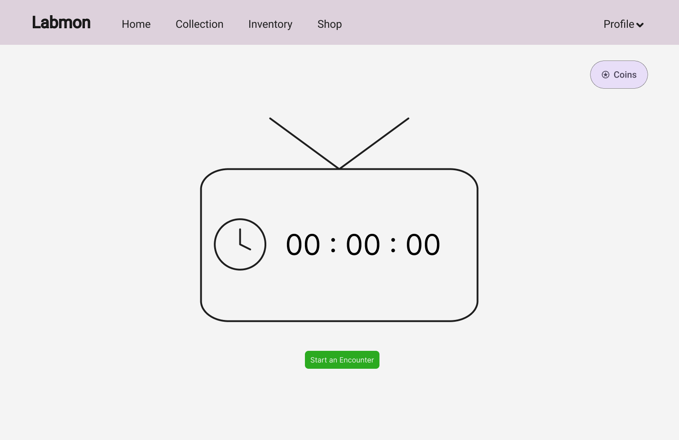
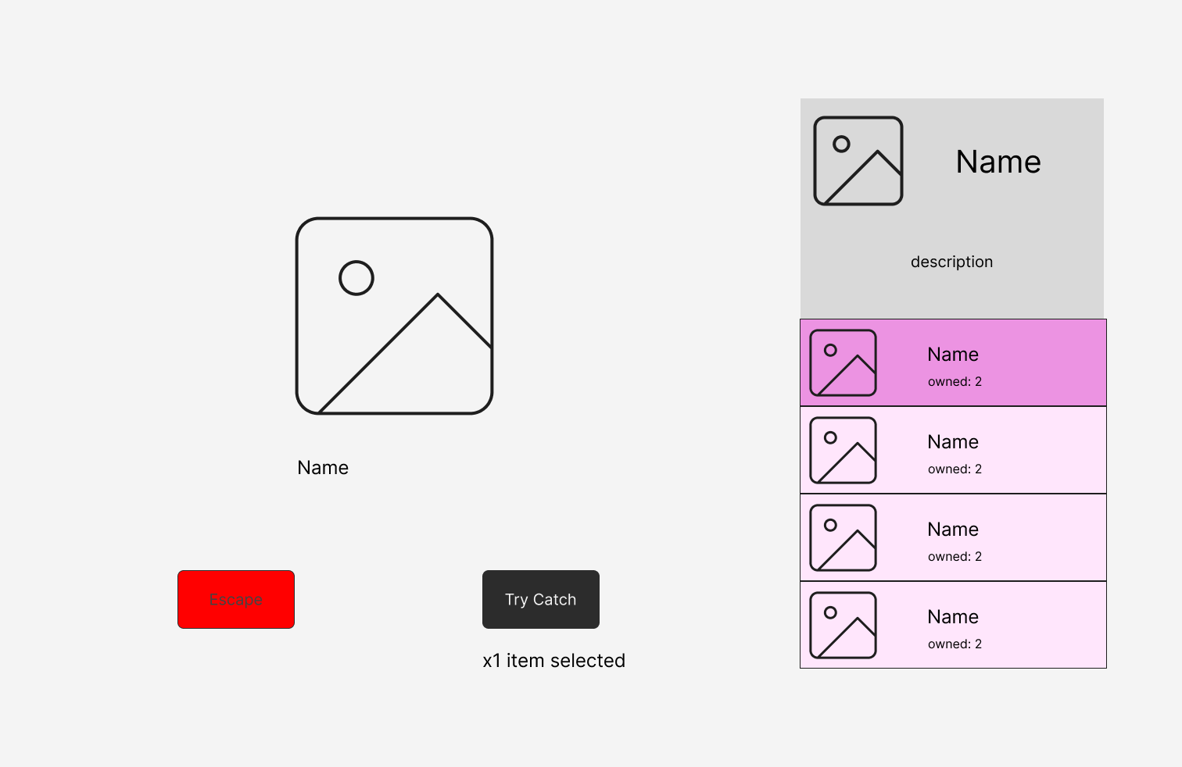
Encounter
13. As a Player, I want to generate an encounter with a monster, so that I can try to catch it
14. As a Player, I want to try to catch a monster, so that I can add it to my collection
15. As a Player, I want to use my items in an encounter, so that I can increase my chances of capturing the monster
16. As a Player, I want to see how much time has passed from the last encounter, so that I can choose the best moment to trigger a rare encounter

Slide 8
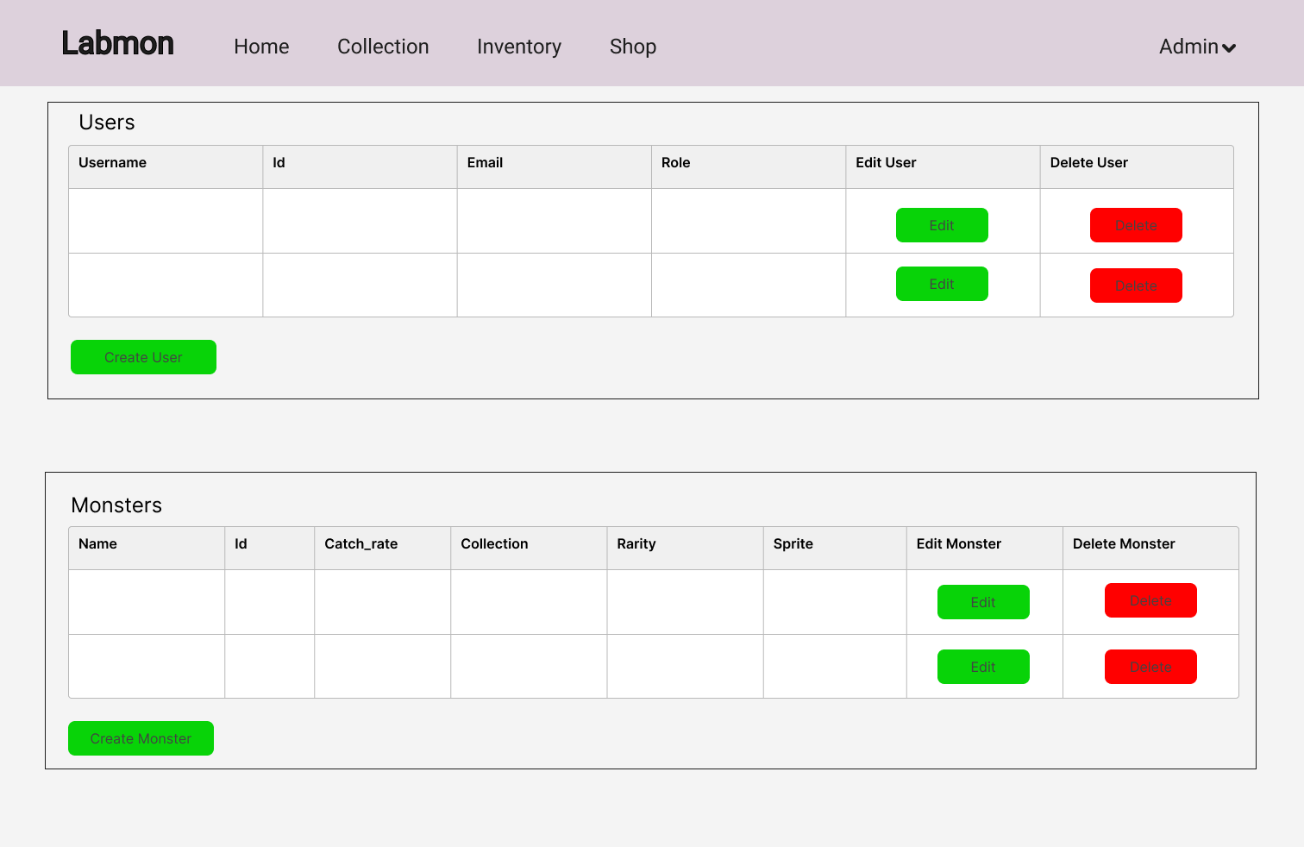
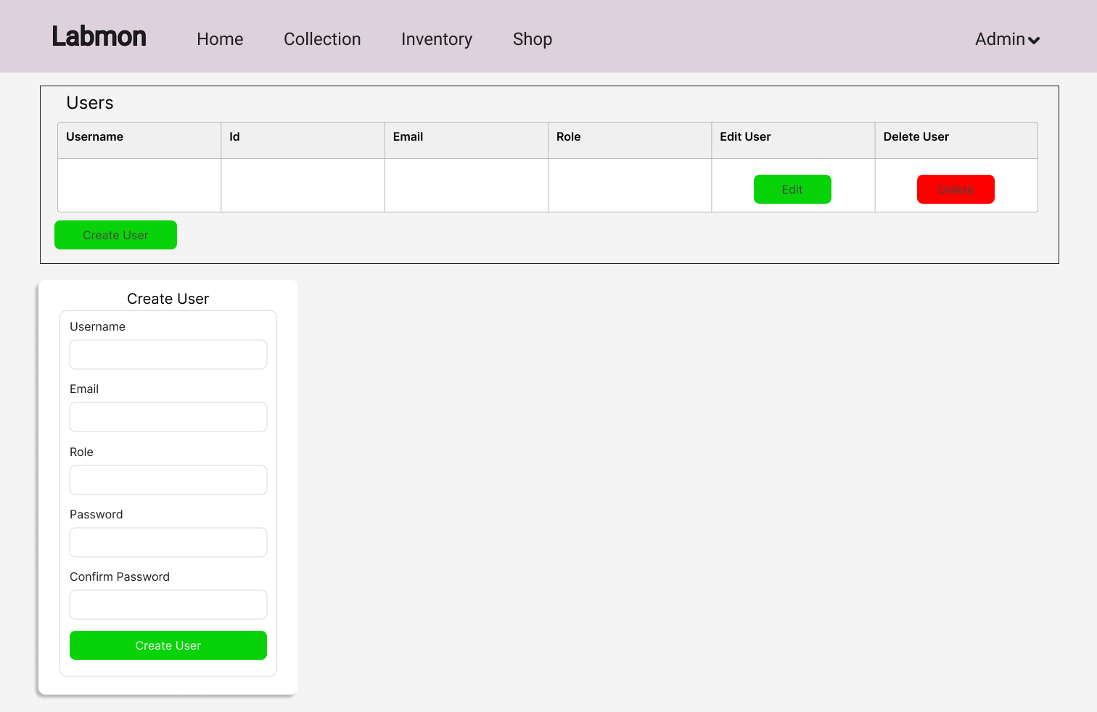
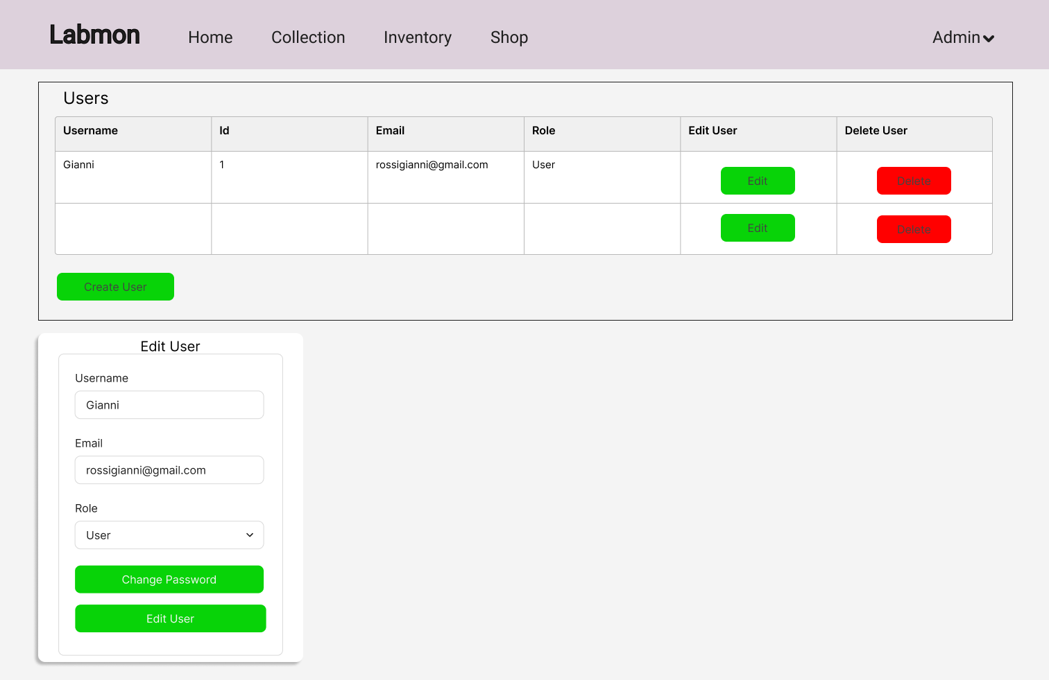
Admin Page
17. As an Admin, I want to see all users' accounts, so that I can have a clear view of the people in the system
18. As an Admin, I want to edit users' accounts, so that I can help users in managing their personal information
19. As an Admin, I want to delete users' accounts, so that I can remove malicious users from the system
20. As an Admin, I want to create new users, so that I can add new admins or users to the system

Slide 9
Admin Page
21. As an Admin, I want to access monsters' information, so that I can have a clear view of monsters in the system
22. As an Admin, I want to edit monsters' information, so that I can better balance the game
23. As an Admin, I want to delete monsters' information, so that I can remove obsolete creatures from the system
24. As an Admin, I want to create new monsters, so that I can add more creatures for the players
25. As an Admin, I want to access items' information, so that I can have a clear view of items in the system
26. As an Admin, I want to edit items' information, so that I can better balance the game
27. As an Admin, I want to delete items' information, so that I can remove obsolete items from the system
28. As an Admin, I want to create new items, so that I can add more items for the players

Slide 10
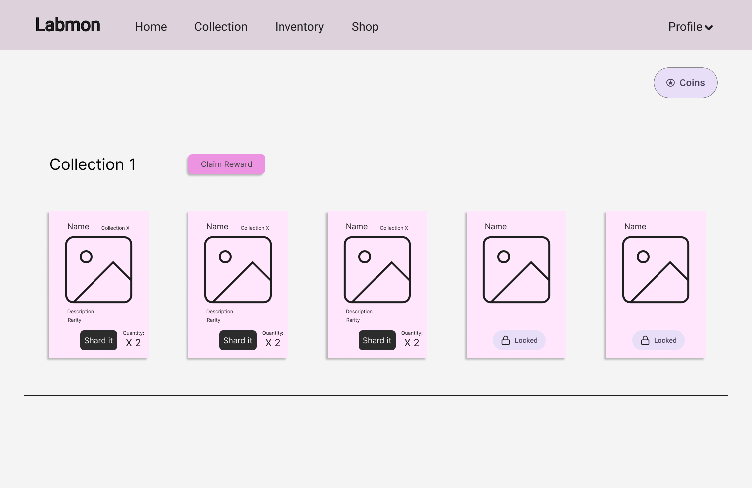
Monster Collection
29. As a Player, I want to sell (shard) monsters, so that I can gain in-game currency
30. As a Player, I want to view my collection of monsters, so that I can track my progress
31. As a Player, I want to see which creatures I’m missing in a collection, so that I know what to aim for
32. As a Player, I want to receive a reward (in-game currency) for completing a collection, so that my effort feels meaningful
33. As a Player, I want duplicates to be clearly marked in my collection, so that I know what can be safely “sharded”

Slide 11
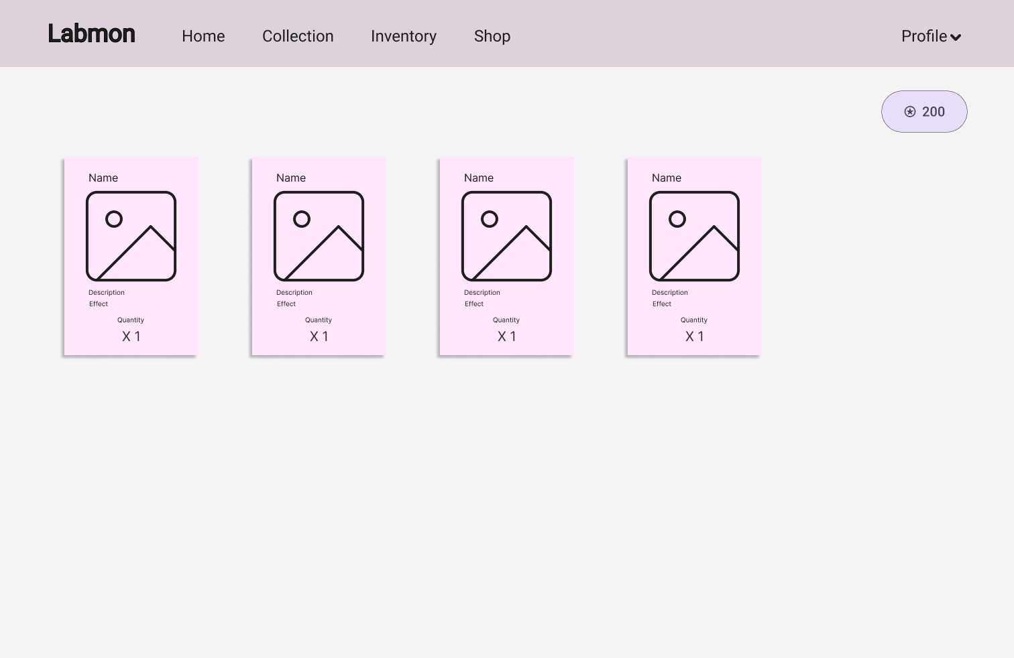
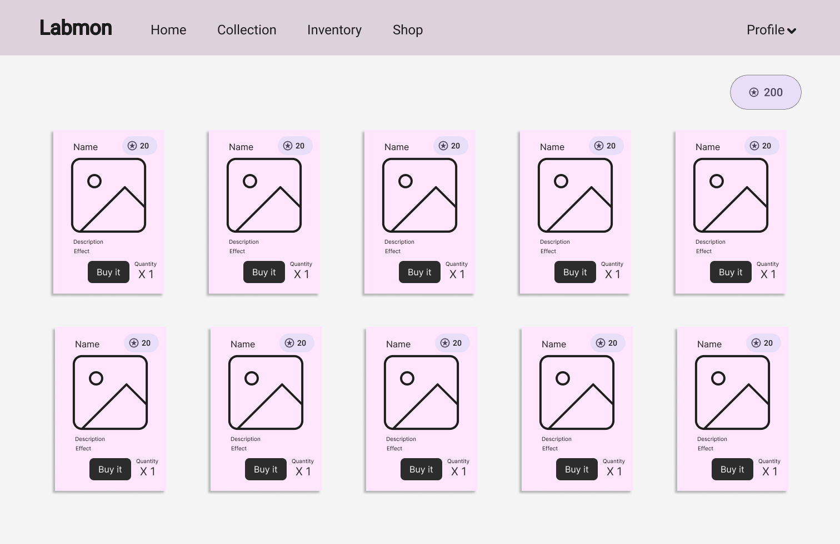
Inventory, Shop and Statistics
34. As a Player, I want to buy items with in-game currency, so that I can use them in an encounter
35. As a Player, I want to view my inventory, so that I can see what items I own
36. As a Player, I want the game to track capture statistics, so that I feel motivated to improve

Slide 12
Architecture

Slide 13
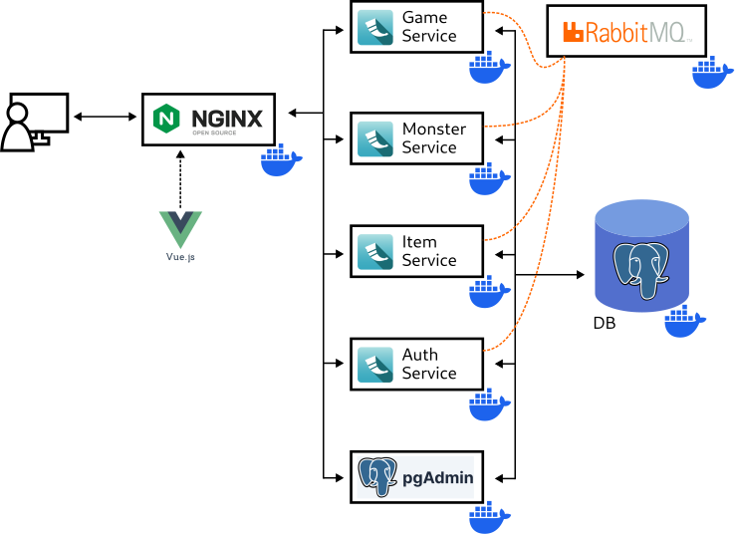
Architecture - System Architecture

Slide 14
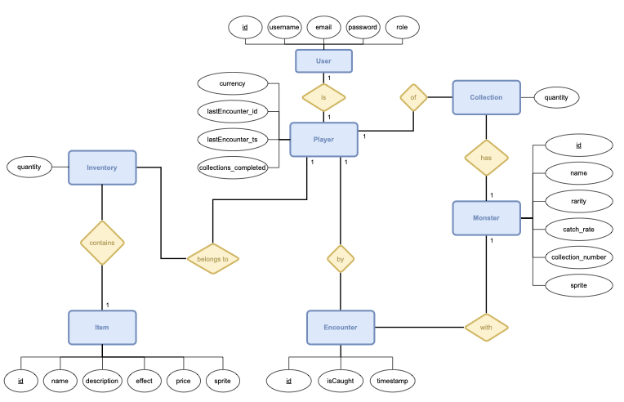
Architecture - ER diagram

Slide 15
Technologies
The app is distributed over different microservices, which are deployed using Docker:
Users service
Monsters service
Items service
Game service
Web server
We used PostgreSQL to manage the DB.
Python was chosen to write the backend, in order to keep things simple, and RabbitMQ was used to keep microservices updated asynchronously.
Vue and Javascript were used in the frontend, along with toolkits as Bootstrap, to create the UI.

Slide 16
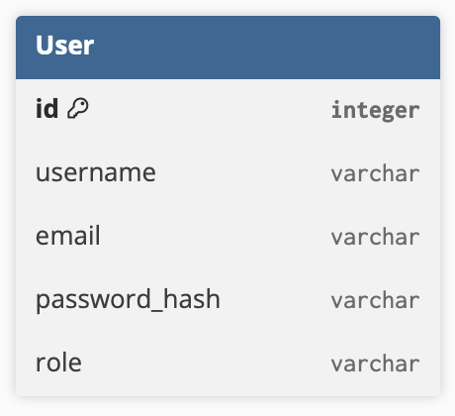
Auth service
The authentication service handles everything related to user account management, starting from registering new accounts and logging in, to updating account information or deleting accounts.
Authentication is managed using JWT tokens, and passwords are hashed before being saved, to guarantee privacy.

Slide 17
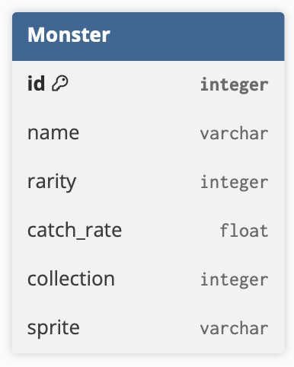
Monster service
The monster service handles everything related to managing the creatures in the game, in particular adding, editing and deleting data.
Authentication is used to separate admin routes from common user routes, to avoid players tampering with monster data.

Slide 18
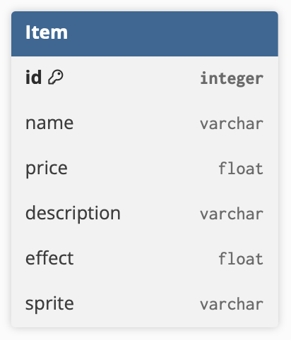
Item service
The item service handles everything related to managing the items in the game, in particular adding, editing and deleting data.
Authentication is used to separate admin routes from common user routes, to avoid players tampering with item data.

Slide 19
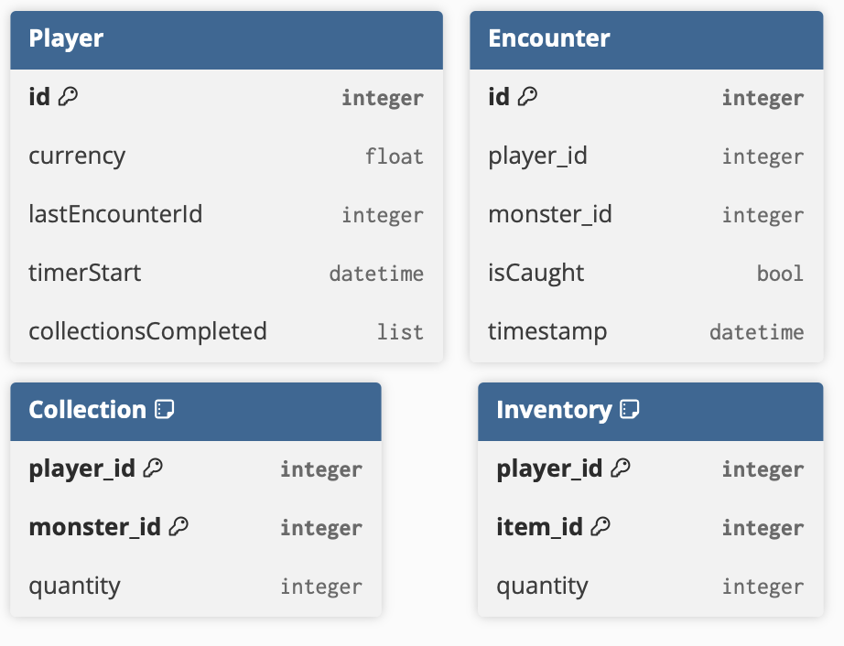
Game service
The game service handles everything related to the game-loop, from encounter generation to player collections.
It also manages all user data related to the game.

Slide 20
FP and COCOMO II

Slide 21
Function Points
We computed the function points after having defined the architecture of the system.
The VAF was computed considering the 14 GSCs.
The KLOC estimation was done assuming ⅓ of the code to be written in Python (backend), while ⅔ would be written in Vue + Javascript (frontend).
UFP = 97
AFP = 107.67
KLOC ≈ 4.7 KLOC

Slide 22
COCOMO II
Using the post-architectural model, we estimated an effort of ≈15 PM and a time to develop of ≈8 months, meaning a staffing of 2 people per month.
The scale factors were computed based on the official COCOMO II calibration table, which evaluates Precedentedness, Flexibility, Team Cohesion, Process Maturity, and Risk Resolution.
We actually were able to complete the project as a team of 3 people in 2 months.
This was mainly due to the fact that we fully parallelized tasks across sprints, and some of us had previous experience in parts of the work.

Slide 23
Sprint Planning

Slide 24
SPRINT 1
SPRINT 2
Requirements Definition and Analysis
Key tasks:
Requirements definition
User stories definition
Mock up
Architecture definition
Authentication Service Development
Key tasks:
DB configuration for Users
Login backend implementation
Login and Registration Pages
Admin Panel Page- User Management Section

Slide 25
SPRINT 3
SPRINT 4
Monster Service Development
Key tasks:
DB configuration for Monsters
Backend implementation
Admin Panel Page - Monster Management Section
Item Service Development
Key tasks:
DB configuration for Items
Backend implementation
Admin Panel Page- Item Management Section

Slide 26
SPRINT 5
SPRINT 6
Game Service Initialization
Key tasks:
DB configuration for Encounters
Partial game microservice implementation
Implementation of Inter-Service Communication
Home Page
Encounter Page
Game Service Development (Collection)
Key tasks:
DB configuration for Collection
Extending Game microservice (monster collection)
Collection page

Slide 27
SPRINT 7
SPRINT 8
Game Service Development (Inventory)
Key tasks:
DB configuration for Inventory
Extending Game microservice (inventory)
Inventory page
Game Service Development
(Statistics)
Key tasks:
DB configuration for Statistics
Extending Game microservice (statistics)
Statistics view

Slide 28
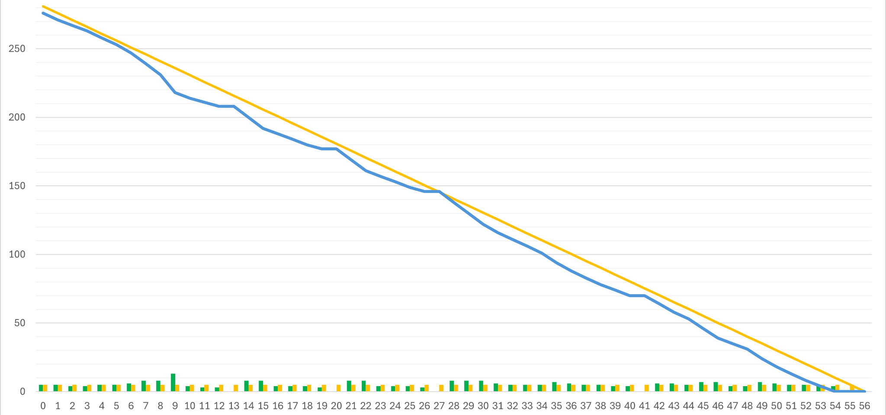
Burndown Chart

Slide 29
DEMO

