Slide 1

Analytics in Business Team Picking
Cecilia Cheung
Louise Fallon
Steven Locorotondo
Siow Meng Low
George Pastakas
Nikhita Venkatesan

Slide 2
Agenda
Methodology
Team Picks
Optimal Leaders
Optimal Members
Optimal Teams
Design Team
Lobby Team
Planning Team
Team Overview

Slide 3








Leader Criteria
TASK | Party Type | Strength | Advice | Flexibility | Friends
 | Expansive | Perceived creativity 0.40 | 0.275 | 0.275 | 0.05
 | Expansive / Exclusive | Perceived influence 0.40 | 0.275 | 0.275 | 0.05
 | Tight | Perceived implementation 0.35 | 0.35 | 0.20 | 0.10
Notes:
Friends – indegree of friendship network
Strength – perceived
Reason for different weight – more important people trust them (advice), less important that he is flexible (cohesion)

Slide 4


Team Criteria
TASK | Party Type | Strength | Network | Leader pick
 | Expansive > Exclusive > Tight 0.15 | Perceived creativity 0.55 | Leverage (Betweenness) 0.15 | 0.15
 | Exclusive or Expansive > Tight 0.15 | Perceived influence 0.35 | Importance (Eigenvector) 0.35 | 0.15
 | Tight > Exclusive > Expansive 0.15 | Perceived implementation skills 0.55 | Cohesion (Closeness) 0.15 | 0.15

Slide 5
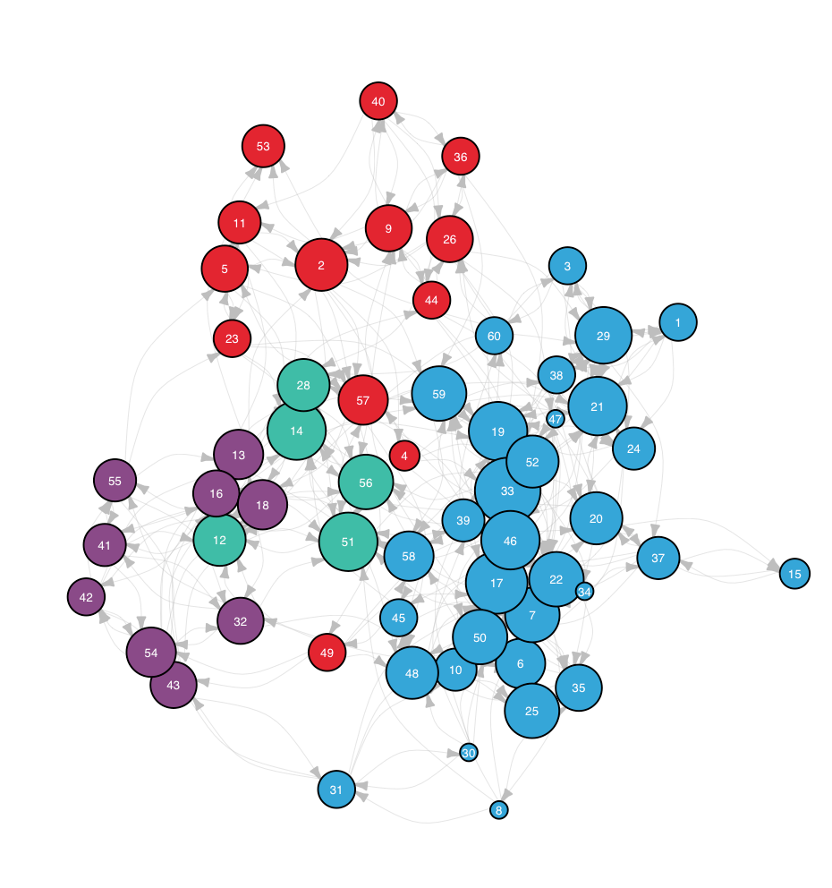
Teams and Communities
4 clusters identified within the network that match intuitive network dynamics
The larger cluster members often have more votes (most likely from within the cluster), but come at higher costs
To pick optimal teams, the following constraints are put into place:
Diversity: No more than 2 members per cluster
Diversity: No more than 2 members per cluster
More cohesion: No more than 3 members per cluster

Slide 6

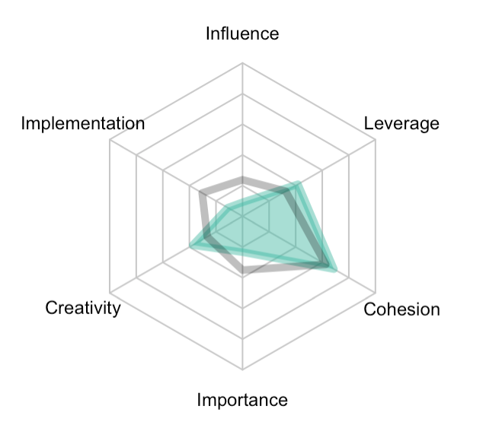
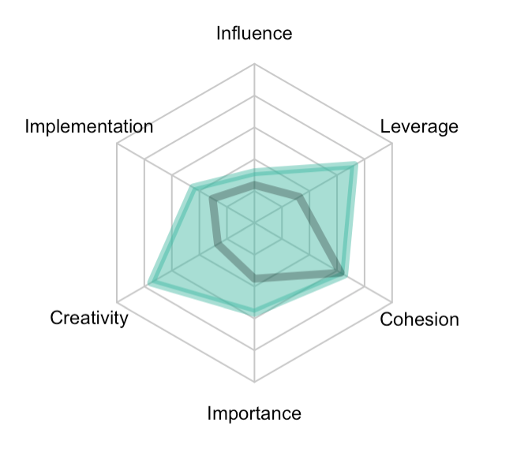
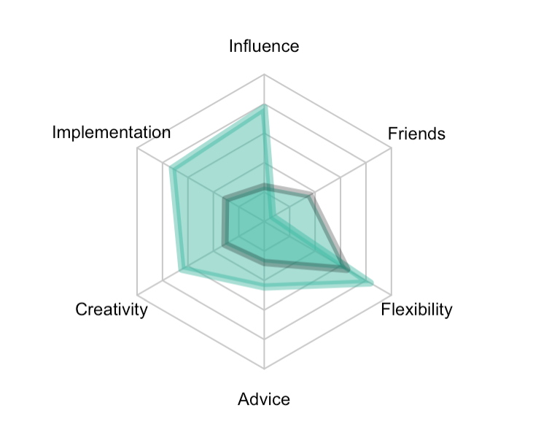
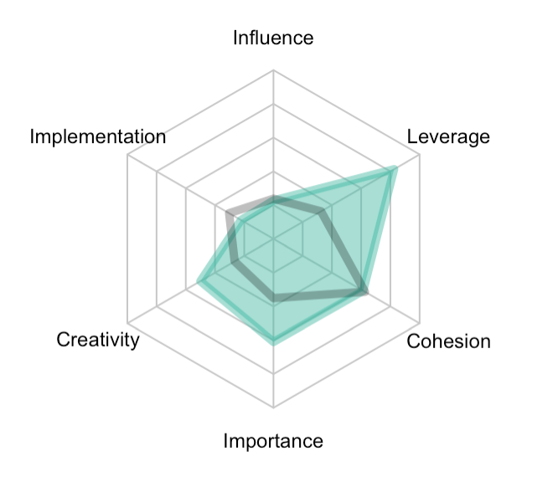
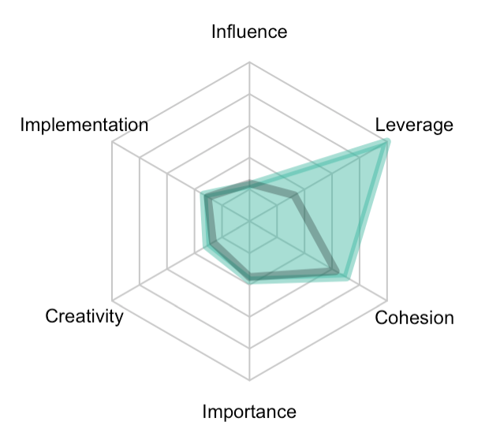
Design Team
id49
id50
id30
id51
id57

Slide 7

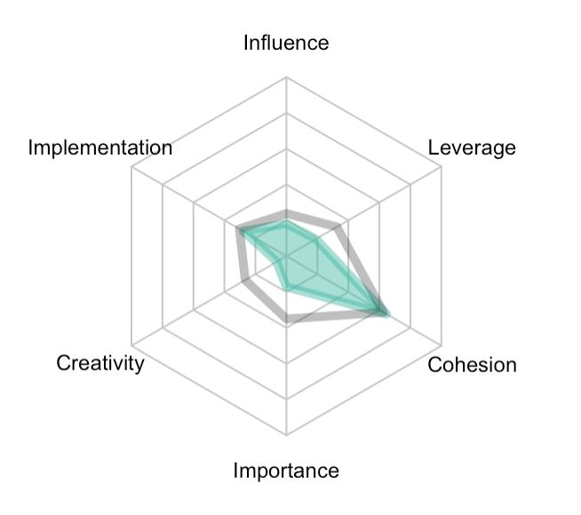
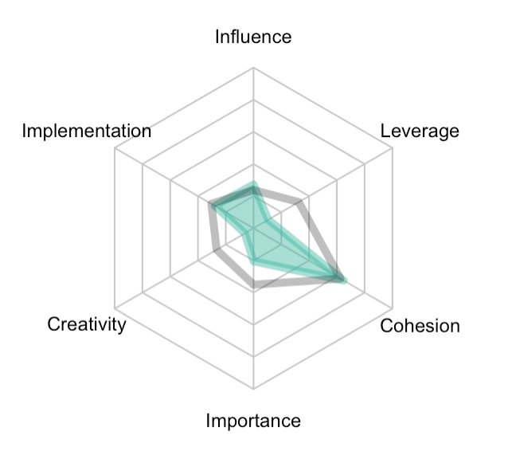
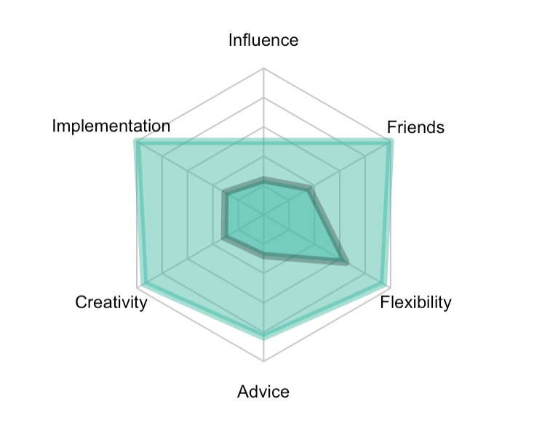
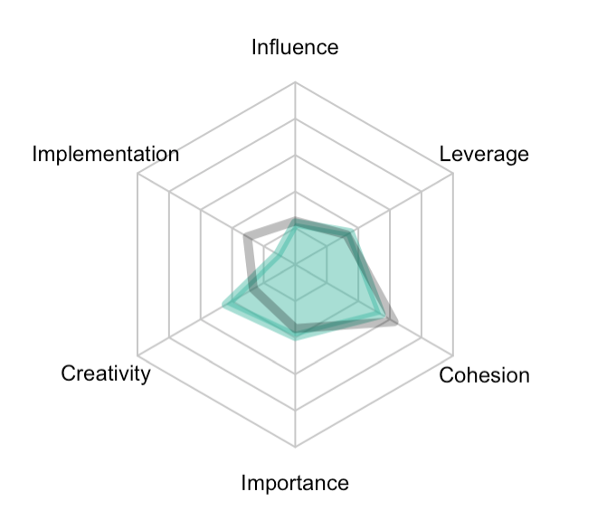
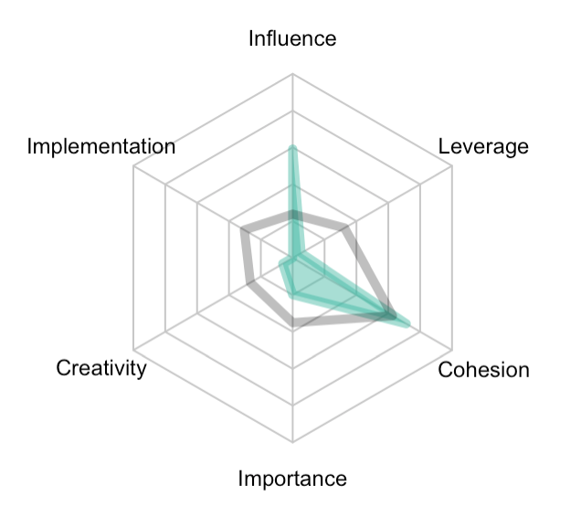
Lobbying Team
id11
id23
id33
id28
id34

Slide 8

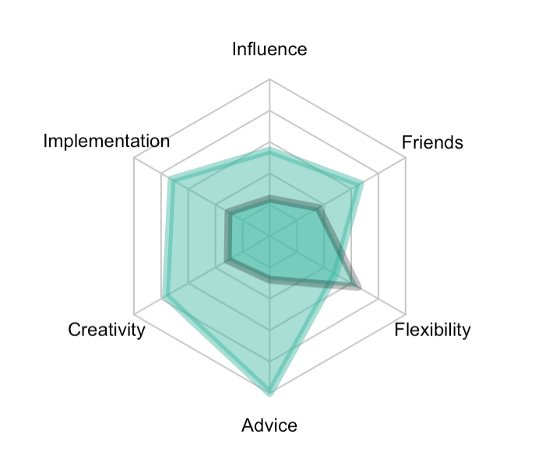
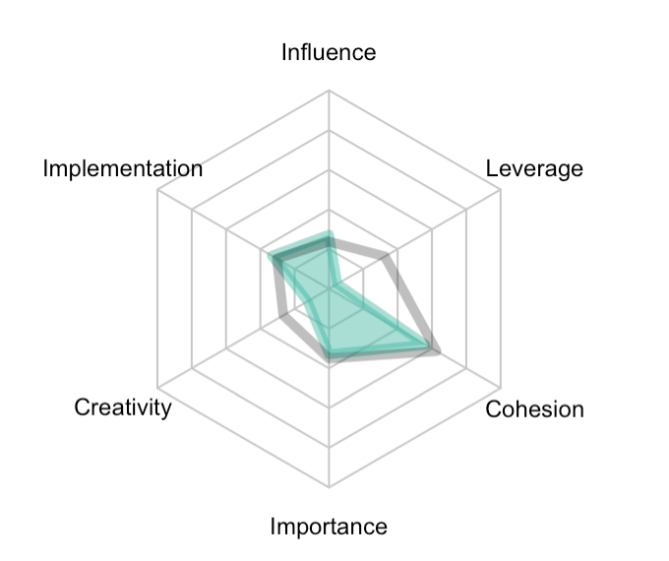
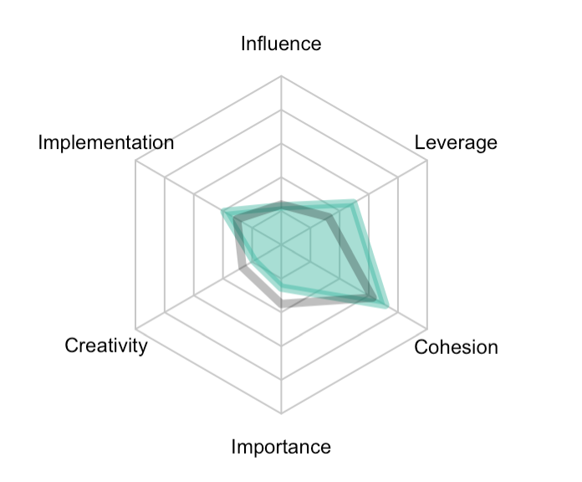
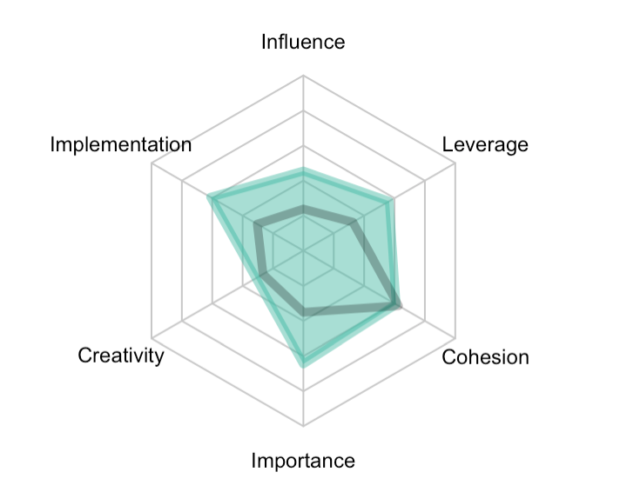
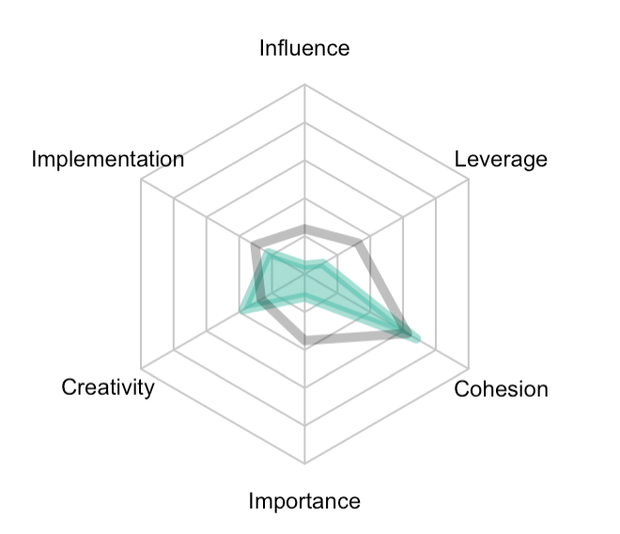
Implementation Team
id19
id1
id18
id22
id42

Slide 9
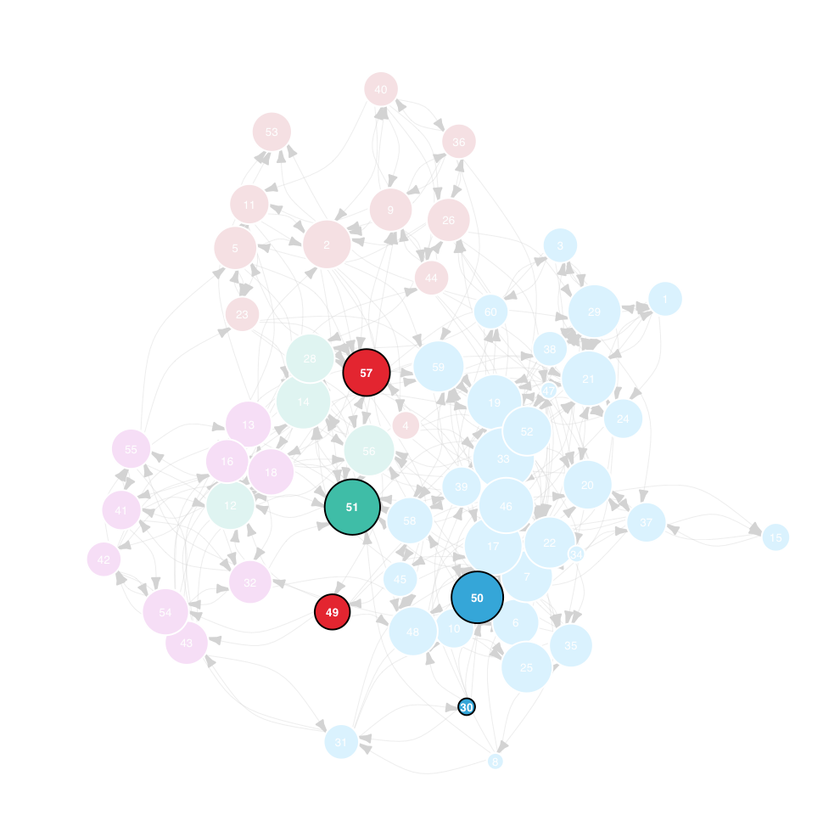
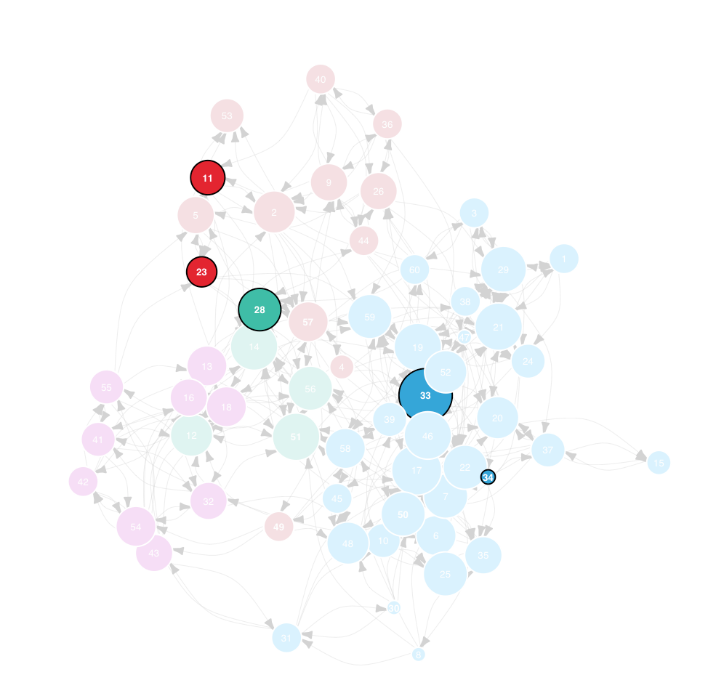
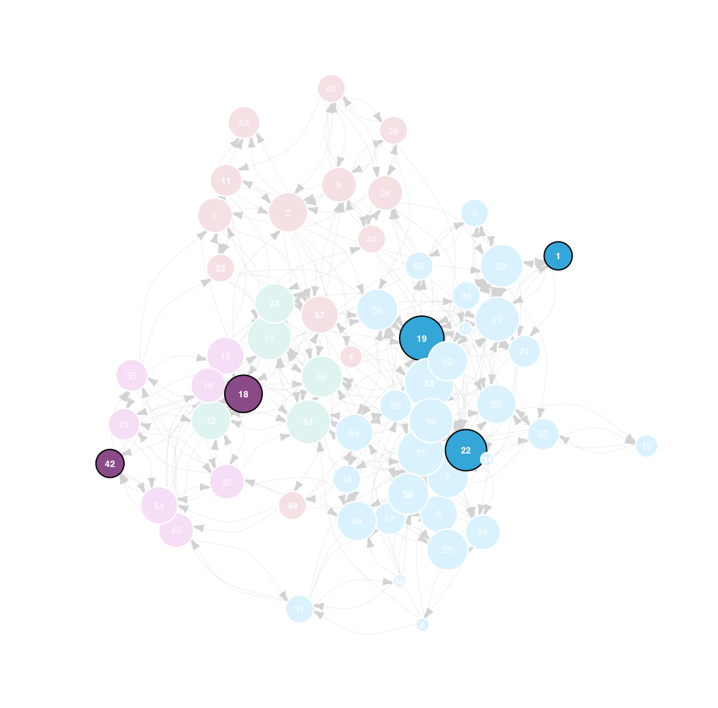
Team Comparison
Design Team
Lobby Team
Implementation Team

Slide 10
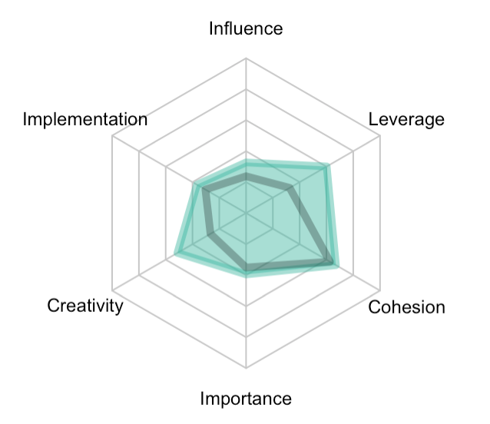
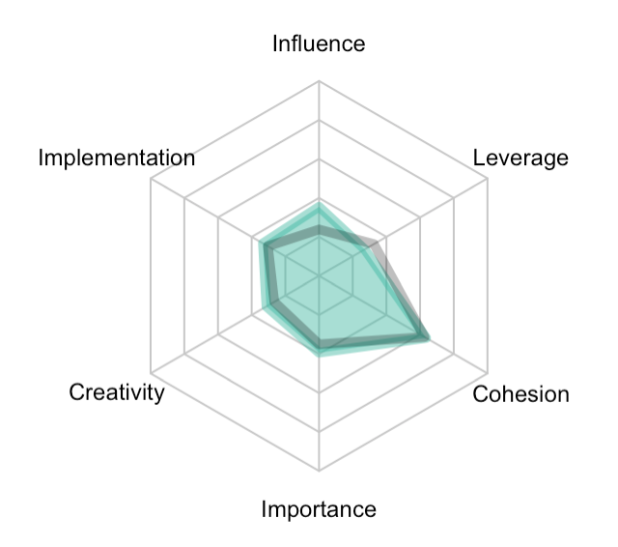
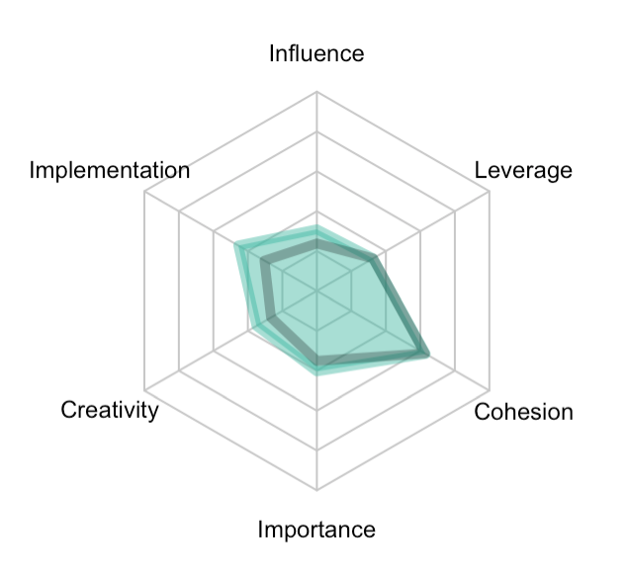
Team Comparison
Design Team
Lobby Team
Implementation Team

Slide 11
End.

Slide 12
Appendix / Old Slides

Slide 13
Agenda
Methodology
Creativity
Leader
Team
Influence
Leader
Team
Implementation
Leader
Team

