Slide 1

Analytics in Business Team Picking
Cecilia Cheung
Louise Fallon
Steven Locorotondo
Siow Meng Low
George Pastakas
Nikhita Venkatesan

Slide 2
Agenda
Methodology
Creativity
Leader
Team
Influence
Leader
Team
Implementation
Leader
Team

Slide 3








Leader Criteria
TASK | Party Type | Strength | Advice | Flexibility | Friends
 | Expansive | Creativity (0.40) | 0.30 | 0.25 | 0.05
 | Expansive / Exclusive | Influence (0.40) | 0.30 | 0.25 | 0.05
 | Tight | Implementation (0.35) | 0.35 | 0.20 | 0.05

Slide 4

Team Criteria
TASK | Party Type | Strength | Friends | Leader pick
 | Expansive > Exclusive > Tight (0.15) | Leverage (0.14) | Perceived creativity (0.55) | 0.15
 | Exclusive or Expansive > Tight (0.15) | Influence (0.35) | Perceived influence (0.35) | 0.15
 | Tight > Exclusive > Expansive party invites (0.15) | Cohesion (0.15) | Perceived implementation skills (0.55) | 0.15

Slide 5
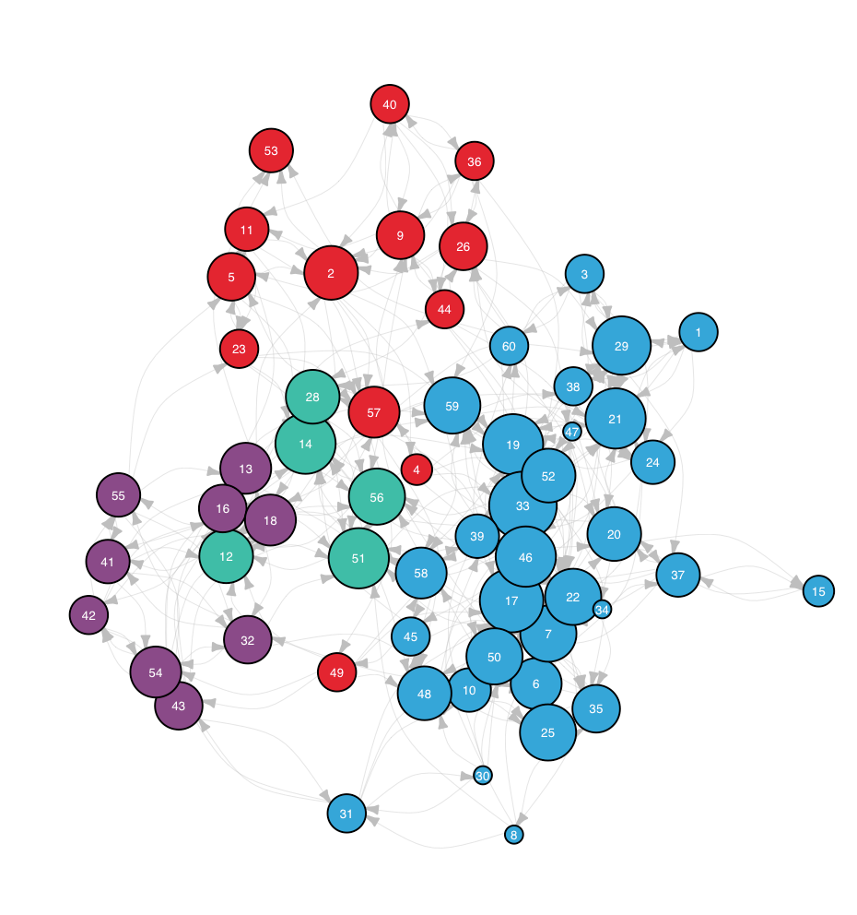
Communities
bla

Slide 6

Design Team

Slide 7

Lobbying Team

Slide 8

Implementation Team

Slide 9
Team Comparison

