Slide 1

Analytics in Business Team Picking
Cecilia Cheung
Louise Fallon
Steven Locorotondo
Siow Meng Low
George Pastakas
Nikhita Venkatesan

Slide 2
Agenda
Methodology
Team Picks
Optimal Leaders
Optimal Members
Optimal Teams
Design Team
Lobby Team
Planning Team
Team Overview

Slide 3








Leader Criteria
TASK | Party Type | Strength | Advice | Flexibility | Friends
 | Expansive | Perceived creativity 0.40 | 0.275 | 0.275 | 0.05
 | Expansive / Exclusive | Perceived influence 0.40 | 0.275 | 0.275 | 0.05
 | Tight | Perceived implementation 0.35 | 0.35 | 0.20 | 0.10
Notes:
Friends – indegree of friendship network
Strength – perceived
Reason for different weight – more important people trust them (advice), less important that he is flexible (cohesion)
Explain headers
Explain differences between weights (especially flexibility and advice)

Slide 4


Member Criteria
TASK | Party Type | Strength | Network | Leader pick
 | Expansive > Exclusive > Tight 0.15 | Perceived creativity 0.55 | Leverage (Betweenness) 0.15 | 0.15
 | Exclusive > Expansive > Tight 0.15 | Perceived influence 0.35 | Importance (Eigenvector) 0.35 | 0.15
 | Tight > Exclusive > Expansive 0.15 | Perceived implementation skills 0.55 | Cohesion (Closeness) 0.15 | 0.15
Notes:
Explain network metrics
Leader pick – added 0.15 to the score if leader picked him for specific task
Focus on interpretation of network metrics and differences in weights
Creativity - directly observable skill, betweeness, less convincing as creativity measure
Closeness, getting a lot of ideas from different people
Looby –
Implementaiton – node generally favors being close to a lot of people and being close to as many people as possible

Slide 5
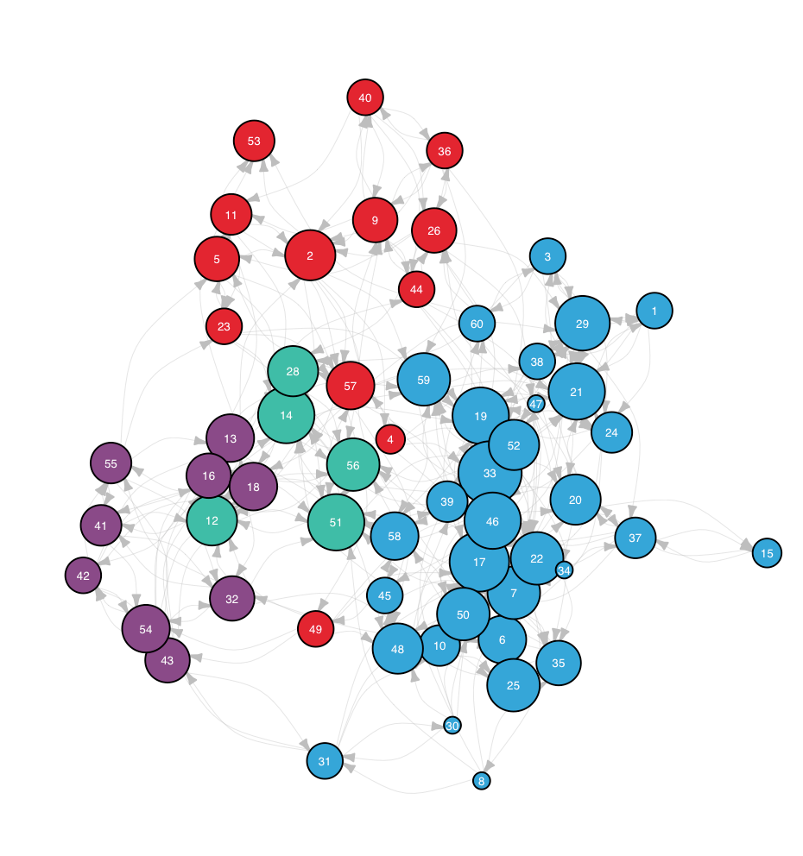
Team Criteria
4 clusters identified within the network that match intuitive network dynamics
To pick optimal teams, the following constraints are put into place:
Diversity: No more than 2 members per cluster
Diversity: No more than 2 members per cluster
More cohesion: No more than 3 members per cluster
Notes:
When creating optimal teams we also considered the communities in the network
Info map clustering algorithm
Different teams should more or less diverse in terms of community
AND being from same cluster doesn’t necessarily mean that it is a good team
Don’t forget to mention that our model has point constraints which are represented by the indegree friendship of each ID

Slide 6

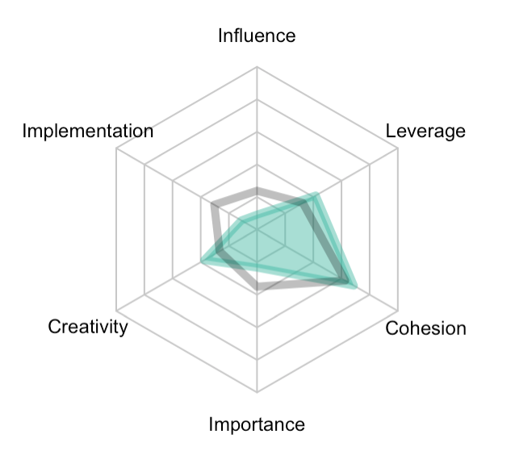
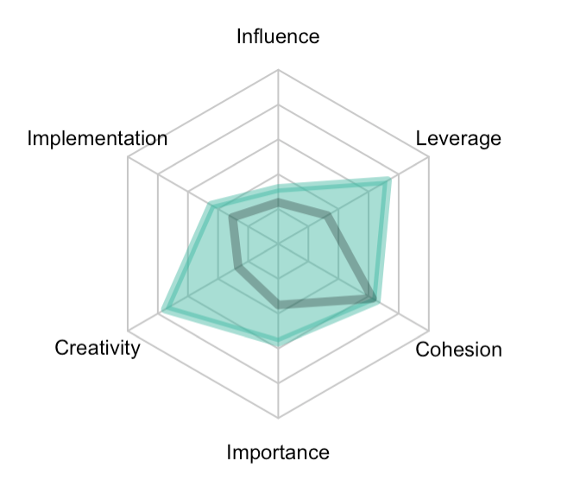
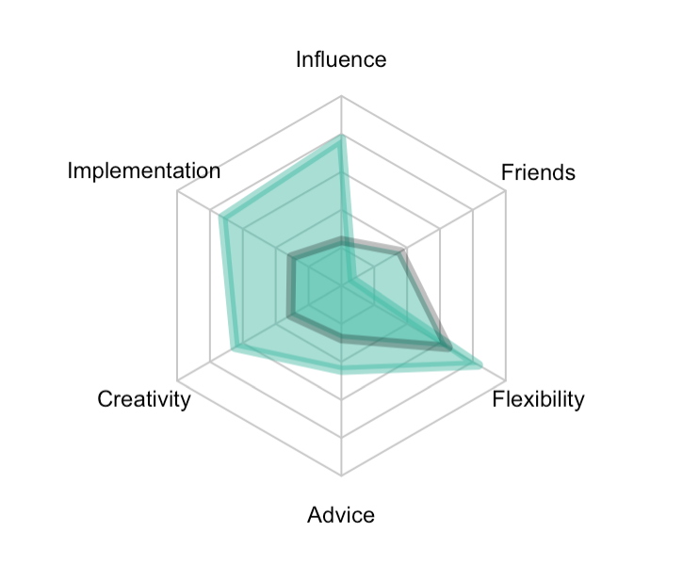
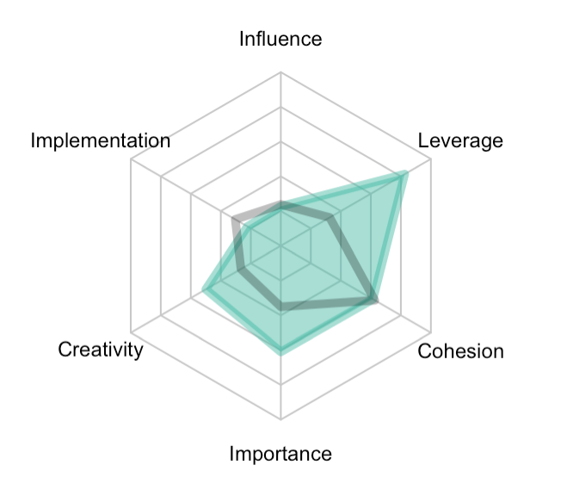
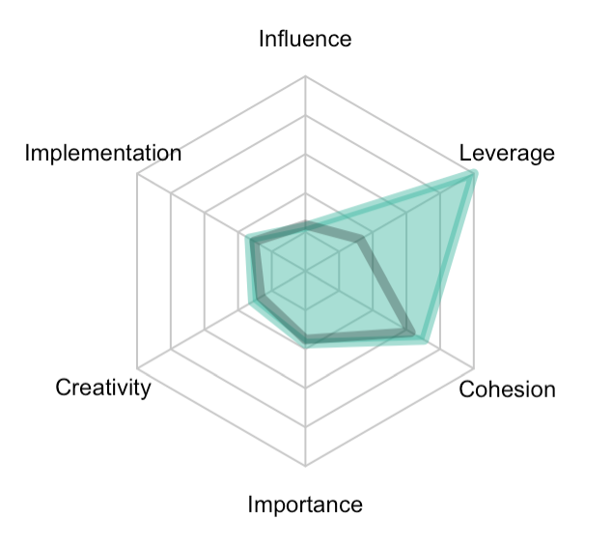
Design Team
id49
id50
id30
id51
id57
Notes:
More qualitative in this part, try to make analogies to real life teams
Say why it is a good team:
Start with leader, who shows specific quality and talk about supporting team

Slide 7

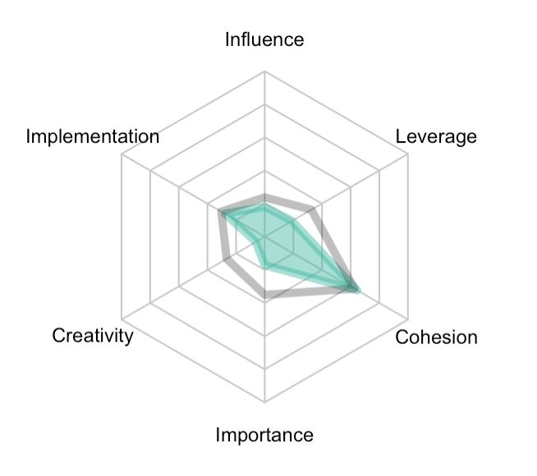
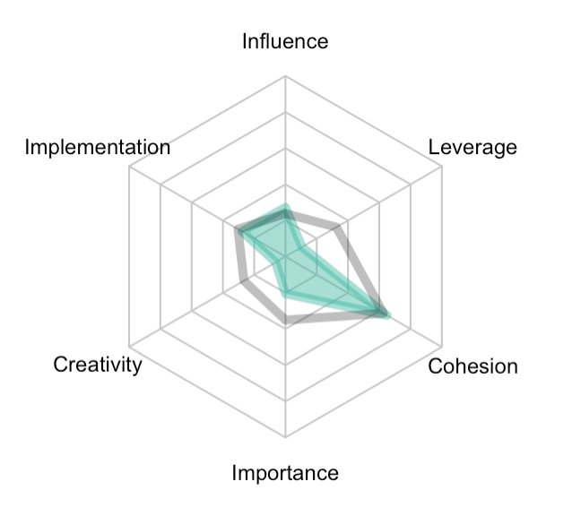
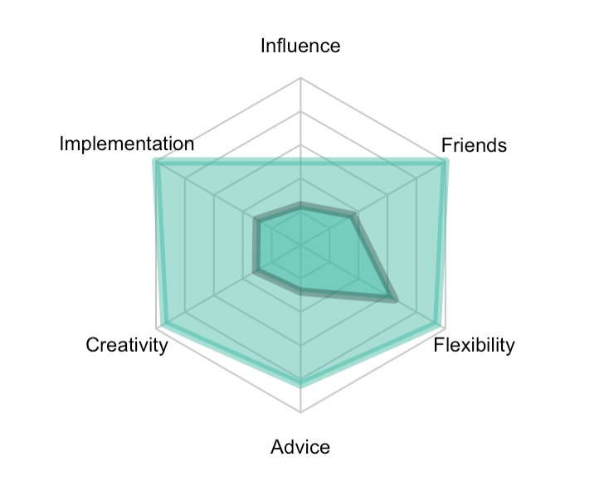
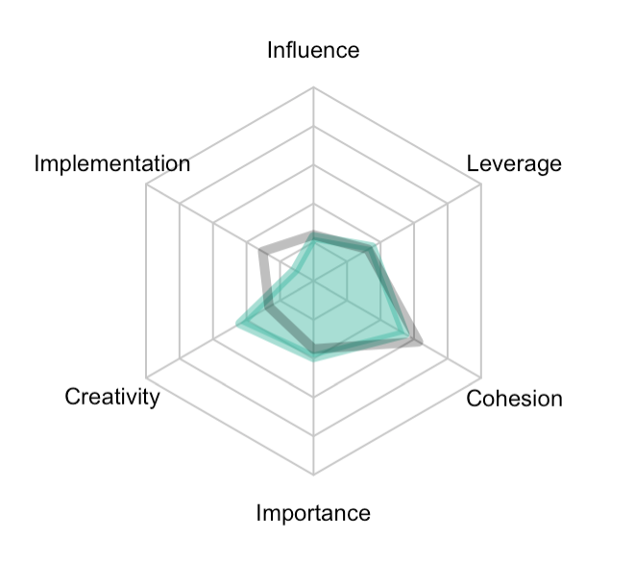
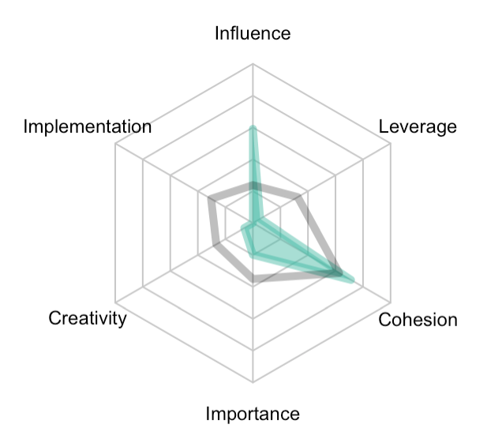
Lobbying Team
id11
id23
id33
id28
id34
Notes:
Lobby is more of a leader specific team
Not a balanced team
33 president
34 vice president

Slide 8

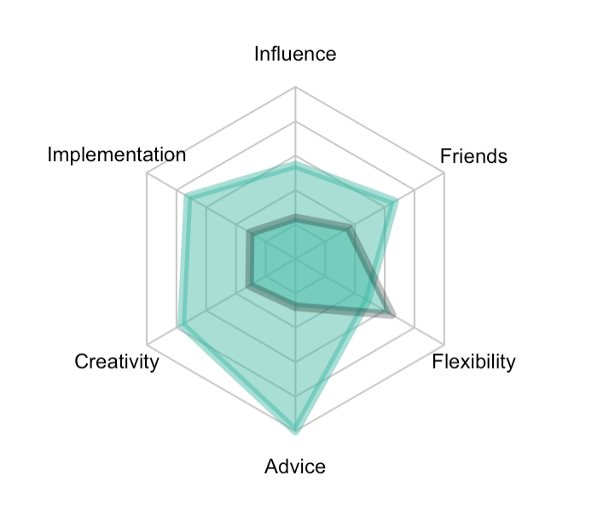
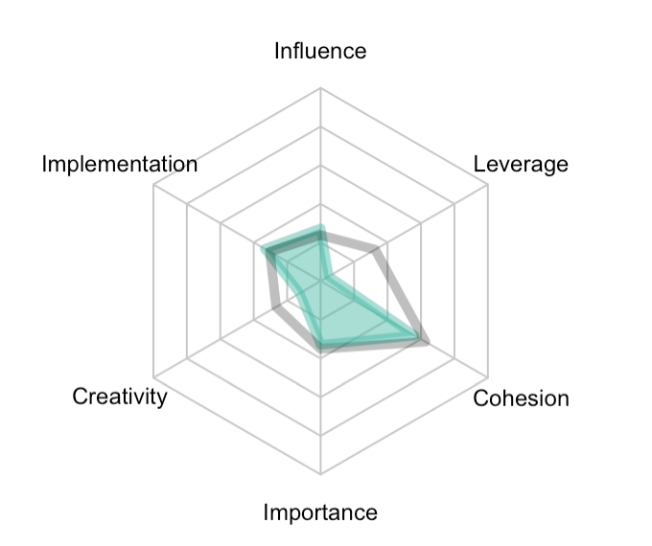
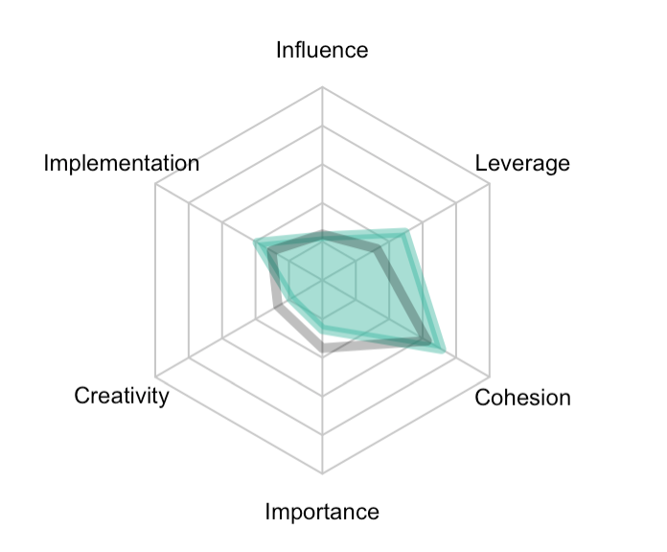
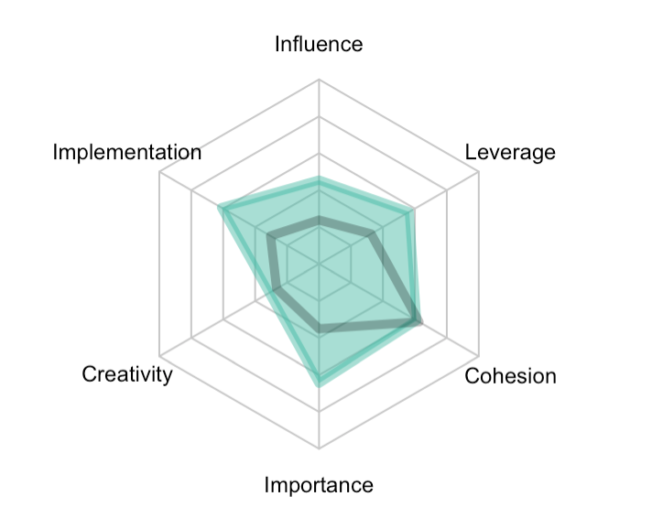
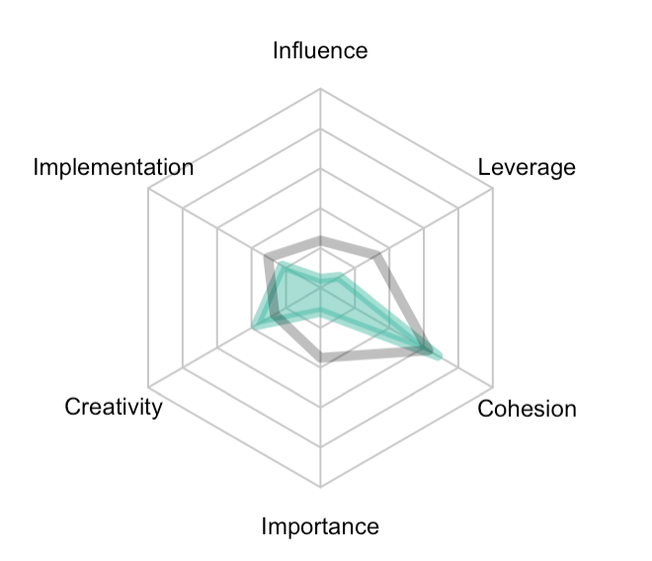
Implementation Team
id19
id1
id18
id22
id42
Notes:
More of a supervisor!!
Strong leader in terms of pulling things together
The rest of the team are good at….

Slide 9
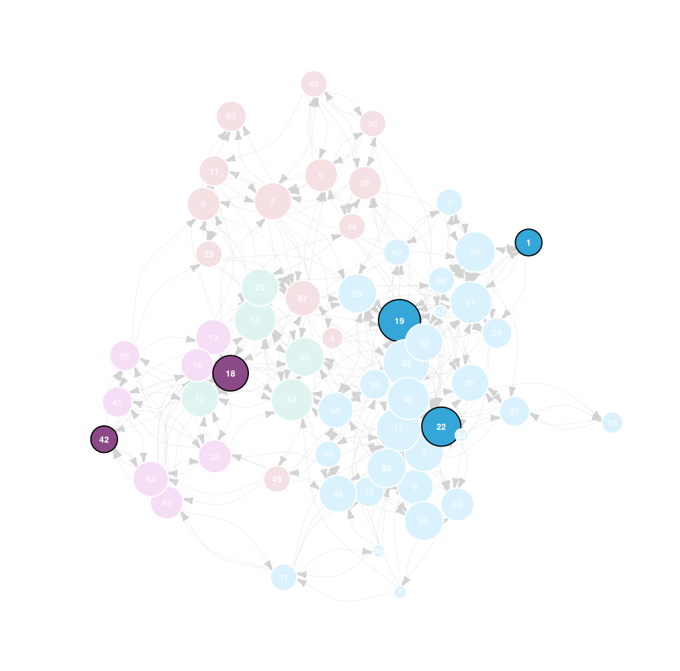
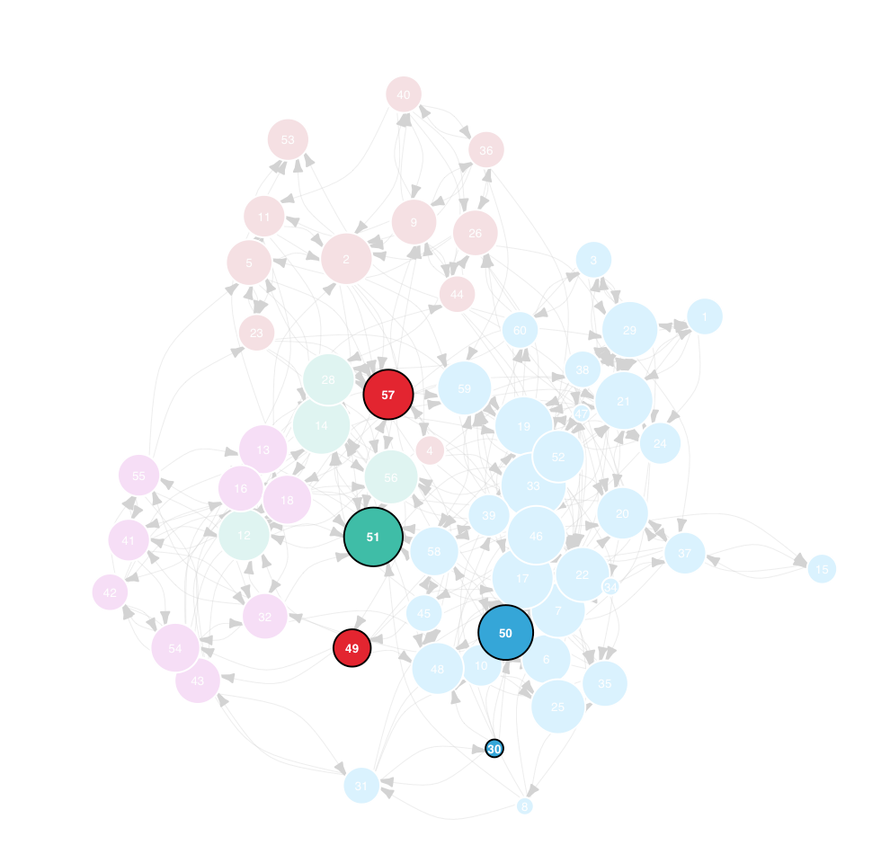
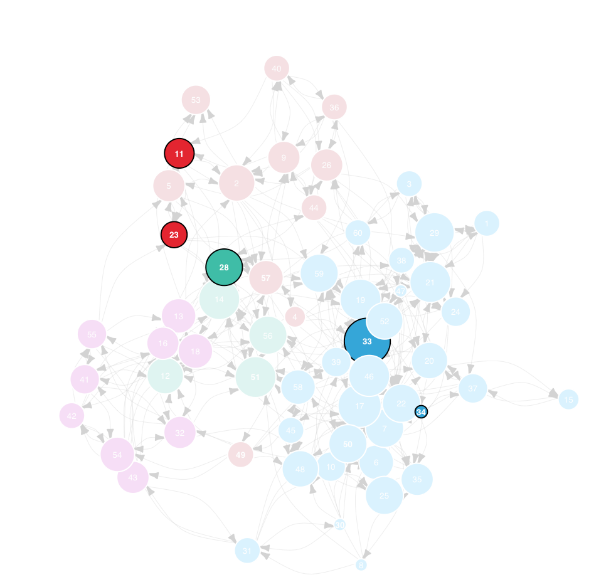
Team Comparison
Design Team
Lobby Team
Implementation Team
Notes:
Design team – looks like ids are between two clusters (get ides from all clusters)
Lobby team – also diverse
Implementation – shows more cohesion

Slide 10
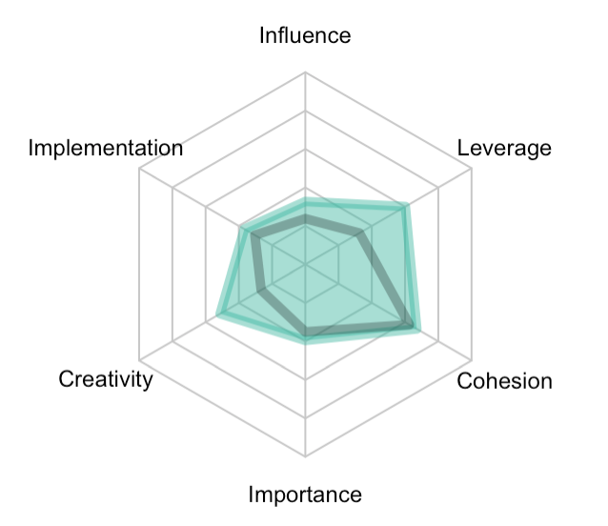
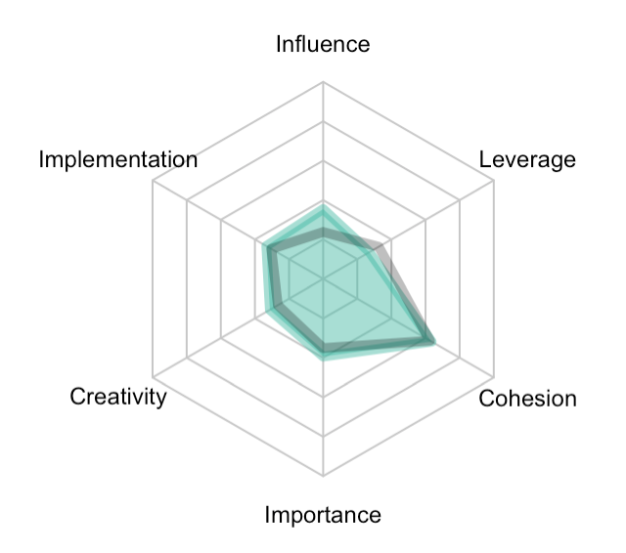
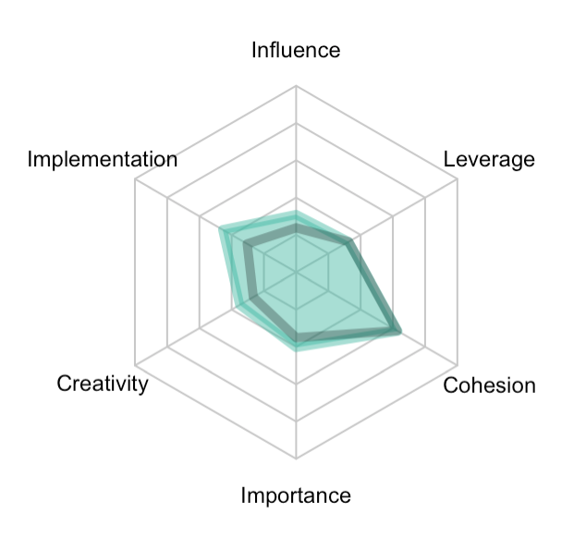
Team Comparison
Design Team
Lobby Team
Implementation Team
Notes:
All teams show that they are good at the most important

Slide 11
End.

