Slide 1
Probability & Statistics

Slide 2
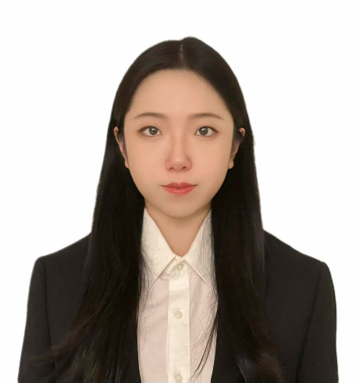
People:
Instructor: Qi Lei
Recitation leader: Elias Hess-Childs
Grader: Xuan Zhao

Slide 3
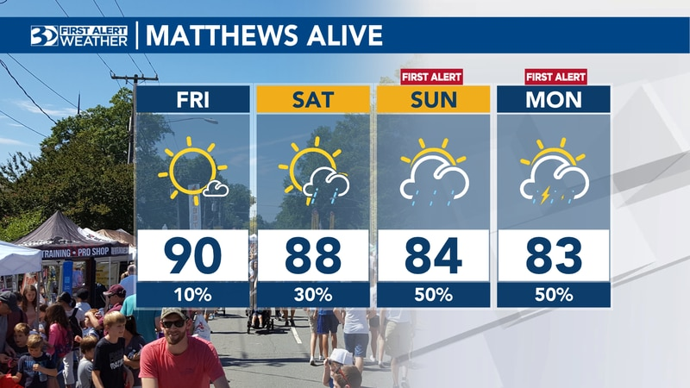
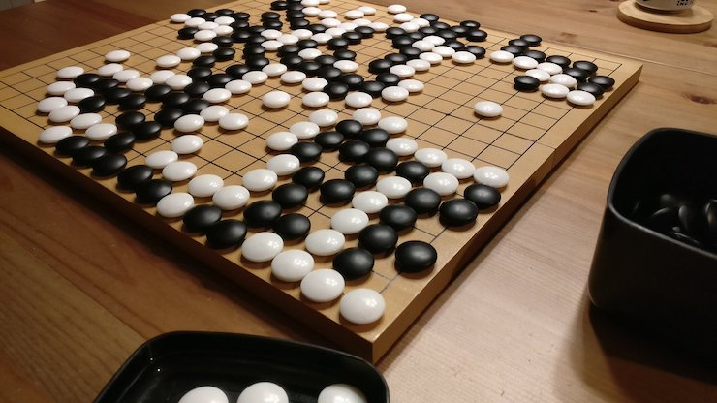
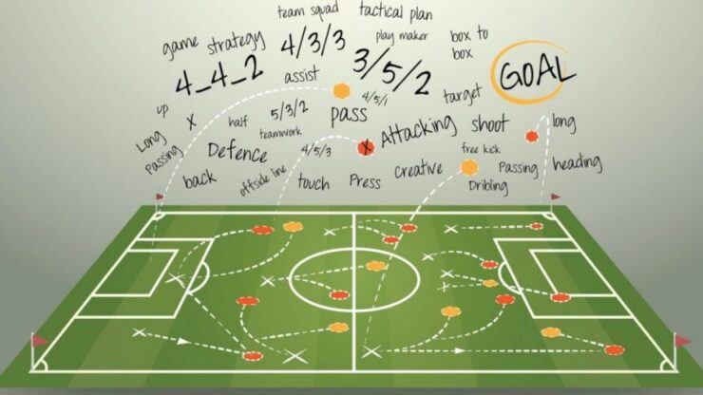
Motivations
Probability and statistics are everywhere
weather forecast
Board games
Sports and gaming strategies
Applications:
Biology
History
Finance
Gambling
Notes:
weather forecast, sports and gaming strategies, buying or selling insurance, online shopping, and online games, determining blood groups, and analyzing political strategies

Slide 4
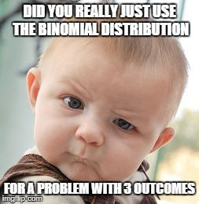
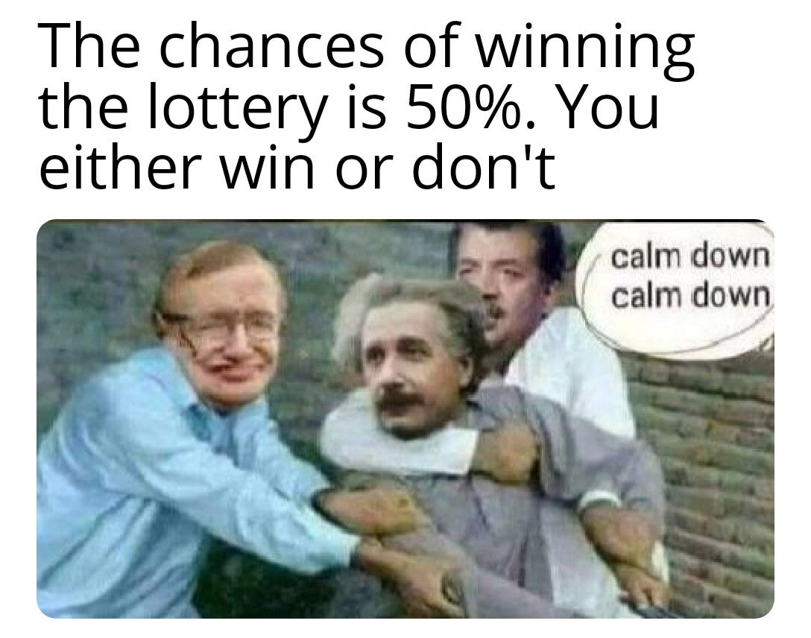
Goals
Level I: understand basic concepts
Level II: solve specific probability and statistical problems
Level III: identify the statistical tools when facing a real problem
Notes:
Discrete and continuous Random variables, different distributions and processes

Slide 5
Syllabus
Link to syllabus
Notes:
Prestigious university– challenges in the course. This is harder when I learned in undergrad.. You will need exercises to practice and form your understanding of what you learned. This is very necessary to help you achieve these different levels of goals.

