Slide 1
Probability & Statistics

Slide 2
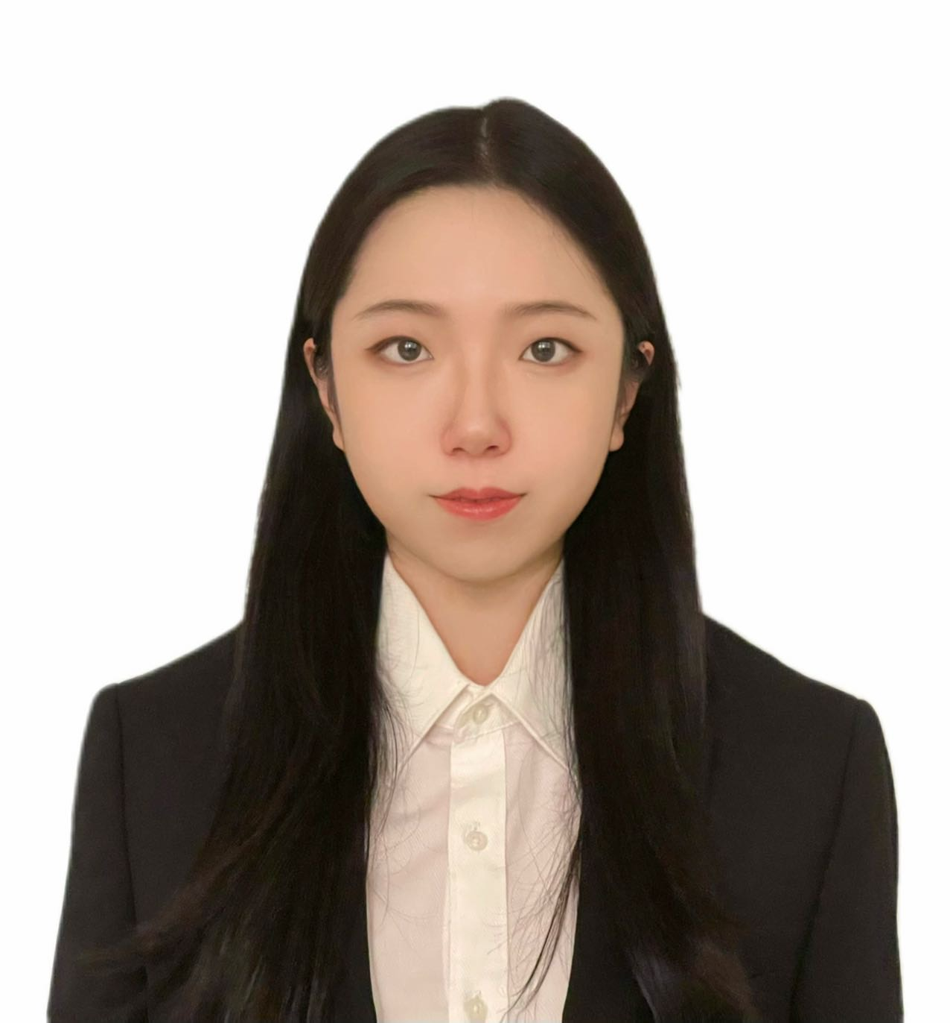
People:
Instructor: Qi Lei
Recitation leader: Elias Hess-Childs
Grader: Xuan Zhao

Slide 3
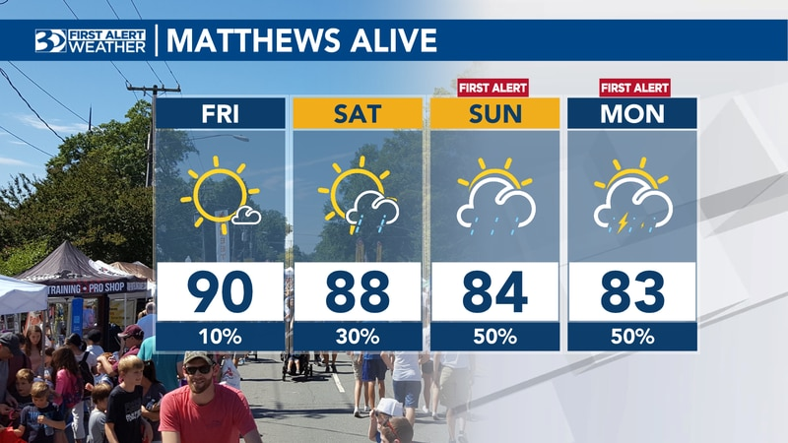
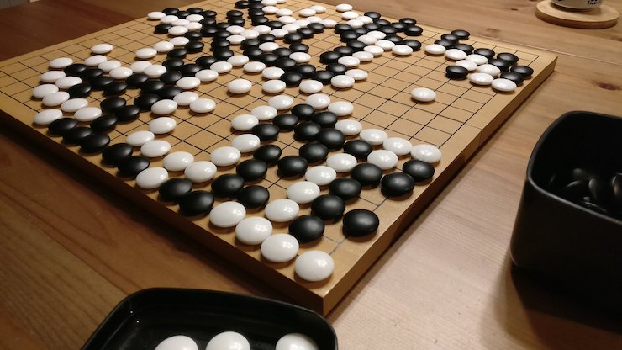
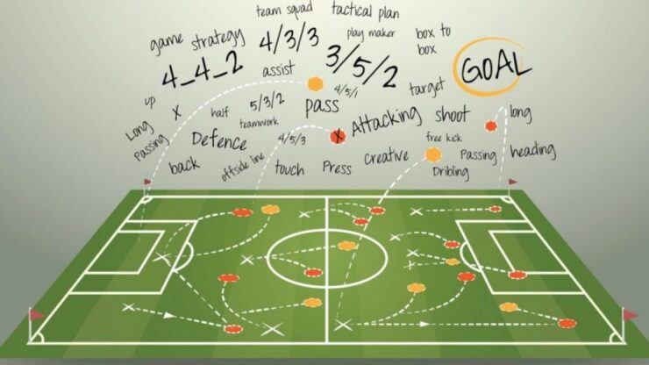
Motivations
Probability and statistics are everywhere
weather forecast
Board games
Sports and gaming strategies
Applications:
Biology
History
Finance
Gambling
Notes:
weather forecast, sports and gaming strategies, buying or selling insurance, online shopping, and online games, determining blood groups, and analyzing political strategies

Slide 4
Goals
Level I: understand basic concepts
Level II: solve specific probability and statistical problems
Level III: identify the statistical tools when facing a real problem
Notes:
Discrete and continuous Random variables, different distributions and processes

Slide 5
Syllabus
Link to syllabus
Notes:
Prestigious university– challenges in the course. This is harder when I learned in undergrad.. You will need exercises to practice and form your understanding of what you learned. This is very necessary to help you achieve these different levels of goals.

Slide 6
What
Quantifying uncertainty

