Slide 1
Data Reconstruction Attacks and Defenses: From Theory to Practice
Qi Lei, Courant Math and CDS
With Zihan Wang, Sheng Liu, Jianwei Li, Jason Lee
https://arxiv.org/abs/2212.03714
https://arxiv.org/abs/2402.09478
https://arxiv.org/abs/2312.05720

Slide 2
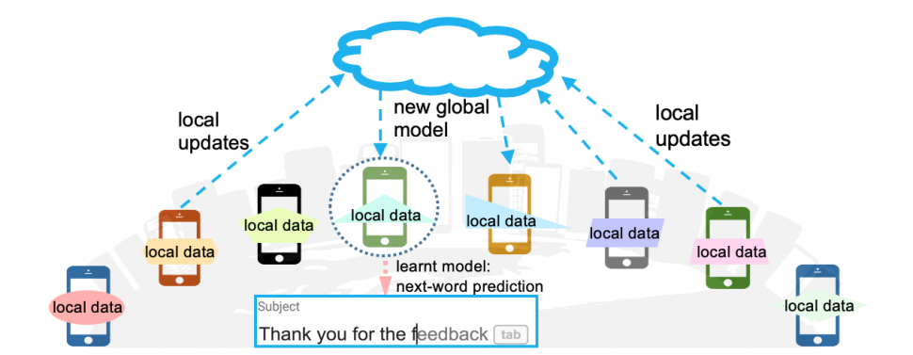


Federated learning
[Konečný et al. 2016, McMahan et al. 2017]
Privacy leakage in distributed learning - Data and model not co-located
$$Θ$$
$$ΔΘ$$
Subject
My credit card # is 11|2233….
Notes:
Most attacks actually happens at inference time, others happen in distributed systems, where data and model are not co-located.
Jakub and Brenden and many others proposed the federated learning framework in 2016.
By definition. Federated Learning is privacy-preserving model training in heterogeneous, distributed networks. But how ironic that FL is in fact not privacy-preserving.
This figure illustrates next-word prediction.. (don’t type sensitive information in your search box)
Back to the story.. Since the local users don’t want to leak their own information to others, and the only information they gave out is the partial gradient/local updates, we are interested in the question, whether that causes potential privacy issues.

Slide 3
Privacy leakage in distributed learning
Does local update reveal the training data?
$$Θ$$
$$ΔΘ$$
Subject
My credit card # is 11|2233….
Notes:
By definition. Federated Learning is privacy-preserving model training in heterogeneous, distributed networks. But how ironic that FL is in fact not privacy-preserving.
Challenges behind: since which data to use in the local update is determined by the user, the PS cannot control it. Therefore if to reconstruct individual data, will need to reconstruct at a single query.

Slide 4
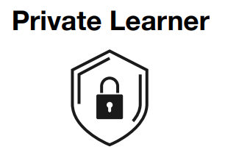

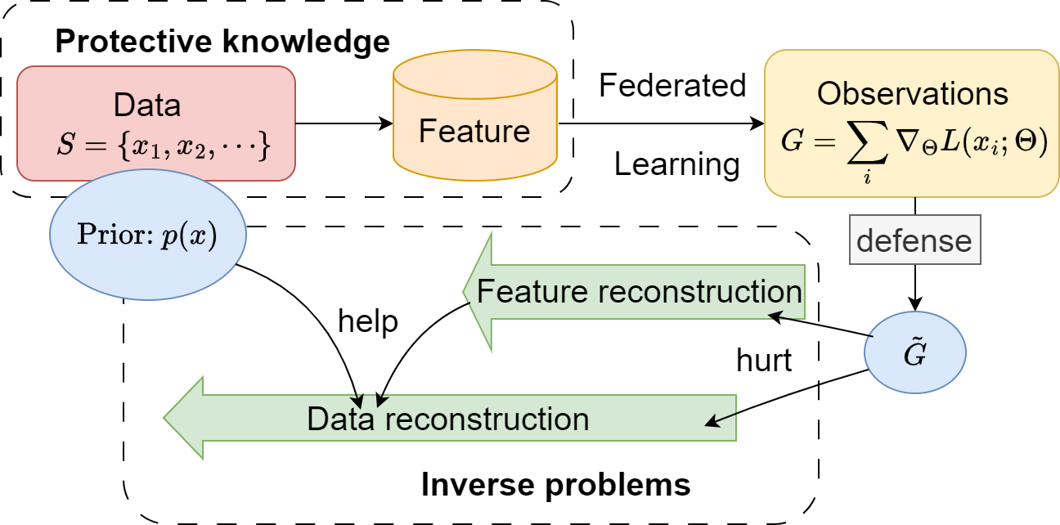

Slide 5
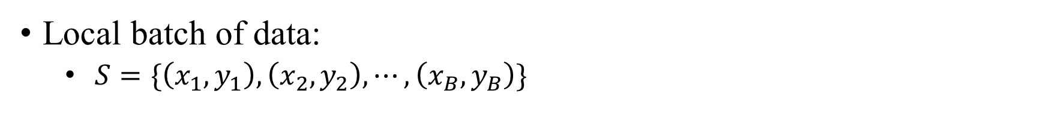
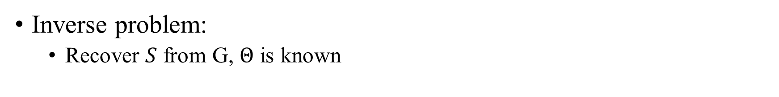
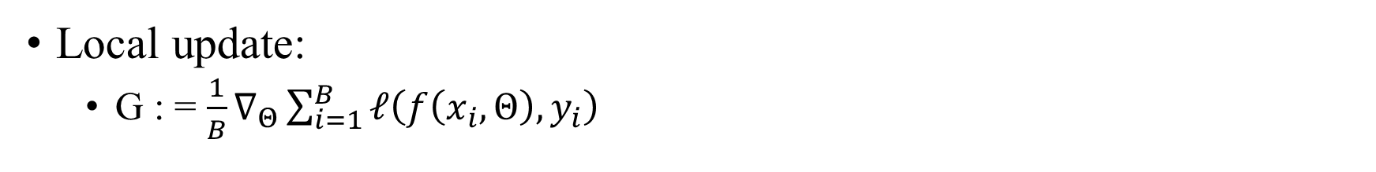
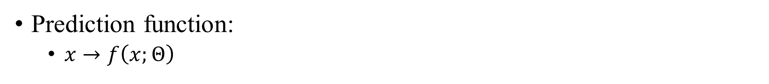
Threat model more formally:
Local batch of data:
$S=\{\left(x_{1},y_{1}\right),\left(x_{2},y_{2}\right),⋯, \left(x_{B},y_{B}\right)\}$
Private learner
Prediction function:
$x→f\left(x;Θ\right)$
Adversary
Local update:
G : = $\frac{1}{B}∇_{Θ}\sum_{i=1}^{B}{ℓ\left(f\left(x_{i},Θ\right),y_{i}\right)}$
Inverse problem:
Recover $S$ from G, $Θ$ is known
Notes:
Agnostic to the data modality

Slide 6
Fundamental questions
When is the model gradient G sufficient to identify the training samples?
➔ defending with information-theoretic bottleneck guarantees
If so, is there an efficient algorithm to recover the samples?
➔ defending with computational barriers

Slide 7
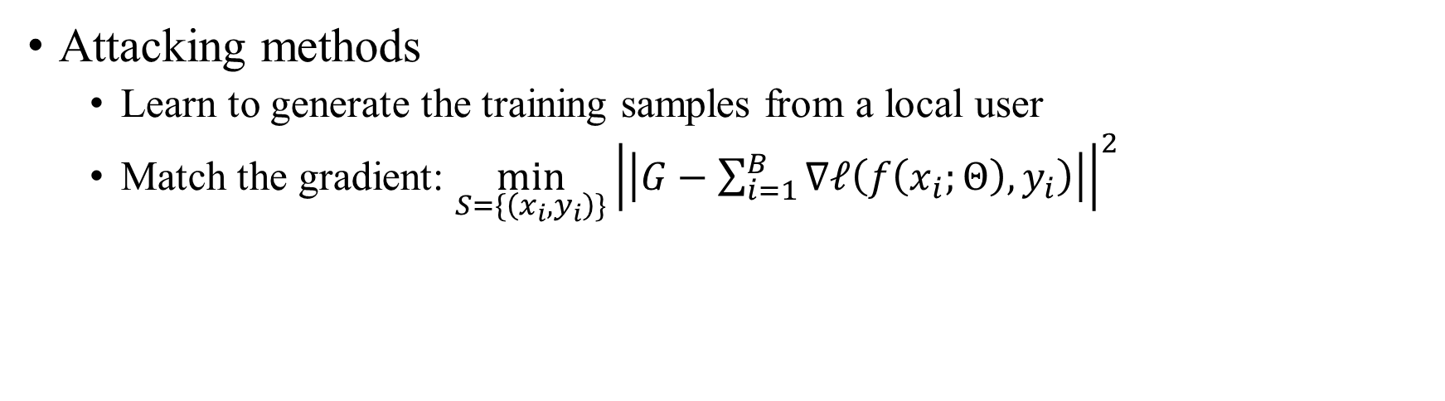
Prior work
Attacking methods
Learn to generate the training samples from a local user
Match the gradient: ${\min_{S=\{\left(x_{i},y_{i}\right)\}}\left|\left|G−\sum_{i=1}^{B}{∇ℓ\left(f\left(x_{i};Θ\right),y_{i}\right)}\right|\right|}^{2}$
Defending methods
Quantizing/pruning the gradient
Dropout
Secure aggregation
Multiple local aggregation
Add noise
[Zhu et al., 2019; Yin et al., 2021; Jeon et al., 2021]
Notes:
Defending: affect the information retrieved from the gradients

Slide 8
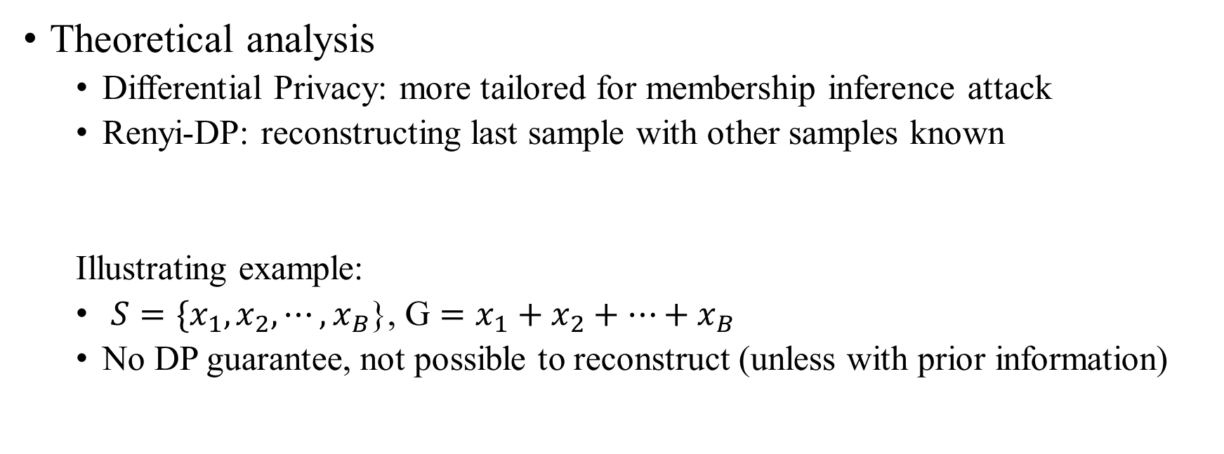
Prior work
Theoretical analysis
Differential Privacy: more tailored for membership inference attack
Renyi-DP: reconstructing last sample with other samples known
Illustrating example:
$S=\{x_{1},x_{2},⋯,x_{B}$}, G $=x_{1}+x_{2}+⋯+x_{B}$
No DP guarantee, not possible to reconstruct (unless with prior information)
A more common trajectory in security:
➔ stronger attack ➔ stronger defense➔…
[Guo et al. 2022]
Notes:
The de facto standard for data privacy seems doesn’t apply so well here: adjacent datasets D and D0 that differ in a single training sample, a model trained on D is almost statistically indistinguishable from a model trained on D0

Slide 9
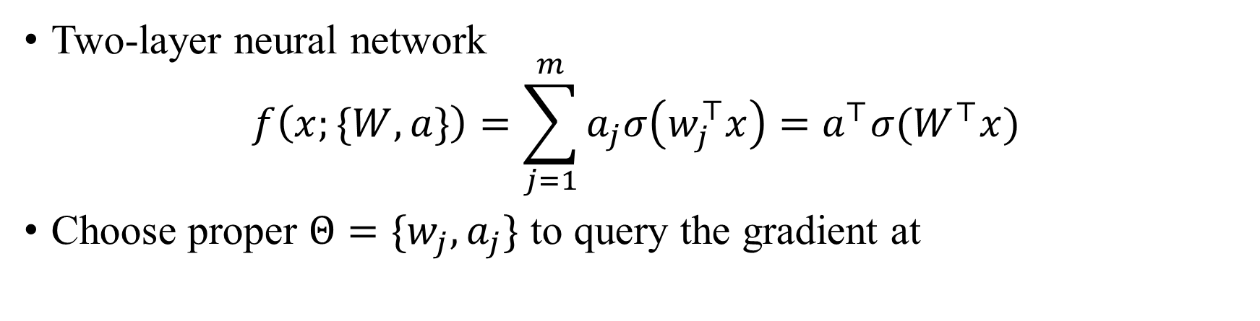

Warm-up:
Two-layer neural network
$$f\left(x;\{W,a\}\right)=\sum_{j=1}^{m}{a_{j}σ\left(w_{j}^{⊤}x\right)=a^{⊤}σ(W^{⊤}x)}$$
Choose proper $Θ=\{w_{j},a_{j}\}$ to query the gradient at
$$∇_{a_{j}}L=\sum_{i=1}^{B}{l_{i}^{′}σ\left(w_{j}^{⊤}x_{i}\right)}$$
Notes:
Add a image of 2 layer nn?

Slide 10
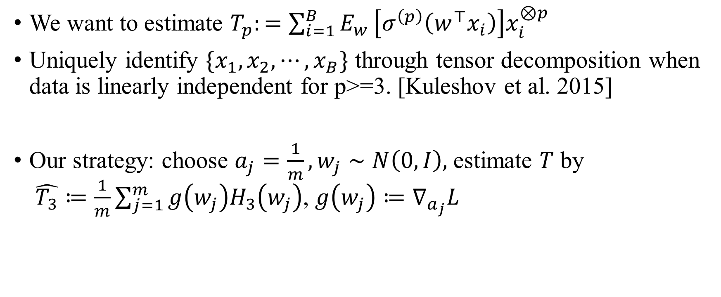
Our findings: recover third moment of data
We want to estimate $T_{p}:=\sum_{i=1}^{B}{E_{w}}\left[σ^{\left(p\right)}\left(w^{⊤}x_{i}\right)\right]x_{i}^{⊗p}$
Uniquely identify $\{x_{1},x_{2},⋯,x_{B}\}$ through tensor decomposition when data is linearly independent for p>=3. [Kuleshov et al. 2015]
Our strategy: choose $a_{j}=\frac{1}{m},w_{j}∼N\left(0,I\right),$ estimate $T$ by $\hat{T_{3}}≔\frac{1}{m}\sum_{j=1}^{m}{g\left(w_{j}\right)H_{3}\left(w_{j}\right)}$, $g\left(w_{j}\right)≔∇_{a_{j}}L$
[Wang et al. 2023] https://arxiv.org/abs/2212.03714

Slide 11
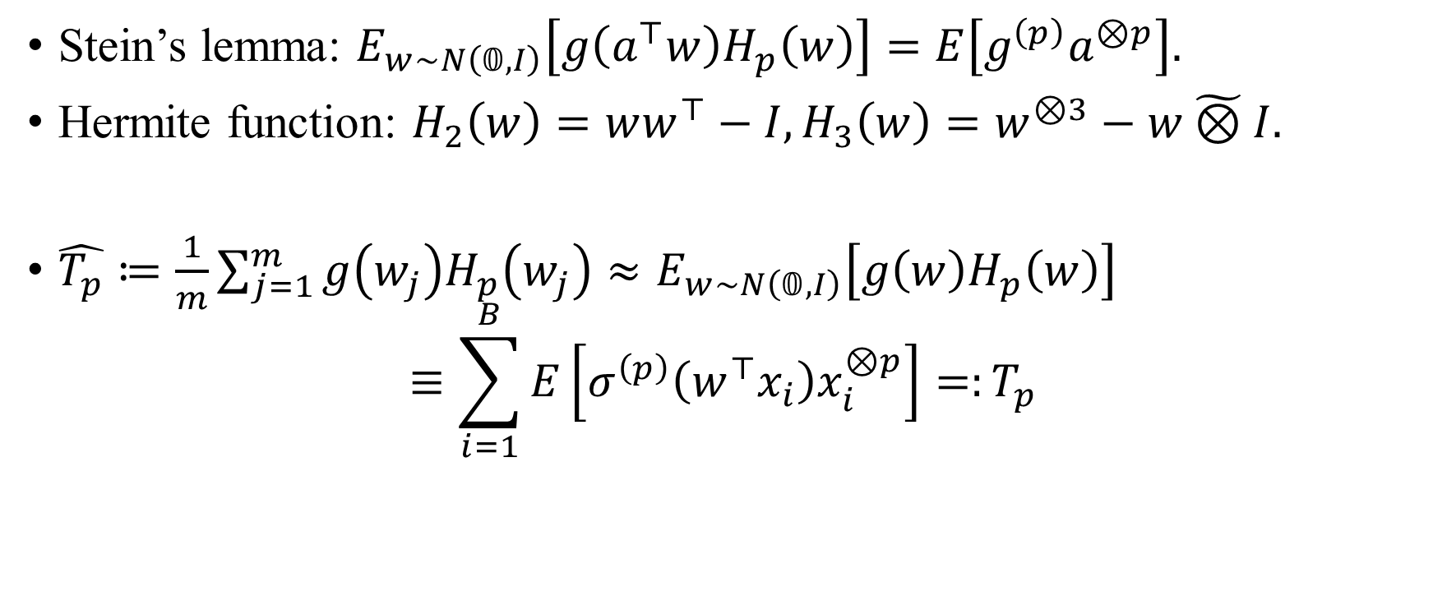
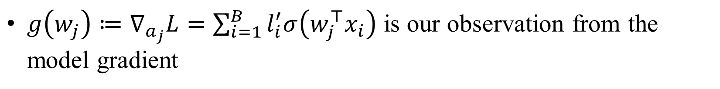
Tensor decomposition
Stein’s lemma: $E_{w∼N\left(𝟘,I\right)}\left[g\left(a^{⊤}w\right)H_{p}\left(w\right)\right]=E\left[g^{\left(p\right)}a^{⊗p}\right].$
Hermite function: $H_{2}\left(w\right)=ww^{⊤}−I,H_{3}\left(w\right)=w^{⊗3}−w\tilde{⊗}I.$
$\hat{T_{p}}≔\frac{1}{m}\sum_{j=1}^{m}{g\left(w_{j}\right)H_{p}\left(w_{j}\right)}≈E_{w∼N\left(𝟘,I\right)}\left[g\left(w\right)H_{p}\left(w\right)\right]$
$$≡\sum_{i=1}^{B}{E}\left[σ^{\left(p\right)}\left(w^{⊤}x_{i}\right)x_{i}^{⊗p}\right]=:T_{p}$$
$g\left(w_{j}\right)≔∇_{a_{j}}L=\sum_{i=1}^{B}{l_{i}^{′}σ\left(w_{j}^{⊤}x_{i}\right)}$ is our observation from the model gradient
[Wang et al. 2023] https://arxiv.org/abs/2212.03714
Notes:
H_p is the p-th hermite function.

Slide 12

Theoretical analysis on attack
Applies when $E\left[σ^{\left(3\right)}\left(w\right)\right]$ or $E\left[σ^{\left(4\right)}\left(w\right)\right]≠0.$Applies to sigmoid, tanh, ReLU, leaky ReLU, GeLU, SELU, ELU etc.
Reconstruction error $≤\tilde{O}\left(\sqrt{d/m}\right).$
[Wang et al. 2023] https://arxiv.org/abs/2212.03714

Slide 13
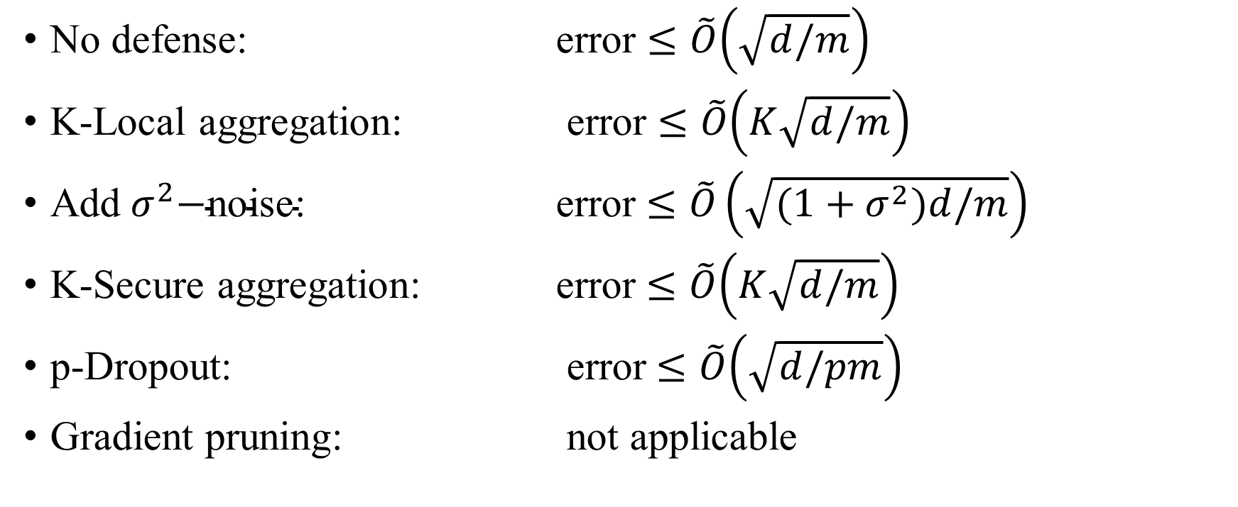
Theoretical analysis on defense
No defense: error $≤\tilde{O}\left(\sqrt{d/m}\right)$
K-Local aggregation: error $≤\tilde{O}\left(K\sqrt{d/m}\right)$
$\text{Add} σ^{2}\text{−}\text{noise}\text{: }$ error $≤\tilde{O}\left(\sqrt{(1+σ^{2})d/m}\right)$
K-Secure aggregation: error $≤\tilde{O}\left(K\sqrt{d/m}\right)$
p-Dropout: error $≤\tilde{O}\left(\sqrt{d/pm}\right)$
Gradient pruning: not applicable
[Liu et al. 2024] https://arxiv.org/abs/2402.09478

Slide 14
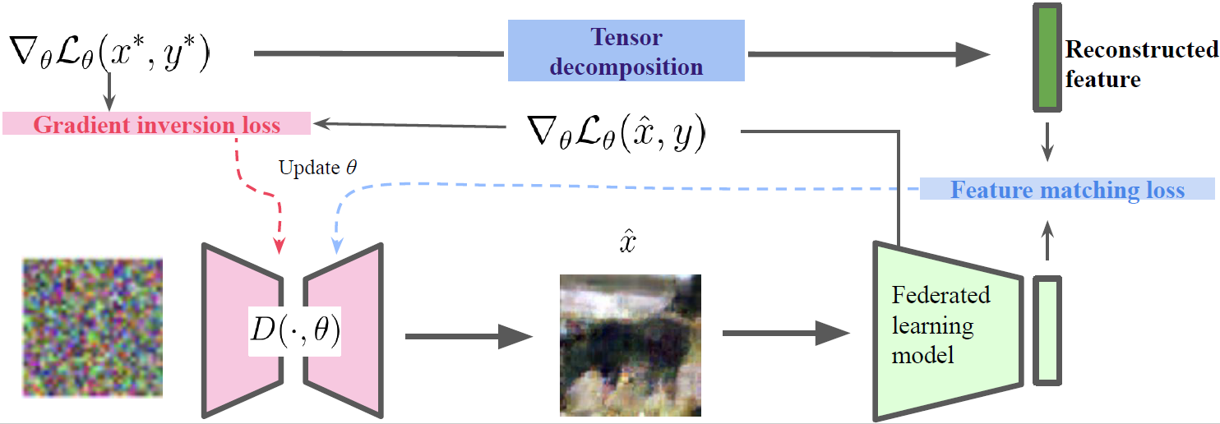
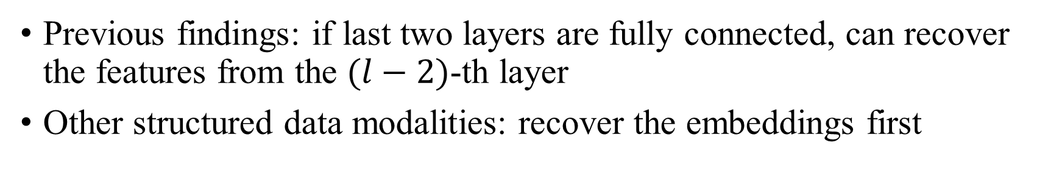
Beyond two-layer networks
Previous findings: if last two layers are fully connected, can recover the features from the $(l−2)$-th layer
Other structured data modalities: recover the embeddings first
[Liu et al. 2024] https://arxiv.org/abs/2402.09478

Slide 15
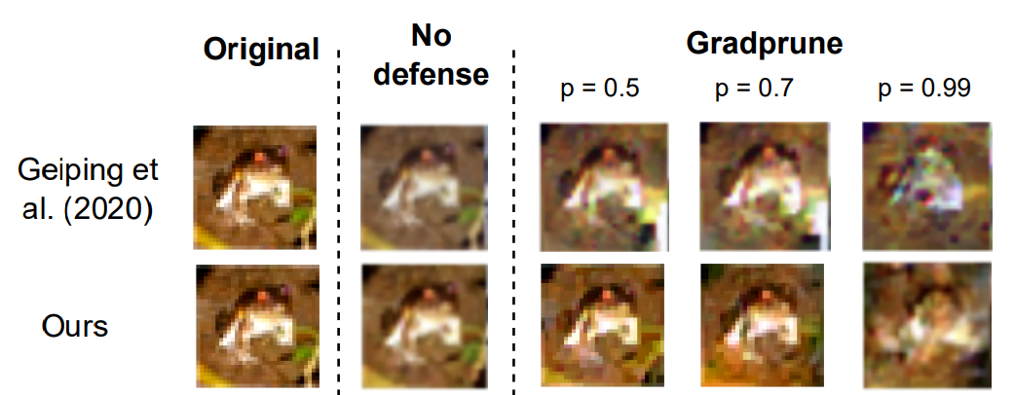
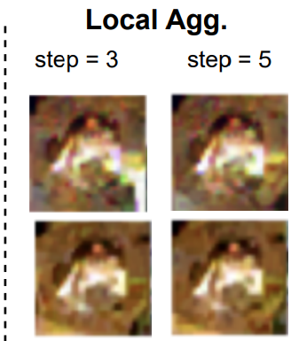

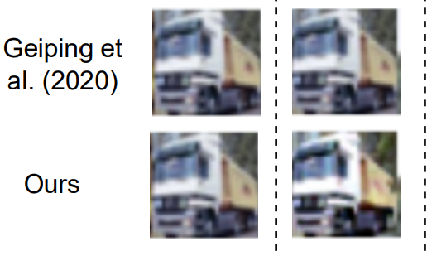
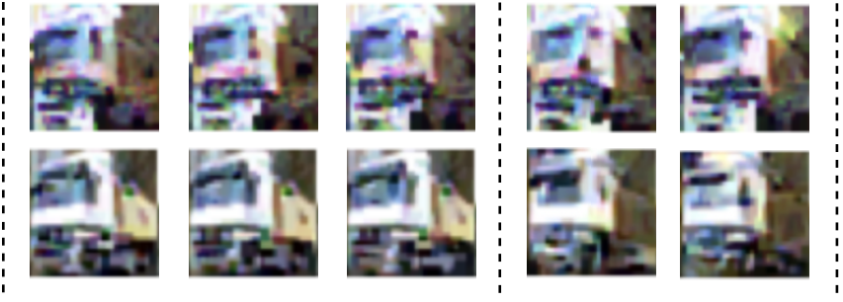
Empirical results:
[Liu et al. 2024] https://arxiv.org/abs/2402.09478

Slide 16
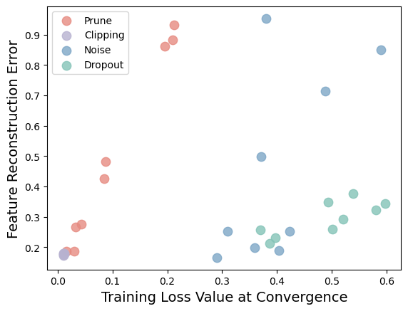
Privacy-utility trade-offs
[Liu et al. 2024] https://arxiv.org/abs/2402.09478

Slide 17
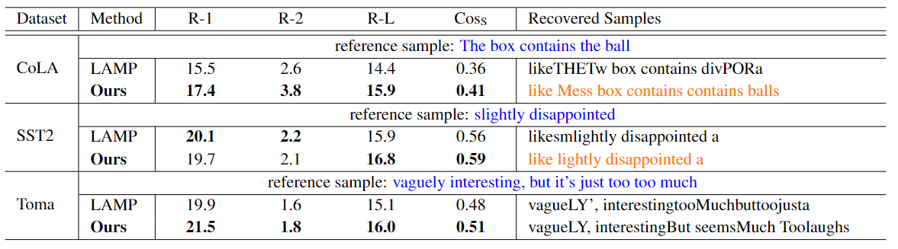
Beyond computer vision tasks…
More results in: [Li et al. 2024] https://arxiv.org/abs/2312.05720

Slide 18
Discussions
Gradient pruning is the most effective defending method (theoretically, empirically: better privacy-utility trade-off)
Call for more tailored concept of privacy in reconstruction attack in federated learning
Information-theoretical or computational lower bound in reconstruction attack

Slide 19
Thank you

