Slide 1
NewsReaderLondon Hack!
Team: Fail fast, fail often
(Cecilia Liao, German Rigau, Julian, Rajeev, Yow Tzu)

Slide 2
Cars & players
All events involving Automobiles
Cross-referenced with list of soccer players

Slide 3
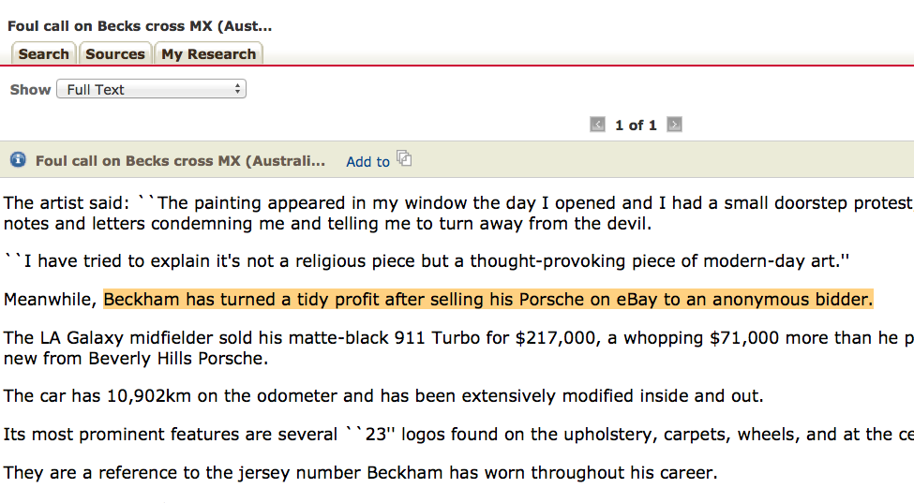
Cars & players

Slide 4
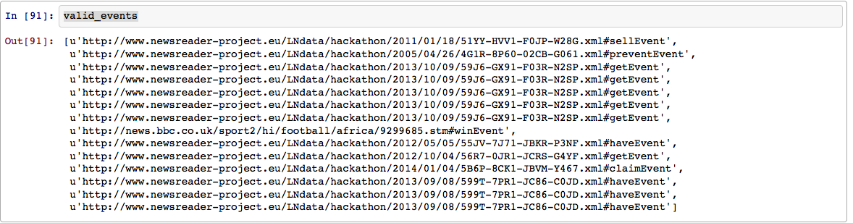
Cars & players
Conclusion: Hmmm…..

Slide 5
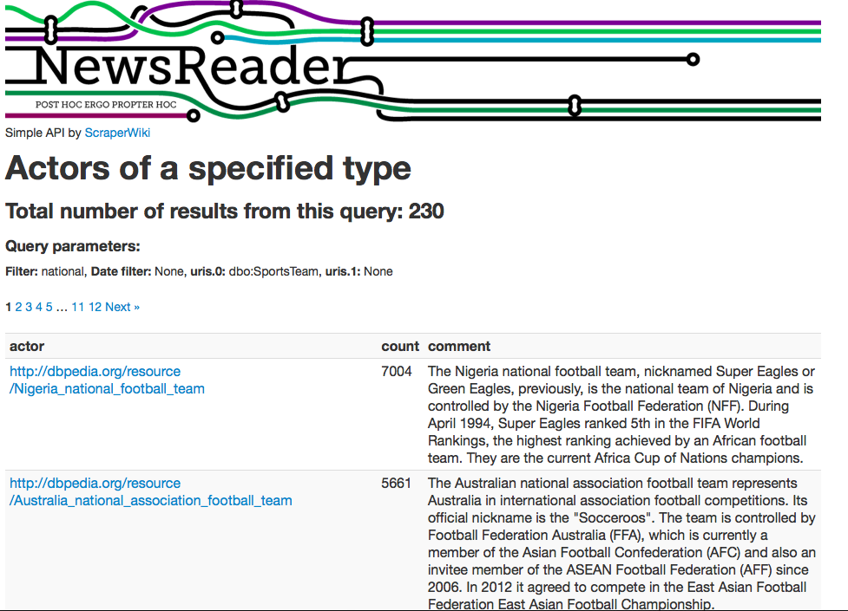
National team and news mentions

Slide 6
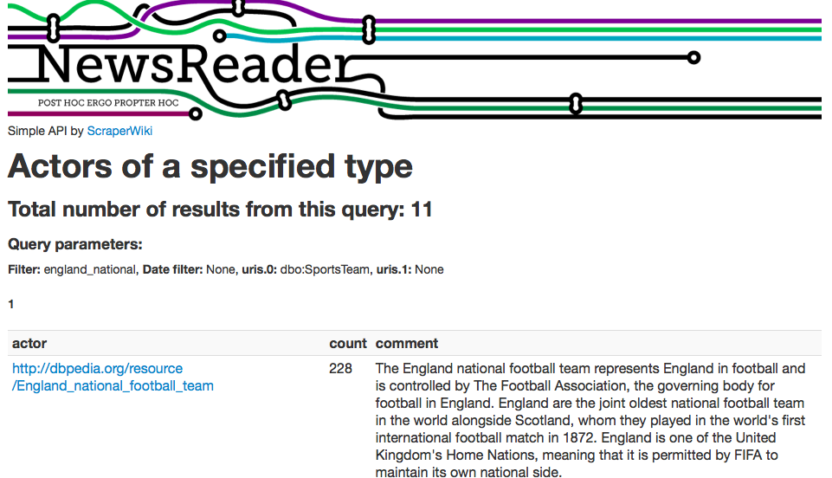
National team and news mentions
Why does Nigeria national football team have 7004 mentions (when England only had 228!?)

Slide 7
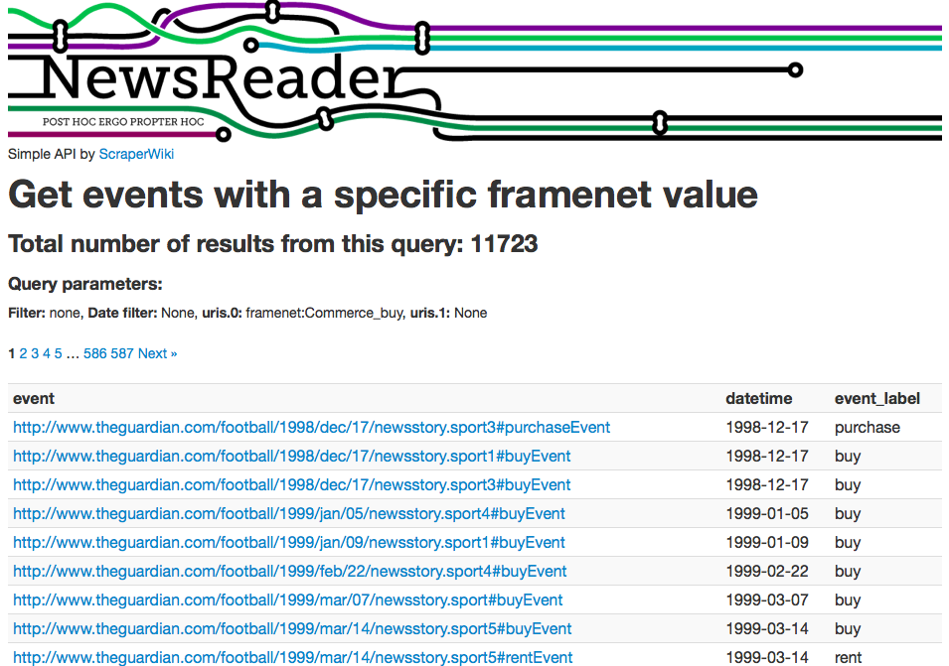
Buy (and sell)
Use framenet https://newsreader.scraperwiki.com/summary_of_events_with_framenet?uris.0=framenet:Commerce_buy

Slide 8
Buy (and sell)
Found actors related to each Commerce_buy event
Create a network graph using Gephi

Slide 9
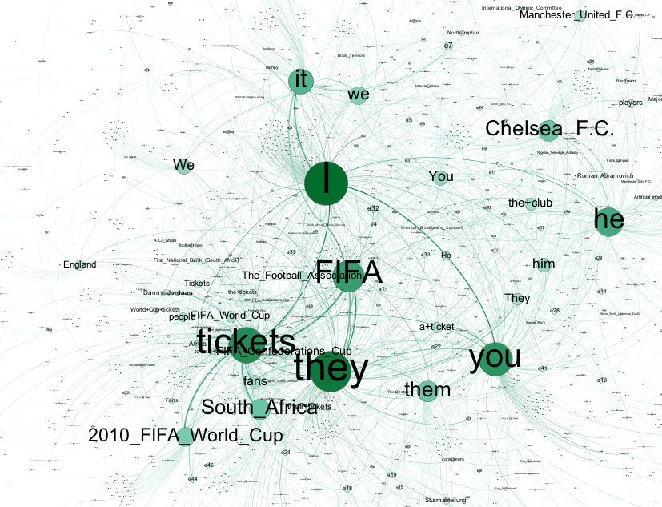
Buy (and sell)

Slide 10
Buy (and sell)
Ran out of time to…
process all the records (we only had about 3000 events for visualisation)
visualise properly (configure the settings to make sense of the data)
try Commerce_sell

