Slide 1
Build A Segment-Based Product Recommendation Engine
To help to make our first-time buyers return!

Slide 2
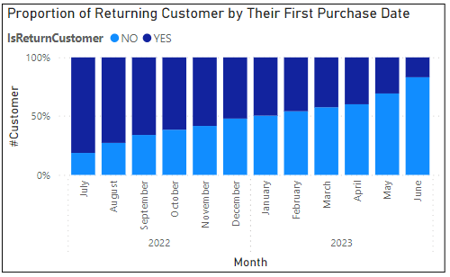
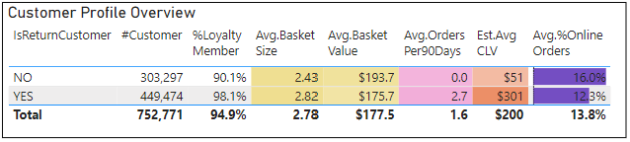
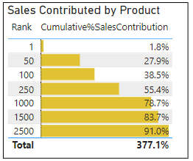
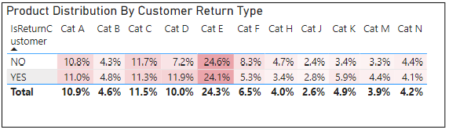
Diagnostic Analysis
Customer Retention
Customer Shopping Pattern
Product Purchase Pattern
With an average days between orders of 18, it is seen that proportion of returning customers* is declining over the past year.
In terms of single-order shopping pattern, non-returning customers are mostly indifferent from returning customers. The only notable difference is that non-returning customers seem to be acquired more from online channels.
With c.a.17,000 products available, top selling 2,500 products contributed 90% sales. Product preferences are highly concentrated.

Slide 3
Problem Statement
1. Compared to non-returning customers, returning customers are more valuable with a significantly higher average customer lifetime value (CLV), It is important to develop effective marketing strategy to improve the customer retention.
2. Since non-returning and returning customers have similar single-order shopping pattern and product preference, it is expected that recommending products to non-returning customers based on returning customers’ choices will be an solution.
The goal is to create a customer-segment-based product recommendation engine to help to make our first-time buyers return!

Slide 4
Methodology Formulation
Know Your Customer
Classify Your First Time Buyer
Recommend to Your First Time Buyer
Customers’ recency, frequency, monetary, and product preference related features were engineered*
Using segment outputted from Step 1, a supervised classification model is trained using features only reflecting single-purchase behaviours.
All first-time buyers were than been classified using this model.
Based on the classified segment for the first-time buyers. Product recommendation can be made focusing on:
- Products that were bought together by their peer returning customers
- Product that were bought in the next order by their peer returning customers.
Based on above engineered features, an unsupervised segmenting exercise was performed on returning customers. The goal is to provide a comprehensive the characterises of the customer base.
Evaluation
Pros:
It is usually hard to clearly picture the first-time buyers or non-returning customers. In this method, they are not viewed and modelled in insolate, rather a picture of what their comparable peer returning customers look like is accessible.
Common modelling methods for product recommendation engine such as collective filtering, usually unfriendly to customers with only single transaction records. This segment-based recommendation can mitigate this problem.
Cons:
Product recommendation results highly depends on the quality of the segmenting task and the classification task.
*For full feature engineered list, please view appendix Feature Engineered.

Slide 5
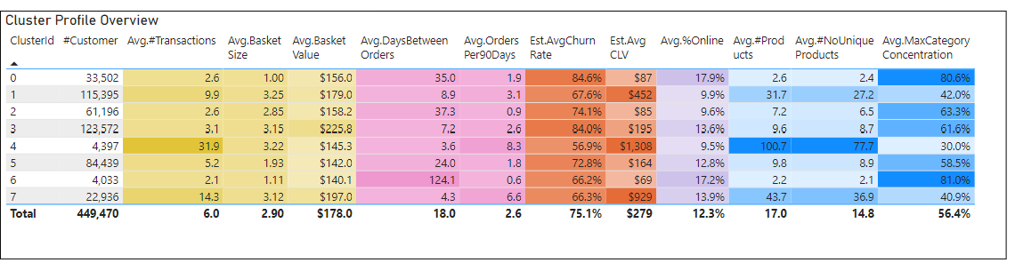
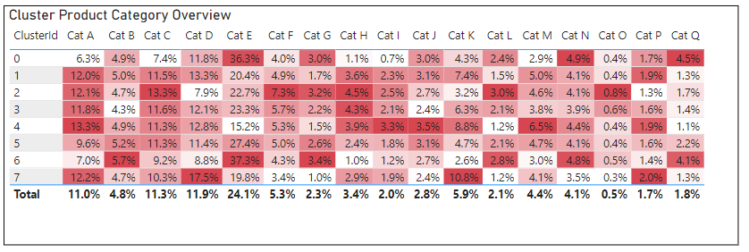
Know Your Customers
- Feature Selection: Features were selected to ensure that they are not correlated with each other, and also related to customer lifetime value (CLV). Some numerical features such as average basket, were categorised into bucket to ensure the robust of the segment model.
- Model Selection: K-Means is the algorithm used for the segmenting exercise.
- Model Training & Evaluation: Three metrics were used to evaluate the model performance:
Inertia: to ensure the formed segments are low in terms of in-cluster variance
Minimal Distance across clusters: to ensure the formed clusters were distant enough with each other, this is key to ensure the robustness of the trained model.
Product Category Concentration: product category concentration by each cluster were also monitored. This is to ensure the formed cluster is capable to reflect the product preference difference.
Please note cluster 1, 4, 7 are characterized as high-frequent buyers, where first-time/non-returning customers definitely not belong to. Hence only remaining clusters were used for the next classification exercise.

Slide 6
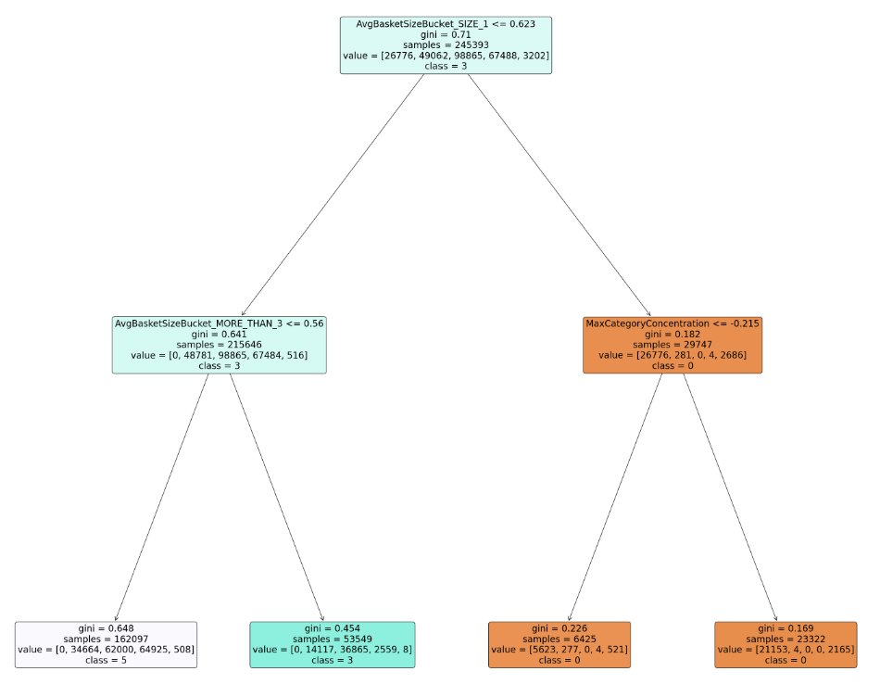
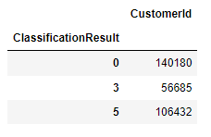
Classify First-time Buyers
Classification Decision Tree:
- Feature Selection: Only Features related to single-purchase behaviors and product preferences were used. This is to avoid the bias introduced by #purchases. Only when such biases were avoided, non-returning customers and first-time buyers can be classified into identified customer segments on an unbiased basis.
- Model Selection: Decision Tree is selected, given it has good interpretability and relatively simple to be trained. Given the #features selected is relatively few, a complex classification might overfit
- Model Training & Evaluation: F1 score is the main metrics that monitored when training and evaluating the model
Classification Results on Non-Returning/First-time Buyers

Slide 7
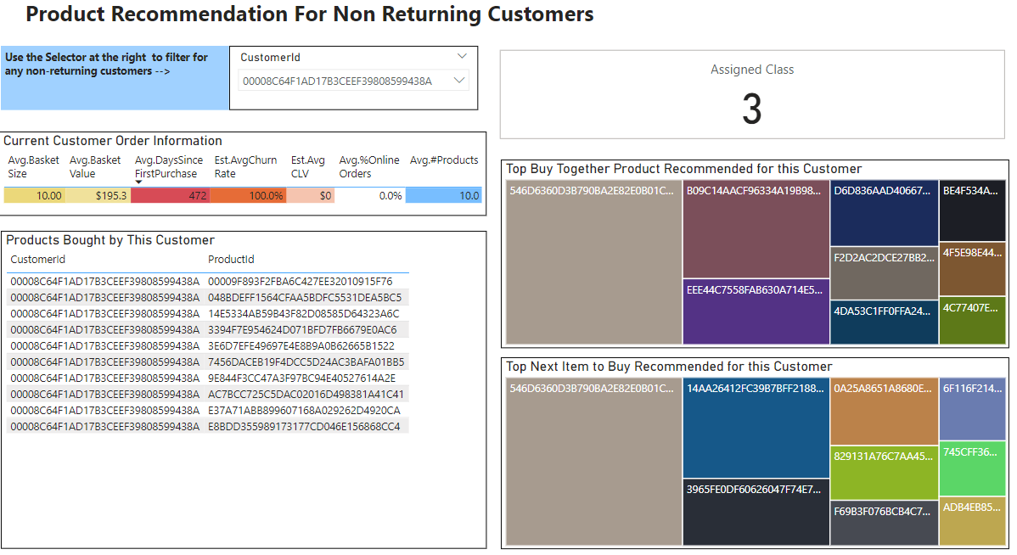
Recommend Products to Your First Time Buyer
Product Recommendation Engine Demo. For details, please refer to the associated PowerBI File:

Slide 8
Future Implementation & Evaluation
Products Often Bought Together
Evaluation
Given first-time/non-returning buyers are often acquired online/ via other apps. In-page recommendation on product bought together can be made when they browse the page or ready to make a payment
This recommendation strategy can be easily extended to returning customers too.
Marketing strategy evaluation such as A/B testing should be implemented to monitor the effectiveness of such campaigns.
Current Top-N based product recommendation engine can be further developed to embed solutions such as collective filtering, to support more personalised product recommendation.
Product Often Bought Next
Personalised emails can be send to the first-time/non-returning buyers on a regular basis to promote products that are often bought next by their peer returning customers, discounts can be offered for these products, too.

Slide 9
Thank You
Cecilia Meng | P: 0424495928 | E: wabi1171039353@gmail.com

Slide 10
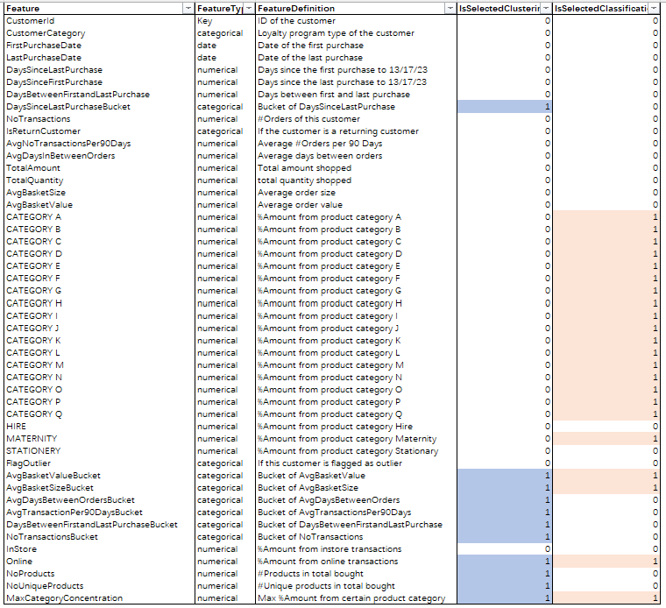
Appendix: Feature Engineered & Selected

