Slide 1
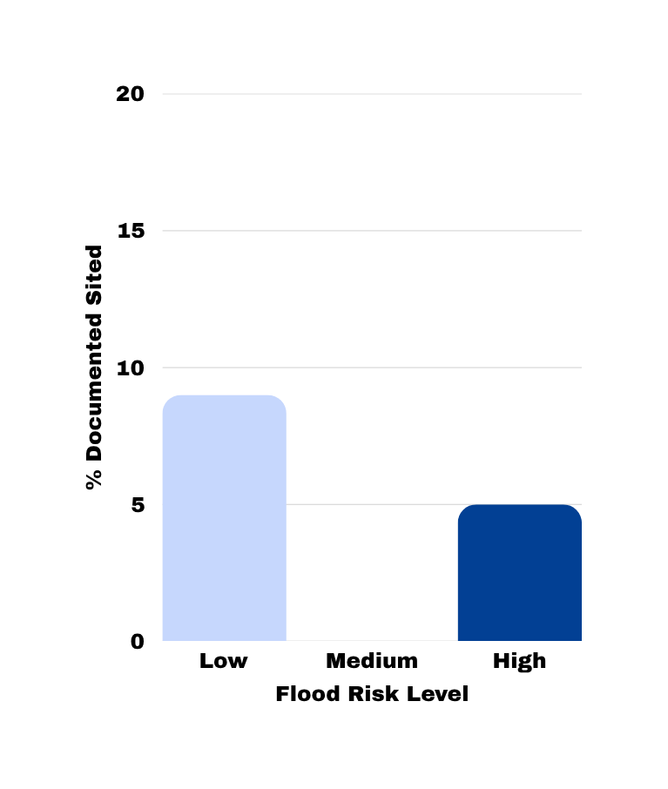
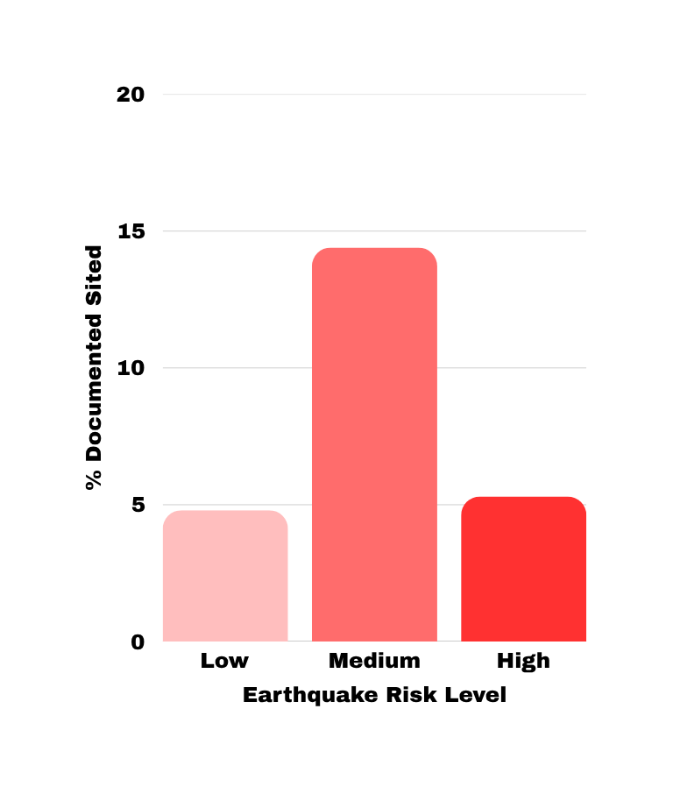
Artresearch:
Environmental Risk vs. the Digitization of Archaeological Sites
Data Analysis:
The graph reveals a complete lack of correlation between a territory’s level of risk and the digitization of sites. The trend appears unrelated to environmental priorities: the peak in documentation for flood risk is found at sites with a “Low” risk (9%), while for earthquake risk, it is found at sites with a “Medium” risk (14.4%). The data on high-risk sites is concerning, as coverage remains at a critically low 5% in both scenarios.
Interpretation and Critical Conclusion:
The analysis indicates that preventive conservation does not drive digitization processes (which are likely driven by considerations of tourist appeal). However, a structural limitation inherent in the digital cultural heritage ecosystem emerges: the absence of a shared unique identifier (URI) between Wikidata and ArtResearch, combined with inconsistencies in the tagging of site names, fragments the data. The exact matching method applied inevitably resulted in false negatives (actual sites not found), demonstrating how the lack of interoperable semantic standards hinders the monitoring and protection of the historical memory of endangered heritage.
1

