Slide 1
Big Data Applications Symposium - Fall 2017
Project Name:
Your Neighborhood Finder
Team:
Abstract:
We are buiding a living area recommendation system that can output a list of neighborhoods in United States for user according to his / her personal demands.
Oukan Fan
Xi Huang
Yanyu Zhang

Slide 2
Your Neighborhood Finder
Motivation
Who are the users of this application?
People who want to relocate in the U.S. but have no idea where is the best living place.
Who will benefit from this application?
People who want to find a living area in the U.S. and know more about it.
Why is this application important?
People keep relocating during their lifetime. Due to the nature of diversity among different cities, it has always been a difficult decision to make to choose an area that makes them feel most comfortable to live in. Our application can make it easier.

Slide 3
Your Neighborhood Finder
Remediation
What actuation(s) or remediation actions are performed by the application?
Based on various datasets, our application provides an quantified method for people to choose their living, which leads to more persuasive recommendations that people can refer to other than just making the decisions by stereotypes or some random thoughts.

Slide 4
Your Neighborhood Finder
Data Sources
Name: House-renting Price Dataset by Zillow
Description: Home value and rental price data by state, metro, city, zip code in the U.S.
Size of data: 60 MB
Name: United States Crime Rate Dataset
Description: Crime data and crime rate by city of the U.S.
Size of data: 337 KB
Name: Demographic Dataset
Description: Population structure by county in the U.S.
Size of data: 135 MB

Slide 5
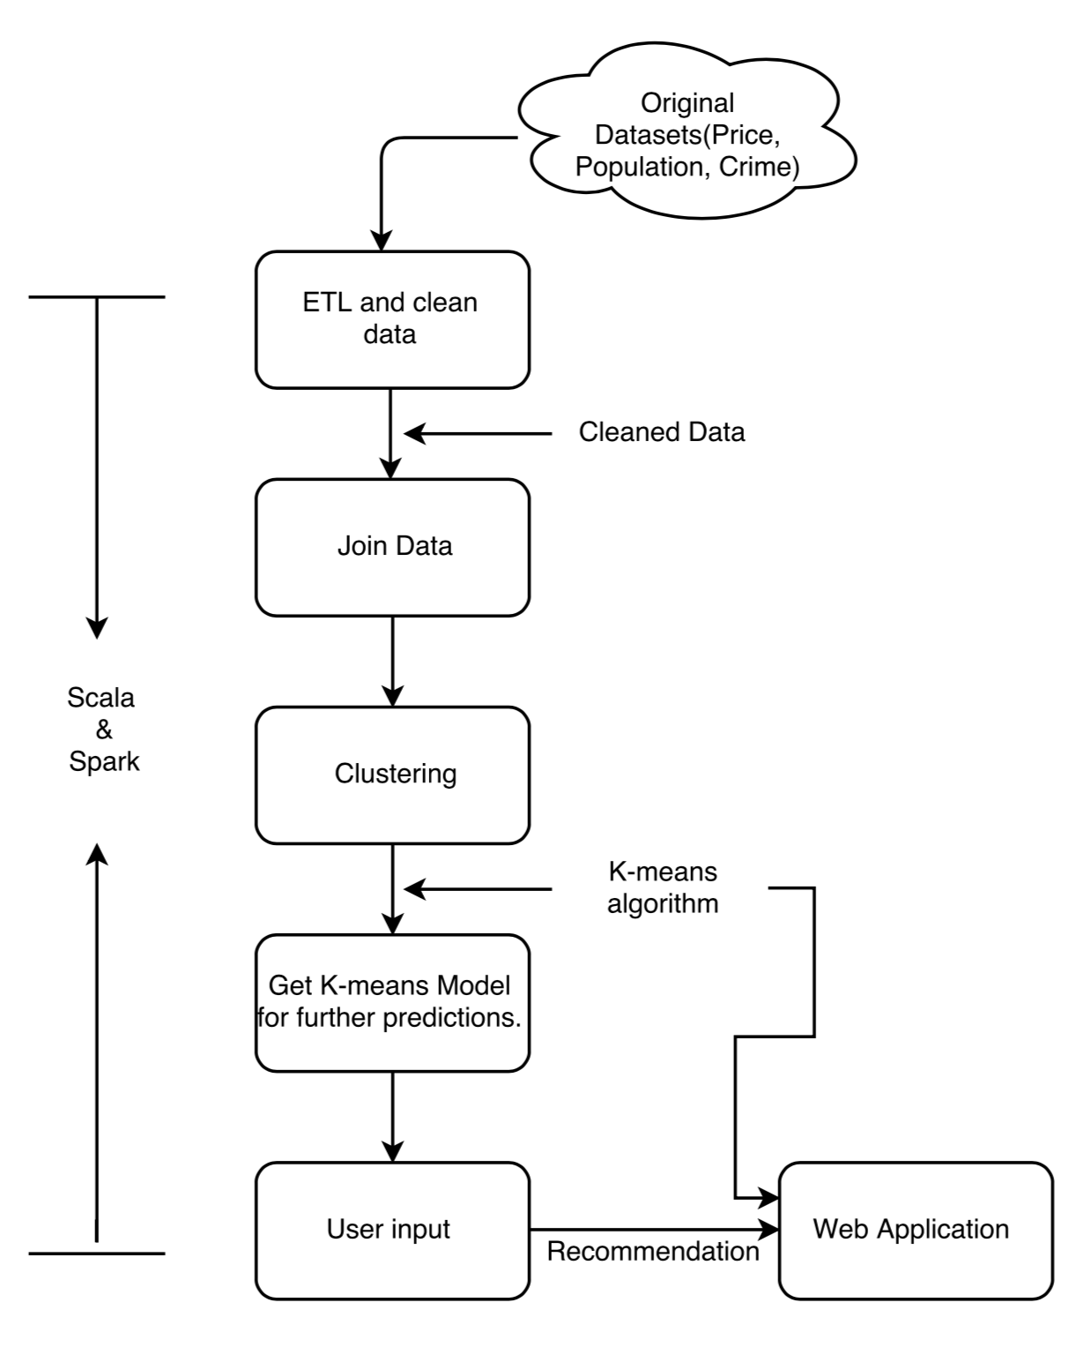
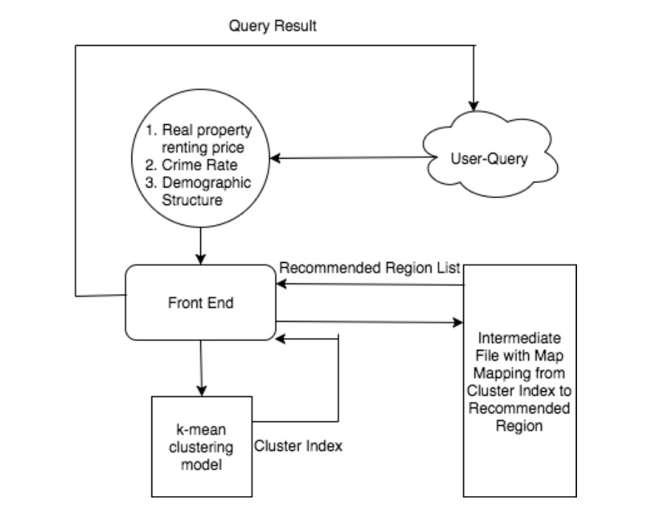
Your Neighborhood Finder
Design Diagram
Platform(s) on which the application runs:
Quickstart VM, Dumbo, Local Virtual Environment.

Slide 6
Your Neighborhood Finder
Experiments/Results
1. To test the goodness of experiments, we use computing WSSSE(Within Set Sum of Squared Errors) to evaluate clustering.
Test ID | Number of Cluster | Number of Interation | WSSSE(Within Set Sum of Squared Errors
1 | 500 | 50 | 6302.72309
2 | 1000 | 50 | 3008.96067
3 | 2000 | 50 | 9024.257221
4 | 2500 | 50 | 56149.3695
5 | 3000 | 50 | 37704.77441
6 | 2800 | 50 | 43402.57687
7 | 3200 | 50 | 42066.45644
8 | 3400 | 50 | 43066.45644

Slide 7
Your Neighborhood Finder
DEMO PART!
NYU CIMS (Currently running):
http://linserv2.cims.nyu.edu:26292

Slide 8
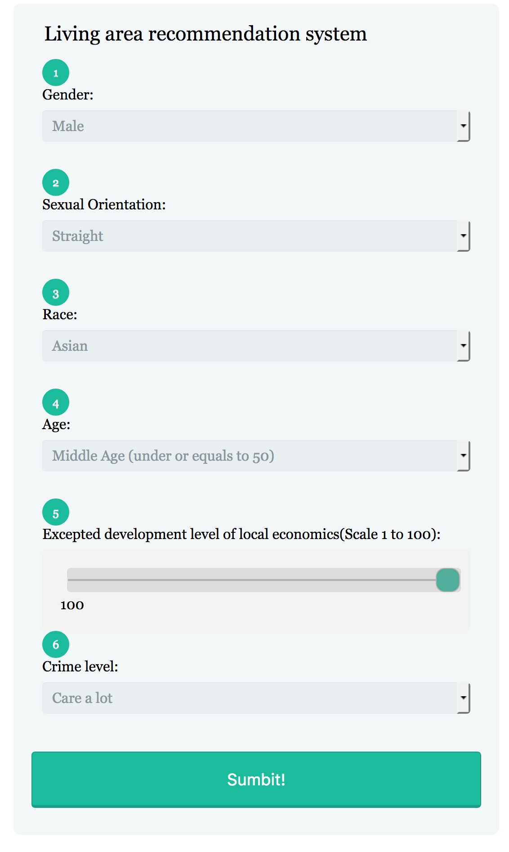
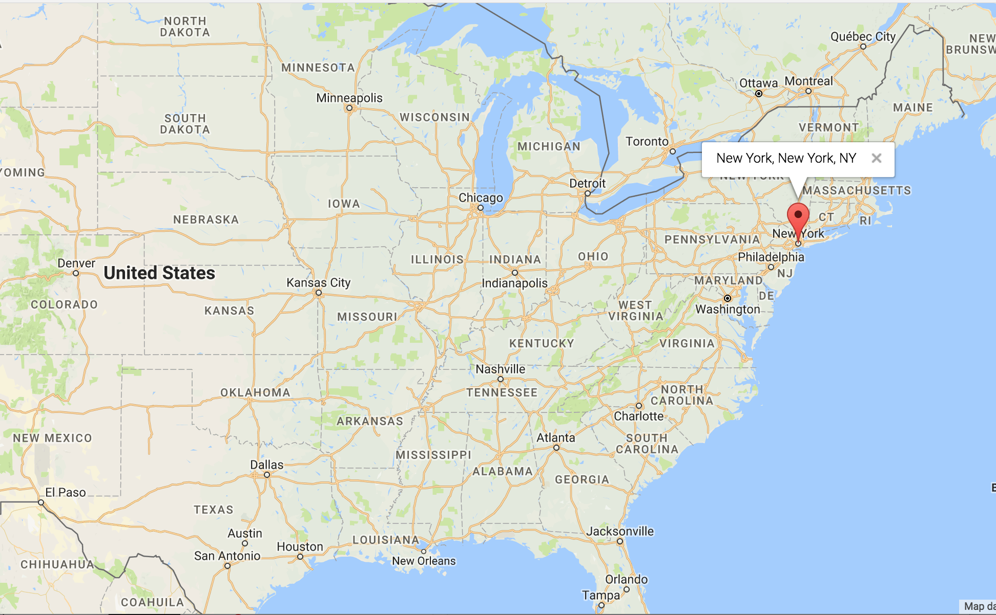
Your Neighborhood Finder
Predict Example 1:
NYU CIMS (Currently running):http://linserv2.cims.nyu.edu:26292
With such input, it shows our user wants to live in an area with super blooming economy, and the recommendation result is NYC

Slide 9
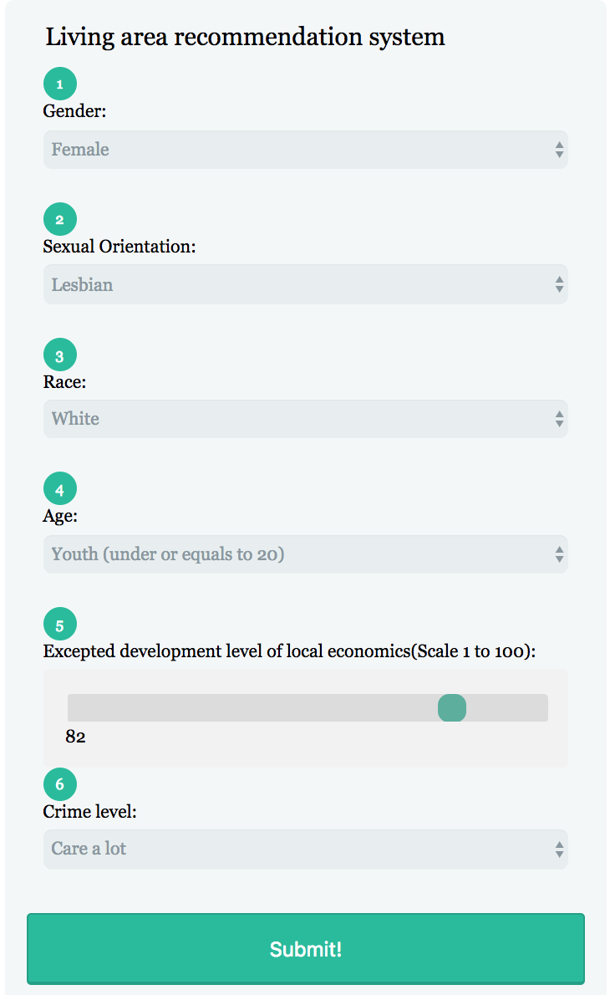
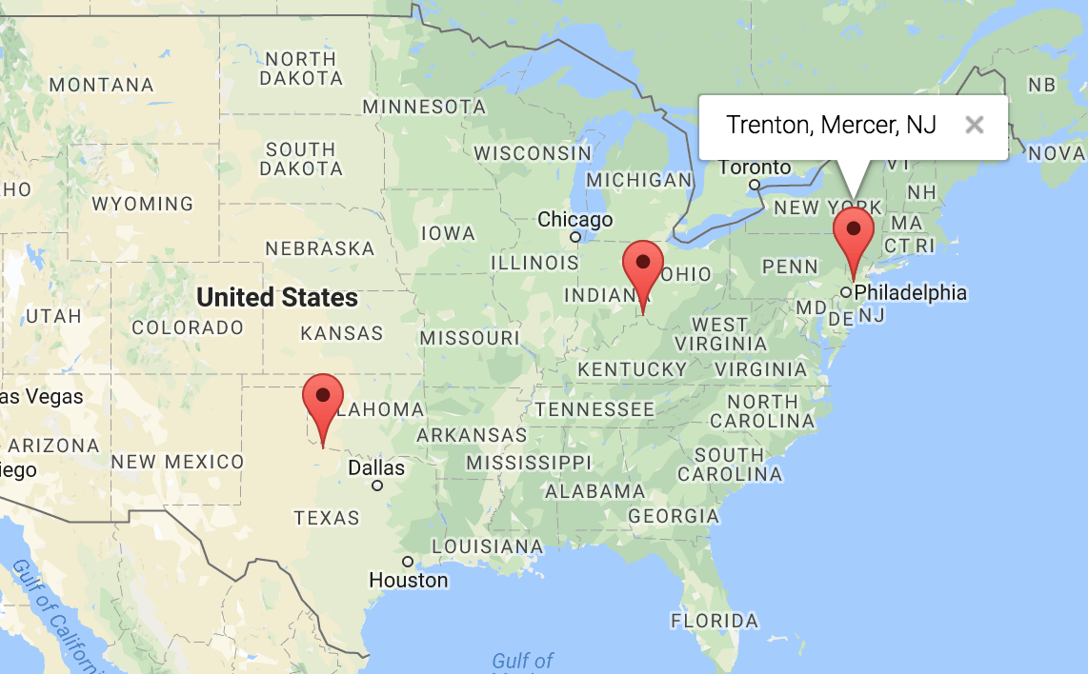
Your Neighborhood Finder
Predict Example 2:
The recommendation result are cities with mostly white population and youth, whose local economy is also good

Slide 10
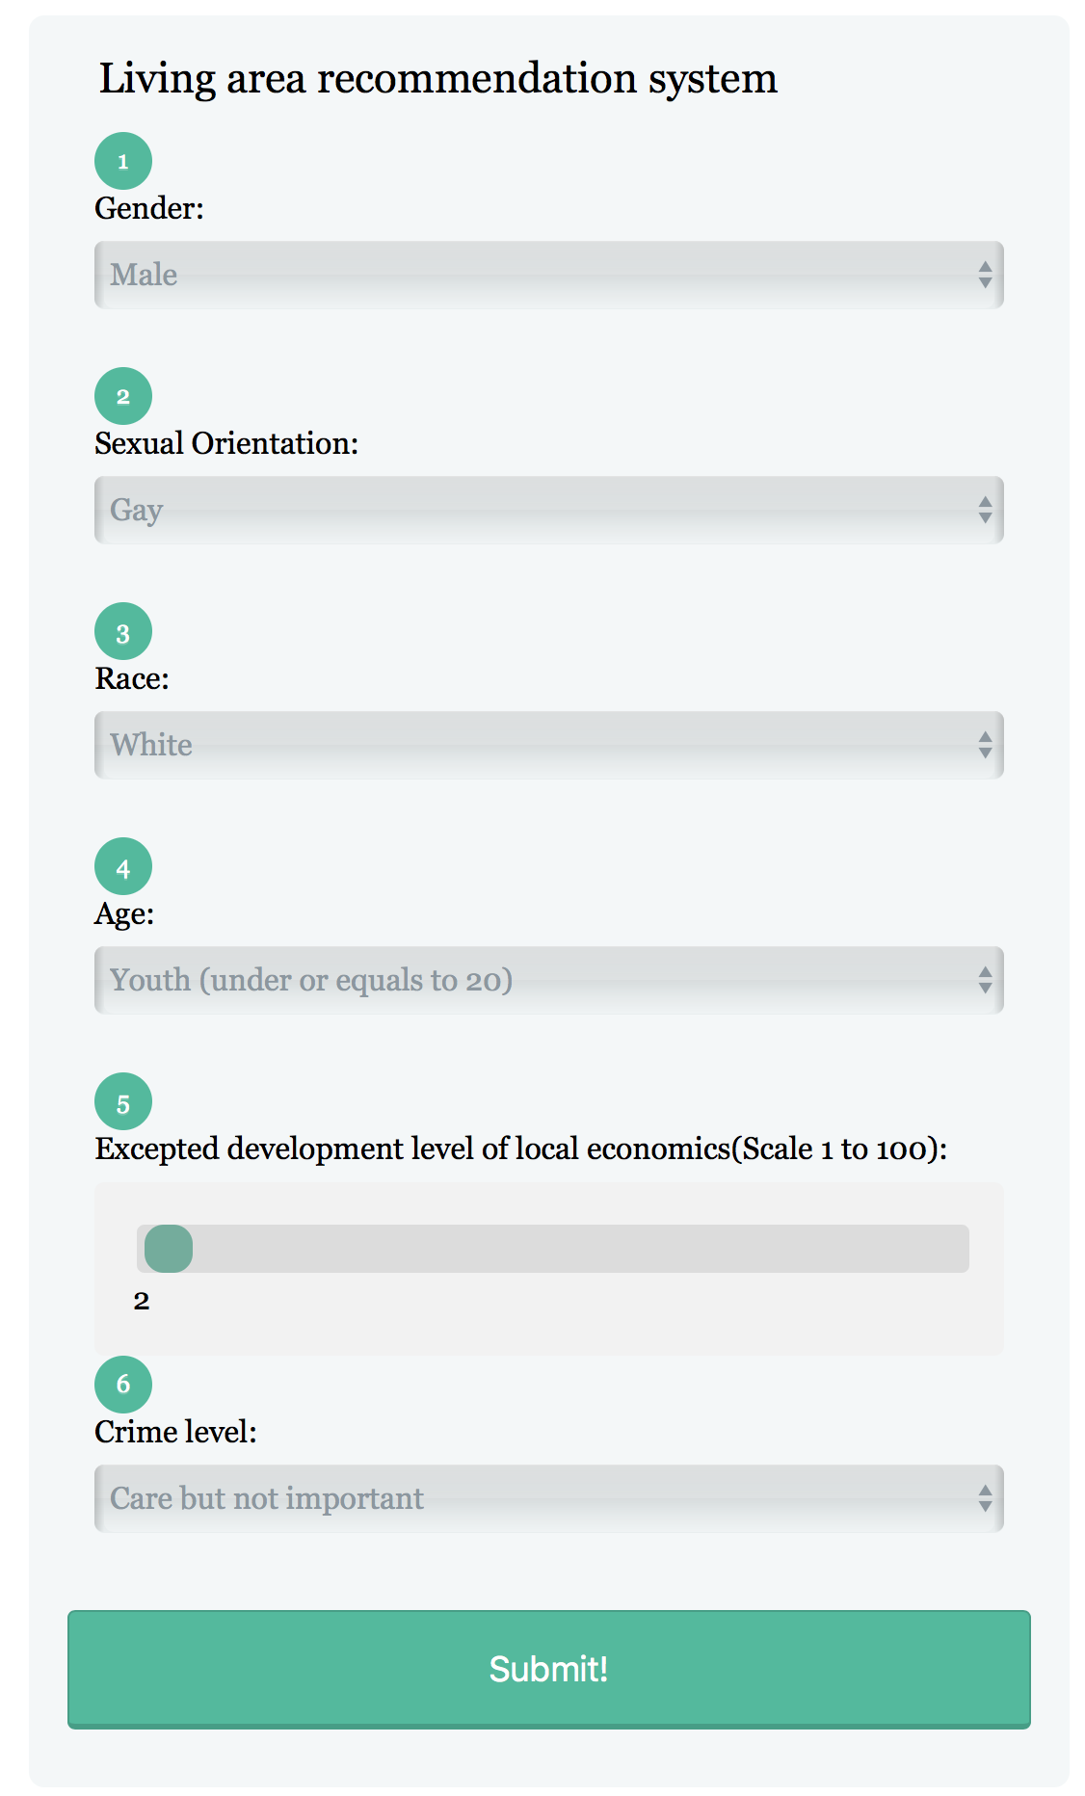
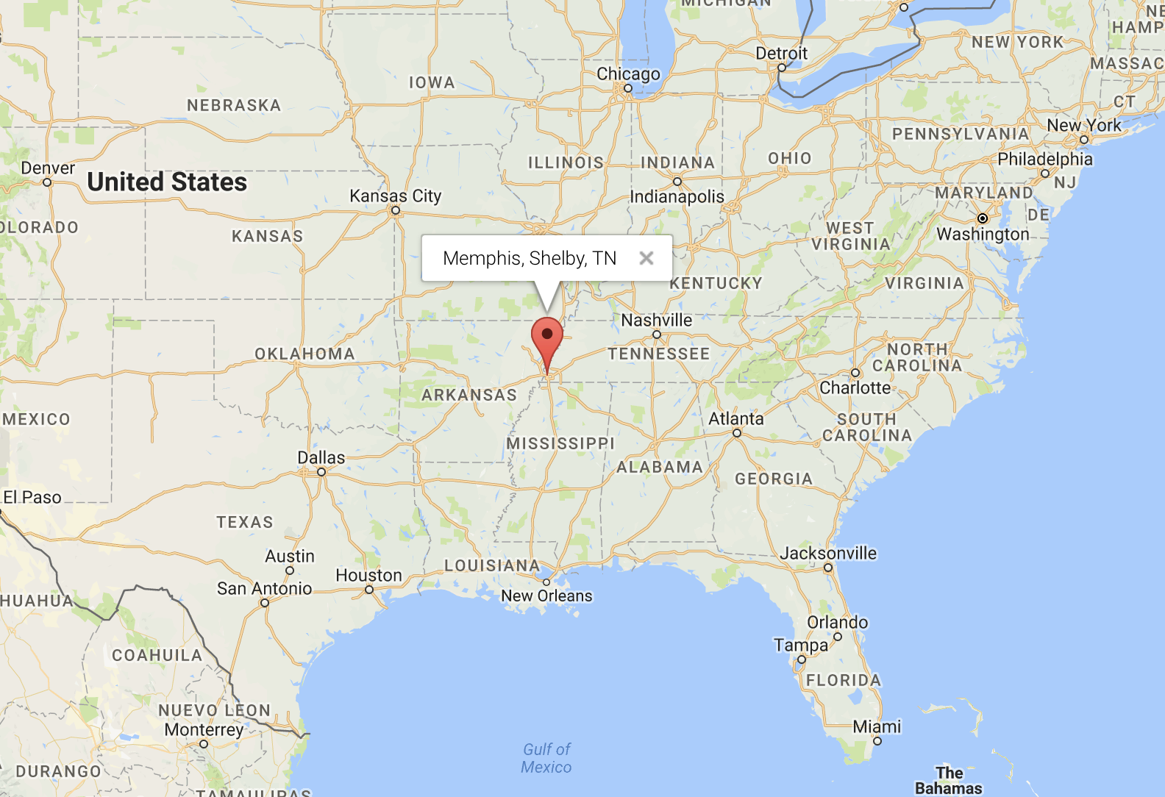
Your Neighborhood Finder
Predict Example 3:
The recommendation result are cities with mostly white population and youth, whose local economy is under-developing

Slide 11
Your Neighborhood Finder
Obstacles
1. How to join dataset?
Different location formats in datasets
state, county, city, zip code
Unify the format of county, state names
Join data based on county and state
2. How to transform user input to parameters feeding our model?
Profiling the dataset
Design the questions properly
Assigning reasonable weights to each answer option

Slide 12
Your Neighborhood Finder
Summary
Collect several related datasets
Parse and clean data with Spark
Join and perform clustering using Spark and Spark MLlib
Build UI to ingest user input and provide visualized results
Acknowledgements
Professor Suzanne McIntosh
Zillow, Kaggle and U.S. government Census for providing these datasets for free
Google Maps for providing map service
NYU HPC, CIMS

Slide 13
Your Neighborhood Finder
References
[1] Shyam Varan Nath, Crime Pattern Detection Using Data Mining, Proceedings of the 2006 IEEE/WIC/ACM international conference on Web Intelligence and Intelligent Agent Technology, p.41-44, December 18-22, 2006.
[2] Neli Esipova, Anita Pugliese, and Julie Ray, 2013 May, “381 Million Adults Worldwide Migrate Within Countries”, GALLUP News.
[3] Jie Bao, Yu Zheng and Mohamed F.Mokbel: Location-based and Preference-Aware Recommendation Using Sparse Geo-Social Networking Data. SIGSPATIAL ’12 Proceedings of the 20th International Conference on Advances in Geographic Information Systems. Pages 199-208.
[4] Zillow Median Home Value DataSet. [Online]. Available: https://www.zillow.com/research/data/.
[5] Róbert Pálovics, Péter Szalai, Júlia Pap, Erzsébet Frigó, Levente Kocsis, András A.Benczúr. Location-aware online learning for top-k recommendation. Pervasive and Mobile Computing. Volume 38, Part 2, July 2017, Pages 490-504

Slide 14
Your Neighborhood Finder
Thank you!

