Slide 1
Big Data Applications Symposium - Fall 2017
Project Name: Your Neighborhood Finder
Team:
Oukan Fan
Xi Huang
Yanyu Xhang
Abstract: we are buiding a living area recommendation system that can output a list of neighborhoods ranking in United States for user according to his/her demands.

Slide 2
Your Neighborhood Finder
Motivation
Who are the users of this application?
People who want to find a living area in USA.
Who will benefit from this application?
People who want to find a neighborhod and want to know more about the living area in USA.
Why is this application important?
People keep relocating during their lifetime. Due to the nature of diversity between different cities and counties, it has always been a difficult decision to make to choose an area that makes them feel most comfortable to live in. So our application can make it eaiser.

Slide 3
Your Neighborhood Finder
Remediation
What actuation(s) or remediation actions are performed by the application?
Our application can take user’s input such as price for living area, crime rate, population structure, people age distribution. And with these input, our application will give a result for recommendation living area to user.

Slide 4
Your Neighborhood Finder
Data Sources
Name: Zillow Data
Description: Zillow data contains about home value and rental price data group by state, metro, city, zip code.
Size of data: 60 MB
Name: Crime data with population and crime rate.
Description: Crime data and crime rate by city of the United States, which could used for calculating the crime data for each city.
Size of data: 300 KB
Name: Demographic Data.
Description: Population structure in each cities and counties.
Size of data: 100 MB

Slide 5
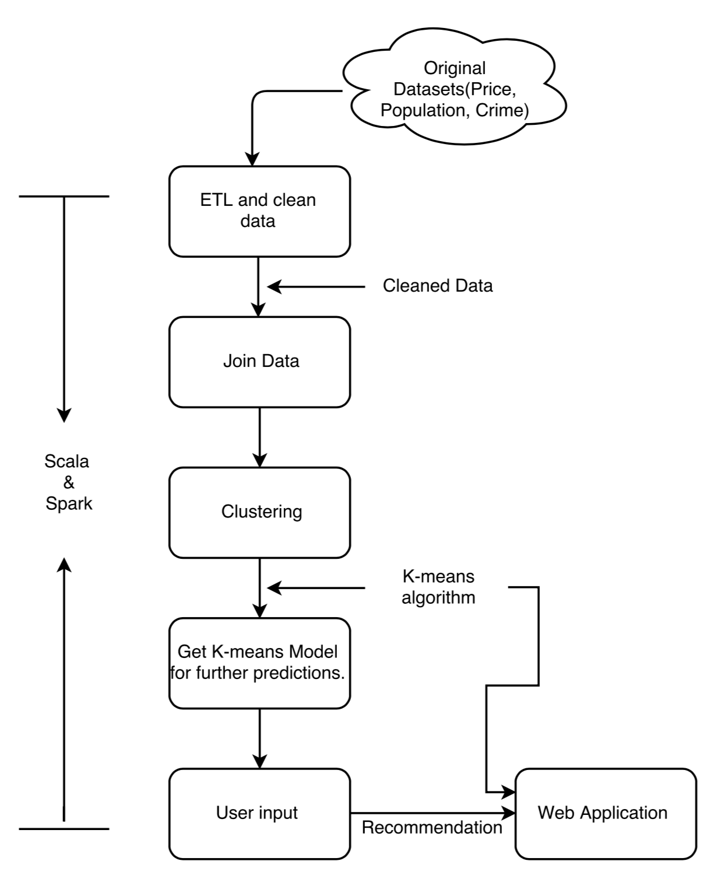
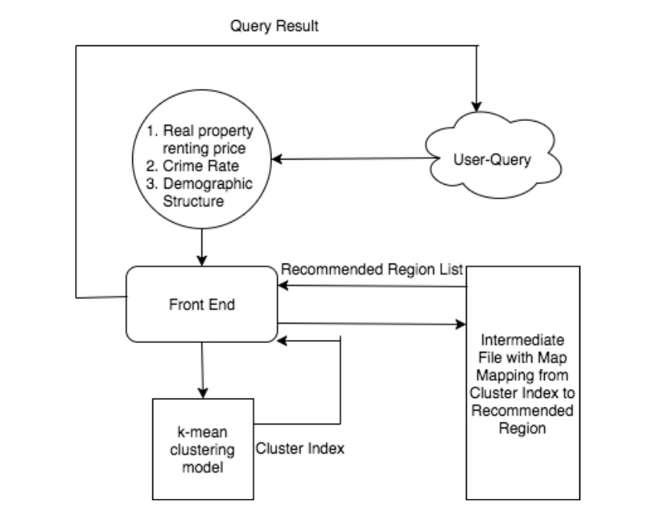
Your Neighborhood Finder
Design Diagram
Platform(s) on which the application runs:
Quickstart VM, Dumbo, Local Virtual Environment.

Slide 6
Your Neighborhood Finder
Experiments/Results
1. <Result 1>
<Tell us about experimental results, insights, or other key observations.>
2. <Result 2>
3. <Result 3>

Slide 7
Your Neighborhood Finder
Obstacles
1. How to join dataset
Our datasets have different format and we need join the data by county, city, state and zip code. We need to find each county, city, zip code and state information for each single row data and join them, which costs us a lot of time.
2. How to evaluate the data for each cluster.
In our data, just like the population structure in each area, it’s hard to evaluate them and give users a choice to choose their preference, we need make it proper to let it come out with right result and right aggregation.

Slide 8
Your Neighborhood Finder
Summary
With Your Neighborhood Finder, you can use it as your living area recommendation tool or a search tool for a living area. And you can get the information for those recommendation area as well.
Acknowledgements
We would like to express our sincere gratitude to our respected Professor Suzanne McIntosh, supported us and assisted us whenever we came across difficulties during this course project.
We also want to thank Zillow, Kaggle and U.S. government census for sharing the data for free.

Slide 9
Your Neighborhood Finder
References
Shyam Varan Nath, Crime Pattern Detection Using Data Mining, Proceedings of the 2006 IEEE/WIC/ACM international conference on Web Intelligence and Intelligent Agent Technology, p.41-44, December 18-22, 2006.
Neli Esipova, Anita Pugliese, and Julie Ray, 2013 May, “381 Million Adults Worldwide Migrate Within Countries”, GALLUP News.
Jie Bao, Yu Zheng and Mohamed F.Mokbel: Location-based and Preference-Aware Recommendation Using Sparse Geo-Social Networking Data. SIGSPATIAL ’12 Proceedings of the 20th International Conference on Advances in Geographic Information Systems. Pages 199-208.
Zillow Median Home Value DataSet.
Róbert Pálovics, Péter Szalai, Júlia Pap, Erzsébet Frigó, Levente Kocsis, András A.Benczúr. Location-aware online learning for top-k recommendation. Pervasive and Mobile Computing. Volume 38, Part 2, July 2017, Pages 490-504

Slide 10
Your Neighborhood Finder
Thank you!

