Slide 1
Online Analytic Processing
COMP323 Chapter 5

Slide 2
Outline
Sequence of queries in a typical analysis session
OLAP features:
Multidimensional data analysis
Complex calculation
Speed of thought
OLAP architecture
Client and server
XMLA and MDX
Defining a cube
MDX basics
Notes:
Read Chap 1 in Rizzi, Chap 15 in Ponniah

Slide 3
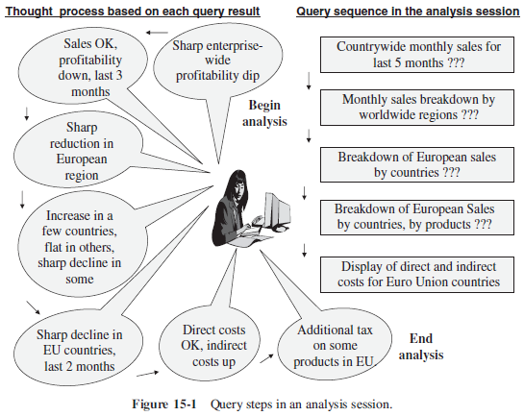
A typical analysis session

Slide 4
Queries in a typical analysis session
Why profitability dipped sharply in recent months in the entire enterprise?
What are the overall sales for the last five months for the entire company, broken down by individual months?
The sales do not show a drop, but there is a sharp reduction in profitability for the last three months.
Give me a breakdown of monthly sales by major worldwide regions.
The European region is responsible for the reduction in profitability.
Give me a breakdown of European sales by individual countries.
Profitability has increased for a few countries, decreased sharply for some other countries, and been stable for the rest.
Give me a breakdown of profitability for the European countries by country, month, and product.
Very sharp decline in profitability for the last two months for some products in the countries.
Display the direct and indirect costs for European countries of those products.
Direct costs (e.g. manufacturing) remain at the usual levels, but the indirect costs have shot up.
The decline is due to additional tax levies on some products in the EU.

Slide 5
Online Analytical Processing
Online Analytical Processing (OLAP) is a category of software technology that enables analysts, managers and executives to gain insight into data through fast, consistent, interactive access in a wide variety of possible views of information that has been transformed from raw data to reflect the real dimensionality of the enterprise as understood by the user. (from OLAP council)
Major features:
Multidimensional data analysis
Complex calculation
E.g. margin (sales – cost), percentage of parts to the whole, moving average, growth percentage, trend analysis using statistical methods
Speed-of-thought response
Critical to maintain the train of thought in interactive analysis session

Slide 6
Multidimensional data analysis
Multidimensional data analysis supports complex analysis along several business dimensions, at any level of aggregation, and provide a multidimensional view of data
Multidimensional data model conforms to how the users perceive business problems.
Able to handle multidimensional query (e.g. "how much revenue did the new product X generate during the last three months, broken down by individual months, in the south central territory, by individual stores, broken down by promotions, compared to estimates, and compared to the previous version of the product?")
OLAP operators convert one multidimensional view to another

Slide 7
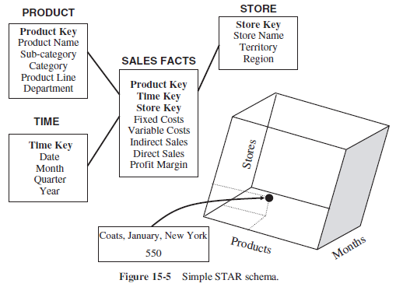
Example: Sales Fact

Slide 8
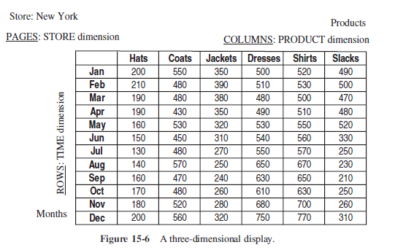
Display multidimensional data
We can display the result of a query on the cube by assigning a dimension (at a chosen aggregation level) to columns, rows and pages.

Slide 9
Sample queries and results, 1
Display the total sales of all products for past five years in all stores
Rows: year numbers 2011, 2010, 2009, 2008, 2007
Columns: total sales for all products (one column only)
Page: all stores (one page only)
Compare total sales for all stores, product by product, between year 2011 and 2010.
Rows: year numbers 2011, 2010; difference; percentage increase or decrease
Columns: one column per product, showing all product
Page: all stores (one page only)
Show comparison of total sales for all stores, product by product, between year 2011 and 2010 only for those products with reduced sales.
Rows: year numbers 2011, 2010; difference; percentage increase or decrease
Columns: one column per product, showing only the qualifying products
Page: all stores (one page only)

Slide 10
Sample queries and results, 2
Show comparison of sales by individual stores, product by product, between year 2011 and 2010 only for those products with reduced sales.
Rows: year numbers 2011, 2010; difference; percentage increase or decrease
Columns: one column per product, showing only the qualifying products
Page: one store per page
Show the results of the previous query, but rotating and switching the columns with rows.
Rows one row per product, showing only the qualifying products
Columns: year numbers 2011, 2010; difference; percentage increase or decrease
Page: one store per page

Slide 11
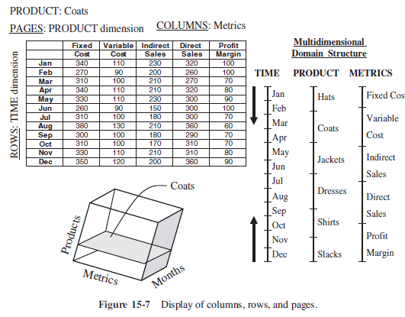
Multiple measures in the fact

Slide 12
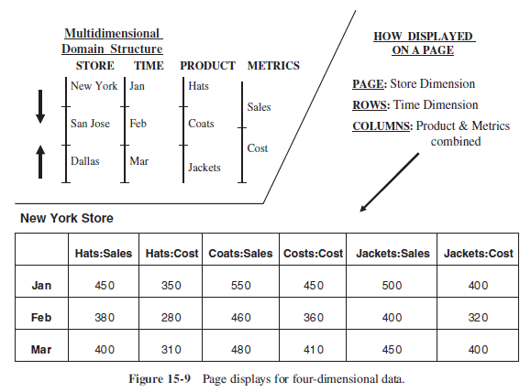
More dimensions
Display more than 1 dimensions on an axis

Slide 13
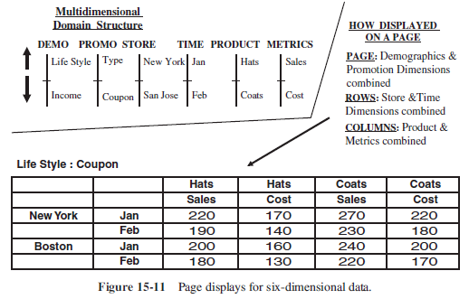
Example: Six dimensions

Slide 14
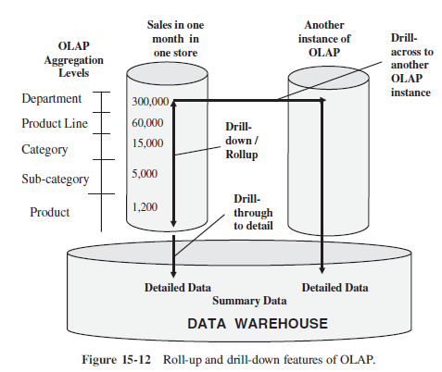
Common OLAP operators
Rollup along a hierarchy reveals less detail
Drill-down along a hierarchy reveals more detail
Drill-through shows the detail transaction data
Pivoting changes the axis of the multidimensional view
Slicing restricts the data used in calculation

Slide 15
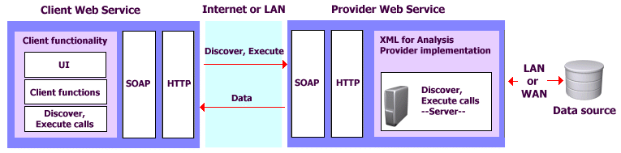
OLAP architecture
Client/Server architecture
XMLA
XMLA provider, XMLA consumer
Query language: MDX

Slide 16
Lab: MDX and the icCube OLAP engine
The MDX query language
Basic syntax: axis and slicer
Hierarchy navigation and member functions
Tuples and cross-join
Calculated members
Defining an OLAP cube (icCube)
Dimensions
Hierarchy and levels
Unique names for level and keys
Multiple hierarchies
Measures and fact

