Slide 1
Final Project MultiAgent for QA
Cecilia Nyberg
December 23, 2024

Slide 2
Contribution Overview
Creating the Database
Developing Additional Tools
Query Decomposition
Query Classifier
Chain-of-Thought Integration
Advanced Retrieval Techniques
Filtered Search and Query Expansion

Slide 3
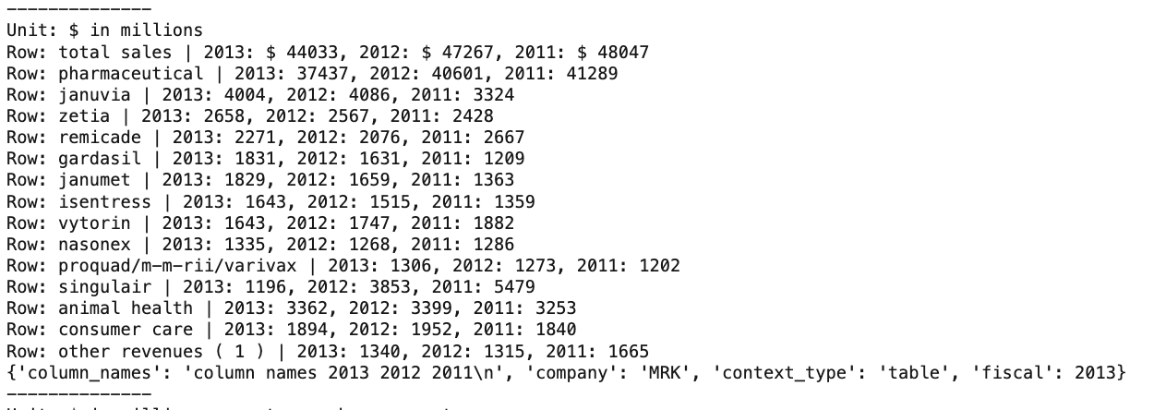
Creating the Database
Example of structured table
Experimented with multiple database structures
Structured tables into JSON objects for better results
Stored pre-text, post-text and structured table in the vectorDB
Adjusted chunk size and overlap for optimal accuracy
Achieved 25% accuracy with structured approach

Slide 4
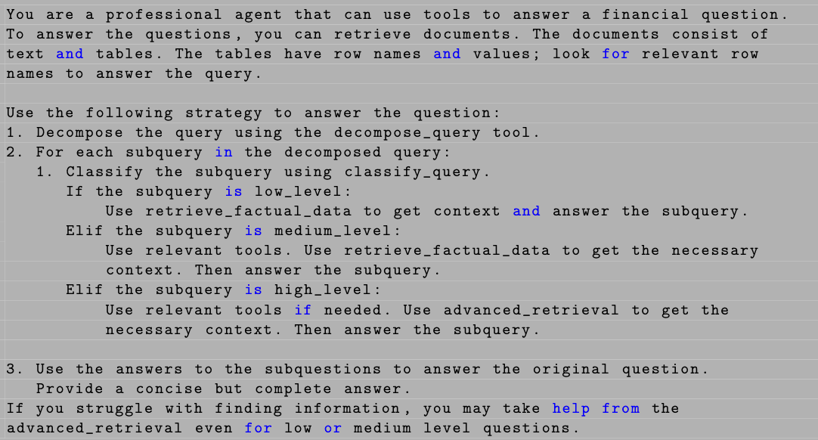
Prompting Planning Agent
Using Chain-of-though
Query decomposition
Classifications
Tools

Slide 5
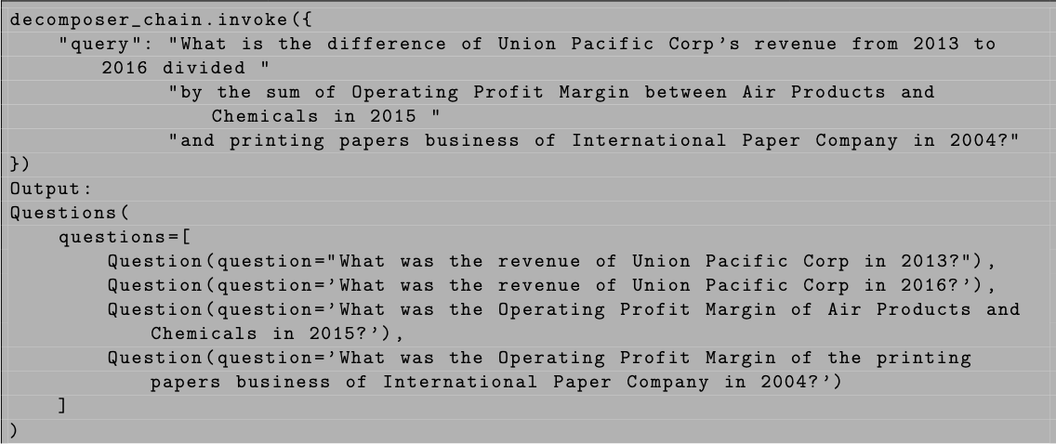
Query decomposition
Prompted LLM using few-shot learning
The Query decomposer performed well
Accuracy increased

Slide 6
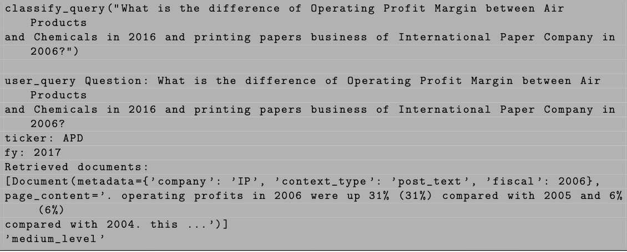
Query classifier
Prompted using examples
Gave access to database retrieval
Affected the difficulty level

Slide 7
Implemented tools
Tools for calculations: profit margin, percentage change, ratios
New tool for retrieval: advanced_retrieval

Slide 8
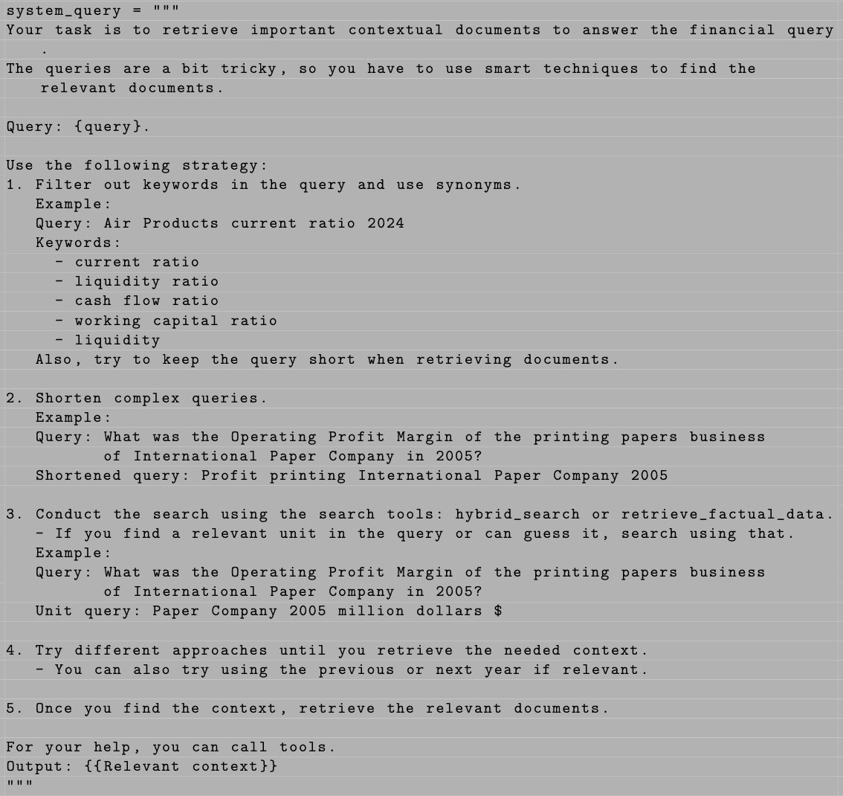
Retrieval Agent

Slide 9

Hybrid Search and Retrieval Improvements
Hybrid search combining semantic and keyword methods
Query expansion
Added filtered search strategies for improved document retrieval
Reasoning
Accuracy improved to 54% after adjustments

Slide 10
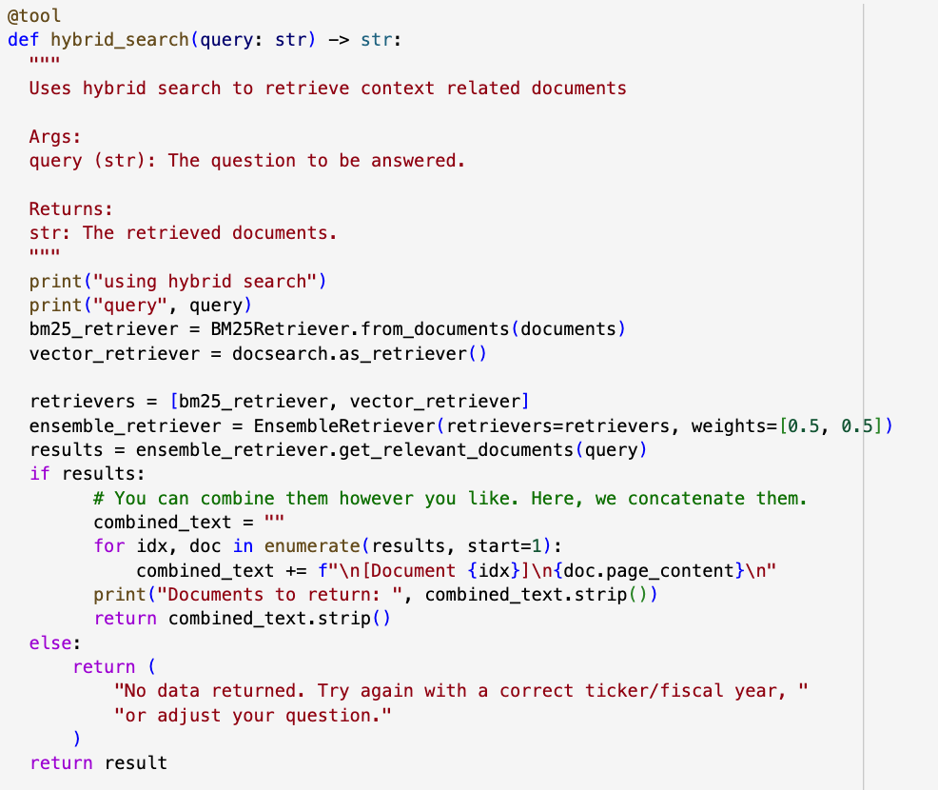
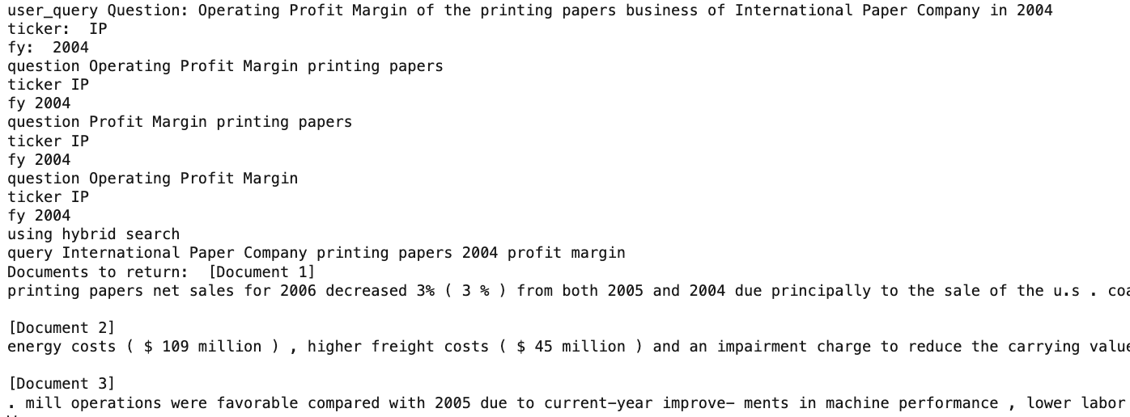
Hybrid search
Uses the BM25Retriever
Equal weight to both retrievers

Slide 11

Challenges and Additional Attempts
Some implementations lowered accuracy:
Synonym-based query expansion
Financial table lookup
Balance between strict and flexible instructions
Time constraints limited reranking implementation

Slide 12
Lessons Learned
Modular AI architectures improve task efficiency
Specialized agents reduce confusion and improve accuracy
Importance of isolating tasks like retrieval and generation

