Slide 1
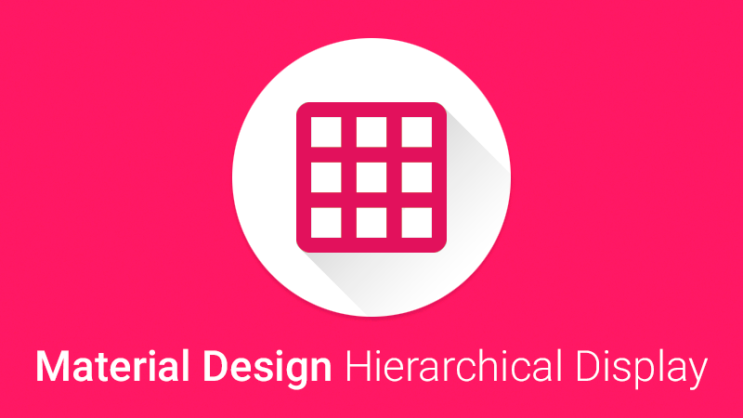
Client Side Programming (Assignment 2)
Tsvetoslav Dimov

Slide 2
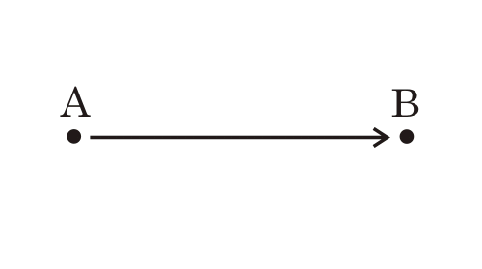
HIERARCHICAL DISPLAY
A jQuery & CSS3 solution to create the famous hierarchical timing display animation as introduced in Google Material Design's meaningful transitions.
It focuses your users attention in an app or how an app element got from point A to point B.

Slide 3
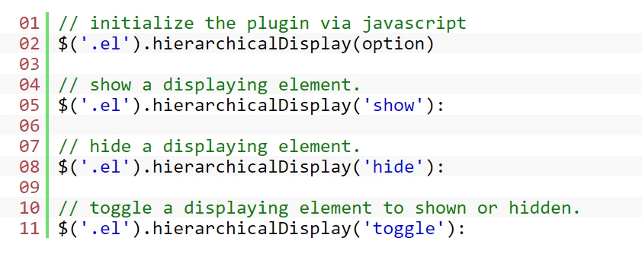
PUBLIC METHODS

Slide 4
IMPLEMENTATION
Step 1:
Load jQuery library and the jQuery Hierarchical Display plugin's stylesheet and JS files in the document.

Slide 5
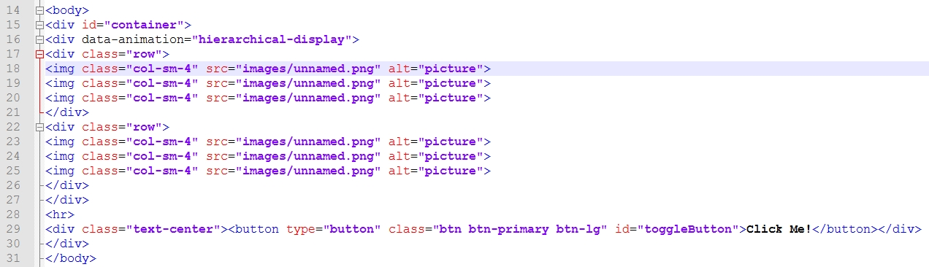
Step 2: Adding the data-animation="hierarchical-display" attribute to an element. Child elements of the element will automatically inherit the functionality.

Slide 6
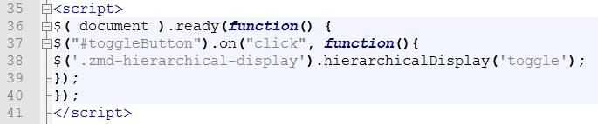
Step 3: Target the element you wish with jQuery.
Sources used:
http://www.jqueryscript.net/animation/Material-Design-Hierarchical-Display-Animation-with-jQuery-CSS3.html
http://zavoloklom.github.io/material-design-hierarchical-display/

