Slide 1
iChildlab
Introduction to Swift, Xcode, and building iOS experiments
Casey Colby, April 06 2015

Slide 2

Introducing Swift
2010: Development begins
2014: 1.0 Launched
2015: 2.0 released & made open-source (freely accessible to anyone who wants to try their hand at Apple app development)!
Current Version: 2.2
In progress: 3.0

Slide 3
Swift 2.2
Apple programming language for iOS (OSX, watchOS, tvOS) development
More concise, targeted alternative to Objective-C.
You can also create apps using a combination of Swift, Objective-C, C, and C++
Notes:
Pulls from many many programming languages (Objective-C, C#, Haskell, Ruby, Python, etc.)
Safer, simpler alternative to Objective-C syntax

Slide 4

Basics
Constant: let
Variable: var
Assignment: =
Comment: // single line
/* multiple lines
Types: String, Int, Bool, Double, Float, Array, Set, Dictionary
Loops: For-In, For, While, Do-While If, Switch
Standard Operators
Functions: startButtonPressed () {
//stuff that happens
}
No ; needed
Notes:
Optionals: neater way to handle variables that may have a value or no value
Don’t need a semicolon after each line

Slide 5

Optionals
Variable that may contain a value or no value, written with ?
Implicitly unwrapped optionals
often we know an optional contains a value
force-unwrap it in to access its value instead of explicitly unwrapping it in every use
Written with !
If we know it has a value why make it an optional?
Notes:
Not critical to understand, but you’ll run into a lot of questionmarks and exclamation points anytime you look at a swift program
Basically ! Keeps our code much cleaner
We can check for a value using if statements (if myAnswer != nil), but often we know an optional contains a value. So initialize it as an implicitly unwrapped optional and force-unwrap it to access its value instead of explicitly unwrapping it in every use
If we know it has a value why make it an optional?
Doesn’t have a value during initialization. E.g. buttons or images in a UIView and properties of these can’t be initialized until the view is loaded but we know they’ll have a value

Slide 6

Xcode 7.3
Integrated Development Environment (comprehensive application for software development) full of tools for iOS (tvOS, watchOS, OS X) software development
Not just for Swift app-building!– Compatible with 10 programming languages, build and run code directly
Notes:
Xcode 7.3 is latest version, for El Capitan release of OSX
IDE – has certain tools like source code editor, build tools, compiler, debugger – basically everything to translate your code from this high level human-understandable language into an executable computer language for whatever platform you’re working on… Everything to make an app!
Not just for apps – can use things like command line tools to complie and execute code
If you’re running on yosemite you can run xcode 7.2

Slide 7
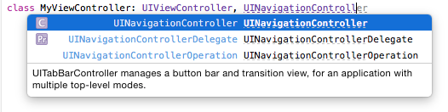
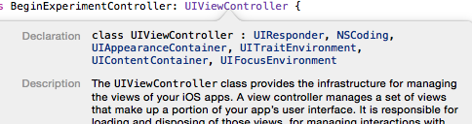
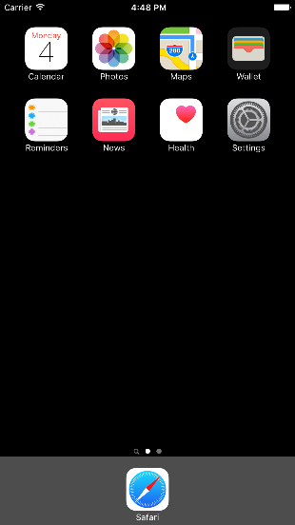

Key Features
Built-in Apple developer documentation: option-click the name of a variable, type, etc. to read about it
See errors as you work
Auto-complete as you type
Built-in iOS simulator

Slide 8
Do I need a developer account?
Not anymore (Xcode 7)!
Free account:
Build apps in the Simulator, preview on any apple device
Deploy apps on your own device for testing
Paid account ($99/yr):
Publish and distribute (in the App Store)
Notes:
Just register your device to your apple ID and add your account to your Xcode project
When you connect your device to the computer you’ll be able to deploy the app on your device
Only works on the device for a few weeks, just for testing purposes – once you want to distribute your app for actual use you’ll need to upgrade to a developer account

Slide 9
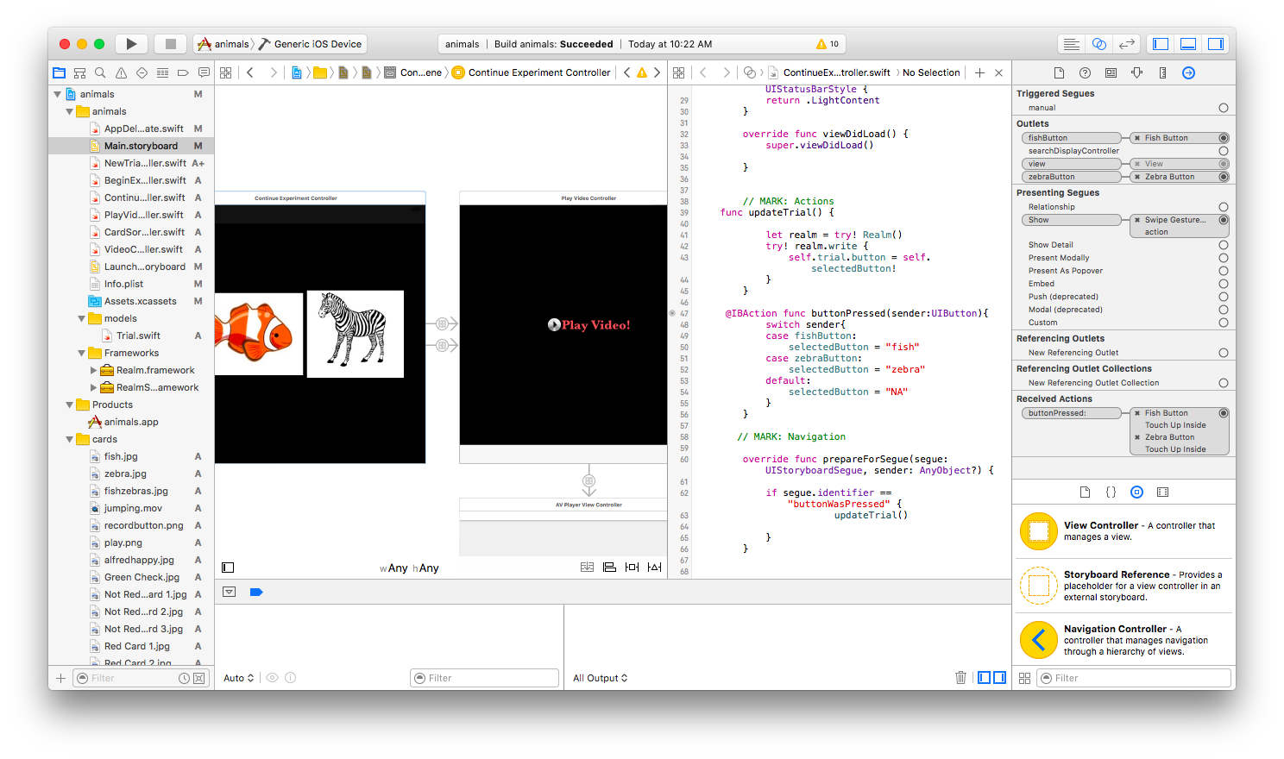
Interface Builder
Assistant Editor
Storyboard
Design your graphical user interface (what the user sees!)
Arrange app screens on a Storyboard
Drag and drop objects and app screens (View Controllers) onto your storyboard
Each View Controller corresponds to a Swift file with code
Connect View Controllers together with Navigation and Segues
Open the Assistant Editor next to your storyboard to link user-actions in your storyboard directly to the code they execute
View Controllers
Swift files
Code executed on button press
Segues
Code executed by segue trigger
Notes:
Mostly visual, little code
Control-drag is your new best friend!
IBAction (IB -> interface builder)

Slide 10
Frameworks
Provide interfaces to write particular features into your app
UIKit – user interface
AVFoundation –play/record audio and video
HealthKit – store health related user info
MapKit – embed a map interface
RealmSwift- data & database handling
import framework
Notes:
Frameworks are like libraries
UIKit is most important (UI → user interface)
Import at beginning of code file

Slide 11
View Lifecycle
A series of methods to manage as views are taken on and off of the screen (view hierarchy)
Automatically called as user moves through the app
Customize behaviors by adding code to any of these methods
loadView() – creates and instantiates the view
viewDidLoad() – initial setup for when view loads (happens once)
viewWillAppear() – operations before view appears (happens every time it appears)
viewDidAppear() – operations as soon as view appears (e.g. start video/audio)
performSegueWithIdentifier(_:sender) – manually call segues between controllers
prepareForSegue(_:sender:) – pass data in segue between two view controllers
viewWillDisappear() – operations just before view disappears (e.g. saving)
viewDidDisappear() – operations after view disappears (e.g. stop tasks)
Notes:
These are the basics, though there are a number of others

Slide 12

Our app needs
Display pictures
Play videos
Select between choices
Sort cards
Collect subject info
Pass data between View Controllers
Problem: Extract data (subject info, user interactions) from the app in useable format

Slide 13

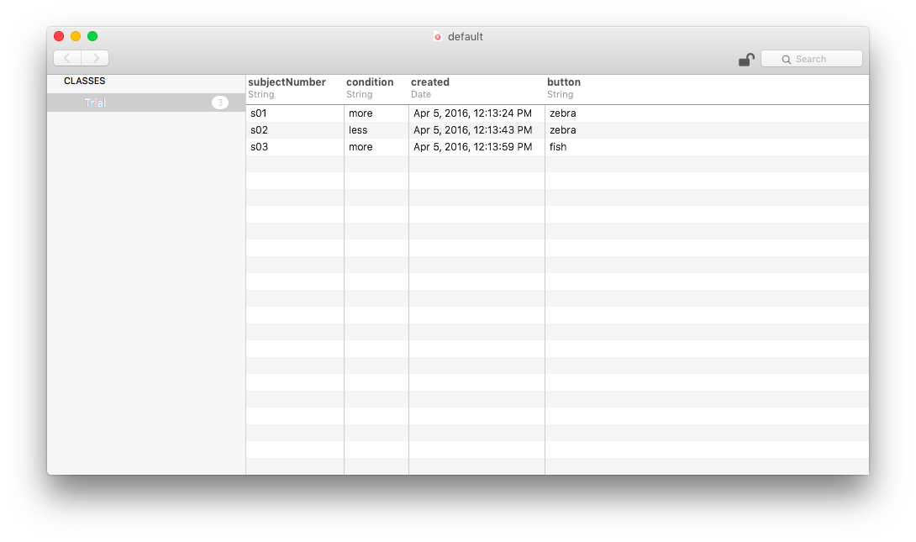
Realm
Solution: create and update a database file that can be downloaded when iPad is connected to computer
Realm:
Mobile database released in 2014
Realm Swift: More concise code than SQLite or Core Data
Realm Browser: App (available in app store) for reading and editing Realm Databases

Slide 14
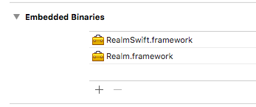

Step 1: Add Frameworks
Download the latest version (0.98.6) of Realm Swift from the Realm website
Drag the iOS frameworks to the Embedded Binaries section of your project to add
If working in Xcode 7.2 (Swift 2.1), you’ll need an older version of Realm
Import RealmSwift

Slide 15
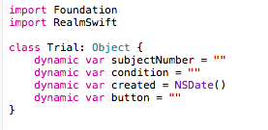
Step 2: Create a Model
Determines the database structure
Model is defined by creating a new class. Subclass Object or another model
Add & initialize properties you want as database fields

Slide 16
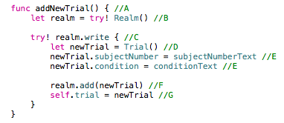
Step 3: Add New Record
Storyboard: create text fields, buttons, etc. to collect user input
Write helper function to generate new record
Create a Realm instance (access point to a db)
Start a write transaction (to create/edit/delete in the db)
Create a new Trial instance
Assign trial values (populate properties with the text from the text fields)
Add the newTrial to the db
Assign the newTrial to the Trial property
Call addNewTrial() in prepareForSegue(): create and save the user input when the user calls the Segue to next screen

Slide 17
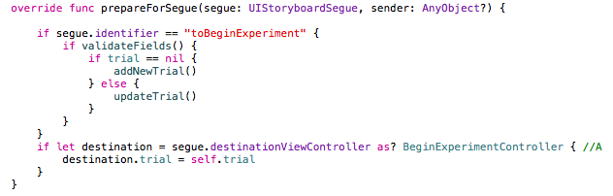
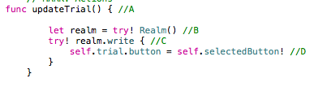
Step 4: Update Record
Pass the Trial instance (from newTrial) to the next View Controller using prepareForSegue()
In that View Controller:
Write helper function to update Record
Get Realm Instance
Start Write Transaction
Update/assign values to the trial instance you passed into the View Controller
Call updateTrial() in prepareForSegue(): save the updated Trial when the user calls the Segue to next screen

Slide 18
Beyond Text
Problem: Update the database with other forms of user input
Solution:
Write a helper IBAction function to determine which UIButton was pressed, swipe direction, etc.
Use Switch function to update some variable depending on which action was the Sender
Assign that variable’s value as the property value in your Trial

Slide 19
App Demo

Slide 20
Next steps
Record video of user in background
Collect reaction time

Slide 21
Your Turn!

Slide 22
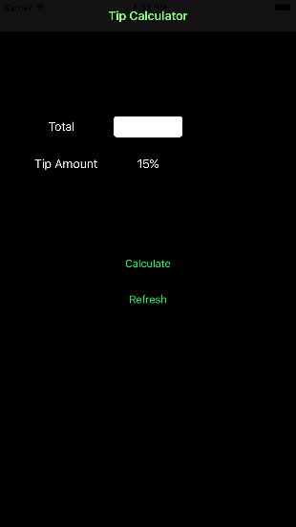
Create a Project : Tip Calculator
Open Xcode
Create New Xcode Project
iOS application > Single View Application > Next
Product name: TipCalculator
Organization: self
Language: Swift
Devices: iPhone

Slide 23

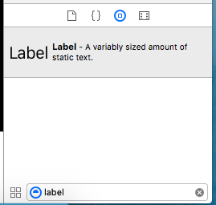
Building the User Interface
Show/hide Utility area
Click on Main.Storyboard
Open the Utilities Sidebar
Add one text field, one button, and three labels
In the Object Library on the bottom right, search for the object and drag it onto your view controller
Object library
search

Slide 24

Run in Simulator
In the top-left of the Xcode window:
Set your device to iPhone 6s plus
Click the play button
Build in Simulator
Select device

Slide 25

Arranging the UIObjects
Show/hide Utility area
Attributes inspector
Select an object and open the attributes inspector to edit the title/text
Control-drag from one object to another to add a constraint on the distance between them, control-drag from object to itself in a direction to add constraints on dimensions
Center the text field horizontally: control-drag towards the top of the VC and select ‘center Horizontally in Container’
Center a label below it and change its text to 15%
Change the other two labels to ‘Total’ and ‘Tip Amount’ and arrange these next to the text field and 15% label
Change the button title to ‘Calculate’ and place it below the rest

Slide 26
Run in Simulator
In the top-left of the Xcode window:
Set your device to iPhone 6s plus
Click the play button
Adjust wacky contraints
Build in Simulator
Select device

Slide 27

Connect UIObjects
Show Assistant Editor
Open the Assistant Editor
Control-drag from an object to ViewController.swift in the Assistant Editor (inside the class declaration)
Connect the text field:
Connection: Outlet
Name: totalEntered
Connect the Calculate Button:
Connection: Action
Name: calculateButtonPressed

Slide 28
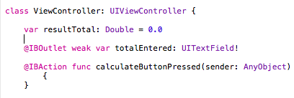

Add Calculate Function
In ViewController.Swift:
Right under the class declaration, create a variable resultTotal (of type: Double, initialize it to 0)
In your calculateButtonPressed Function, calculate the tip and update the value of resultTotal with your result
Get the text field input as a string: totalEntered.text
Convert the user input from type String to Double
The text field won’t initially have a value so it should be treated as an implicitly unwrapped optional (!)
Notes:
totalText.text will be a Double (decimal)
We’re using tip amount = .15 to simplify our app, could have had the user choose a tip amount though

Slide 29
Run in Simulator
In the top-left of the Xcode window:
Set your device to iPhone 6s plus
Click the play button
Build in Simulator
Select device

Slide 30
Use what you’ve learned: Display result
Add a new label to the bottom of the VC, add the position constraints you want
Connect it to ViewController.Swift as an Outlet called resultLabel
Delete the label’s text so it’s blank
In your calculateButton function set resultLabel.text to the value of resultTotal
What error do you get? How can you fix it?

Slide 31
Finishing Touches
Show/hide Utility area
Attributes inspector
Add a background
Click inside the View Controller
Open the Utilities Sidebar (button in top-right)
Select the Attributes Inspector
Change the Background color
Add a Navigation Bar (drag from Object Library to top of VC)
Double click in the Bar and change the title to ”Tip Calculator”
Change keyboards to numerical
Select text field
In Attributes Inspector change Keyboard Type to Decimal Pad

Slide 32
Bonus Challenge: Refresh
We want a tip calculator we can use more than once without quitting the app!
Create a button titled ‘Refresh’
Add constraints
Connect it to your code as an Action
In the @IBAction function, call:
self.[the name of the lifecycle function for loading the view]

