Slide 1
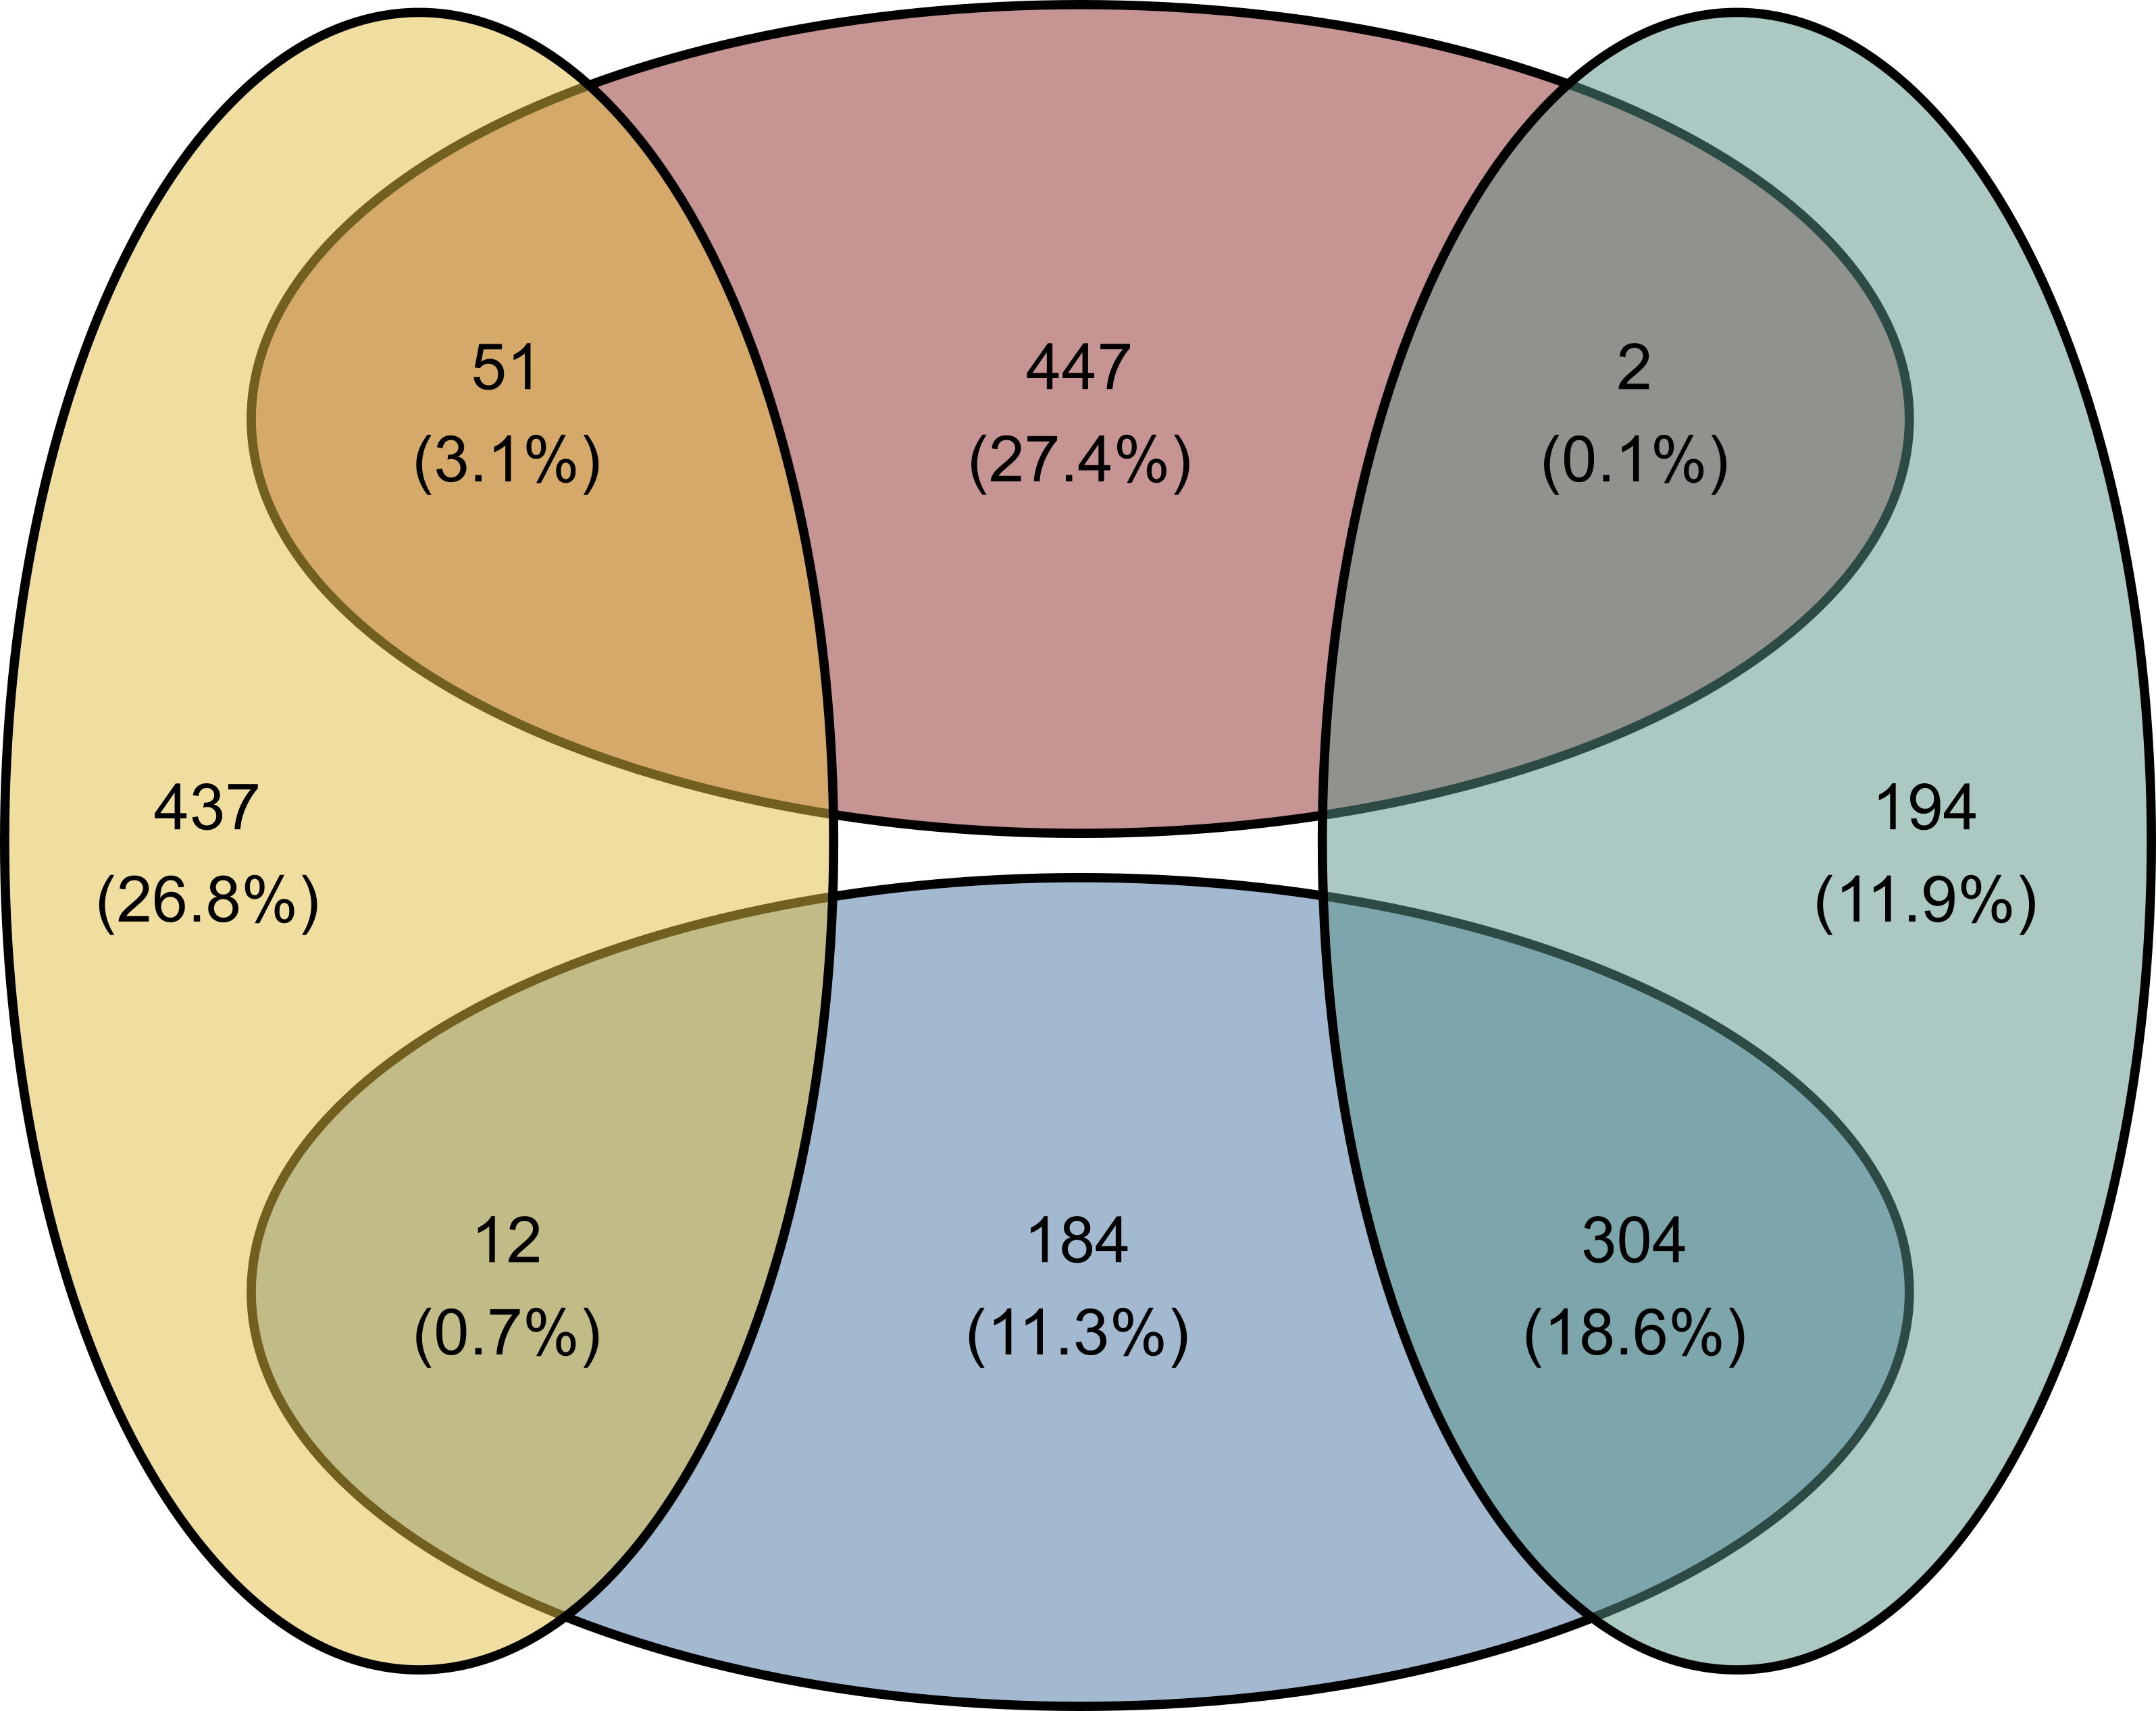
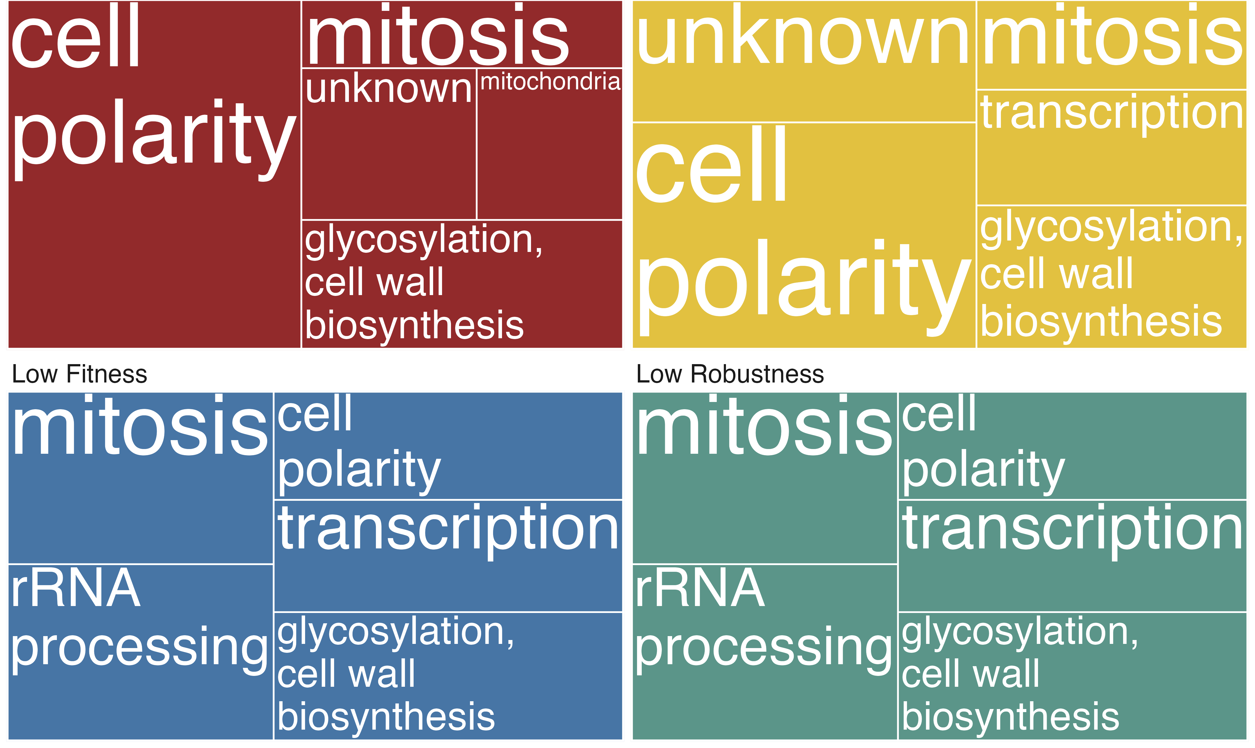
A
B
High Fitness
High Robustness
Low Fitness
Low Robustness

