Slide 1

Strategic Growth: Converting Casual Cyclistic Riders to Annual Members
Data-Driven Marketing Recommendations for 2026
Kristina Čečura
Junior Data Analyst
December 2025

Slide 2
Agenda
01 Business Task
02 Data Preparation & Cleaning
03 Rider Behavioral Analysis
04 Marketing Recommendations

Slide 3

How do annual members and casual riders use Cyclistic’s bikes differently?
The objective is to maximize Cyclistic’s profitable annual membership base by converting existing casual riders into members.
Analyzing how annual members and casual riders use Cyclistic’s bikes differently will inform a targeted marketing strategy designed to achieve this conversion goal.
Primary Stakeholder: Lily Moreno, Director of Marketing

Slide 4
Data Integrity & Credibility
Reliable & Original: Primary source data collected directly by Bikeshare and owned by the City of Chicago.
Comprehensive: Full dataset includes all necessary variables to perform deep behavioral profiling: ride duration, timestamps, and station locations
Current: Analysis utilizes the most recent 12-month trailing period, accounting for post-pandemic urban mobility shifts.
Cited & Licensed: Data is accessed and used in strict accordance with the Divvy Data License Agreement.
Source: Chicago Department of Transportation (CDOT)

Slide 5
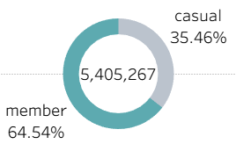
Dataset at a Glance
Member vs. Casual
Analysis Scope
Timeframe: 12-month period (Dec 2024 - Nov 2025).
Total Volume: 5.4 Million verified rides analyzed post-cleaning.
Technical Rigor: Data transformed via SQL to calculate trip duration, day types, and seasonal identifiers.
Current Landscape
Core Users: Annual members provide the consistent, high-volume foundation of the service.
Opportunity Segment: Casual riders represent a significant portion of total trips, primarily concentrated in leisure-heavy timeframes.

Slide 6




How do annual members and casual riders use Cyclistic bikes differently?
Time of Day
Trip Duration
Behavioral Analysis
Key differences in rider behavior were identified across four primary dimensions →
Seasonality
Geography

Slide 7
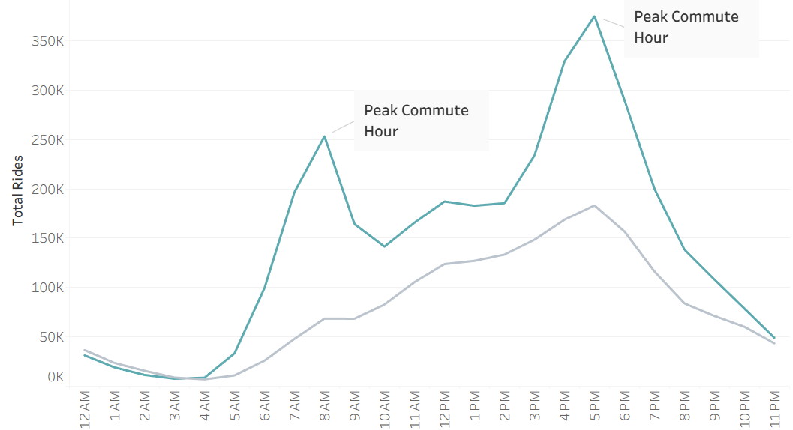

The "Tourist vs. Commuter" Pattern
Annual Members: Exhibit a distinctive "M-shaped" ridership curve, with sharp peaks during standard commuting hours (8:00 AM and 5:00 PM) on weekdays.
Casual Riders: Display a steady, building growth in volume throughout the day, peaking in the afternoon and reaching maximum capacity on weekends.
Key Insight: This data suggests that while Members rely on Cyclistic for essential daily transit, Casual riders primarily view the service as a recreational luxury.

Slide 8
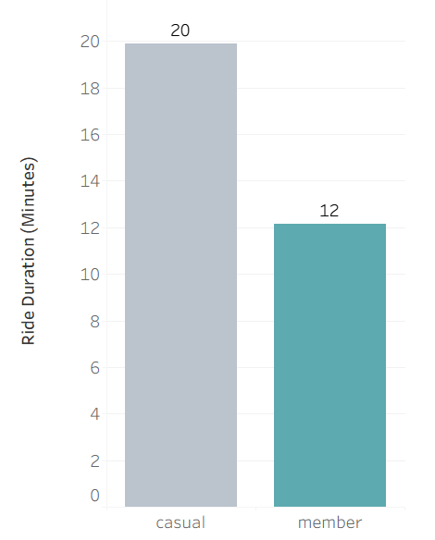
Trip Duration & Engagement
Annual Members: Average trip length is 12 minutes, reflecting direct transit to work or errands.
Casual Riders: Average trip length is 20 minutes, nearly double the duration of members.
Strategic Implication: Casual riders are high-engagement users but low-frequency. The goal is to show them that membership makes their "long rides" more cost-effective.

Slide 9
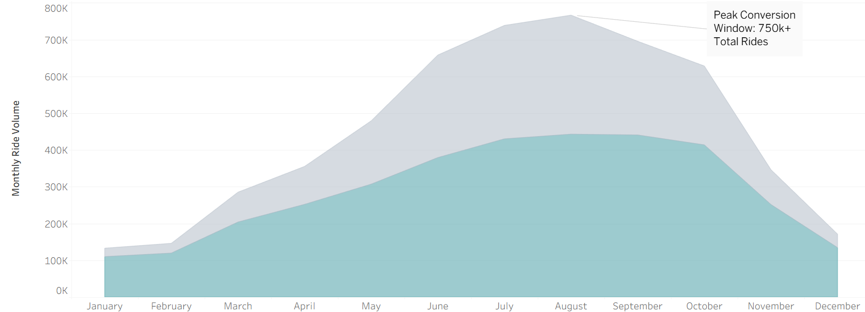
Year-Round Reliability
Peak Season: Both groups peak in July/August, but Casual volume drops by over 80% during winter months.
Member Retention: Members maintain a significantly more stable ridership floor during the off-season.
The Window: May through September is the "Golden Window" for conversion campaigns when Casual volume is at its highest.

Slide 10
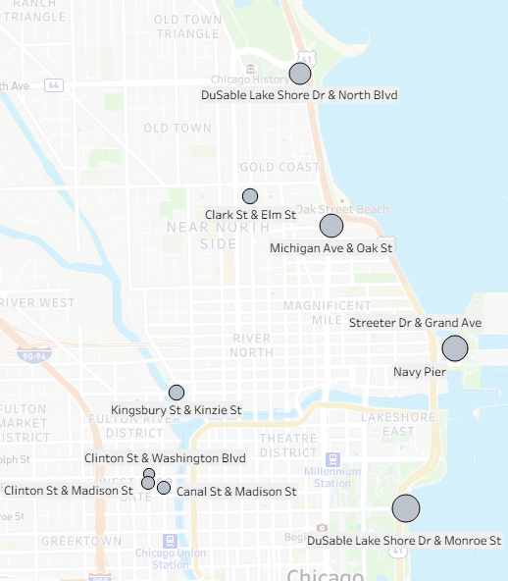
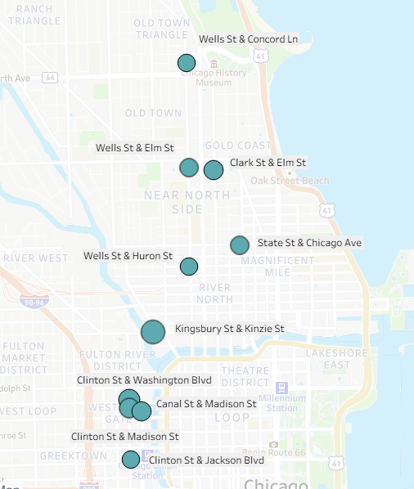
Geographic Footprint
Casual Rider Hotspots
Annual Member Hotspots
Casual Hubs: Concentrated near the Lakefront, Parks, and Tourist Landmarks (e.g., Streeter Dr & Grand Ave).
Member Hubs: Distributed across Residential Neighborhoods and Commercial Centers.
The geographic footprint supports the "Tourist vs. Commuter" hypothesis.
Action: Physical marketing for memberships should be saturated at the top 10 "Casual-Heavy" stations.

Slide 11
Proposed Strategy: The "Casual-to-Commuter" Pipeline
1. Targeted Seasonal Memberships: Launch a "Weekend Warrior" or "Summer Pass" (3 - month tier) to bridge the gap for recreational users.
2. Station-Based Digital Ads: Use geo-fencing to push membership promos to users' phones when they start/end rides at high-volume leisure stations.
3. Benefit Messaging: Shift marketing copy from "Faster Commute" to "Unlimited Weekend Exploration" to appeal to the Casual rider's actual behavior.

