Slide 1
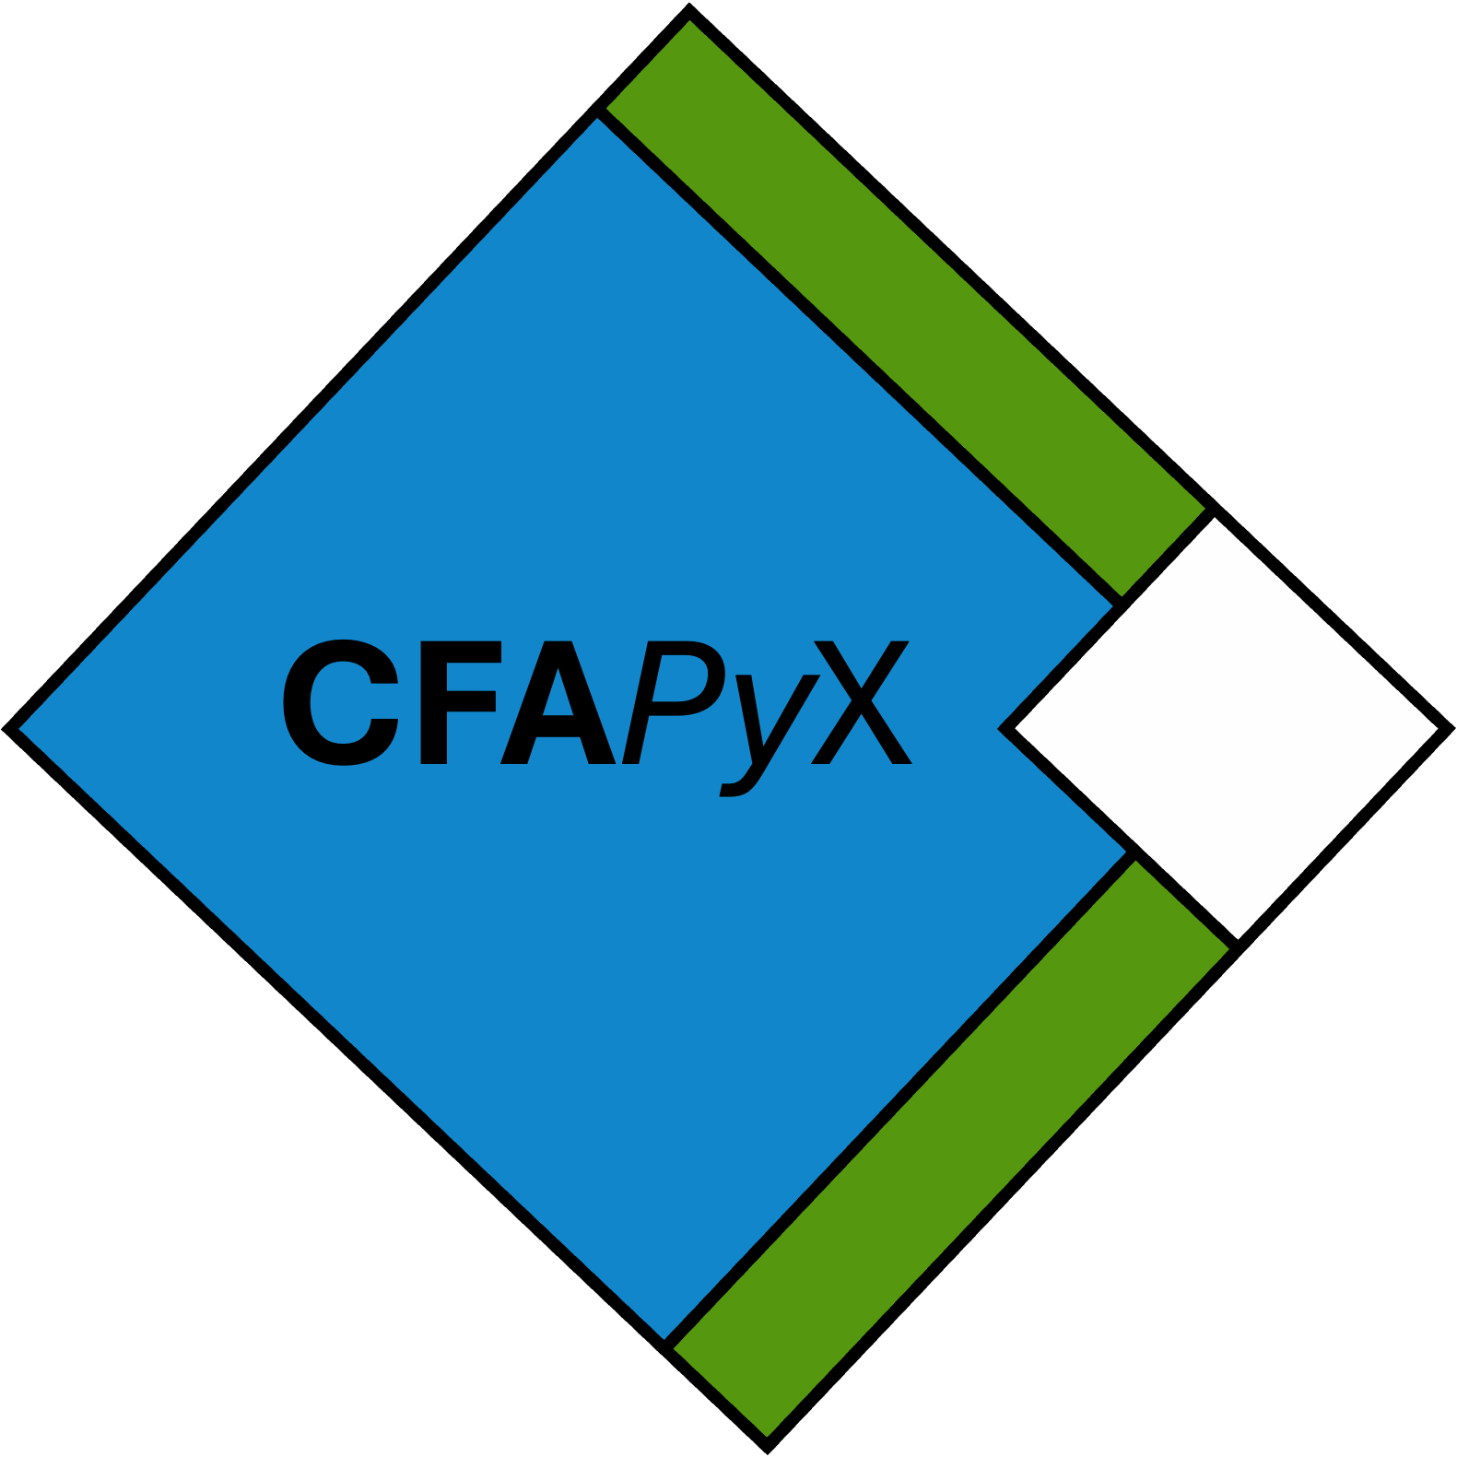
Data Array

Slide 2
Data Array
Fragments (CFA)

Slide 3
Data Array
Fragments (CFA)
Dask Compute Chunks

Slide 4
Data Array
Fragments (CFA)
Dask Compute Chunks
One fragment across multiple chunks.

Slide 5
Internal Terminology
Partition: The general term for an Array-Like object within CFAPyX. This could occupy any shape and exist as part of any coordinate system. Partitions are just any subdivision of an array. A partition may be further subdivided into other partitions.
Array: Refers to the array of real data values in all instances.
Fragment: CFA description for arrays that come from different files. A fragment may cover all or part of an array from a single file. Fragments do not cross between files.
Chunk: Compute chunks specified by dask are another type of partition which may cross any other boundaries. A chunk may consist of one or more Fragments and is therefore composed of multiple partitions.
Space: The total allowed extent for a given coordinate system.
Shape: The shape of a partition which covers part of a space. A partition’s shape within a specific space cannot exceed the size of that space. In almost all cases, the shape is exclusively in Array Space because fragments and chunks typically always have size of (1,1,1) within their own spaces.
Position: Within a coordinate space, a partition will occupy a given set of coordinates.
Axis: NumPy terminology for the index numbers of the dimensions.

Slide 6
Internal Terminology – Example Uses
Array Space: (4, 180, 360)
Fragment Space: (2, 2, 2)
Chunk Space: (2, 2, 4)
*Assuming all fragments and chunks are square in this scenario.*
Fragment Shape: (2, 90, 180)
Chunk Shape: (2, 90, 90)
Fragment Positions: (0, 0, 0) to (1, 1, 1)
Chunk Positions: (0, 0, 0) to (1, 1, 3)
Within CFAPyX:
1 FragmentArrayWrapper (Fragment Space (2,2,2))
8 ChunkWrappers
- Each ChunkWrapper contains a CFAPartition representing half of a Fragment (1, 1,

Slide 7
Open Dataset
Super-Dask Structures
Backend
Variable
Datastore
Variable
Variable
CFAVariable
FragmentArrayWrapper
Dask “Surface”

Slide 8

Dask “Surface”
Sub-Dask Structures
Scenario 2: Any-Size Compute Chunks
Dask-Like Array
Scenario 1: No Compute Chunks
CFAPartition
CFAPartition
ChunkWrapper
ChunkWrapper
CFAPartition
CFAPartition
CFAPartition
CFAPartition
ChunkWrapper
ChunkWrapper
CFAPartition
CFAPartition
Dask “Second Surface”
Equivalent to Scenario 1 for each ChunkWrapper

