Slide 1

Overview of Framework Programme 6: funding and programme development opportunities
Ruth Boumphrey, International Strategy Group
NCAS FP6 Town Meeting, 10/01/03

Slide 2
Talk Overview
Context
Programme overview
Instruments and Management
Insights and future influence
Sources of Information

Slide 3
Talk Overview
Context
Programme overview
Instruments and Management
Insights and future influence
Sources of Information

Slide 4
The European Research Area
A blueprint for the future of research in Europe
Broad support at the highest political, scientific and industrial levels
Being implemented
European Research Area
National
programmes
European
research policy
‘Open
Coordination’
Framework
programme
European
organisations

Slide 5
The 6th Framework Programme
The ERA: Diagnostic and Solutions?
European Structural
Weaknesses:
Research investment
Human resources
Innovation
Regional imbalances
Fragmentation
The ERA must:
reduce the competitive gap
increase RTD efforts
promote capacity building
address the broad context
strengthen coherence
improve impact of RTD

Slide 6

Enlargement
EU
Candidate countries:
Bulgaria
Cyprus
Estonia
Hungary
Latvia
Lithuania
Malta
Poland
Czech Republic
Romania
Slovenia
Slovakia
Turkey

Slide 7
European Union Funding
Why Does the EU Fund Research?
The EU is not a research funding body
Funding is given to assist in the development and furthering of EU policy aims
Treaty of the European Union
Article 163.- The Community shall have the objective of strengthening the scientific and technological basis of Community industry and encouraging it to become more competitive at international level, while promoting all research activities deemed necessary by virtue of other chapters of this Treaty.

Slide 8

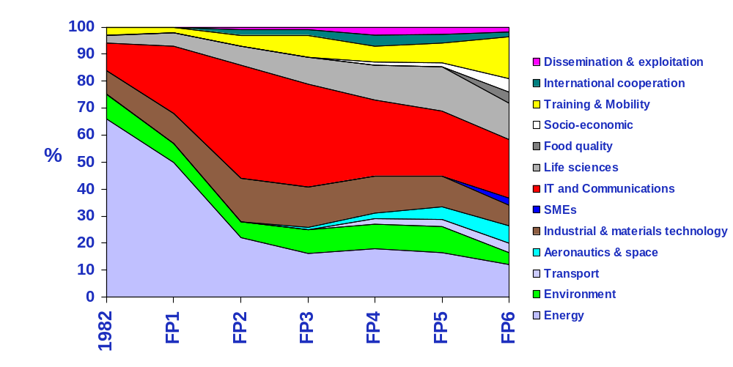
Changing Priorities
INCO
Energy
SMEs

Slide 9
The Sixth Framework Programme
2002-2006 (“co-decision”)
Commission opinion
on EP amendments
New !
Direct approval if agreement with EP
Consultations
CREST
Council
2
4
5
(within 3 months)
(approval within
6 weeks)
Commission
Proposal
Opinion
Common
position
Amendments
Conciliation:
joint text
Adoption
(absolute majority
of members)
European
Research
Advisory Board
(within 3 months)
(approval within
6 weeks)
1
3
4
5
European Parliament
FP evaluations
Qualified majority:
F, D, I, UK: 10 votes
E: 8 votes
B, GR, NL, P: 5 votes
A, S: 4 votes
DK, IRL, SF: 3 votes
L: 2 votes
Council decides by qualified majority (62 out of 87 votes) except on EP amendments not approved by the Commission
PRODUCT: SPECIFIC PROGRAMME

Slide 10
The 6th Framework Programme
Why Get Involved?
Total number of applications funded 28%
Total projects with UK participant 55%
Total UK participation in projects 16.54%
(cf D 16.51%, F 14.98%)
Total projects with UK Coordinator 17%
Total Income to UK participants 17.7%
(cf ‘juste retour’ 15.8%)
Plus: contacts, partnerships, mobility, wider scientific opportunity, international benchmarks.
FP5 Statistics (2000)

Slide 11
Talk Overview
Context
Programme overview
Instruments and Management
Insights and future influence
Sources of Information

Slide 12
The 6th Framework Programme
Overall Structure
Focussing
and Integrating
Community Research
€13,345 Million
Structuring
the ERA
€2,605 Million
Strengthening the
Foundations of the ERA
€320 Million
TOTAL (excl. EURATOM): €16.27 Billion

Slide 13
The 6th Framework Programme
Detailed Structure
Life Sciences, Genomics and Biotechnology for Health
New/Emerging S&T
and Policy Support
Information Society Technologies
Nanotechnologies and Nanosciences,
Knowledge-Based Multifunctional Materials and
New Production Processes and Devices
SME Activities
Thematic
Specific Activities Covering
a Wider Field of Research
Aeronautics and Space
Food Quality and Safety
International
Co-operation
Sustainable Development, Global Change and Ecosystems
Citizens and Governance in the Knowledge Society
Innovation
and SMEs
Human Resources
and Mobility
Research
Infrastructures
Science and
Society
Horizontal
Co-ordination of Research Activities
Development of RTD/Innovation Policies
Underpinning

Slide 14

The 6th Framework Programme
What Happened with the Expressions of Interest?
11,700 complete EoIs received (after duplicates, etc)
Good distribution – note social science and environment
More than 50 countries represented
≥5%from France, Germany, Italy, Netherlands, Poland, Spain and UK
65% IP versus 35% NoE
46% HEI versus 32% research organisations and 14% industry
Poor SME representation
15-20% ‘convincingly’ met the requirements
20% wanted confidentiality
Rest published at: http://eoi.cordis.lu/dsp_results.cfm
Report to indicate topics for inclusion in the first call

Slide 15
The 6th Framework Programme
Sustainable Development, Global Change and Ecosystems
Genomics & Biotech
SCIENTIFIC AND POLITICAL OBJECTIVES
Implementing sustainable development
Mitigate/Reverse adverse trends
Integrate research capacity across Europe
Integrate all parts of the R&D spectrum
Address implications for other research areas
Information Society Tech
2N, 2M, 2P
Aeronautics and Space
Food Quality and Safety
Sust. Dev & Global Change
Citizens and Governance

Slide 16
The 6th Framework Programme
Sustainable Development, Global Change and Ecosystems
Sustainable
Energy Systems
Sustainable
Surface Transport
Global Change
and Ecosystems

Slide 17
The 8th priority
Detailed Structure
Life Sciences, Genomics and Biotechnology for Health
New/Emerging S&T
and Policy Support
Information Society Technologies
Nanotechnologies and Nanosciences,
Knowledge-Based Multifunctional Materials and
New Production Processes and Devices
SME Activities
Thematic
Specific Activities Covering
a Wider Field of Research
Aeronautics and Space
Food Quality and Safety
International
Co-operation
Sustainable Development, Global Change and Ecosystems
Citizens and Governance in the Knowledge Society
Innovation
and SMEs
Human Resources
and Mobility
Research
Infrastructures
Science and
Society
Horizontal
Co-ordination of Research Activities
Development of RTD/Innovation Policies
Underpinning

Slide 18
The 6th Framework Programme
Specific Activities Covering a Wider Field of Research
Supporting Policies and Anticipating
Scientific and Technological Needs
€555 M
Specific SME Activities
€430 M
Specific International
Co-operation Activities
€315 M

Slide 19
Scientific Support to Policies: Objectives
Underpin formulation and implementation of Community policies
Provide scientific support that is:
  Targeted precisely on needs (demand-driven)
  Integrated across policy areas and relevant scientific inputs
  Responsive to changes in policy requirements as they occur

Slide 20
Scientific Support to Policies: Programming
Choice of initial priorities based on
  expression of current needs
  prioritisation process
Involving
  user groups
  S/T experts
Allowing a progressive
  incorporation of new priorities in the WP
  allocation of the budget

Slide 21
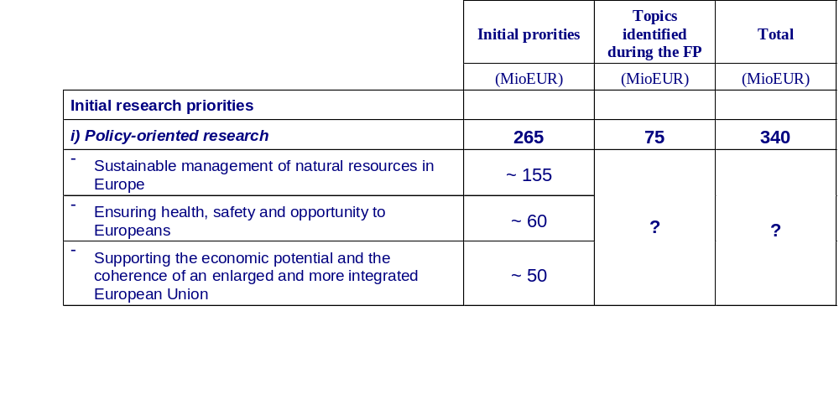
Scientific Support to Policies: Budget

Slide 22
Scientific Support to Policies: Sustainable management of
Europe’s natural resources
Modernisation and sustainability of agriculture and forestry
Tools and assessment methods for sustainable agriculture and forestry management
The modernisation and sustainability of fisheries policy
New and more environment friendly production methods to improve animal health and welfare
Environmental assessment (soil, water, air, noise, including the effects of chemical substances)
Assessment of environmental technologies for support of policy decisions

Slide 23
Scientific Support to Policies: Sustainable management of
Europe’s natural resources
Modernisation and sustainability of agriculture and forestry
First call:
CAP reform: improved tools for forecasting and assessment of the common agricultural policy:
  - Decoupling - Tools and Methods for impact assessment
  - Market Sectors - Development of modelling tools (dairy products, wine, fruit and vegetables)
  - Cross compliance
  - Micro-Economic Modelling of Spatial and Environmental Impacts of Common Market Organisation

Slide 24
Scientific Support to Policies: Sustainable management of
Europe’s natural resources
Environmental assessment (soil, water, air, noise, including the effects of chemical substances)
  First call:
  - Quantify the economic and environmental effects of greenhouse gas emissions and carbon sink enhancements in agriculture and forestry
  - Assessment of air quality in Europe at different temporal and spatial scales on the basis of monitoring data and modelling
  - Improving current assessment of environmental noise and noise impacts from railways, roads and aircrafts
  - Increase the environmental safety of the use of biodegradable waste on soil

Slide 25
Scientific Support to Policies: Providing health, security and opportunity to the people of Europe
Health determinants and the provision of high quality and sustainable health care services and pension systems
Public health issues
The impact of environmental issues on health
Quality of life issues relating to handicapped/disabled people
comparison of factors underlying migration and refugee flows
improved means to anticipate crime trends and causes, and to assess the effectiveness of crime prevention policies; assessment of new challenges related to illicit drug use
issues related to civil protection and crisis management

Slide 26
Scientific Support to Policies: Instruments
Specific targeted research projects
Co-ordination actions
Might be considered in future calls, but not in the December 2002 call:
Specific support actions (conferences, workshops, expert groups, studies)
(possibly) Integrated projects

Slide 27

New and Emerging Science and Technology (NEST): objectives
Stimulate visionary long term research at the frontiers of knowledge, and at the interface between disciplines
Give researchers freedom to develop and prove their ideas without preconceptions and within the broadest possible limits
Respond rapidly to new problems and opportunities

Slide 28
Two modes of operation
“Bottom-up”:
  ADVENTURE projects
  INSIGHT projects
    Open to any research area
    (Probably) Continuously open call for proposals
  SUPPORT measures
Focused actions:
  PATHFINDER initiatives
    Targeted calls for proposals
    Topics identified during the course of the programme
(complementing, not duplicating, the thematic priorities)

Slide 29
Time profile of actions
Relative proportion of budget allocated to open and focused actions
PATHFINDER initiatives
(clusters of projects on specific themes)
Open area
ADVENTURE projects and INSIGHT projects
(based on bottom-up funding mode)
1
2
3
4
Year

Slide 30
“Bottom-up” proposals
ADVENTURE projects
Proposals might (for example) aim to:
  develop new theoretical insights or exploit new experimental methodologies to advance scientific understanding in trans-disciplinary areas
  create new cross-disciplinary “basic technologies”
INSIGHT projects
  evaluate new discoveries or phenomena that could have long term consequences (risks) for European society
SUPPORT measures
  develop research orientations/links with research communities
  understand S/T dynamics, systemic vulnerabilities etc.

Slide 31
The 6th Framework Programme
Specific Activities Covering a Wider Field of Research
Supporting Policies and Anticipating
Scientific and Technological Needs
€555 M
Specific SME Activities
€430 M
Specific International
Co-operation Activities
€315 M

Slide 32
Three major routes for international scientific co-operation in FP6
Opening of “Focusing and Integrating Community Research” to third country organisations (with substantial funding)
Specific measures in support of international co-operation
International mobility of researchers
Over and above these three major routes, the international dimension is a cross-cutting issue which concerns the whole Framework Programme
New

Slide 33
The 6th Framework Programme
Detailed Structure
Life Sciences, Genomics and Biotechnology for Health
New/Emerging S&T
and Policy Support
Information Society Technologies
Nanotechnologies and Nanosciences,
Knowledge-Based Multifunctional Materials and
New Production Processes and Devices
SME Activities
Thematic
Specific Activities Covering
a Wider Field of Research
Aeronautics and Space
Food Quality and Safety
International
Co-operation
Sustainable Development, Global Change and Ecosystems
Citizens and Governance in the Knowledge Society
Innovation
and SMEs
Human Resources
and Mobility
Research
Infrastructures
Science and
Society
Horizontal
Co-ordination of Research Activities
Development of RTD/Innovation Policies
Underpinning

Slide 34
Structuring the European Research Area
Research and Innovation €290M
Human Resources and Mobility €1580M
Research Infrastructures €665M
Science and Society €80M

Slide 35
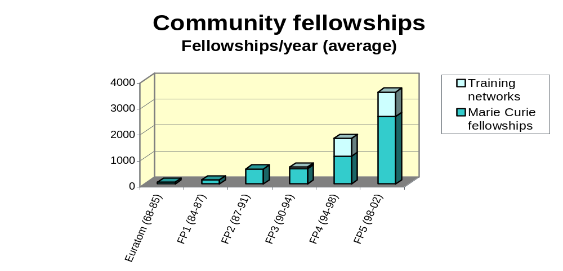
Structuring the ERA - Human Resources and Mobility

Slide 36
FP5 Facts and Figures (2000)
All IHP fellowships: UK 30%
(gained by country) France 17%
Germany 10.5%
IHP Fellowship Types: Individual 72%
(% of participants / total ) Industry 10%
Development 4%
Training Sites 14%

Slide 37
FP6 Marie Curie Schemes
Chairs
Grants
Awards
Excellence
Advanced Training
Intraeuropean and international fellowships
Return and reintegration Grants
Transfer of Knowledge
Host Fellowships for Transfer of Knowledege
Research Training Networks
Initial Training
Conferences and Training Courses
Host Fellowships for Early Stage Research Training

Slide 38
FP6 Marie Curie Schemes
Major Features
Continuity and Evolution
Bottom Up programme
Marie Curie label generalised
Opening of schemes to 3rd country nationals
No age limit, but experience criterion
Reintegration measure
(including incentives to return to Europe)
Excellence promotion
New
New
New
New
New

Slide 39
Research Training Networks
Objectives:
Training for and through research within high quality
international projects
Overcoming institutional and disciplinary boundaries
To achieve a critical mass of qualified researchers,
particularly in highly specialised and/or fragmented areas
Target:
HEIs, research centres, training centres, companies etc
Minimum of three organisations in three different countries
(With at least two from MS or candidate countries)

Slide 40
Research Training Networks
Fellowships:
For ES researchers (can include postdocs)
Fellows are chosen by the host (non-nationals/residents)
Fellowships 3 months - 3 years
Funding: (Min of 65% of funding on researchers’ costs)
Researcher – salary, mobility, career exploratory allowance
Host – Funding for researcher networking, general organisation and management of the project, audit and management costs (7%), overheads (10%), some
equipment costs (on an exceptional basis)

Slide 41
Conferences and Training Courses
Objectives:
To enable ES researchers to profit from the insight of experienced researchers
Focus:
Support for specific training activities (incl. virtual ones)
- Coherent series of conferences, summer schools, laboratory courses, on one or several themes, proposed by one or several organisers (min 4 events over 4 years)
- Participation of ES researchers in large conferences where there is a clear training purpose

Slide 42
Conferences and Training Courses
Target:
ES researchers (exceptionally experienced researchers)
Funding:
Series of conferences:
Researchers – travel and subsistence, fees for attendance
Hosts – organisational expenses, management activities (7%), equipment where necessary
Large conferences:
Researchers – Subsistence costs and attendance fees
Hosts - Management activities (3%)

Slide 43
Excellence Promotion and Recognition
New Schemes in FP6
MC Excellence Grants, MC Chairs and MC Awards
Aim:
To capitalise on the achievements of European researchers and to lead them towards professional independence
To increase visibility and attractiveness of science as a career
To encourage world class European researchers who have moved to other countries to resume their career in
Europe

Slide 44
The 6th Framework Programme
Detailed Structure
Life Sciences, Genomics and Biotechnology for Health
New/Emerging S&T
and Policy Support
Information Society Technologies
Nanotechnologies and Nanosciences,
Knowledge-Based Multifunctional Materials and
New Production Processes and Devices
SME Activities
Thematic
Specific Activities Covering
a Wider Field of Research
Aeronautics and Space
Food Quality and Safety
International
Co-operation
Sustainable Development, Global Change and Ecosystems
Citizens and Governance in the Knowledge Society
Innovation
and SMEs
Human Resources
and Mobility
Research
Infrastructures
Science and
Society
Horizontal
Co-ordination of Research Activities
Development of RTD/Innovation Policies
Underpinning

Slide 45
Support for Research Infrastructures in FP6 - Budget (655 € including administrative costs)
Transnational Access and Integrating Activities (two calls) 250 Mio € (Min.)
Design Studies, Development of New Infrastructures (open call) 200 Mio € (Max.)
Communication Network Development
(DG INFSO)200 Mio € (+ 100 Mio €, IST)

Slide 46
The 6th Framework Programme
Detailed Structure
Life Sciences, Genomics and Biotechnology for Health
New/Emerging S&T
and Policy Support
Information Society Technologies
Nanotechnologies and Nanosciences,
Knowledge-Based Multifunctional Materials and
New Production Processes and Devices
SME Activities
Thematic
Specific Activities Covering
a Wider Field of Research
Aeronautics and Space
Food Quality and Safety
International
Co-operation
Sustainable Development, Global Change and Ecosystems
Citizens and Governance in the Knowledge Society
Innovation
and SMEs
Human Resources
and Mobility
Research
Infrastructures
Science and
Society
Horizontal
Co-ordination of Research Activities
Development of RTD/Innovation Policies
Underpinning

Slide 47
ERA-Net
Aims and Objectives
Aims:
  Improving coherence and co-ordination
  Promoting closer interaction between RTD performers
  Developing an ambitious long-term perspective
Objectives:
  Networking of national/regional research activities
  “Opening” of national/regional research programmes

Slide 48
ERA-Net
Activities - I
Networking:
Co-ordination and co-operation of activities without transnational flows of funding
Mutual Opening:
Co-ordination and co-operation of activities between programmes with transnational flows of funding (through pooling or bilateral/multilateral agreements)

Slide 49
ERA-Net
Activities - II
Networking:
  Systematic exchange of information and best practice
  Strategic activities
  Implementation of joint activities
  Transnational research activities
Mutual Opening:
  Cross funding of researchers and research teams
  Funding of multinational projects
  Access to facilities and laboratories
  Joint calls for proposals

Slide 50
The 6th Framework Programme
NOT discussed
Life Sciences, Genomics and Biotechnology for Health
New/Emerging S&T
and Policy Support
Information Society Technologies
Nanotechnologies and Nanosciences,
Knowledge-Based Multifunctional Materials and
New Production Processes and Devices
SME Activities
Thematic
Specific Activities Covering
a Wider Field of Research
Aeronautics and Space
Food Quality and Safety
International
Co-operation
Sustainable Development, Global Change and Ecosystems
Citizens and Governance in the Knowledge Society
Innovation
and SMEs
Human Resources
and Mobility
Research
Infrastructures
Science and
Society
Horizontal
Co-ordination of Research Activities
Development of RTD/Innovation Policies
Underpinning

Slide 51
Talk Overview
Context
Programme overview
Instruments and Management
Insights and future influence
Sources of Information

Slide 52
The New Instruments
The ERA project as an overarching framework
Scalable architecture of ERA objectives
Projects must reflect the thinking behind ERA
Think:
  European Competitiveness (Lisbon/Gothenburg)
  Changing research landscapes (ERA)
  Meeting other agendas (Barcelona)
Is your aim to deliver or to integrate?

Slide 53
The New Instruments
Architecture of the ERA: Programme
Thematic Priorities
RTD
Innovation
and SMEs
Human Resources
and Mobility
Research
Infrastructures
Science and
Society
Structuring
Co-ordination of Research Activities
Development of RTD/Inno Policies
Co-ordination

Slide 54
The New Instruments
Architecture of the ERA: Projects
RTD Activities
Project
Project
“Structuring” Activities
Co-ordination of National RTD Programmes

Slide 55
The New Instruments
The ERA project as an overarching framework
Scalable architecture of ERA objectives
Projects must reflect the thinking behind ERA
Think:
  European Competitiveness (Lisbon/Gothenburg)
  Changing research landscapes (ERA)
  Meeting other agendas (Barcelona)
Is your aim to deliver or to integrate?

Slide 56
The New Instruments
ERA Building Blocks: Integrated Projects
Co-ordination
Keyword: DELIVERABLES
Create the necessary
critical mass for focussed medium- term scientific breakthroughs that lead to major improvements in the global competitiveness and quality of life of the EU
Activity A
Activity B
Activity C
Activity D
Training
Technology Transfer and Analysis
Ethics/Uncertainty and Communication

Slide 57
The New Instruments
Integrated Projects - Objectives
To integrate the critical mass of activities/resources needed for :
- addressing major societal needs
- increasing EU competitiveness
predefined S/T
results and
clear deliverables
Ethical aspects, science-society dialogue
Training
strong management
structure
RTD 4
RTD 5
RTD 3
Management
RTD 1
RTD 2
Implementation
Plan
Demonstration
Technology transfer, exploitation

Slide 58





The New Instruments
ERA Building Blocks: Networks of Excellence
Keyword: INTEGRATION
To overcome the fragmentation of EU research by fostering long-term integration of research programmes and capabilities of the participants, creating a world-class scientific resource.
RTD
Group E
RTD
Group A
HEI
RTO
Management
Group
RTD
Group D
RTD
Group B
RTD
Group C
SME
PRO

Slide 59





The New Instruments
Networks of Excellence - Objectives
Governing Council
Funding Bodies Representatives
- To structure the EU research potential
by integrating existing research capacities
 To structure the EU research potential
by integrating research capacities
  Joint research activities
  Integrating activities
  Spreading of excellence (training)
  Common management
European Commission
  Joint research activities
  Integrating activities
  Spreading of excellence
  Common management
Management Group
Management Group
Research team leader
Partner Organisation Representative

Slide 60
Old Instruments
Stairway to Excellence
Originally intended to smooth the transition from the “traditional” to the “new” instruments
  support for activities of more limited scope and ambition
  particularly for smaller research actors: SMEs, candidate countries
Three instruments
  specific target projects
    - an evolved form of FP5 shared cost RTD projects
  co-ordination actions
    an evolved form of FP5 concerted actions/thematic networks
  Specific support actions
    A continuation of ‘accompanying measures’
To be ‘phased-out’ as FP6 precedes
  independent evaluation in 2004 of the use of the instruments

Slide 61
Management and Contract Issues
Four Key Aspects
The Co-ordinator
The Project Management Office
The Model Contract
The Consortium Agreement

Slide 62
Management and Contract Issues
Possible Management Model - IPs
Co-ordinator
Project Steering Committee
Project
Management Office
Scientific
Management Board
Activity
Co-ordinator
Activity
Co-ordinator
Activity
Co-ordinator
Activity
Co-ordinator

Slide 63
Management and Contract Issues
Possible Management Model - NoEs
Governance/
Advisory Board
Research
Group
Research
Group
Co-ordinator
Network Steering Committee
Management Office
Research
Group
Research
Group

Slide 64
Writing Successful Applications
Documents and Contacts
Key documents:
Call text
Work Programme
Guide for Proposers
Application Form
Evaluation manual and guidelines
Policy documents
Key contacts:
UKRO
National Contact Points
Commission Desk Officer

Slide 65
Writing Successful Applications
What you Should Cover
Integrated Projects:
Objectives and expected impact
Implementation plan and associated budget
The consortium and the project resources
Project management
Exploitation and dissemination plans
Ethics, safety and other issues

Slide 66
Writing Successful Applications
What you Should Cover
Networks of Excellence
Objectives and strategic impact
Excellence of the participants and resources of the
network
Degree of integration and the Joint Programme of
Activities
Organisation and management
Ethics, safety and other issues

Slide 67
Writing Successful Applications
What you Should Cover
All projects
European infrastructure development,
Co-operation with non-European countries
Special measures for candidate countries,
Integration of the ethical, social, legal and wider cultural aspects,
Gender aspects in research,
Industry and SME participation,
Socio-economic aspects (including innovation and exploitation of knowledge)

Slide 68
Writing Successful Applications
Self-Assessment Questions - I
Does the project fit within the thematic priorities of FP6?
Is there a clear need/benefit to carrying out the work at European level?
Does the project contribute to relevant EU policies (ERA, Lisbon, Gothenburg, etc.)
Does it have a structuring/integrating effect on European research?

Slide 69
Writing Successful Applications
Self-Assessment Questions - II
Are the objectives of the project consistent with the partners’ long-term strategies?
Is the project complementary to partners’ other research activities?
Is there institutional/management backing and support structures?
Are all the partners relevant, with appropriate experience and roles?

Slide 70
Writing Successful Applications
Self-Assessment Questions - III
Are the partners committed to a long-term relationship/ the continuation of a network beyond the term of the funding?
Are the partners committed to exploiting results and/or
are the plans for the use of the results feasible?
Are the proposed transfer/dissemination measures suitable?
Are issues of IPR considered properly?

Slide 71
Talk Overview
Context
Programme overview
Instruments and Management
Insights and future influence
Sources of Information

Slide 72
FP6 decision-making
Evaluators
Programme committees
Horizontal committee

Slide 73
Proposal Evaluation
Evaluators
Independent experts
Minimum of 3 evaluators (min. 2 for Human Resources & Mobility and Co-ordination Actions; 5 for IPs & NoEs?)
Selection – Calls in OJ or direct to research institutions
Selection criteria – research in relevant scientific fields;
May be non-European
Central database – academic/industrial; gender; geographical origin; regular rotation
Conflict of interest / confidentiality

Slide 74
Proposal Evaluation
Follow-up – Priority and Reserve Lists
Priority list – based on evaluators recommendations, programme priorities, etc.
Rejection list – ineligible, out of scope, failing threshold etc.
Reserve list – withdrawal of proposals, negotiation failure
Negotiation and contract preparation – all proposals on
priority list, request for additional information
LOBBYING DOES NOT WORK!

Slide 75
Future influence
Second call
  First indications already
  Programme committee meets March
Subsequent calls
FP7!
  OST’s first consultation later in 2003
  Policy input

Slide 76
Talk Overview
Context
Programme overview
Instruments and Management
Insights and future influence
Sources of Information

Slide 77
The 6th Framework Programme
Further Information
UKRO
  http:// www.ukro.ac.uk
NERC
  http://www.nerc.ac.uk/
OST
  http://www.dti.gov.uk/ostinternational/eu_rtd_d/src/fp6/index.html
National Contact Points (NCPs)
Commission
  http://europa.eu.int/comm/research/fp6/index_en.html
  http://www.cordis.lu/fp6/

Slide 78

Commission Information
General information on research: http://europa.eu.int/comm/research
General information on the Sixth Framework Programme : http://europa.eu.int/comm/research/fp6/index_en.html
Information on research programmes and projects :
http://www.cordis.lu
Information requests:
research@cec.eu.int

Slide 79
The UK Research Office
Services
Enquiry service - advice, guidance and support for subscribers and sponsors
IHP National Contact Point service
Brussels based meeting room and visitors’ office
Annual conference and training courses
UKRO and NCP web sites

Slide 80
The UK Research Office
Website
All UKRO publications searchable by subject and date
FP5 Guide (including frequently asked questions) and guide to non-FP funding
ERA/FP6 Section, including FP6 Tutorial
Search engine
All documents & application forms
UKRO office details & Brussels information
Partner search on-line
Glossary
Links to other R&D web sites

Slide 81
The UK Research Office
Information Management System
New service for early 2003
Tailored information services:
Targeted e-mail alerts allowing a choice of:
Personalised web pages
Access for ELOs to management information on
users from their organisations
Information type
Subject area
Frequency of alert

Slide 82
The European Commission: other funding
Commission Directorates-General
P O L I C I E S
Agriculture
Competition
Economic and Financial Affairs
Education and Culture
Employment and Social Affairs
Energy and Transport
Enterprise
Environment
Fisheries
Health and Consumer Protection
Information Society
Internal Market
Justice and Home Affairs
Regional Policy
Research
Taxation and Customs Union
E X T E R N A L R E L A T I O N S
Development
Enlargement
EuropeAid - Co-operation Office External Relations
Humanitarian Aid Office - ECHO
Trade
On-line:
http://www.europa.eu.int/comm/dgs_en.htm

Slide 83
NERC science priorities
“Science for a Sustainable Future” identifies three science priority areas:
Earth’s life-support systems - water, biogeochemical cycles and biodiversity
Climate change – predicting and mitigating the impacts, quantifying the carbon cycle
Sustainable economies – identifying and providing sustainable solutions for energy, land use and hazard mitigation
Much in common

Slide 84
Acknowledgements
Slides and help from:
UKRO
Commission
Mary Thornton, NERC International Strategy Group
MUCH MORE DETAIL AVAILABLE!

