Slide 1
NERC Centres for Atmospheric Science
N C A S http://ncas.nerc.ac.uk

Slide 2
NERC Centres for Atmospheric Science, NCAS
NCAS delivers NERC’s core-strategic research in atmospheric science and co-ordinates across the UK
It is a set of centres of excellence and facilities, distributed across many UK universities and related institutions
It builds on recent JIF funding of observational facilities and previous NERC investments

Slide 3

Atmospheric Composition Changes
380
Mauna Loa
Observatory
1800
Flasks
360
1600
340
1400
CO₂ concentration/ppm
Methane concentration/ppb
320
1200
300
1000
280
800
Ice cores
260
Ice cores
600
1700
1800
1900
2000
1700
1800
1900
2000
0.5
Sulphate aerosol
0.4
0.3
Atmospheric sulphur / Tg
0.2
0.1
Source: IPCC
0.0
1700
1800
1900
2000

Slide 4
Key scientific challenges
Climate Processes
&
Change
Forcing the Earth System
by changing
atmospheric composition
Atmos. Composition
including
Air Quality
High-impact Weather

Slide 5
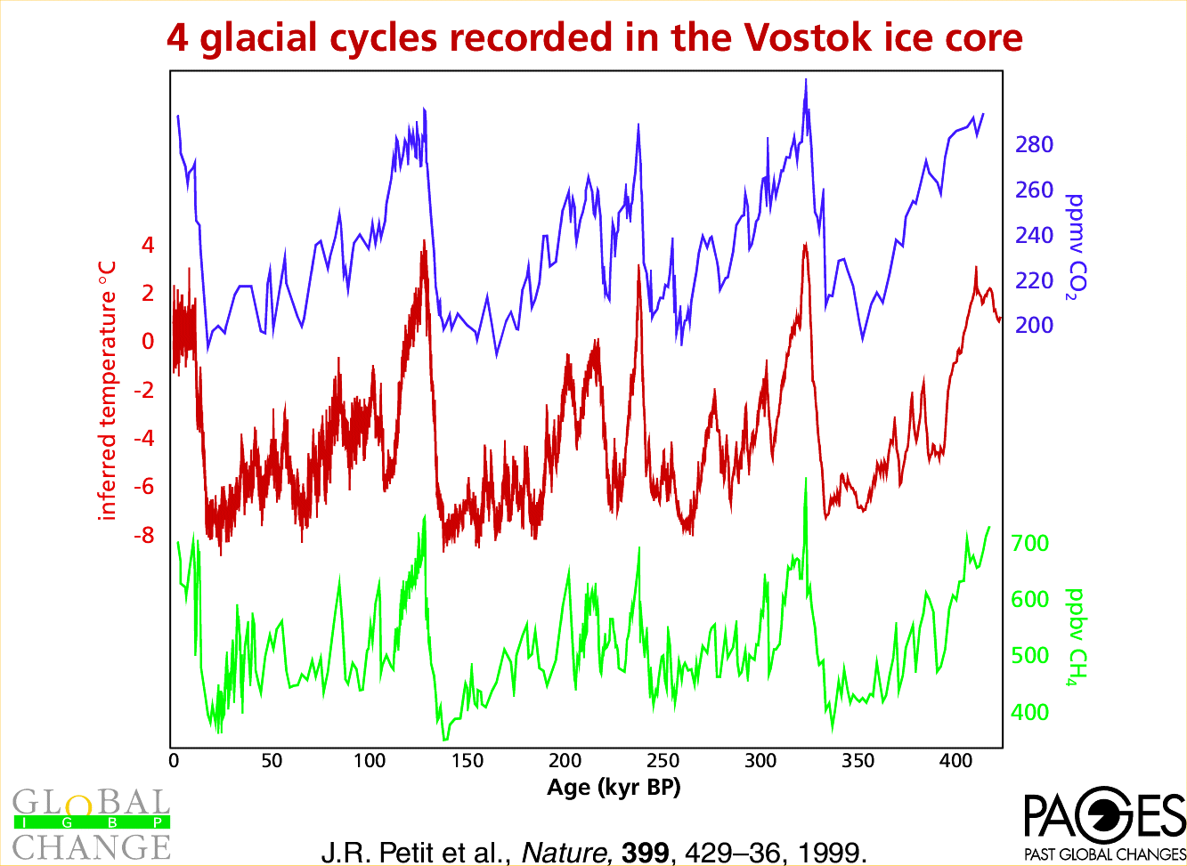
Palæoclimate
Causal
relationship?
CO2
T
Rapid change
in methane?
CH4
Age (kY BP)

Slide 6
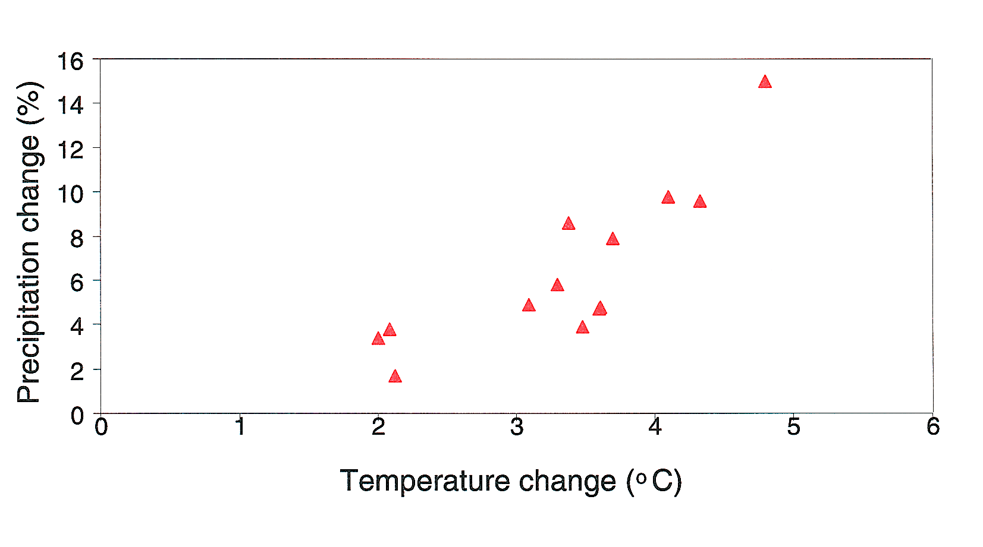
Response of 12 climate models to doubling of CO₂

Slide 7
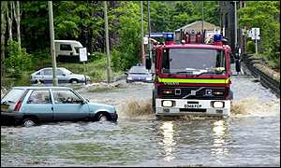
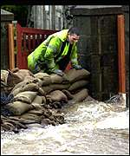
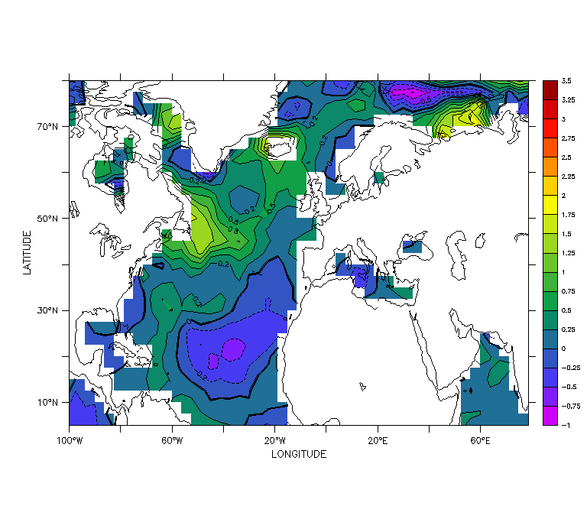
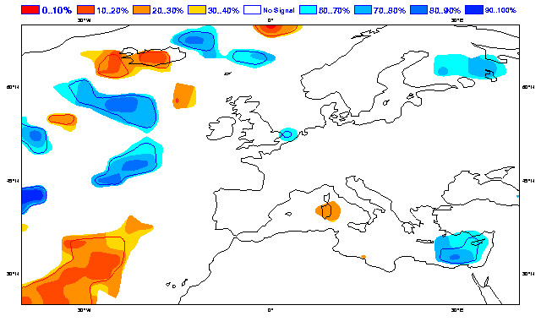
Predictable flood in Autumn 2000?
Obs SST anomaly
Risk of rainfall
HIGH
Probability
?

Slide 8
Observations and Data
Centres-of-excellence for ground-based measurement of the atmosphere
Use of instrumented research aircraft
A data centre for access to research and operational datasets on the atmosphere

Slide 9
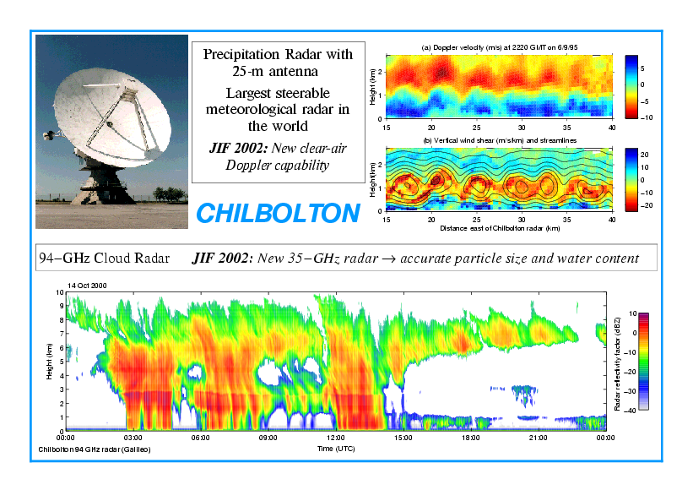

Slide 10
Cooperation and Integration
NCAS contributes to NERC Earth System Science with e.g. hydrologists, ecologists, oceanographers & geologists
NCAS links with key stakeholders such as the Met Office, Environment Agency and govt departments
NCAS collaborates internationally e.g. FP6 and Japan/Earth Simulator

Slide 11
The Roadmap!
John Pyle – Global chemistry under climate change
Julia Slingo - Climate variability and change
Keith Browning - Flooding
Mike Pilling - Urban air quality
Tea-Coffee Break
Peter Jonas & Bryan Lawrence - Observations
John Lawton - The Earth System & NERC’s Sustainability Agenda
David King – Science, Environment and Government
Reception

