Slide 1
Predicting the chemical composition of the atmosphere as climate changes
John Pyle
Head, Atmospheric Chemistry Modelling Support Unit
University of Cambridge

Slide 2
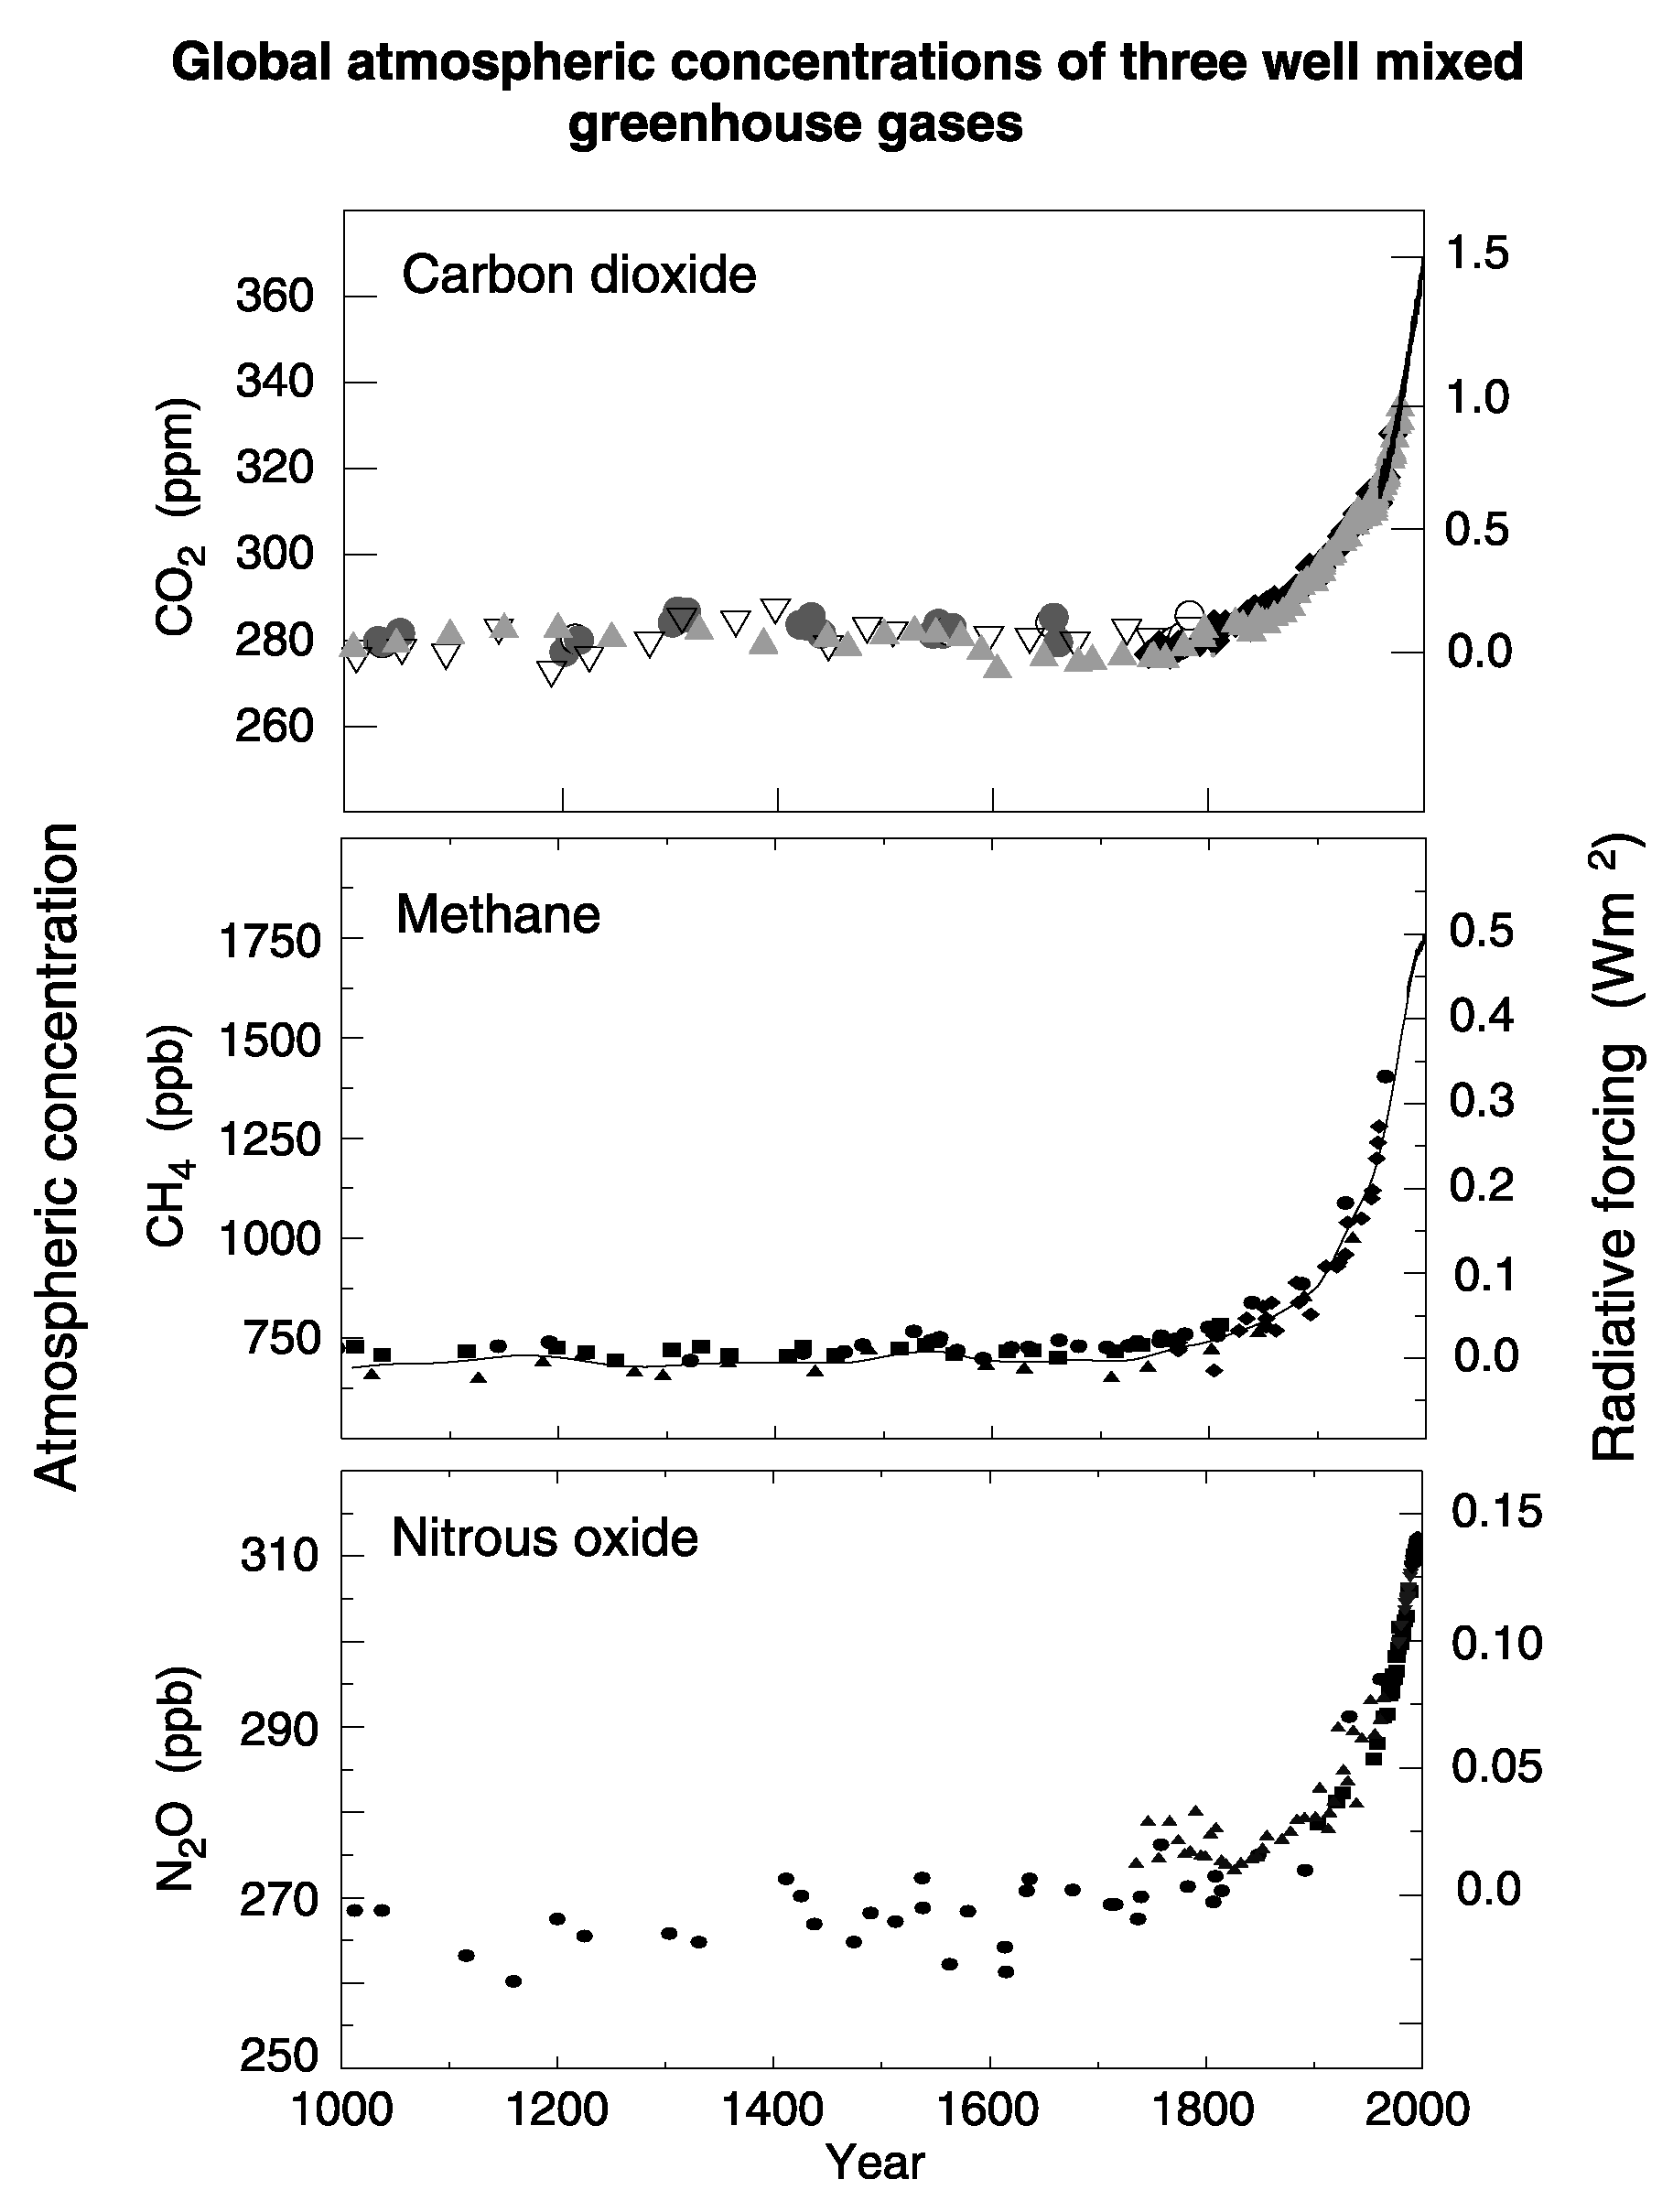

Slide 3
Atmospheric chemistry
Addressing
  problems from the local, through the regional, to the global
        Recovery of the ozone layer
        Changing air quality
        Changing oxidising capacity of the troposphere
        Chemistry/climate interactions
Requiring
  fundamental laboratory measurements at the molecular scale
  high quality in situ observations
  a theoretical (modelling) framework for analysis

Slide 4
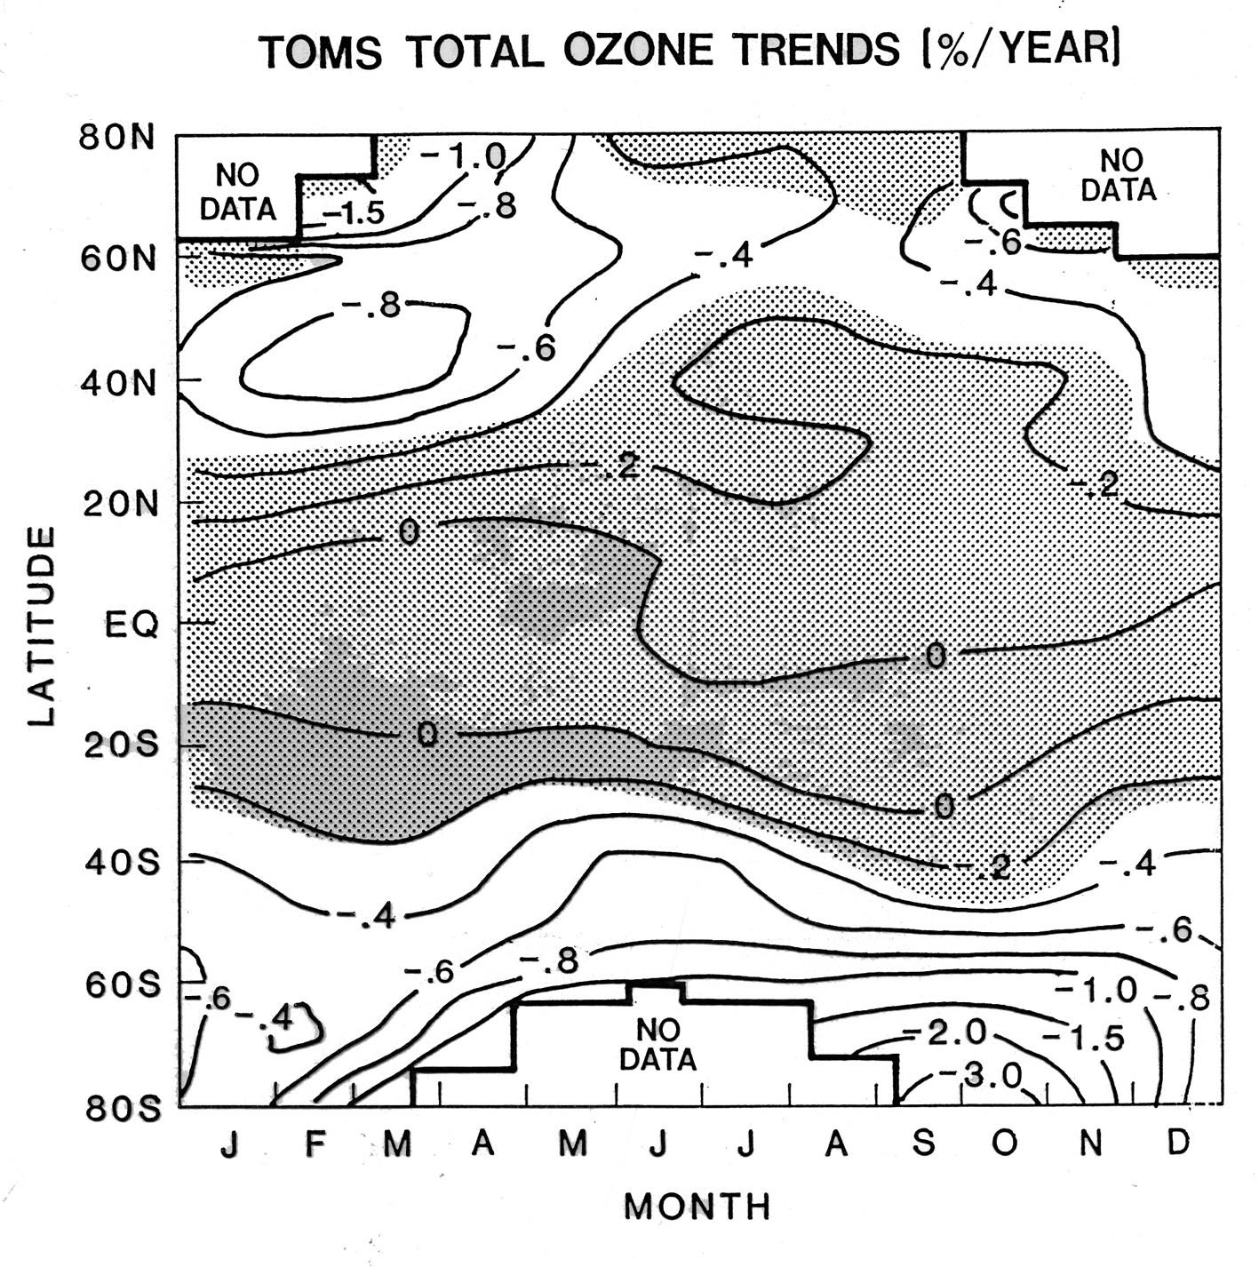

Slide 5
Stratospheric Ozone
SLIMCAT Chemical Transport Model
3D model of the stratosphere
Forced by daily meteorological analyses (v, T)
Resolution ~100km in horizontal, ~1km in vertical
Detailed stratospheric chemistry

Slide 6
Polar ozone loss
Winter low temperatures (T<195K)
⇓⇓⇓⇓⇓
Polar stratospheric clouds (PSCs)
⇓⇓⇓⇓⇓
HCl, ClONO₂ on PSCs→Cl, ClO (active chlorine)
⇓⇓⇓⇓⇓
Rapid ozone loss in sunlight

Slide 7
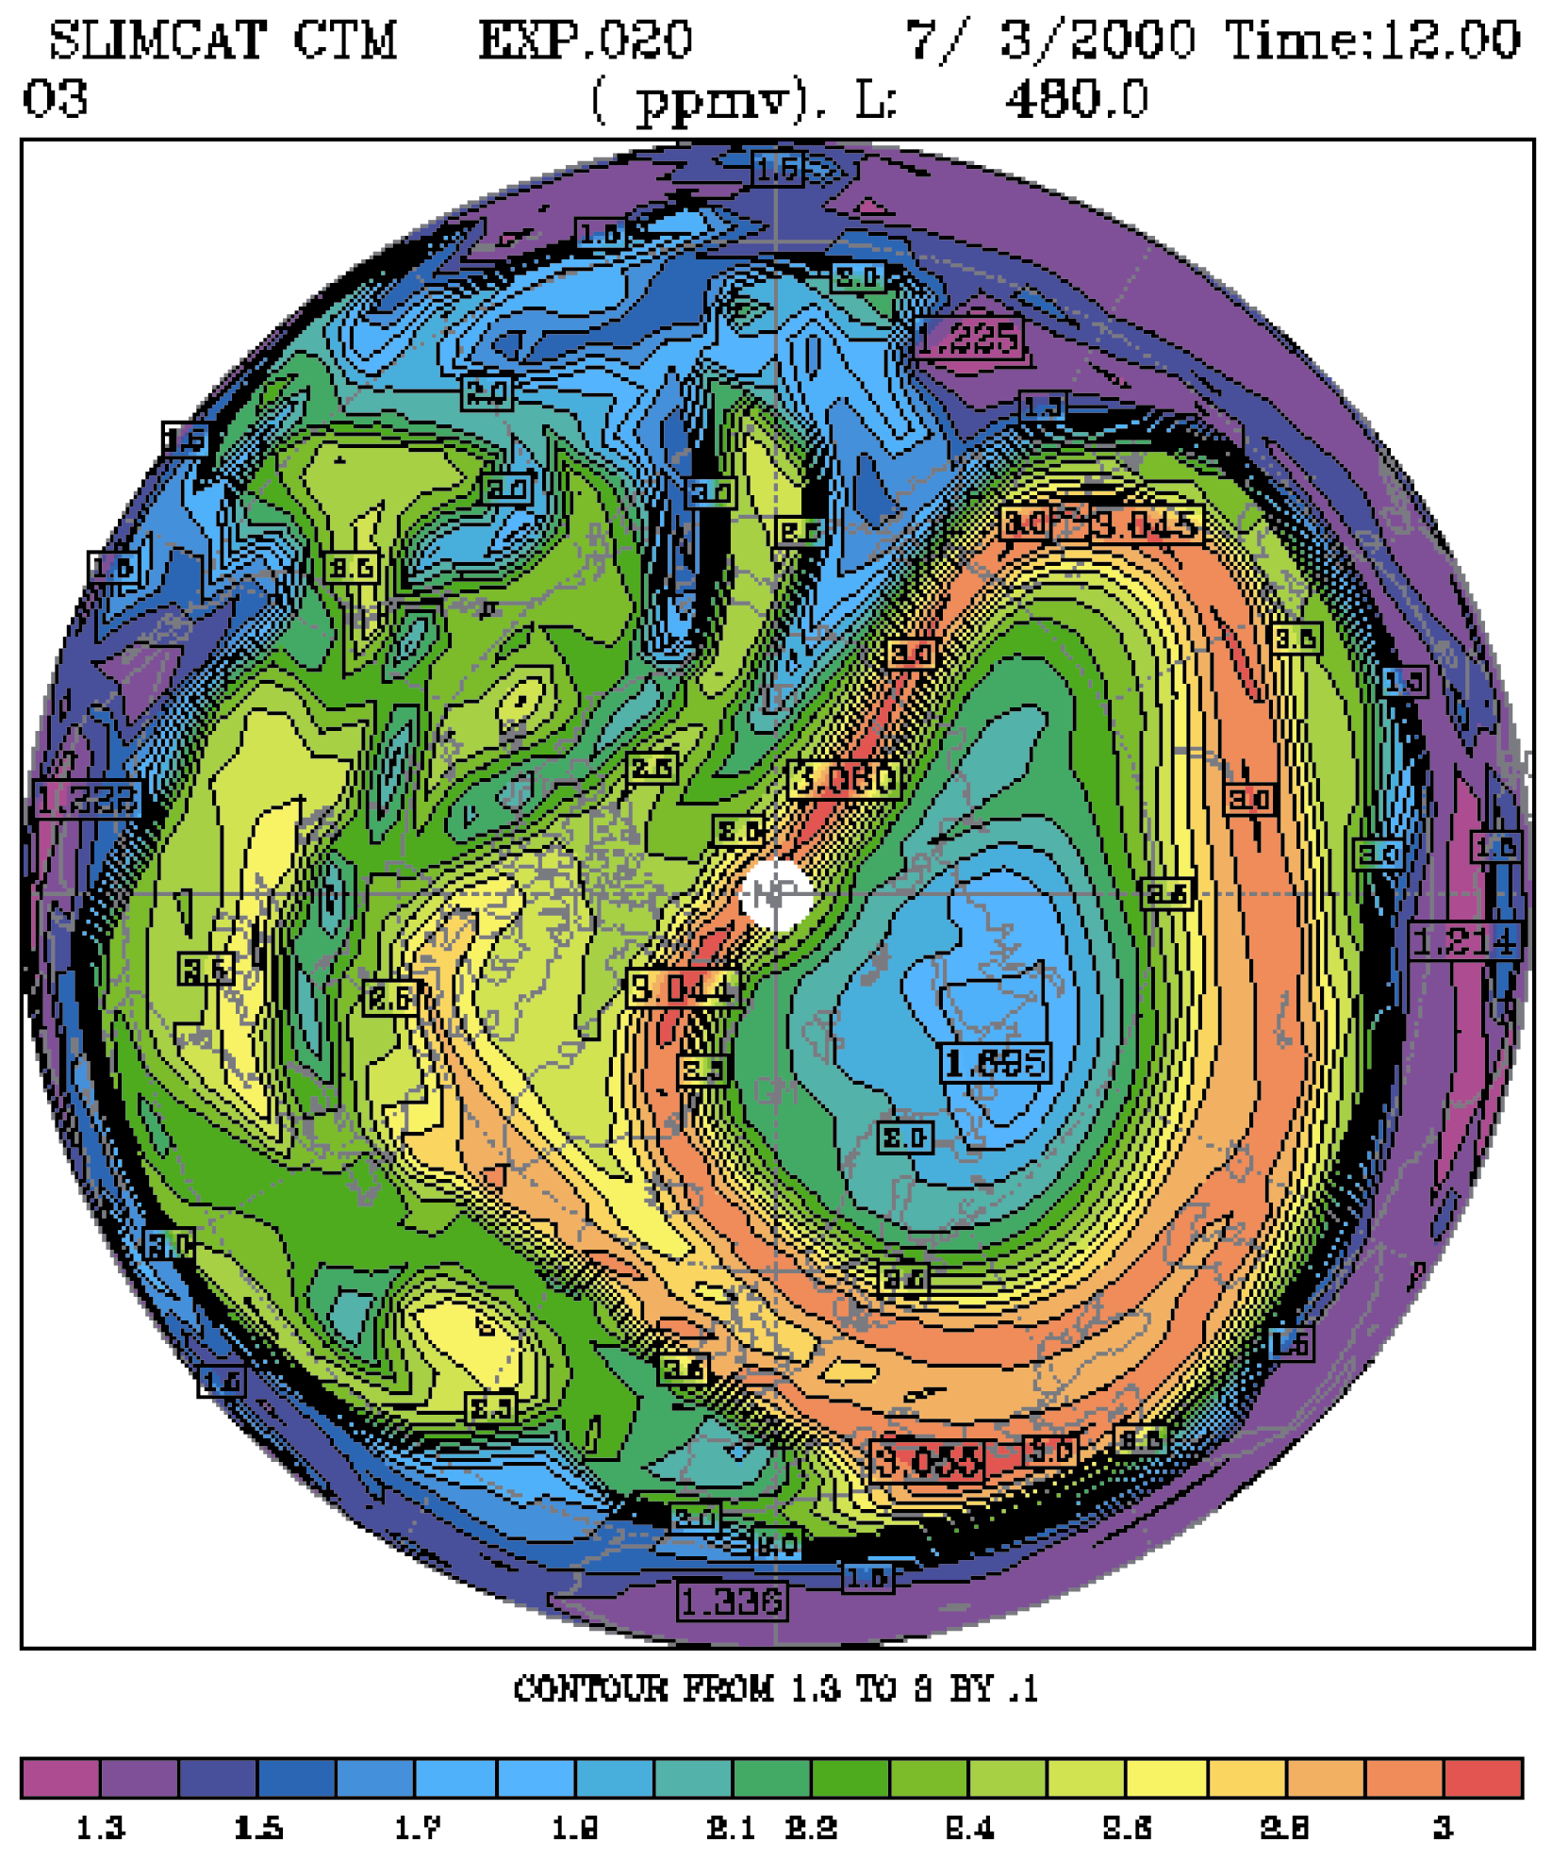
Ozone @ ~20km
7 March 2000
Large ozone loss inside polar vortex-chlorine chemistry initiated by low temperatures

Slide 8
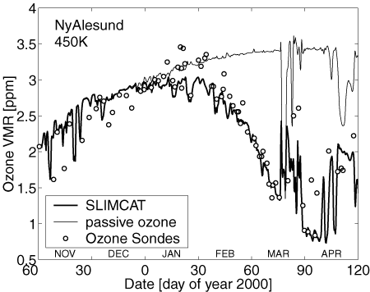
Ozone at ~20km
Approx. 70% depletion by spring

Slide 9

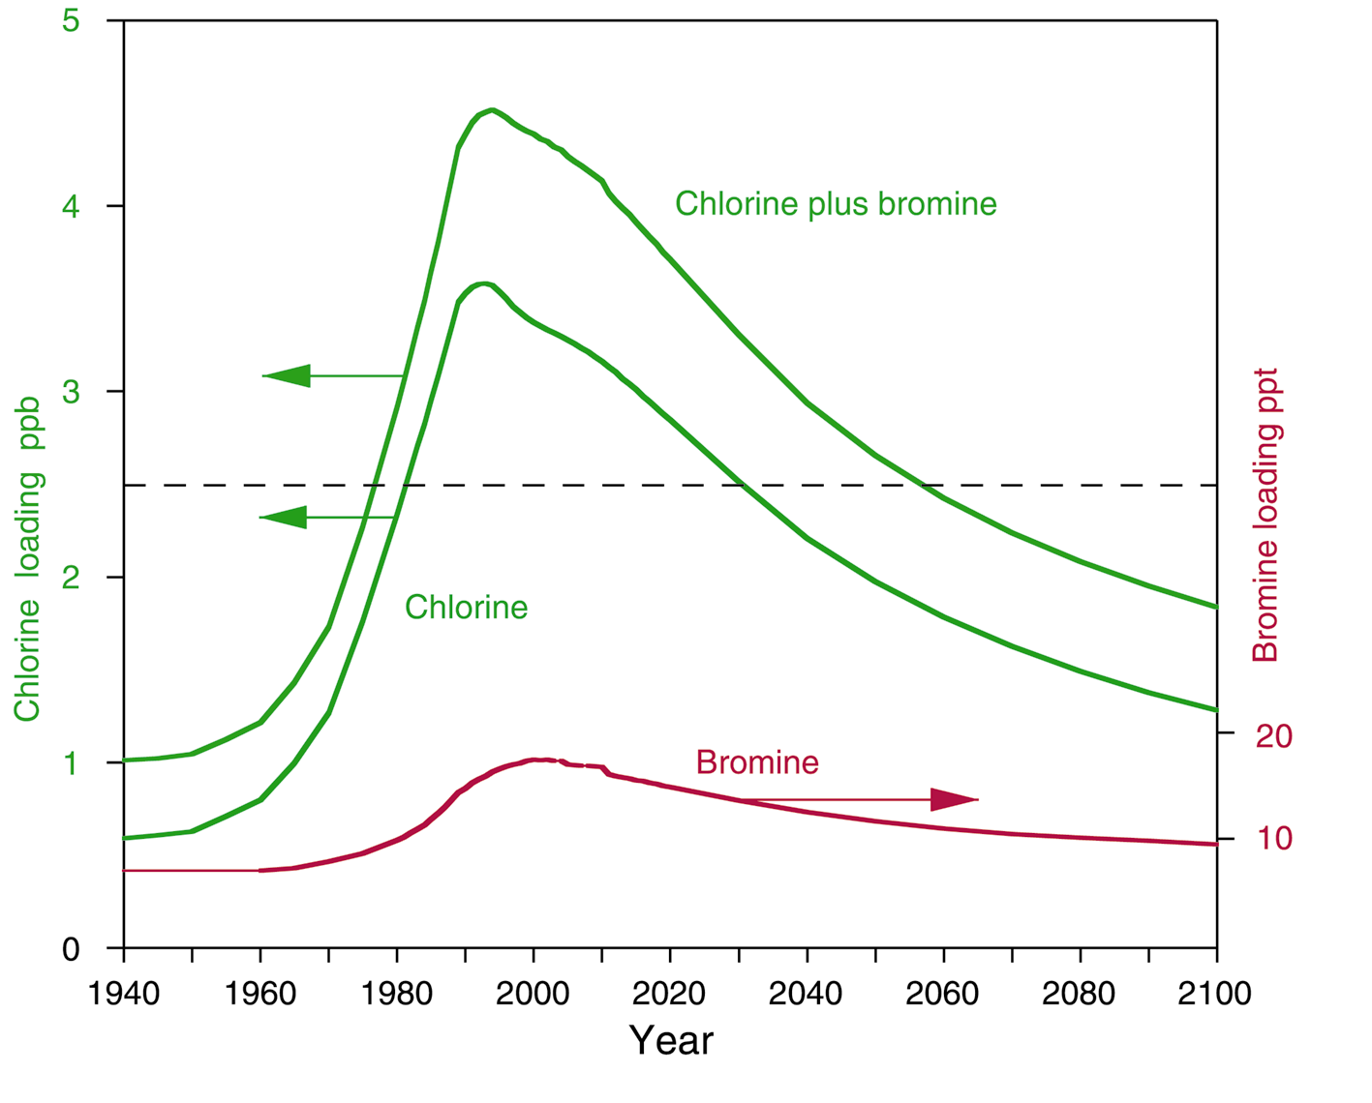
Halogen loading - measurements and projection

Slide 10
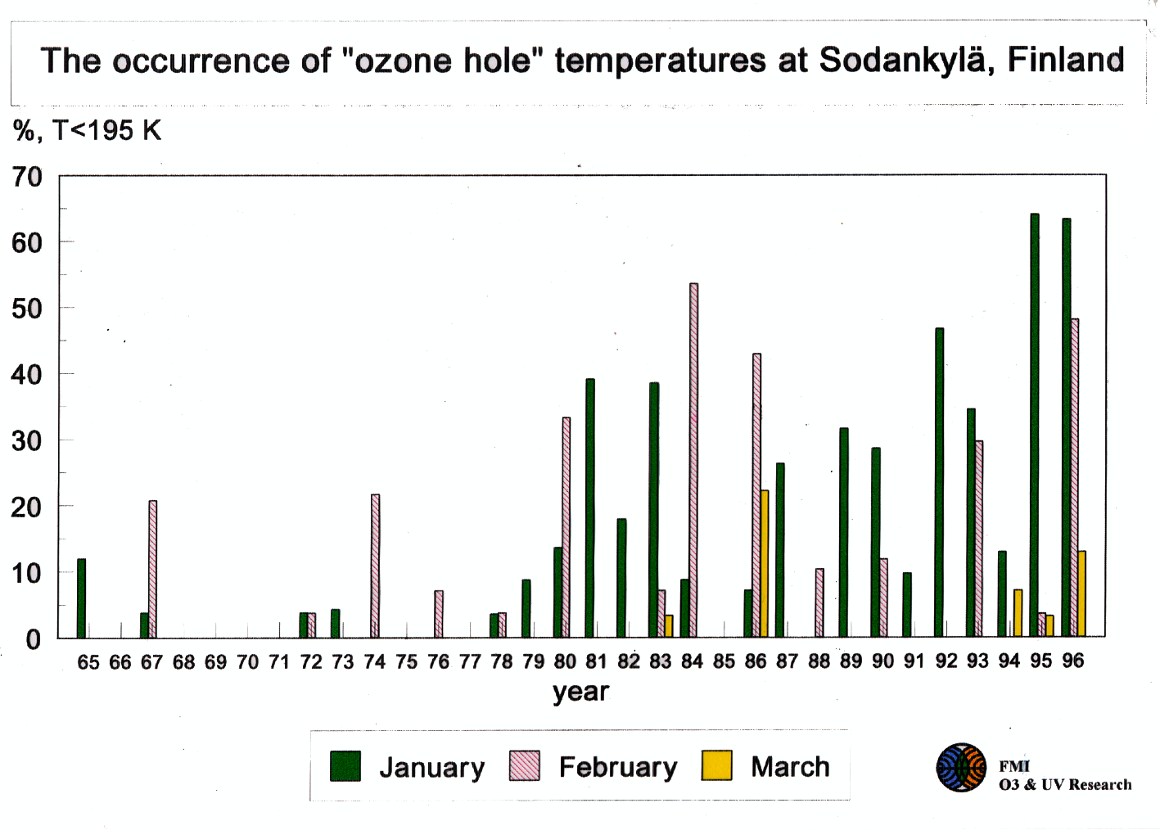

Slide 11
Mid-latitude ozone loss
Loss is observed, but T>195K.
Possible causes include:
  changes in atmospheric circulation & transport
We have examined the role of dynamics in a 20-year model integration using the daily meteorological analyses.
A simple chemistry scheme includes neither changing chlorine, nor aerosol, so any changes must be due to dynamics.

Slide 12
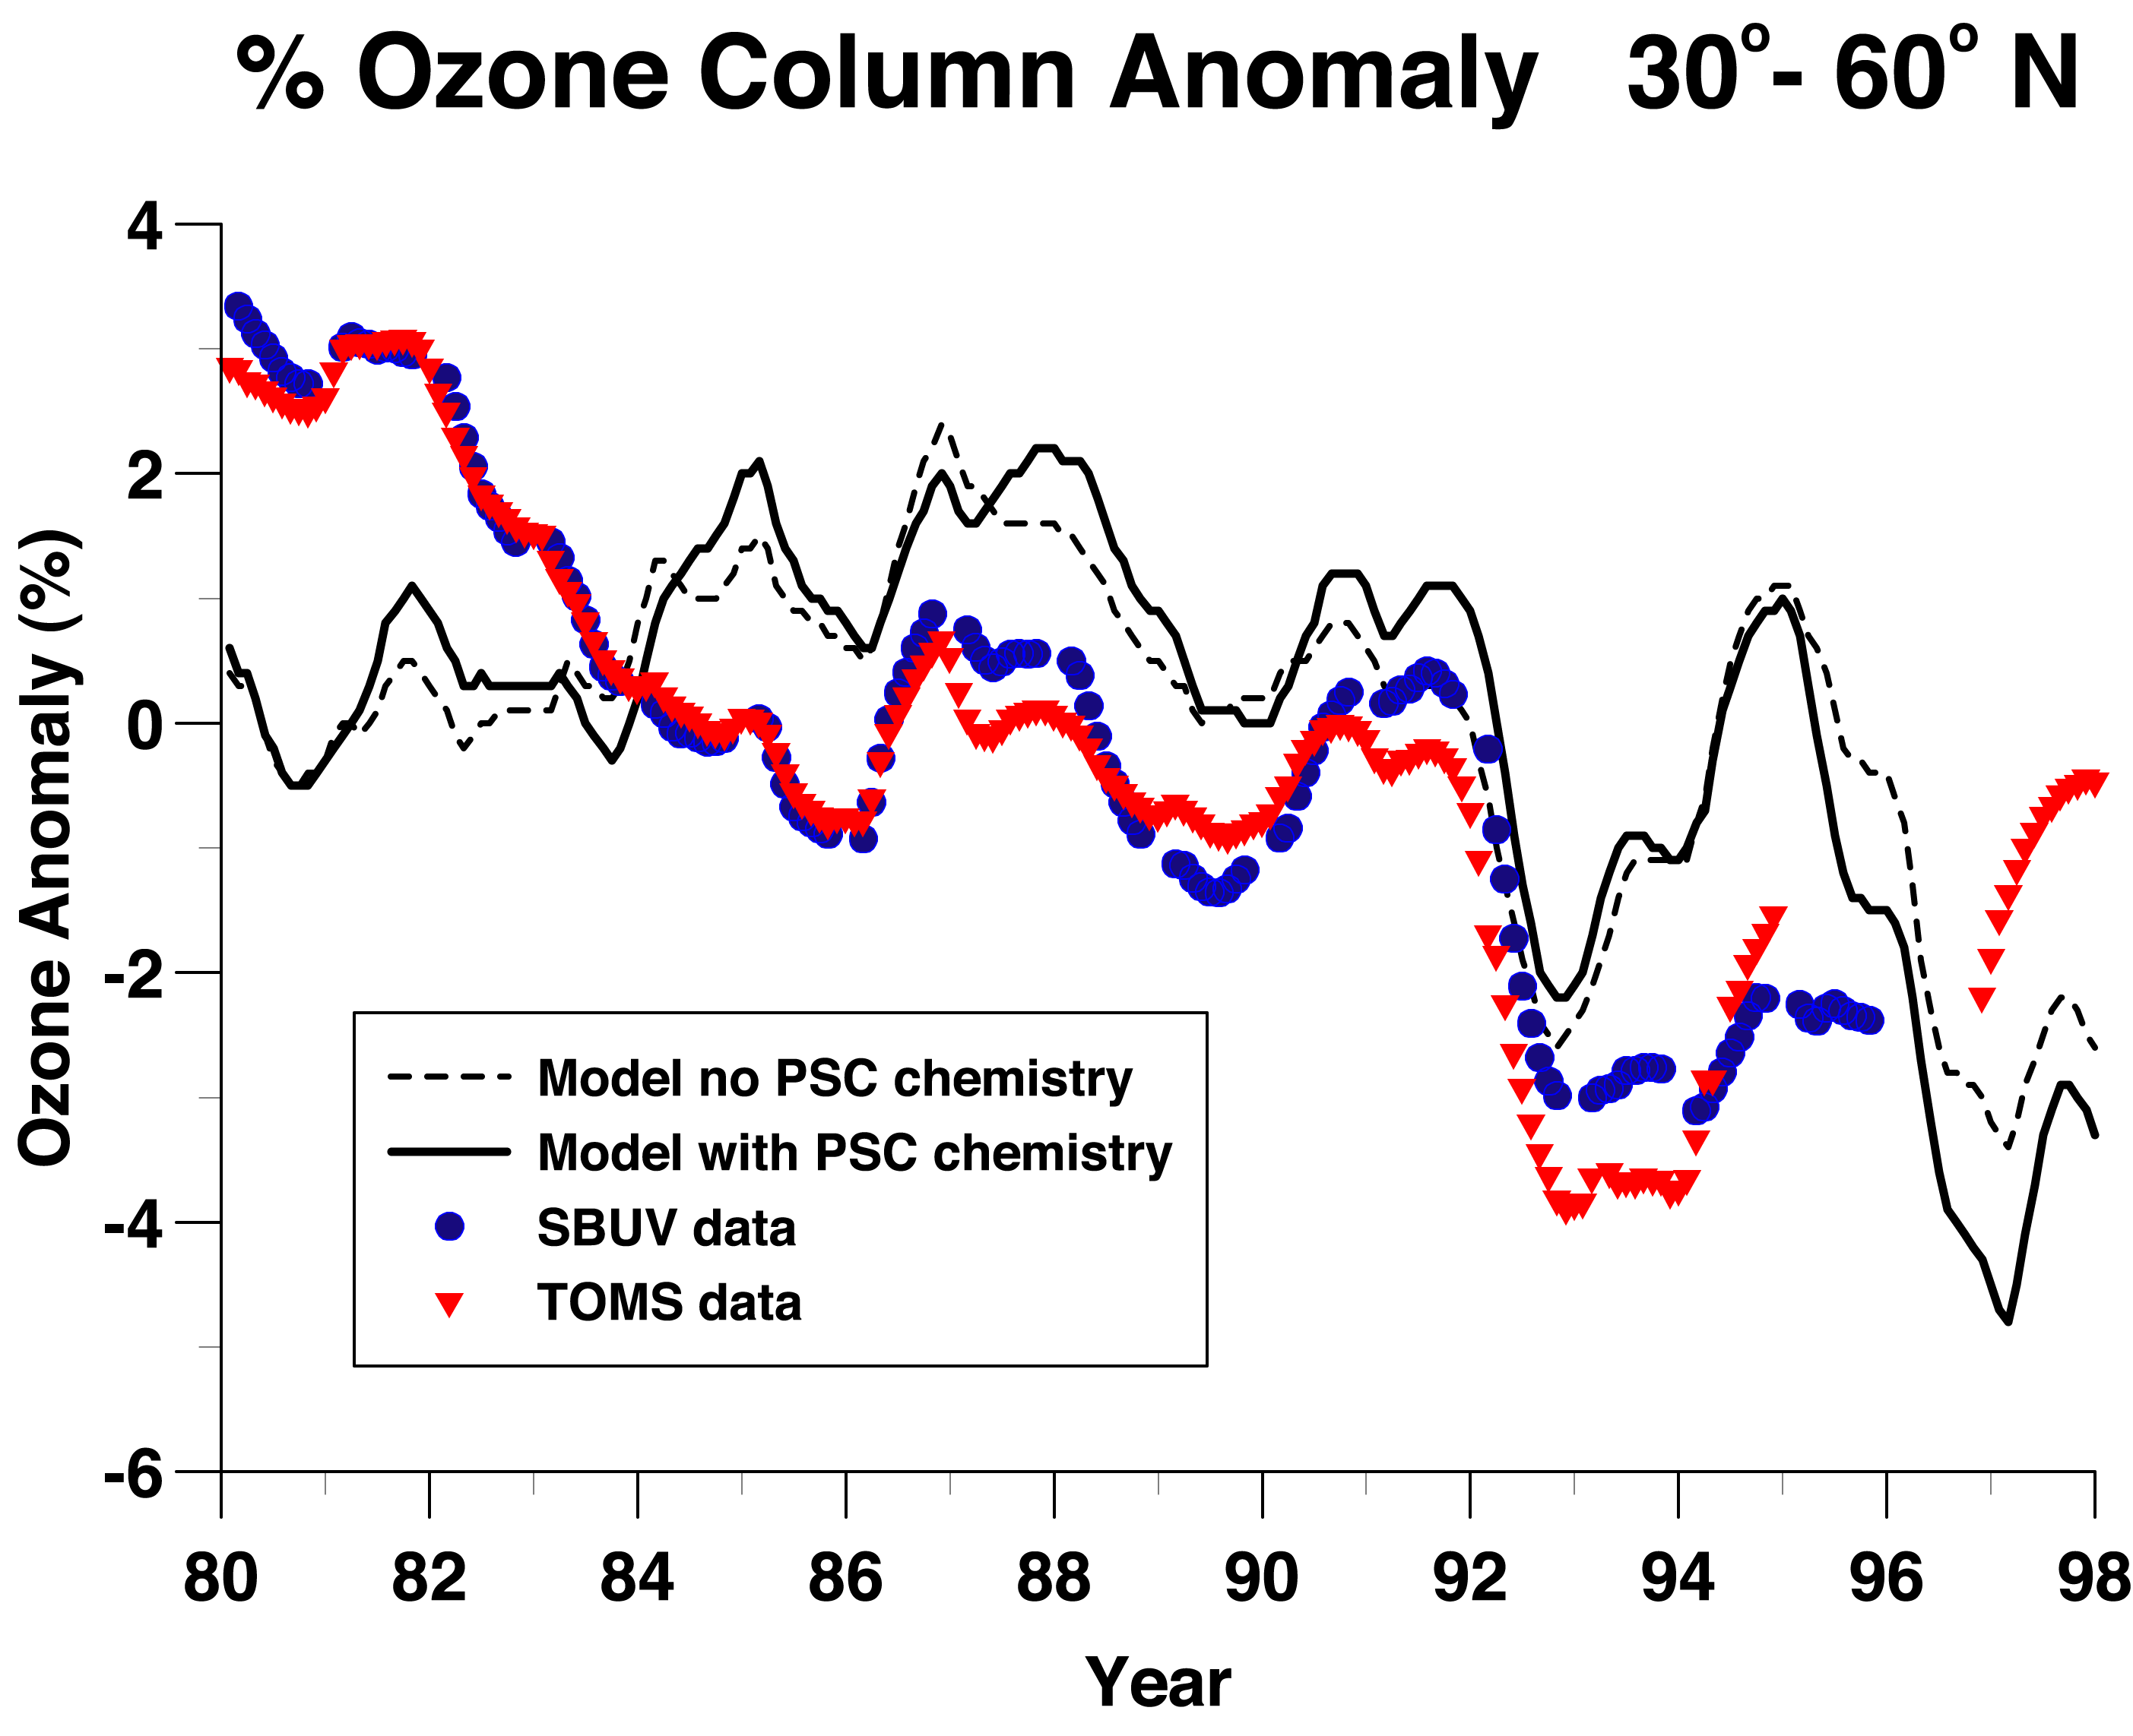

Slide 13
Conclusions - stratosphere
Large polar ozone losses, in north and south
Depends on meteorological conditions
Stratospheric cooling may delay ‘recovery’ of ozone layer
Mid-latitude decline since 1979 is partly (about half?) due to long-term dynamical variability
Important to understand in context of ‘recovery’
Stratosphere a good place to look for (climate-induced) circulation changes?

Slide 14
Tropospheric Chemistry
How will composition change in the future?
Will chemistry/climate interactions affect the change?
  We have added a (fairly) detailed tropospheric chemistry scheme to the Hadley Centre climate model
  46 species (Ox, HOx, NOx, CO/CH4/NMHC), 186 reactions
  Surface emissions of NOx, NMHCs, etc are specified.

Slide 15
Schematic of the tropospheric ozone budget
⇓⇓ Flux from stratosphere⇓⇓
In situ chemistry
RO₂ + NO →RO +NO₂
NO₂ + hν → NO +O (+O₂) → O₃
O₃ + hν → O₂ + O(¹D)
H₂O + O(¹D) → 2OH
⇓⇓ Surface deposition ⇓⇓

Slide 16
Three Experiments
Atmosphere of 2000 with current emissions, etc.
Emissions of NOx, NMHCs, etc, for 2100 from IPCC, but into a ‘background’ 2000 atmosphere
2100 calculation with emissions as in B and an atmosphere with 2xCO₂
At this stage the calculated O₃ does not feedback onto climate, i.e. feedback loop is not complete

Slide 17
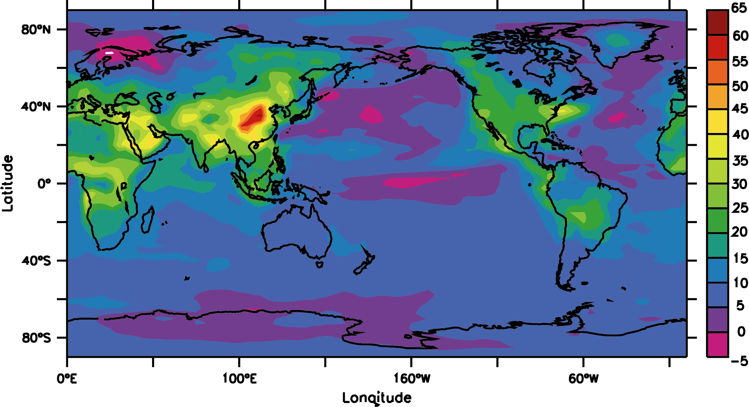
Change in surface ozone 2100-2000
Expt (C-A) : Large ozone increases over continents
Some decreases over the oceans

Slide 18
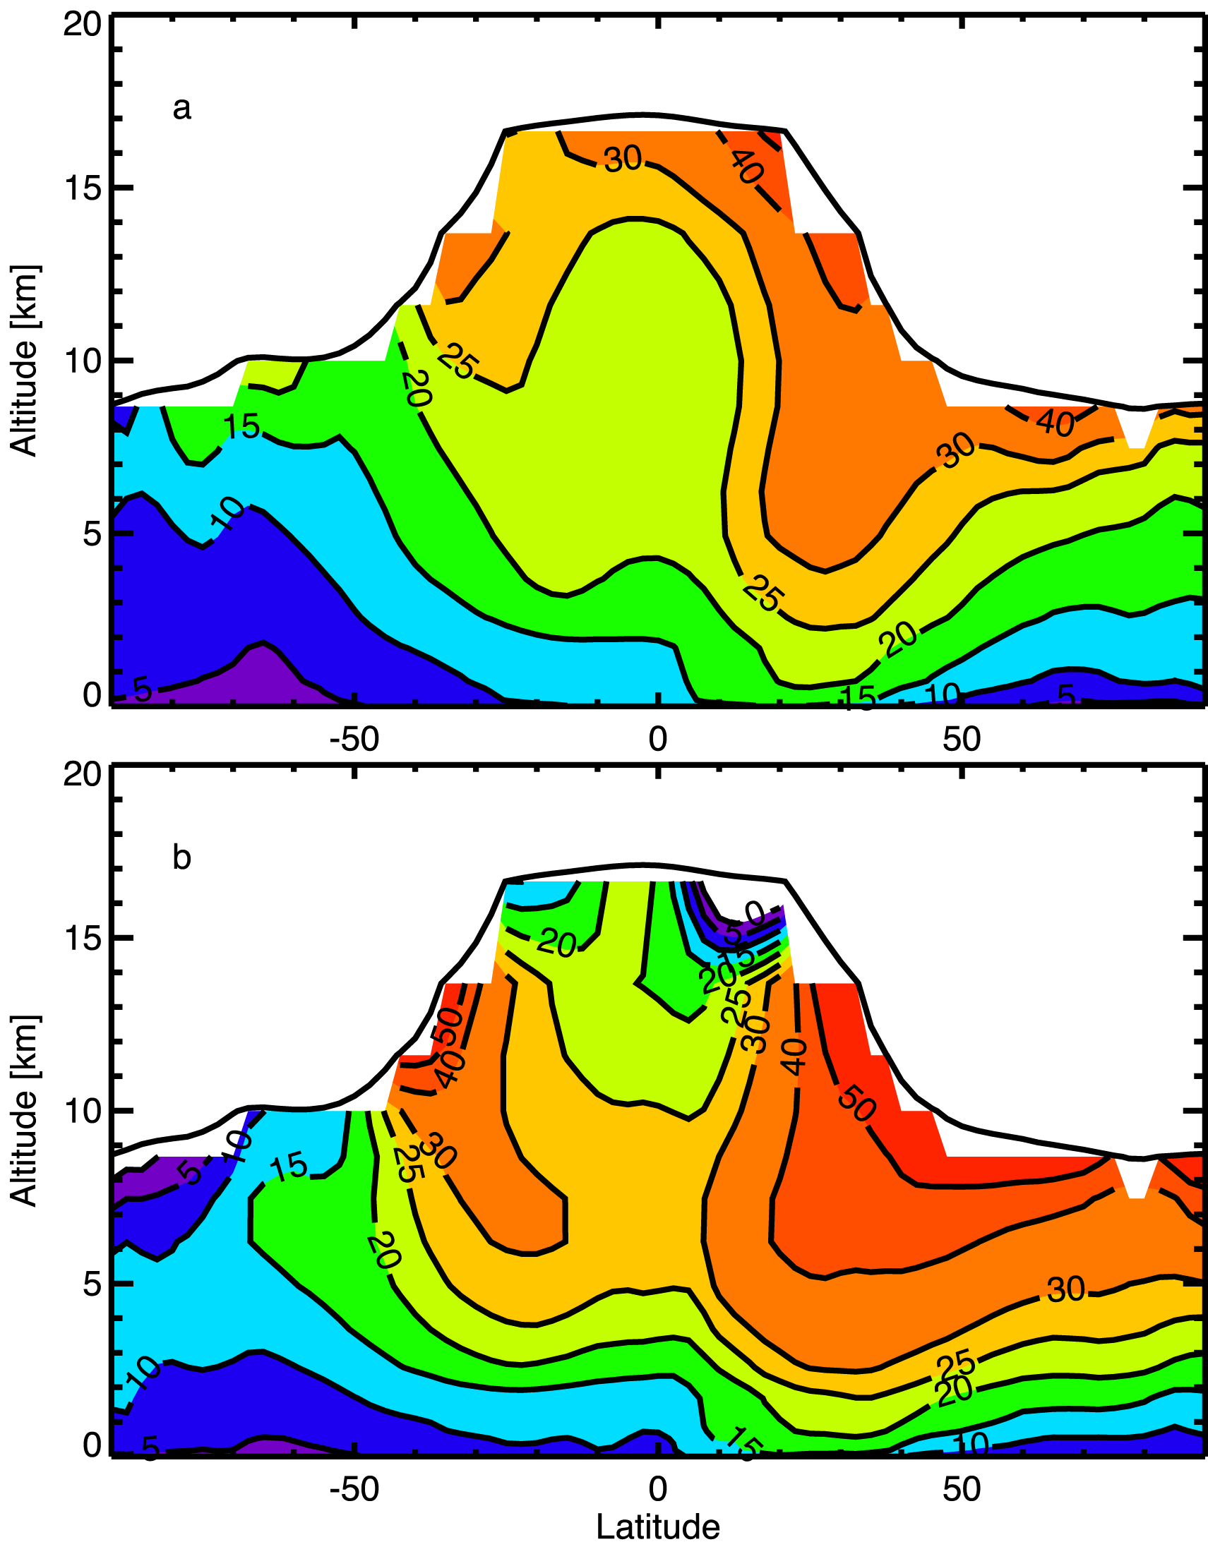
Change in tropospheric ozone 2100-2000
Change in emissions only
(B-A)
ppbv
Add-in climate change
(C-A)
ppbv

Slide 19
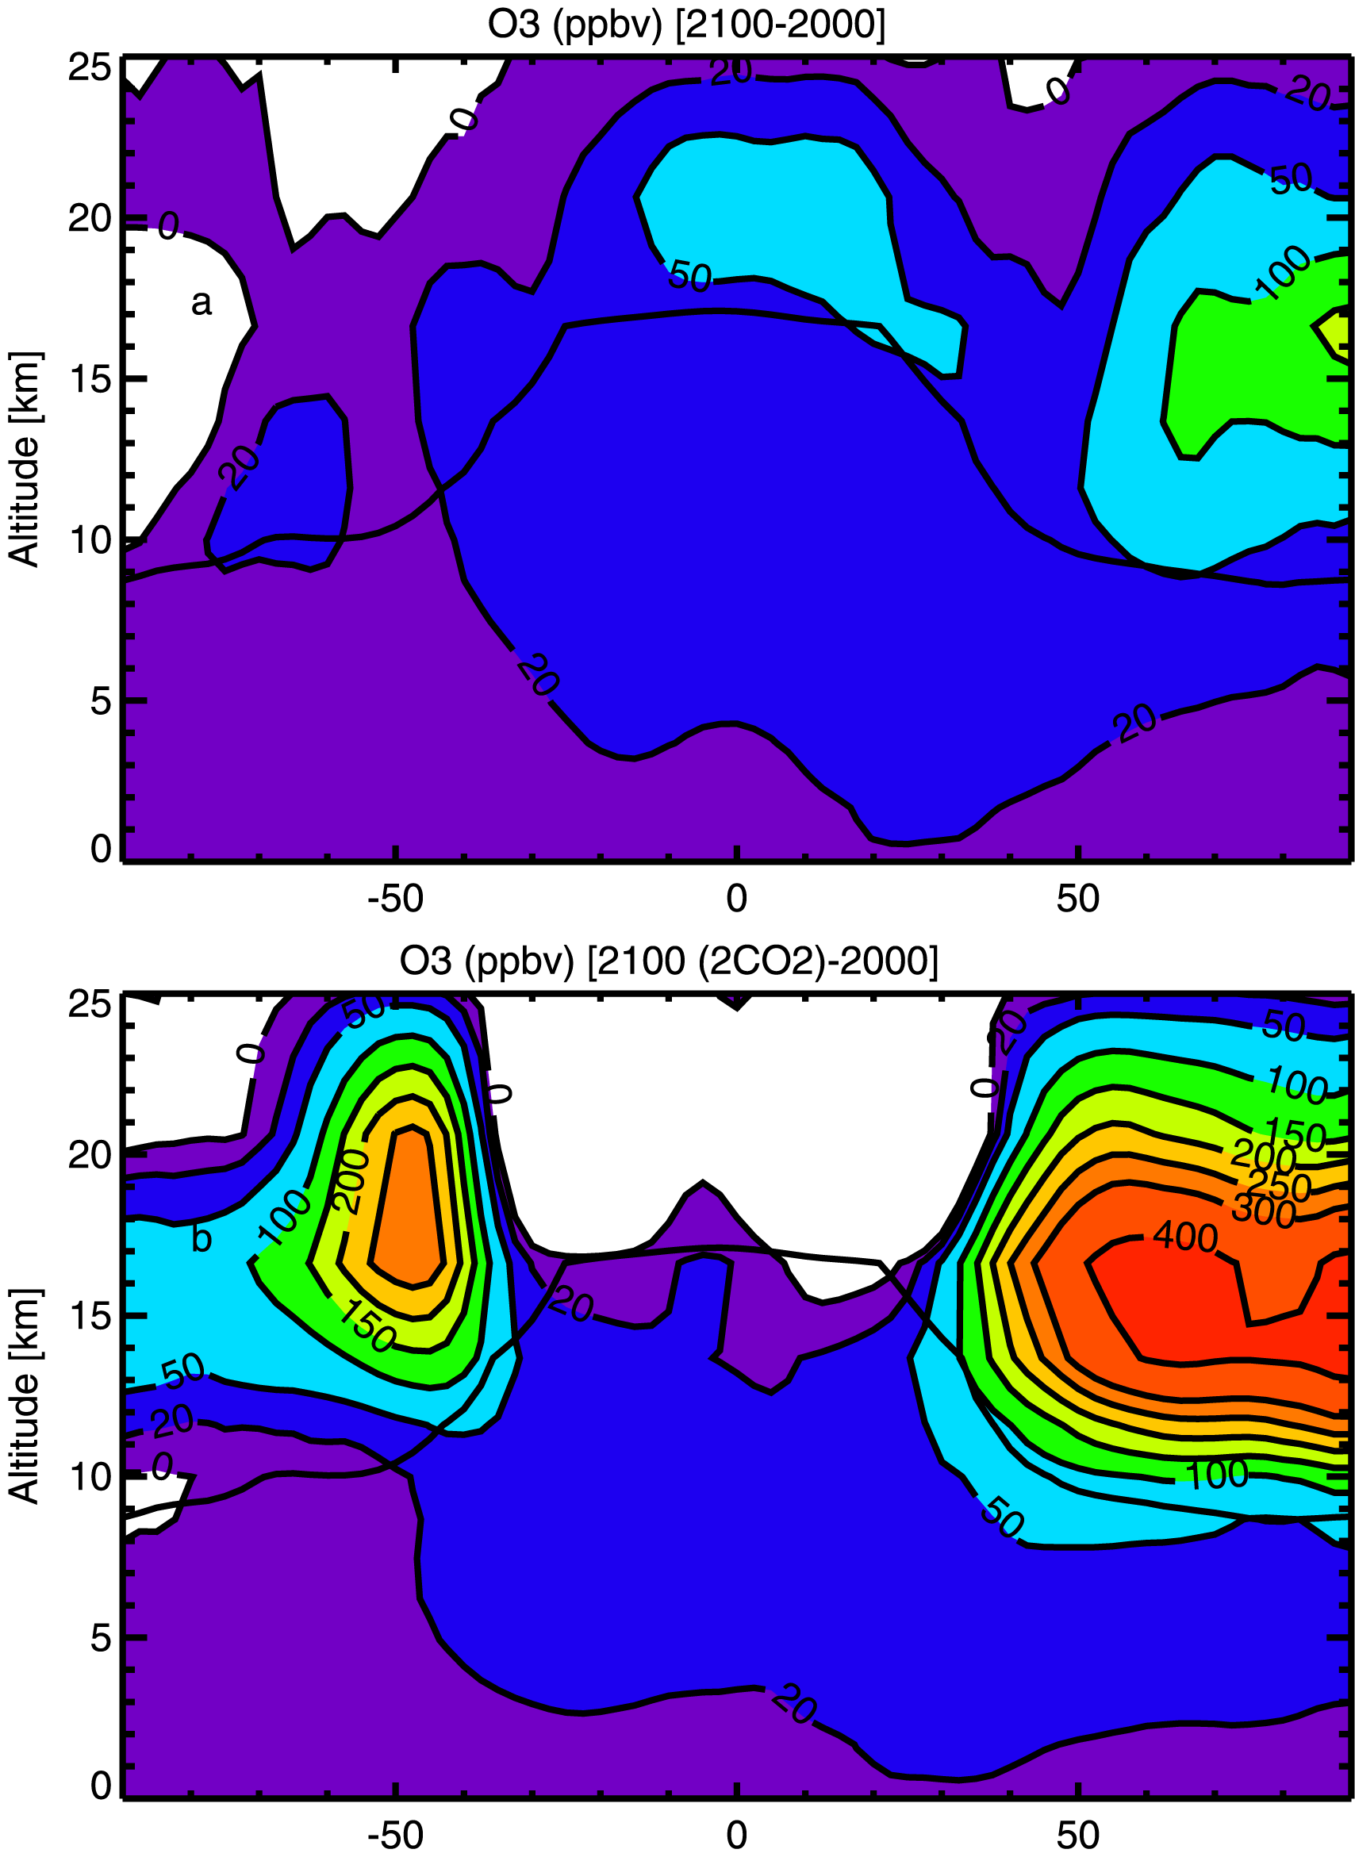

Ozone change in Stratosphere
Increase in lower stratosphere
(B-C)
Large increase in lower strat ⇒ due to cooling there in future climate
(C-A)

Slide 20
Conclusions - troposphere
Surface ozone concentrations set to rise this century - with possible serious consequences for human health
Response is climate-dependent
Future changes in the stratosphere appear to be very important - and only approximately modelled here!
sensitivity calculation, not prediction
Feedback of these changes on climate?

Slide 21
Acknowledgements
Polar work : Adrian Lee, Genevieve Millard, Marielle Guirlet, Martyn Chipperfield and colleagues at Leeds
Middle latitudes : Panos Hadjinicolaou, Amna Jrrar
Tropospheric work : Guang Zeng
and ALL my group within Cambridge
Funding: NERC, EC, DEFRA

