Slide 1

Understanding and forecasting seasonal-to-decadal climate variations
Julia Slingo
Acting-Director, Centre for Global Atmospheric Modelling
University of Reading

Slide 2
Some key questions
Will there be an El Nino this year and how severe will it be?
Will we have another autumn like 2000?
Will the milder winters of the last decade or so continue?

Slide 3
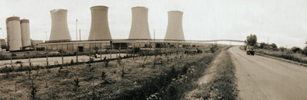




Relevant to many stakeholders
Energy
Water
Management
Health
Food
Chain
Weather
Risk

Slide 4
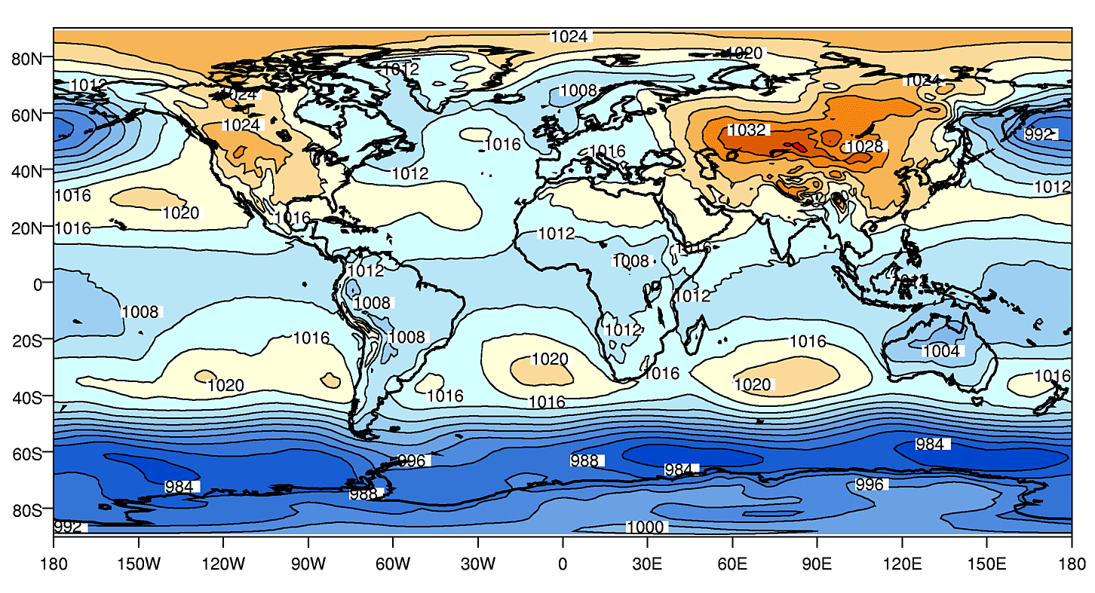
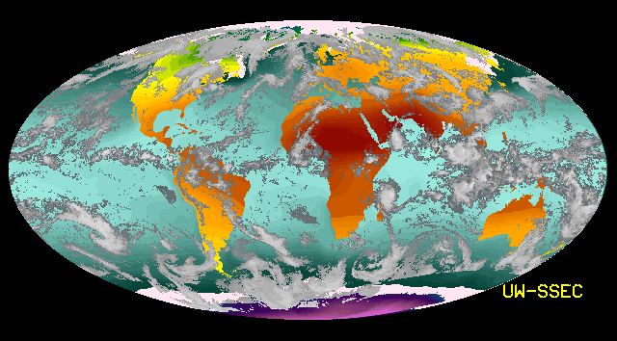
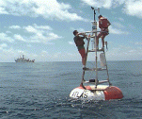
Observations of the climate
Re-analyses of the global circulation
Satellite
Observations
In situ
Measurements
Essential for
(i) describing variability of the current climate,
(ii) evaluating climate model simulations,
(iii) finding associations between different parts of the climate system.

Slide 5
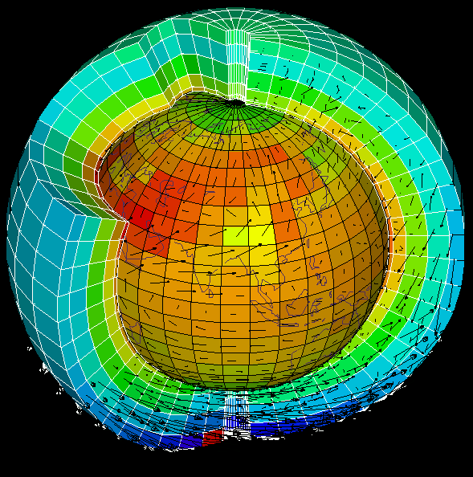
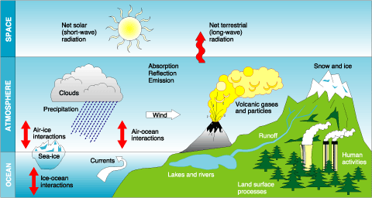
Models
Long-term memory required for predictability, resides in the oceans and land, so we use state-of-the-art models of the complete system:
Models are our laboratory. We use them to
(i) investigate predictability,
(ii) explore forcing and feedbacks in the climate system, and
(iii) test hypotheses.

Slide 6
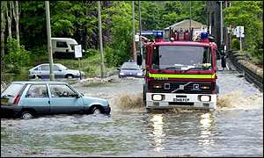
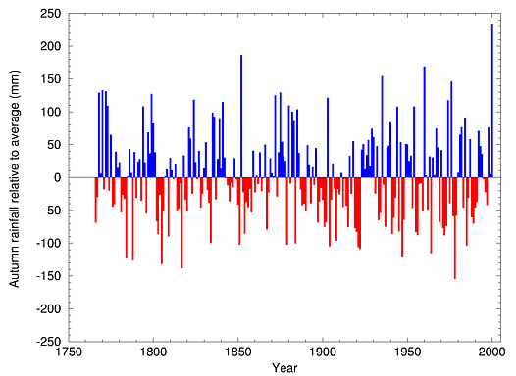
Floods of Autumn 2000
All England Autumn Rainfall since 1765
Wettest Autumn on record
What caused it?
Was it predictable?
Is it a sign of things to come?

Slide 7
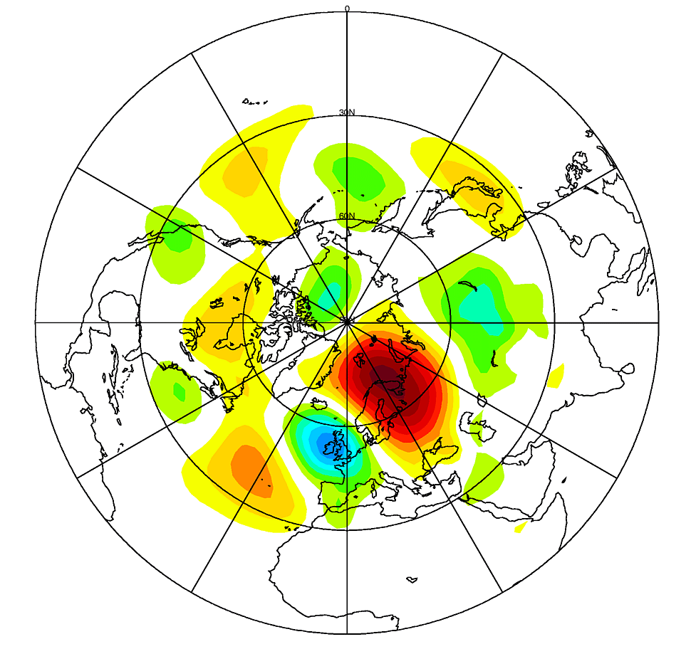
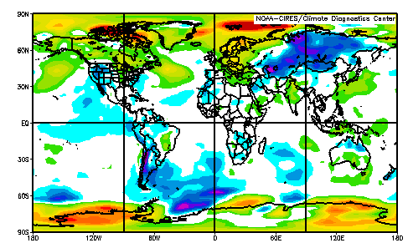
Cause of Floods
Associated with a persistent weather pattern, known as the Scandinavian pattern.
Were the oceans the driver?
Surface Temperature Anomalies
Warm Atlantic Ocean up-stream of the UK
Weakening La Nina in the Pacific

Slide 8
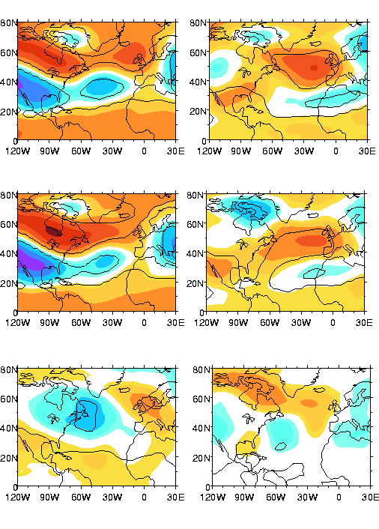
ENSO influence on UK climate
Global
ocean
forcing
Affects of El Nino/La Nina on the seasonal climate of the UK are potentially predictable.
Forcing from the Pacific dominates when El Nino/La Nina is strong.
1997: El Nino
1998: La Nina
Without
Atlantic
forcing
Implied
effect of
Atlantic

Slide 9
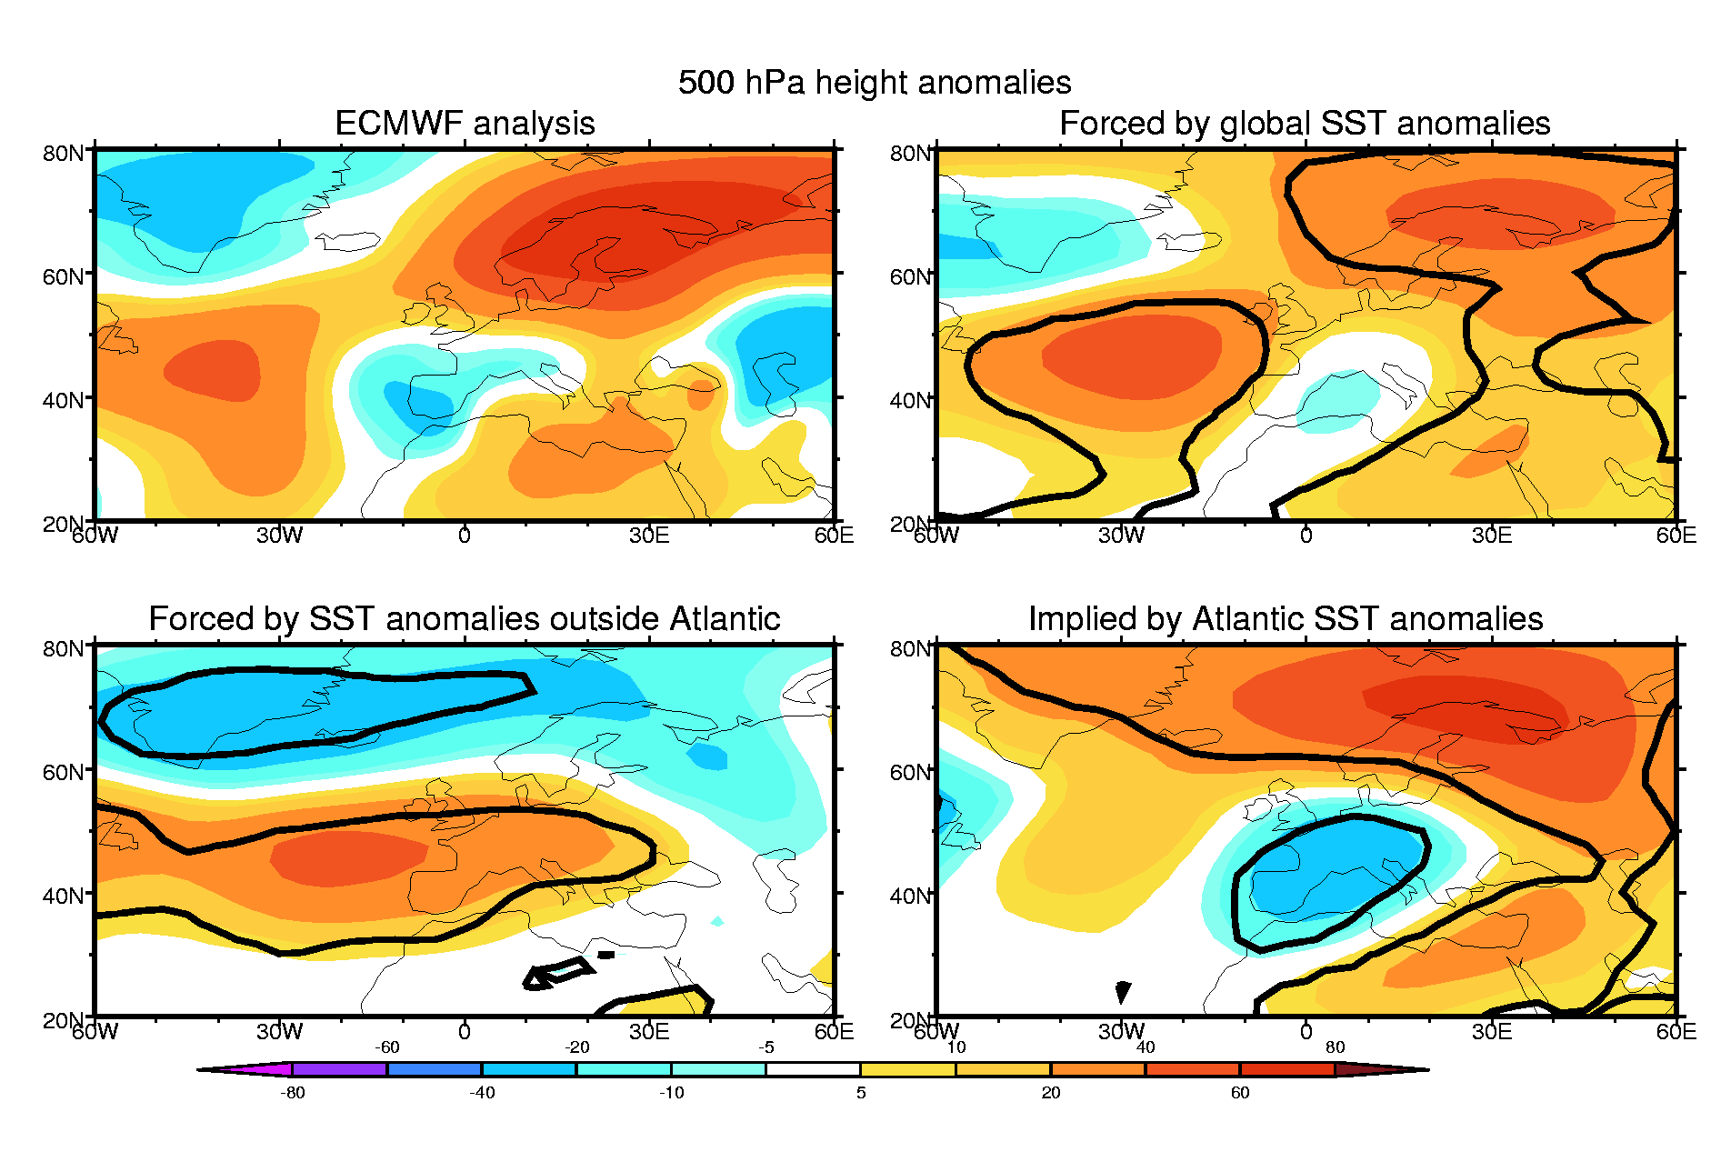
So what role for the Atlantic?
Consider another year (1999) when El Nino/La Nina was weaker:
In the absence of strong Pacific forcing, the state of the Atlantic Ocean is important for seasonal predictability.
Strong evidence that the Atlantic Ocean affects the climate of western Europe.

Slide 10
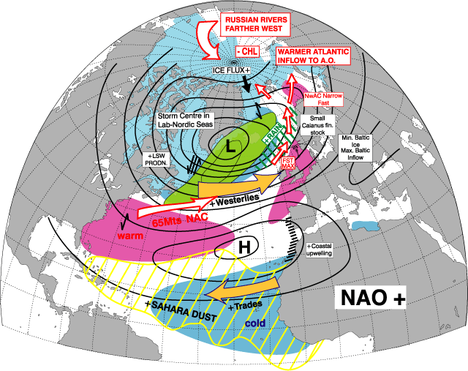
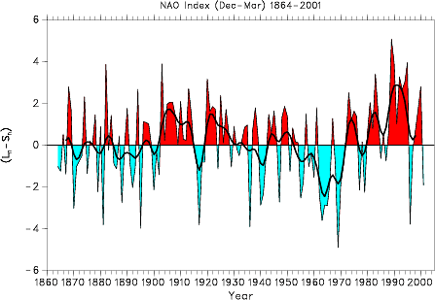
North Atlantic Oscillation (NAO) and UK Climate
NAO dominates UK climate variability on years to decades. In its positive phase, winters tend to be milder, windier and wetter
Positive NAO states have been dominant over past 20 years
What determines this decadal variability and how predictable is it?

Slide 11
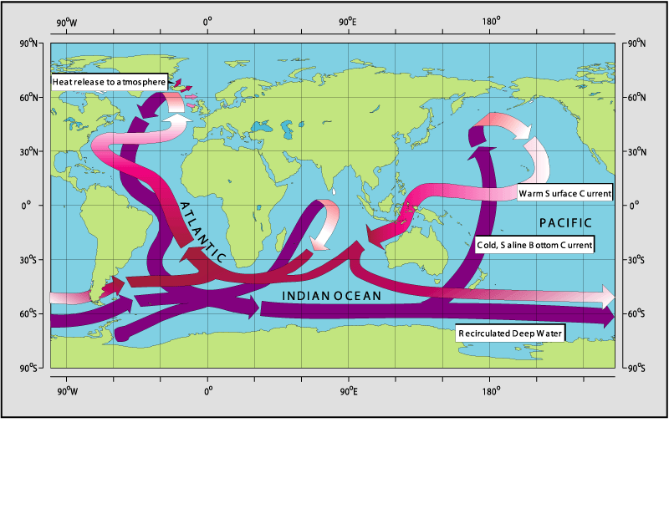
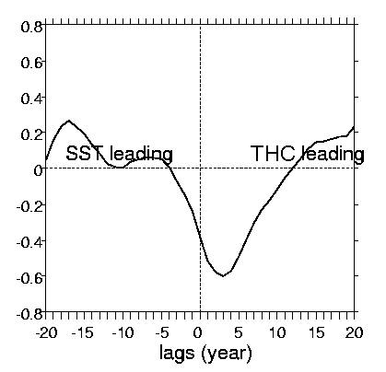
Thermohaline Circulation (THC) and UK climate
The THC describes the transport of heat by the global ocean circulation.
Heat from Atlantic to the atmosphere gives our relatively mild winters.
Our research has quantified the linked changes in the strength of the THC and the NAO. Variations in the THC lead those in sea surface temperatures and the NAO by ~ 3 years.

Slide 12
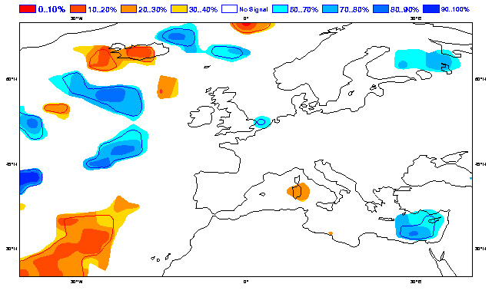
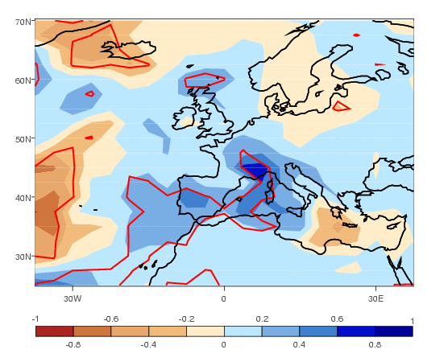
So were the floods of Autumn 2000 predicted?
ECMWF: Operational seasonal
forecast using a coupled model
with predicted ocean temperatures.
NCAS: Seasonal hindcast using an atmospheric model with observed ocean temperatures
Both systems failed but our research suggests that the weather pattern was potentially predictable. So were other factors involved?

Slide 13
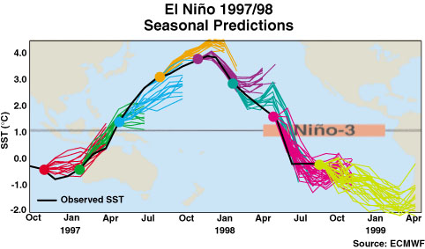
Removing Model Errors
Our complex models are not perfect! Errors currently place huge barriers to progress in seasonal forecasting and its applications, and limits our confidence in climate change scenarios.

Slide 14
Modular Earth System Modelling: A new approach
LAND
BIOSPHERE
REGIONAL
CLIMATE
MODEL
REGIONAL
CLIMATE
MODEL
DATA
ASSIMILATION
SYSTEMS
DATA
ASSIMILATION
SYSTEMS
ATMOSPHERE
LAND SURFACE
COUPLER
ATMOSPHERIC
CHEMISTRY
SOCIO-ECONOMIC
BIO- GEO-
CHEMISTRY
OCEAN
CRYOSPHERE
OCEAN
BIOSPHERE
The core is the coupler, exchanging information between components of the earth system model.
We have pioneered the use of this structure in the UK and shown its value by interchanging ocean and atmospheric modules.

Slide 15
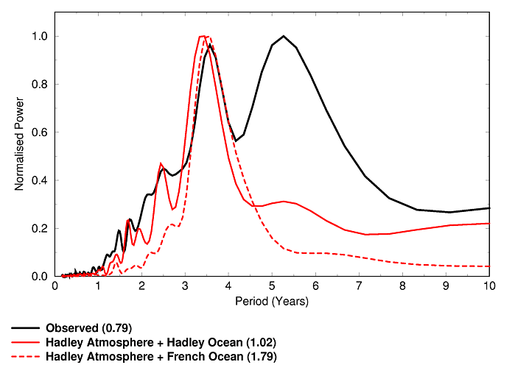
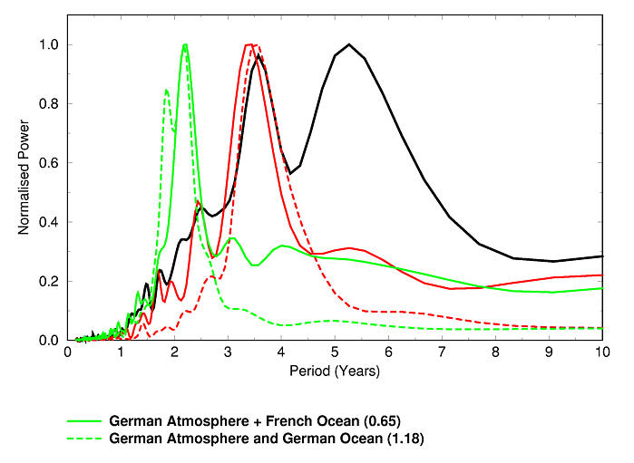
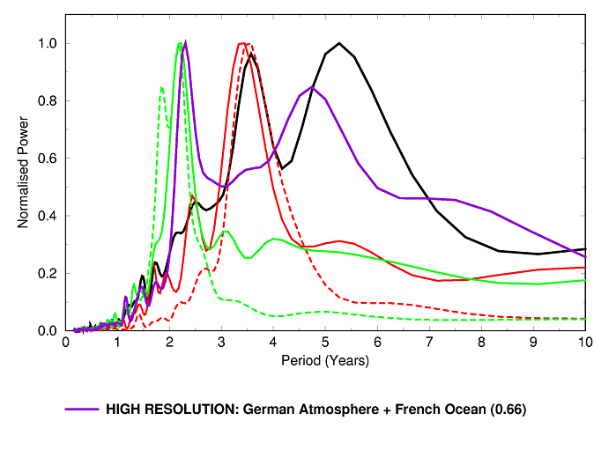
What controls El Nino in Climate Models?
El Nino tends to be too regular and occurs too often.
Model
Observations
Exchanging ocean models suggests that:-
atmosphere controls the periodicity
ocean controls the strength of El Nino
BUT using a high resolution atmosphere (1⁰) dramatically improves the temporal behaviour of El Nino and for the first time provides a more realistic simulation of the lower frequencies.

Slide 16
Seasonal to Decadal Prediction:
A core part of NCAS climate research
Seasonal to decadal prediction presents considerable scientific challenges, but also enormous opportunities for stakeholders.
Working closely with the Hadley Centre, it provides the scientific underpinning for predictions of anthropogenic climate change.
It exploits our expertise in using models as laboratory tools, coupled with observational studies, for exploring climate processes.
The way forward: Modular modelling, combined with higher resolution, offers enormous potential for advancing earth system science.

