Slide 1

Science of Rainstorms with applications to Flood Forecasting
Keith Browning
Director, Universities Weather Research Network
University of Reading

Slide 2
Flooding
Recent flood events in UK have drawn attention to:
  high vulnerability
  increasing risk due to climate change
Hence John Prescott’s ‘wake-up call’ to do something about it
Flooding is the highest-impact natural disaster world-wide

Slide 3
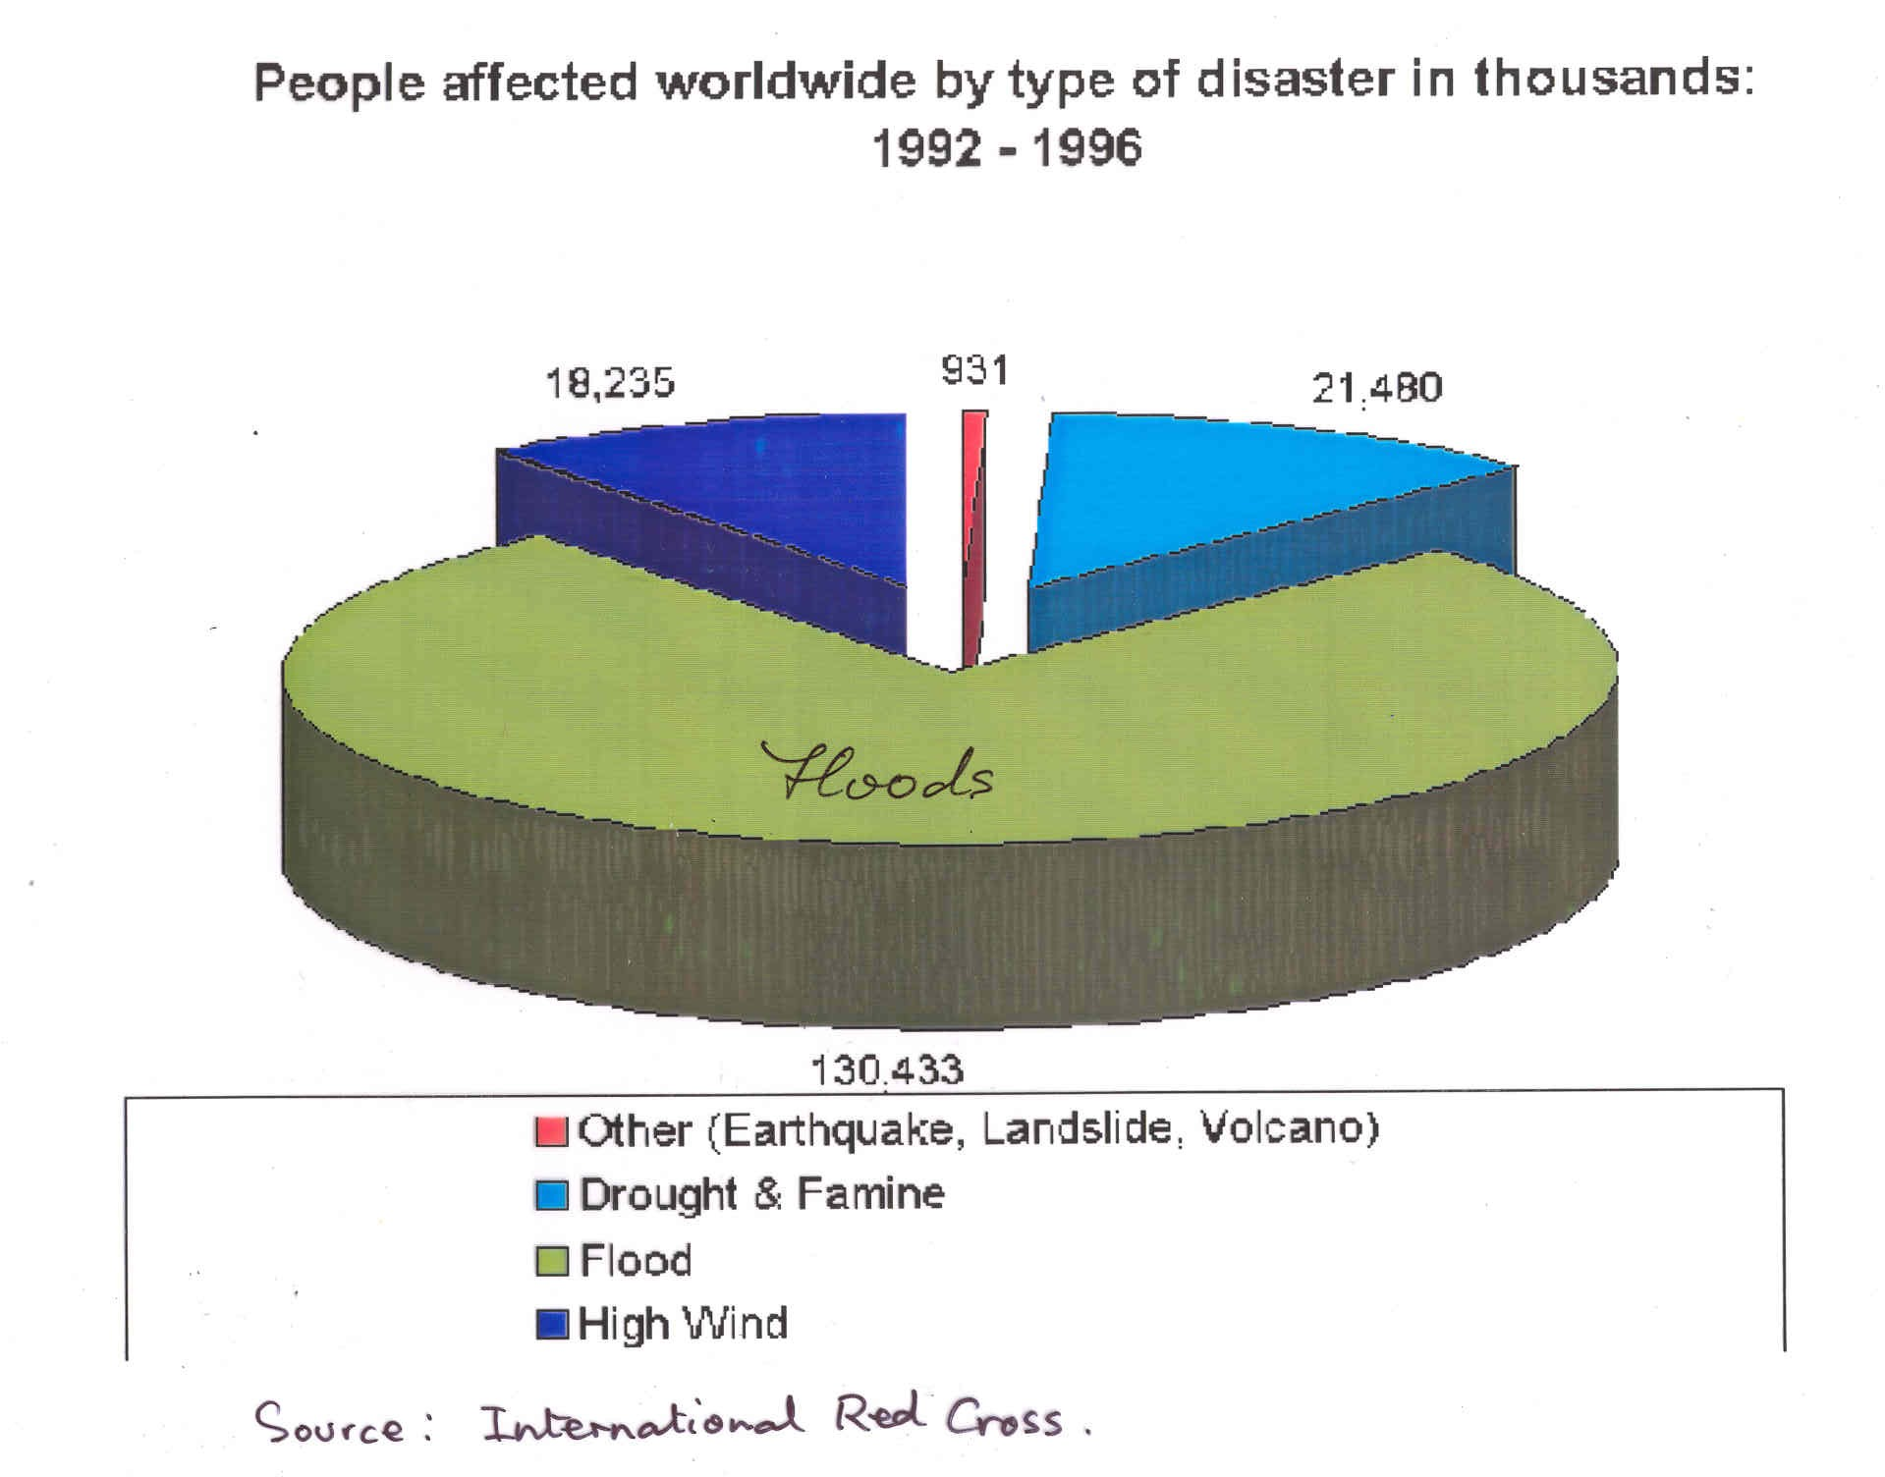
People affected worldwide by type of disaster in Millions: 1991 - 2000
252
31
382
1,443
Other (Earthquake, Landslide, Volcano, Forest fires, Extreme temp
Drought & Famine
Flood
High wind
Source: International Red Cross

Slide 4
The need for Quantitative Precipitation Forecasting (QPF)
Opportunity exists to give radically longer lead times for forecasting floods IF we can improve rainfall forecasts
Major improvements in weather forecasting accuracy in general in recent years BUT short-range rainfall forecasts have not significantly improved

Slide 5
Timeliness of research effort to improve QPF
Current developments in the understanding, measurement and modelling of rain-producing weather systems allow us to undertake an integrated programme to improve QPF and to exploit this for improved flood forecasting
QPF is the topmost priority of the WMO World Weather Research Programme
UK is a world leader in this research

Slide 6
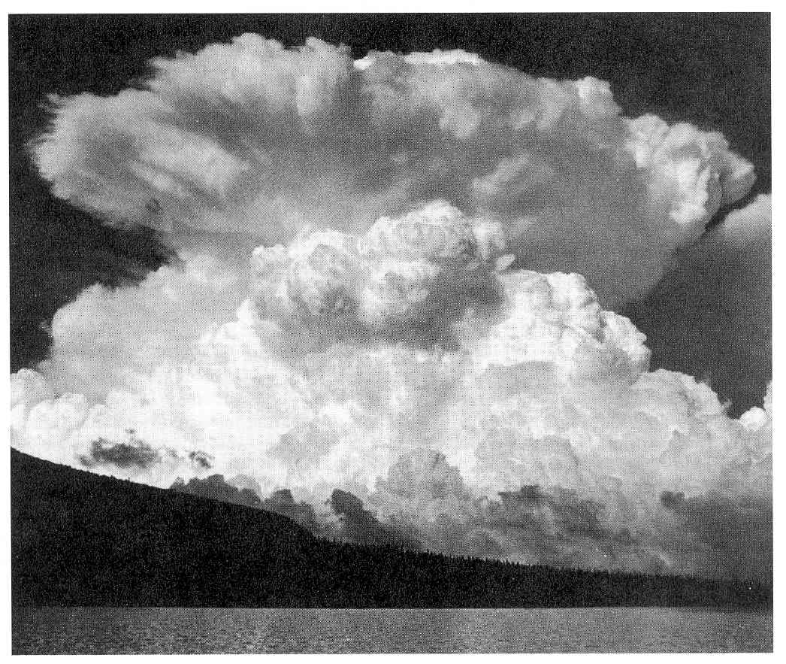
Big Thompson Canyon storm on 31 July 1976
The major forecasting challenge is posed by heavy localised rain due to convective storms (thunderstorms)
Improved measurement and forecasting of convective rain over the 0-6 hour period is needed to improve warnings of flash floods and urban flooding

Slide 7
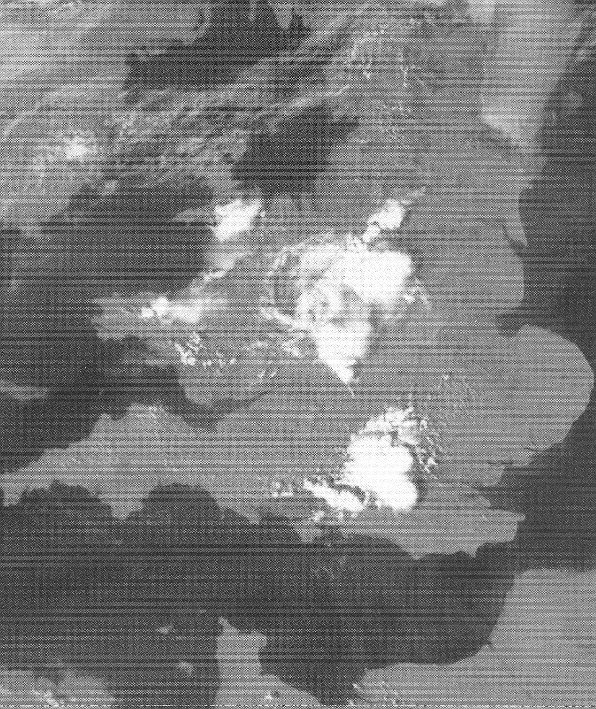
Satellite picture of Mesoscale Convective Systems
(1243 UTC, 24 May 1989)

Slide 8
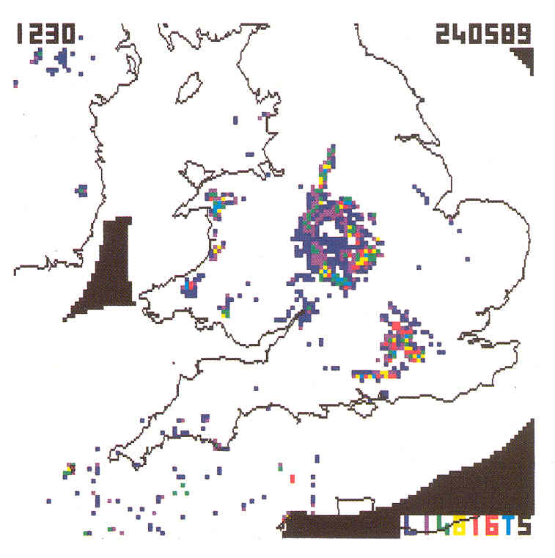
Cores of heavy rain within Mesoscale Convective Systems shown on radar network
(1230 UTC, 24 May 1989)

Slide 9
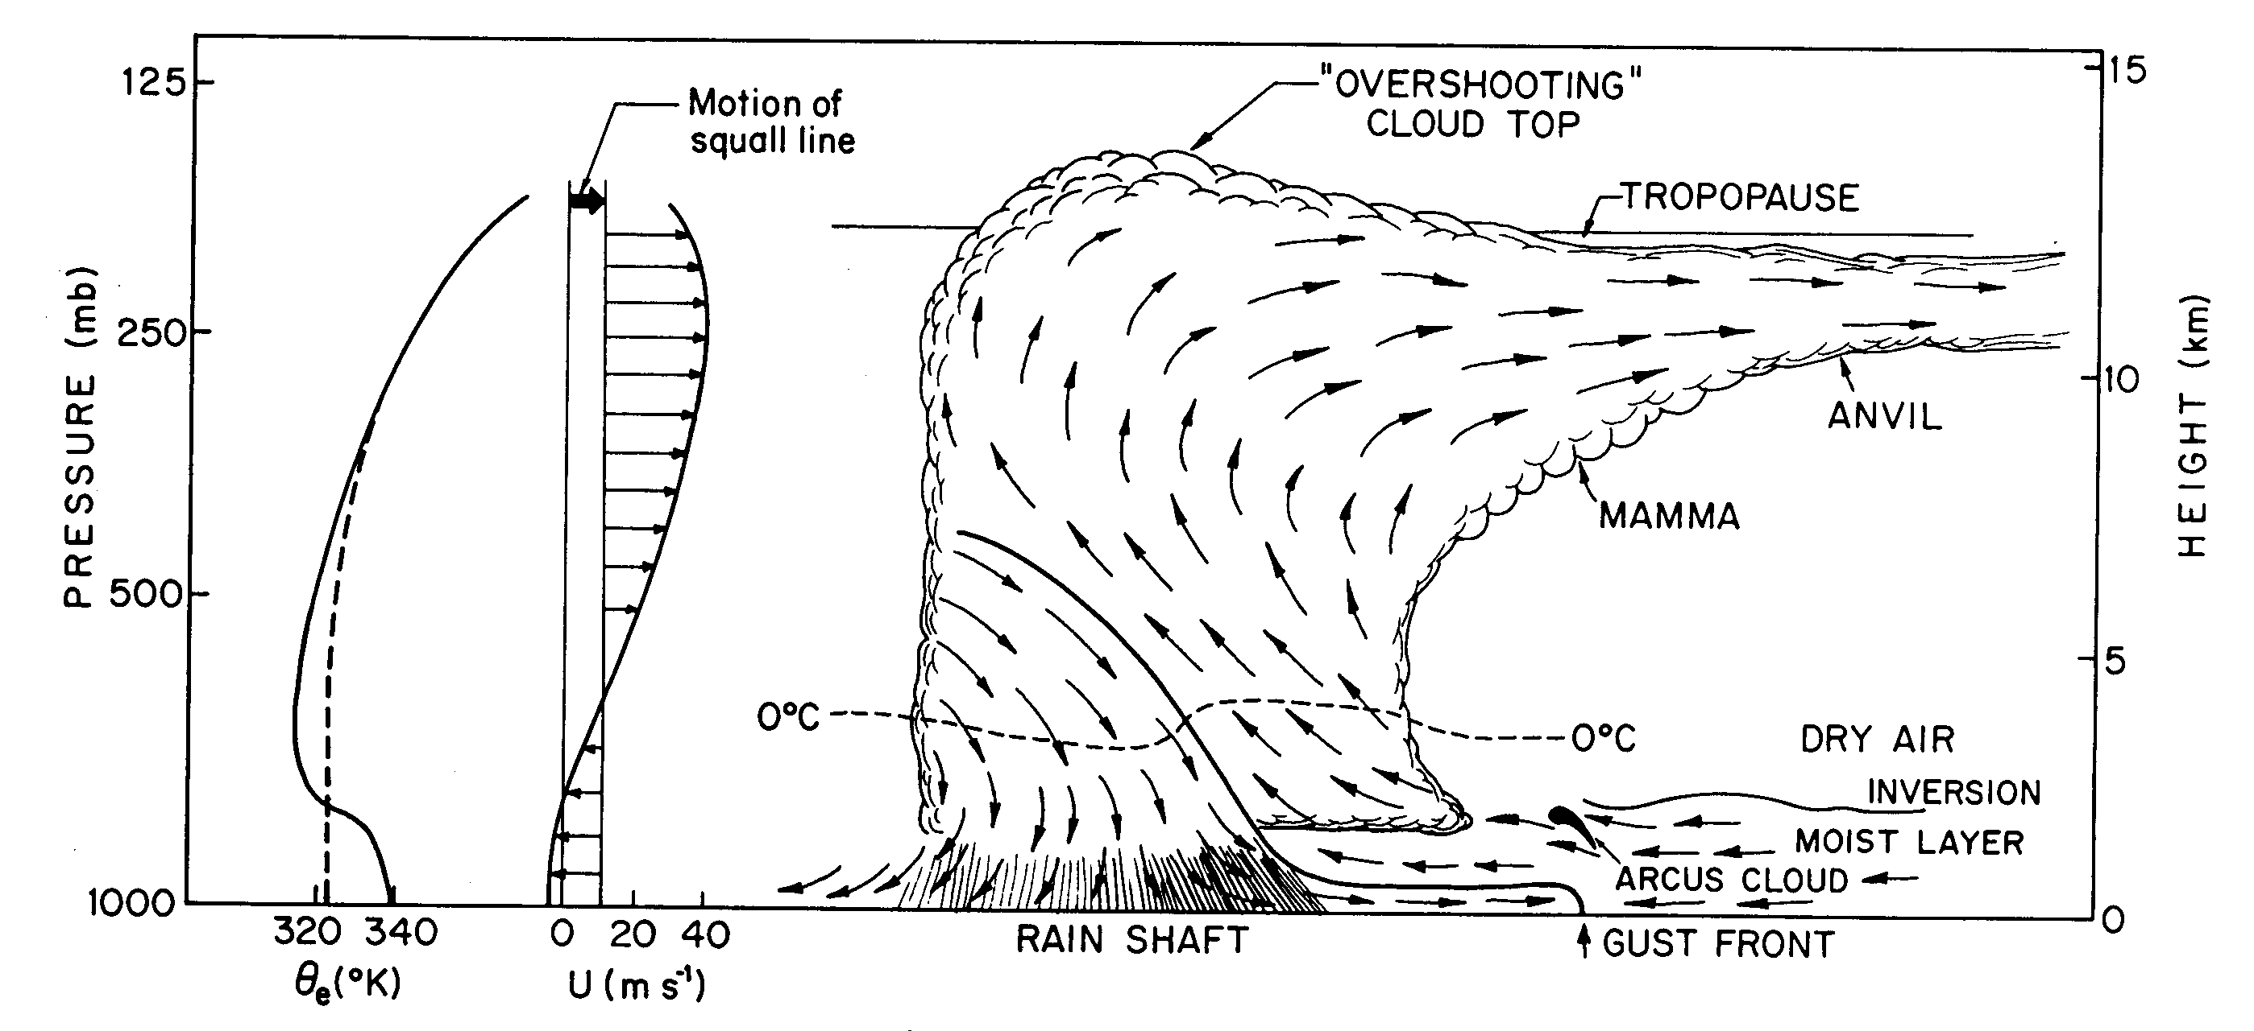
The organization and physical mechanisms within severe convective storms are well understood.
What we now need is to represent the storms, and their interaction with their environment, within a new generation of weather forecast models
(Wallace & Hobbs)

Slide 10
Improving the Value of Rainfall Information for Flood Forecasting
A: Rainfall measurement
Current distribution of rain over sub-catchment
Water Authority Decision Support Systems
Hydrological streamflow model
B: Data Assimilation
C: Atmospheric Numerical Prediction Model
Forecast distribution of rain over sub-catchment
Atmospheric science research is needed on A, B & C
Also need to evaluate & develop these improved procedures within end-to-end system if the users are to reap the benefit
“Flood risk management needs to be a holistic process” Fleming Report (Learning to live with rivers – Nov 2001)

Slide 11
NCAS is promoting a major new thrust:
Science of Rainstorms Applied to Flood-Forecasting
Core-strategic Programme
  – the underpinning R & D (ingredients in place)
Thematic Programme
  – to focus on flood risk issues (bid to NERC & EU/FP6 in late 2002)
Partnerships between NERC (NCAS & CEH), Met Office, EA and Water Industry
  - end-to-end system development

Slide 12
Improving: Rainfall Measurement
High-resolution NWP models
Data assimilation
New international satellite systems, especially Europe’s Meteosat Second Generation (and, later, the Global Precipitation Mission)
New JIF-funded facilities for atmospheric measurements, especially the Chilbolton Advanced Meteorological Radar
  owned by CLRC/RAL
  used & developed for atmospheric research

Slide 13
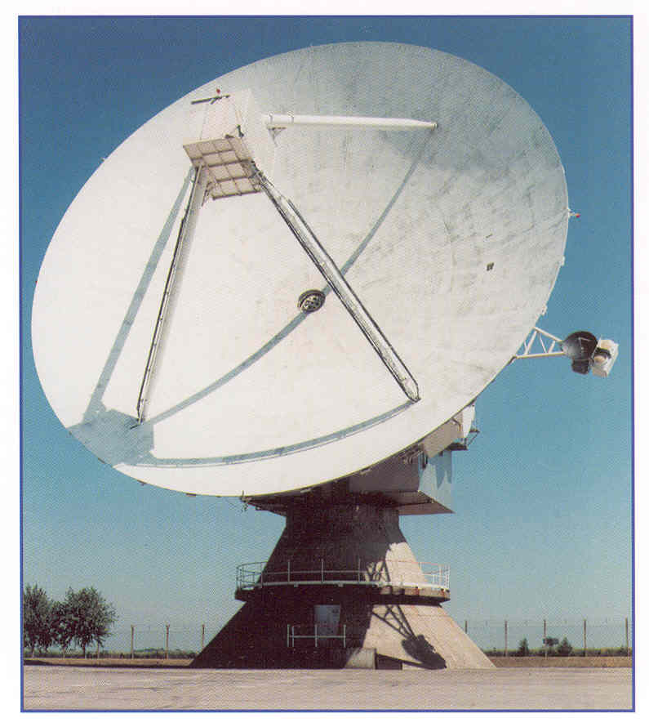
Chilbolton Radar
world-leading facility for developing improved rainfall measurement techniques
provides test bed for developing new-generation operational system

Slide 14
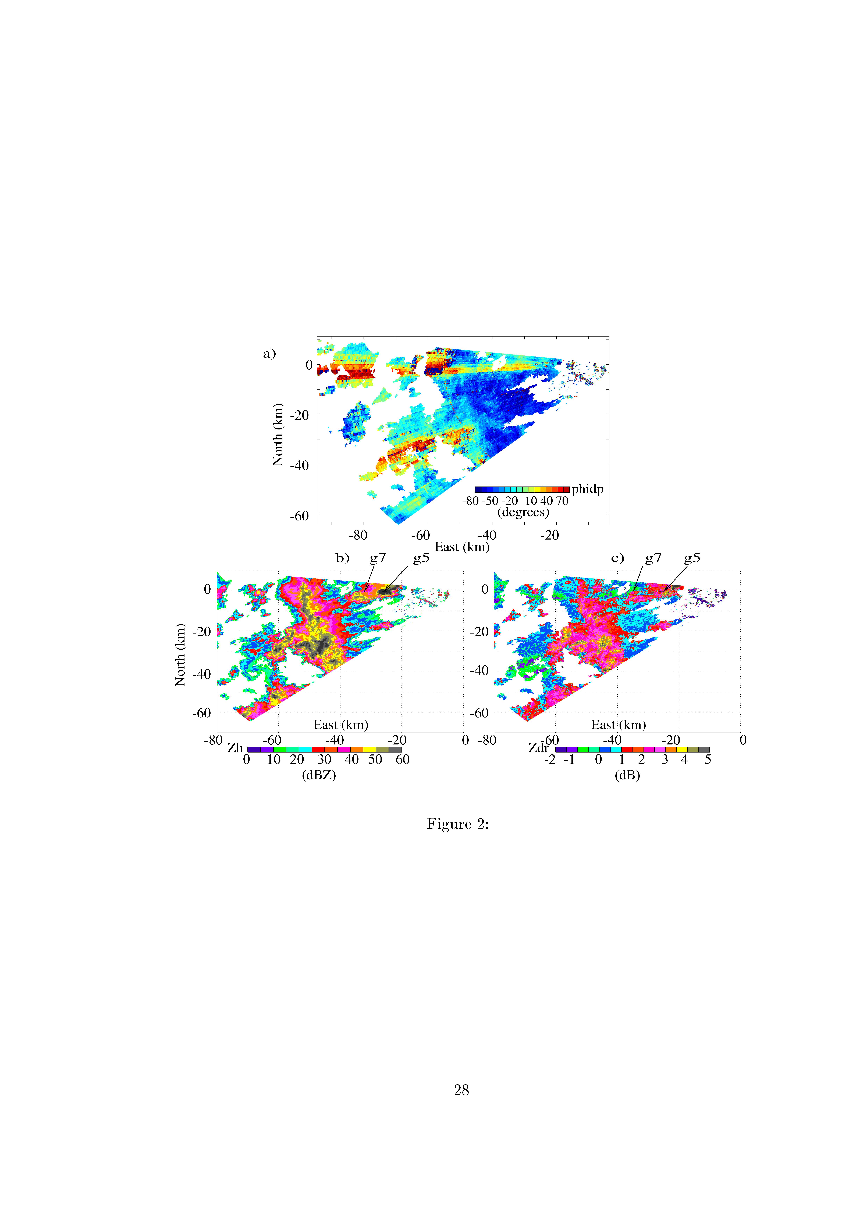
Polarization techniques offer increased accuracy for measuring heavy rain
60 dBZ core could be torrential rain or hail
Conventional Radar Reflectivity
Differential Phase Shift
Phase shift indicates torrential rain
Rain gauge confirmed 250mm/hour

Slide 15
Improving: Rainfall Measurement
High-resolution NWP models
Data assimilation
Numerical Weather Prediction
Met Office researchers are developing model with 2km horizontal grid spacing for operational implementation after 2005
We aim to improve the understanding and representation of convective processes within the model

Slide 16
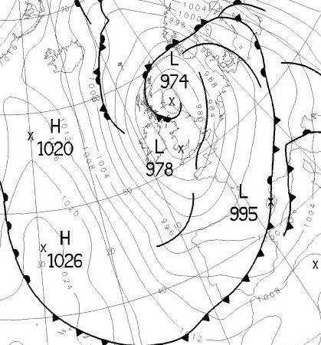
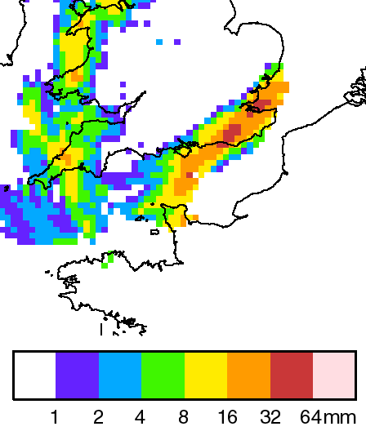
Floods in Kent: 12th Oct 2000
00 UTC Analysis
00-12 UTC NIMROD accumulations

Slide 17
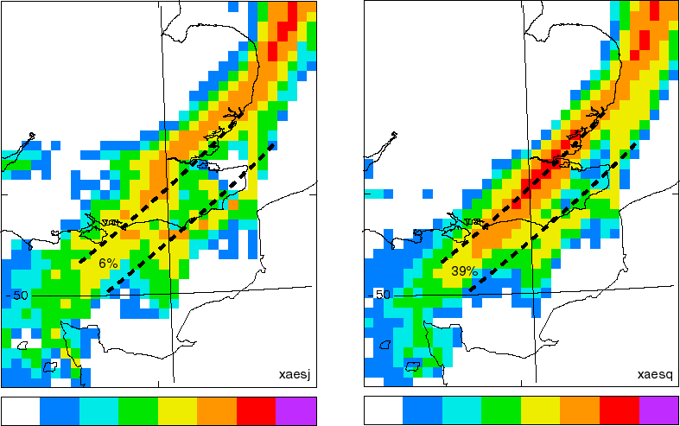
Floods: 12th Oct 2000
Forecast 12-hour accumulations
12km gridlength
2km gridlength
averaged to 12km
1 2 4 8 16 32 64 mm
1 2 4 8 16 32 64 mm

Slide 18
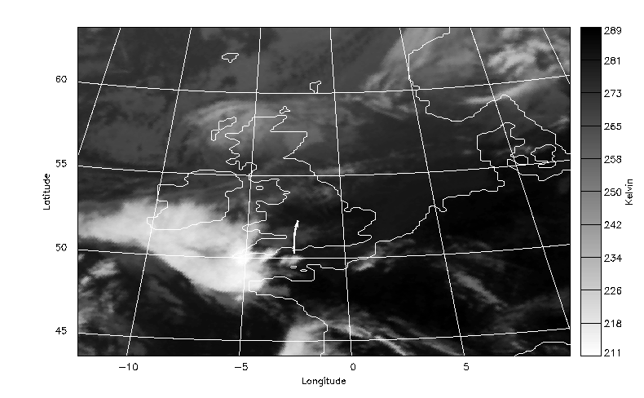
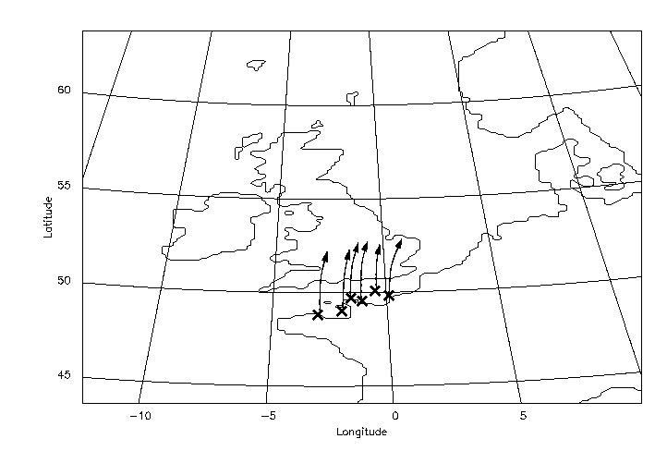
Predictability of Convection
Case 1: Poorly predicted
Observations
Meteosat IR 06:30Z 29/5/99
Mesoscale Model Ensemble

Slide 19
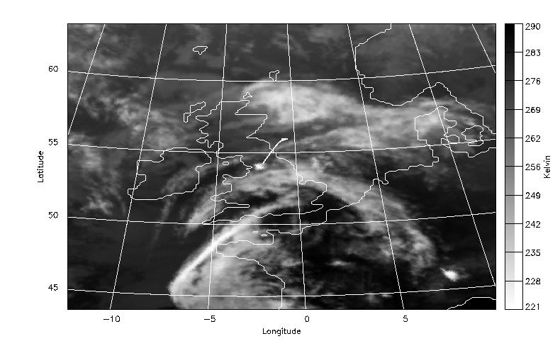
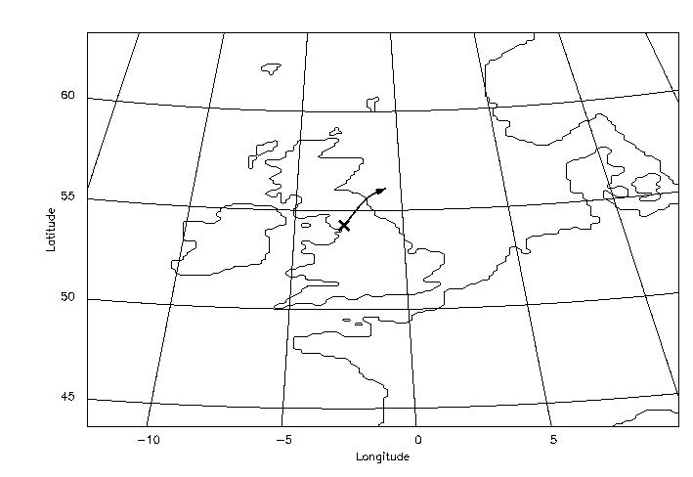
Predictability of Convection
Case 2: Well Predicted
Observations
Meteosat IR 18:30Z 29/5/99
Mesoscale Model Ensemble

Slide 20
Improving: Rainfall Measurement
High-resolution NWP models
Data assimilation
A high-resolution forecast model needs to start from high-resolution observations
Assimilating these data involves minimising the differences between the observations and the model fields. This is difficult to achieve at high-resolution but new mathematical techniques are now available

Slide 21
Observations
X
X
X
X
X
Time

Slide 22
Observations
X
X
future
X
X
X
Time
Clever maths
the relevant optimization theory (variational method) has been around for 15 years
Computational power
only now is the computer power becoming available to implement the method in this context
Special techniques are needed to assimilate detailed observations of clouds and rain from satellites and weather radars.

Slide 23
NERC will work with other agencies to develop an end-to-end programme for improving flood forecasts
Improved rainfall data
Assimilation into hydrological models
Decision support Methods
Verification and evaluation
improved assimilation
improved NWP models
probability forecasts
Improvements generated by NCAS, CEH, MO, EA and Water Companies
feedback

